Slide 1
Introductions

Slide 2
Armin Biere
Freiburg

Slide 3
Vijay Ganesh
Georgia Tech (Waterloo)

Slide 4
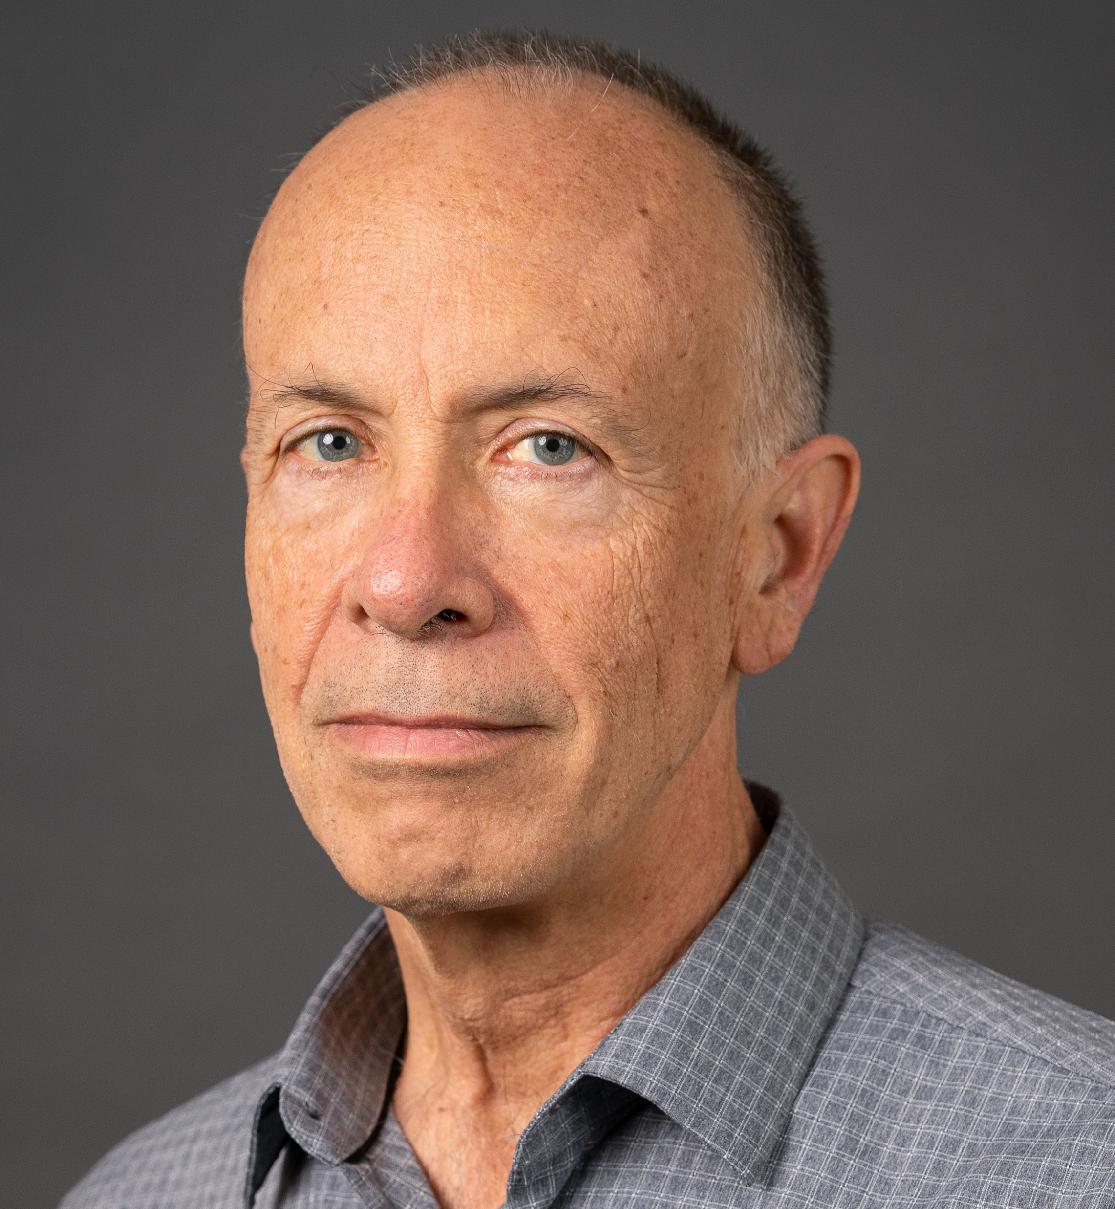
Sam Buss
University of California, San Diego Department of Mathematics
sbuss@ucsd.edu http:/math.ucsd.edu/~sbuss
Interests:
Mathematical logic, proof complexity, bounded arithmetic, SAT solvers and resolution, algorithms and complexity.
Recent research includes: DRAT proofs (with N. Thapen) Independence results for NEXP vs P/poly in Bounded Arithmetic (with A. Atserias and M. Müller) MaxSat (with ML Bonet, A. Ignjatiev, J. Marques-Silva, A. Morgado) OBDD proofs (with D. Itsykson, A. Knop, A. Riazanov, D. Sokolov) TFNP, Proof Systems and Monotone Circuits (with N. Fleming and R. Impagliazzo) Proof Systems for Branching Programs (with A. Das and A. Knop) Proof Complexity survey (Handbook of Proof Theory, with J. Nordstrom).

Slide 5
Jie-Hong Roland

Slide 6
Hiroshi Unno

Slide 7
Stefan Szeider
TU Wien

Slide 8
Akihisa Yamada

Slide 9
Katalin Fazekas
TU Wien

Slide 10
Mathias Preiner
Stanford

Slide 11
Aina Niemetz
Stanford

Slide 12
Soh Takehide

Slide 13
Mutsunori Banbara

Slide 14
Kristin Rozier

Slide 15
Miyuki Koshimura

Slide 16
Masahiro Sakai

Slide 17
Jakob Nordstroem
DIKU

Slide 18
Nina Narodytska
VMWare

Slide 19
Roopsha Samanta

Slide 20
Tachio Terauchi
Waseda

Slide 21
Marijn Heule
CMU

Slide 22
Nikolaj Bjorner
Microsoft

