Slide 1
Introductions

Slide 2
Armin Biere
Freiburg

Slide 3
Vijay Ganesh
Georgia Tech (Waterloo)

Slide 4
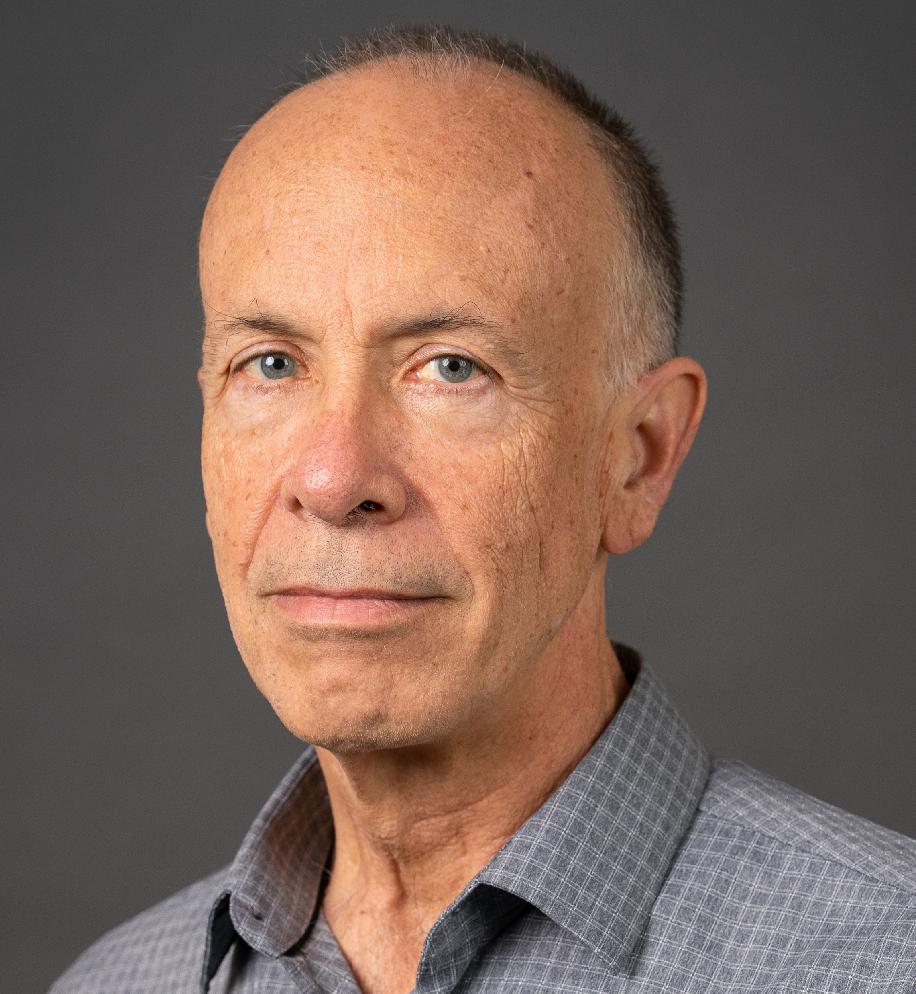
Sam Buss
University of California, San Diego Department of Mathematics
sbuss@ucsd.edu http:/math.ucsd.edu/~sbuss
Interests:
Mathematical logic, proof complexity, bounded arithmetic, SAT solvers and resolution, algorithms and complexity.
Recent research includes: DRAT proofs (with N. Thapen) Independence results for NEXP vs P/poly in Bounded Arithmetic (with A. Atserias and M. Müller) MaxSat (with ML Bonet, A. Ignjatiev, J. Marques-Silva, A. Morgado) OBDD proofs (with D. Itsykson, A. Knop, A. Riazanov, D. Sokolov) TFNP, Proof Systems and Monotone Circuits (with N. Fleming and R. Impagliazzo) Proof Systems for Branching Programs (with A. Das and A. Knop) Proof Complexity survey (Handbook of Proof Theory, with J. Nordstrom).

Slide 5
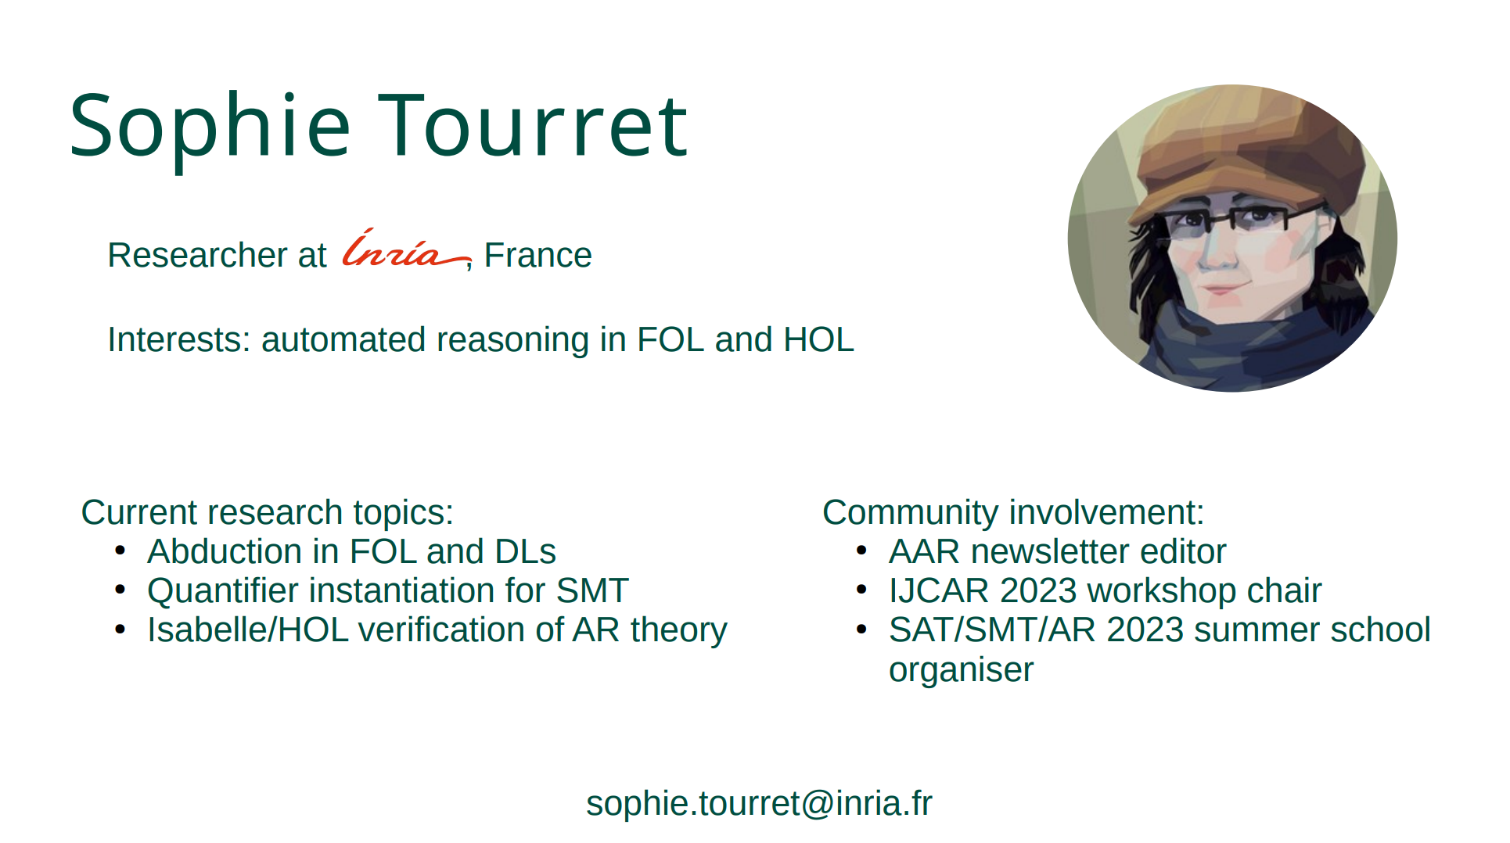

Slide 6
Jie-Hong Roland
National Taiwan University

Slide 7
Hiroshi Unno

Slide 8
Stefan Szeider
TU Wien

Slide 9
Akihisa Yamada

Slide 10
Katalin Fazekas
TU Wien

Slide 11
Mathias Preiner
Stanford

Slide 12
Aina Niemetz
Stanford

Slide 13
Soh Takehide

Slide 14
Mutsunori Banbara

Slide 15
Kristin Rozier

Slide 16
Miyuki Koshimura

Slide 17
Masahiro Sakai
Nagoya University

Slide 18
Jakob Nordstroem
DIKU

Slide 19
Nina Narodytska
VMWare

Slide 20
Roopsha Samanta

Slide 21
Katsumi Inoue
NII

Slide 22
Shin-Ichi Minato

Slide 23
Tachio Terauchi
Waseda

Slide 24
Marijn Heule
CMU

Slide 25
Nikolaj Bjorner
Microsoft

