Slide 1
Introductions

Slide 2
Armin Biere
Freiburg

Slide 3
Vijay Ganesh
Georgia Tech (Waterloo)

Slide 4
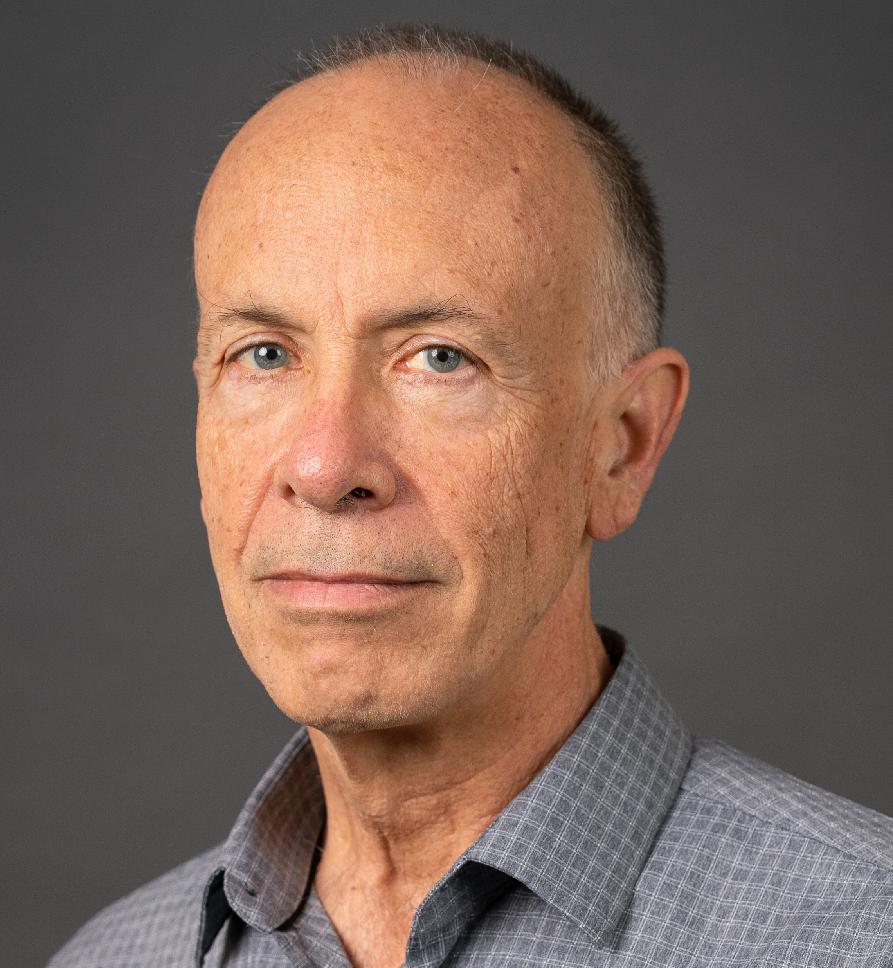
Sam Buss
University of California, San Diego Department of Mathematics
sbuss@ucsd.edu http:/math.ucsd.edu/~sbuss
Interests:
Mathematical logic, proof complexity, bounded arithmetic, SAT solvers and resolution, algorithms and complexity.
Recent research includes: DRAT proofs (with N. Thapen) Independence results for NEXP vs P/poly in Bounded Arithmetic (with A. Atserias and M. Müller) MaxSat (with ML Bonet, A. Ignjatiev, J. Marques-Silva, A. Morgado) OBDD proofs (with D. Itsykson, A. Knop, A. Riazanov, D. Sokolov) TFNP, Proof Systems and Monotone Circuits (with N. Fleming and R. Impagliazzo) Proof Systems for Branching Programs (with A. Das and A. Knop) Proof Complexity survey (Handbook of Proof Theory, with J. Nordstrom).

Slide 5
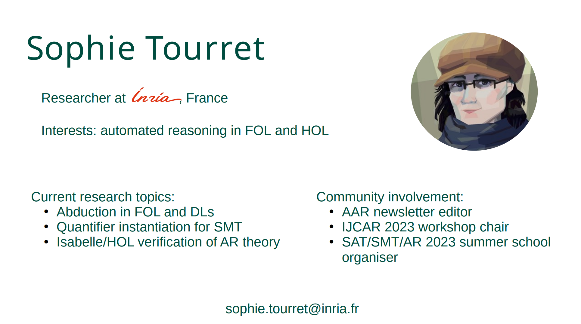

Slide 6
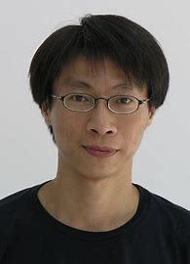
Jie-Hong Roland Jiang
National Taiwan University
Jie-Hong Roland Jiang (江介宏) @ National Taiwan University (ntu.edu.tw)

Slide 7
Hiroshi Unno

Slide 8
Stefan Szeider
TU Wien

Slide 9
Akihisa Yamada
Akihisa Yamada
AIST Japan

Slide 10
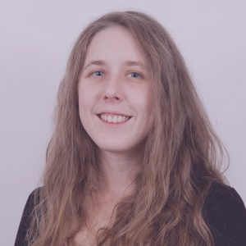
Katalin Fazekas
TU Wien
Katalin Fazekas - Homepage (kfazekas.github.io)

Slide 11
Mathias Preiner
Stanford
Home | Mathias Preiner (stanford.edu)

Slide 12
Aina Niemetz
Stanford
Aina Niemetz | Sr. Research Scientist, Computer ScienceStanford University

Slide 13
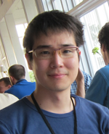
Soh Takehide
tsoh.org
Kobe University

Slide 14
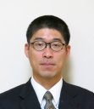
Mutsunori Banbara
Nagoya University

Slide 15
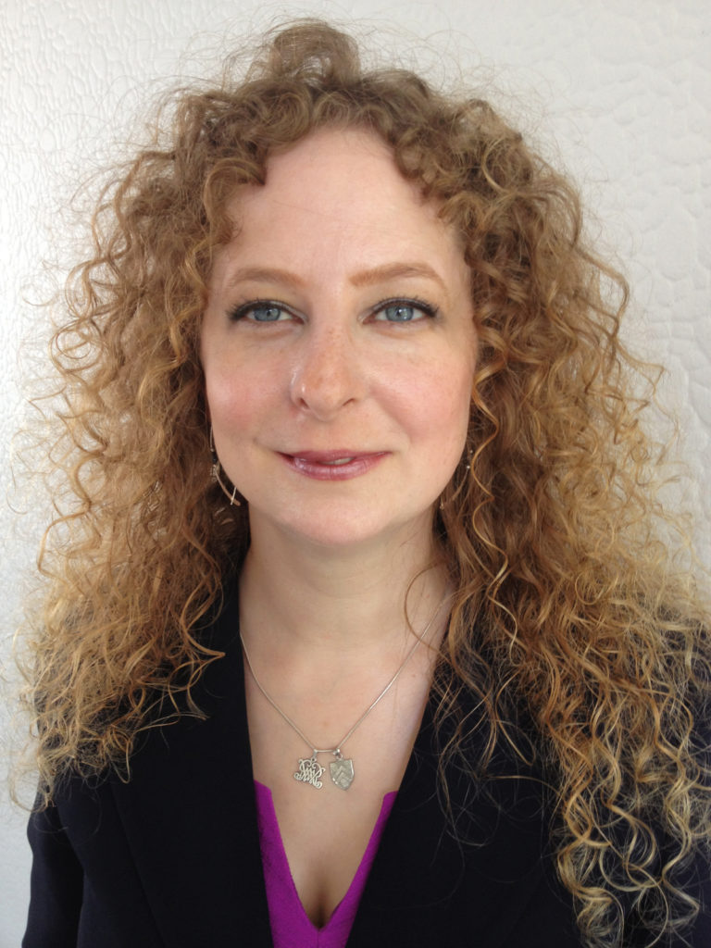
Kristin Rozier
Iowa State University
Kristin Yvonne Rozier, Ph.D. – Iowa State University (iastate.edu)

Slide 16
Miyuki Koshimura
Kyoshu University

Slide 17

Masahiro Sakai
Nagoya University
酒井正彦 ホームページ (nagoya-u.ac.jp)

Slide 18
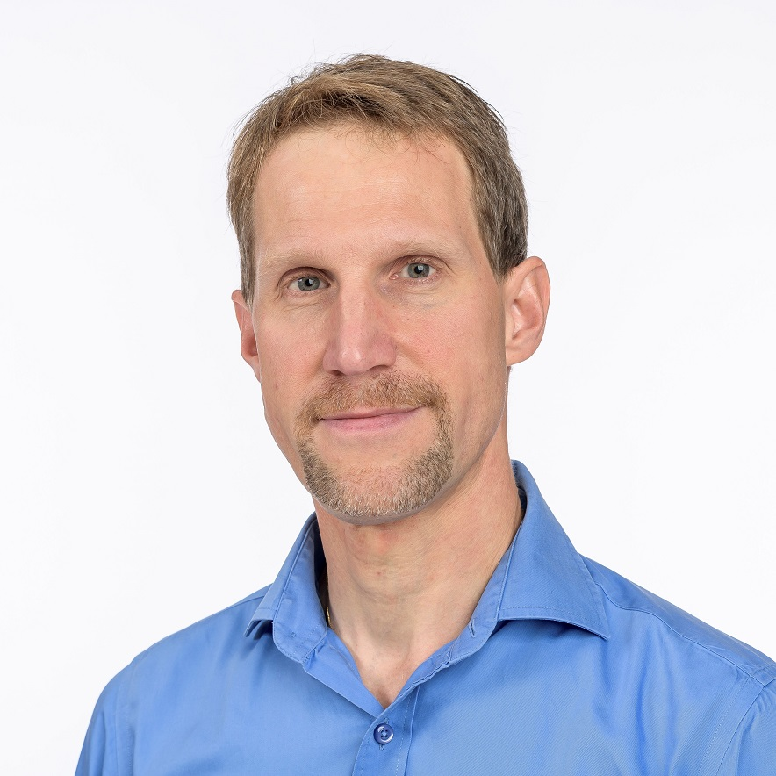
Jakob Nordström
DIKU
Jakob Nordström (jakobnordstrom.github.io)

Slide 19
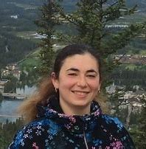
Nina Narodytska
VMWare

Slide 20
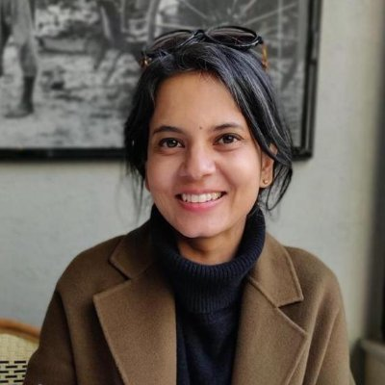
Roopsha Samanta

Slide 21
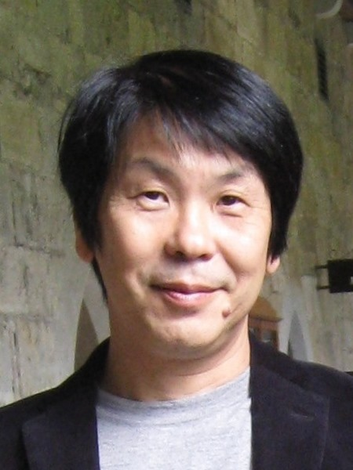
Katsumi Inoue
National institute of Informatics

Slide 22
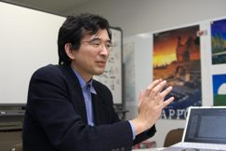
Shin-Ichi Minato
Kyoto University

Slide 23
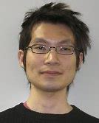
Tachio Terauchi
Waseda

Slide 24
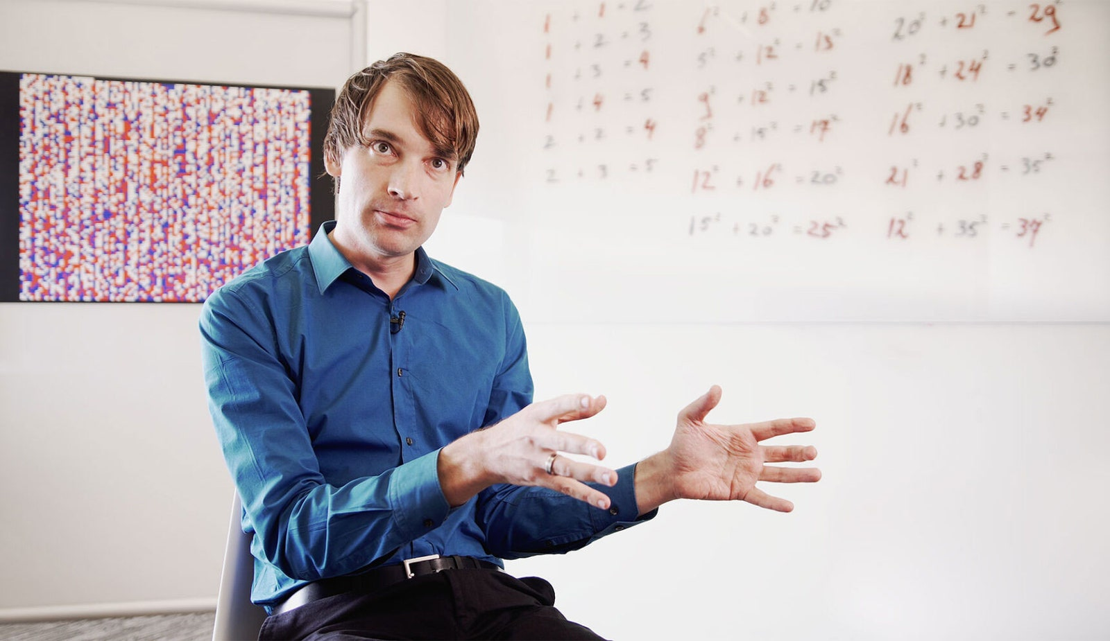
Marijn Heule
CMU

Slide 25
Nikolaj Bjorner
Microsoft

