Slide 1


INFORMATION AND COMMUNICATION
TECHNOLOGIES (TIC) AND
TECHNOLOGIES RELATED TO TIC
Exploring the Evolving
Landscape of
Technological Innovation
MOKRANE MANEL
ID : 232331222407
SECTION : A

Slide 2
THE PLAN :
INTRODUCTION TO ICT
SOME OF THE MAIN TOOL:
Microsoft office
Google services
Overleaf & LaTex
CANVA
Web Development
Git & GitHub
Impact of ICT on society

Slide 3
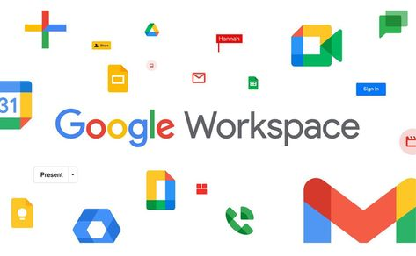
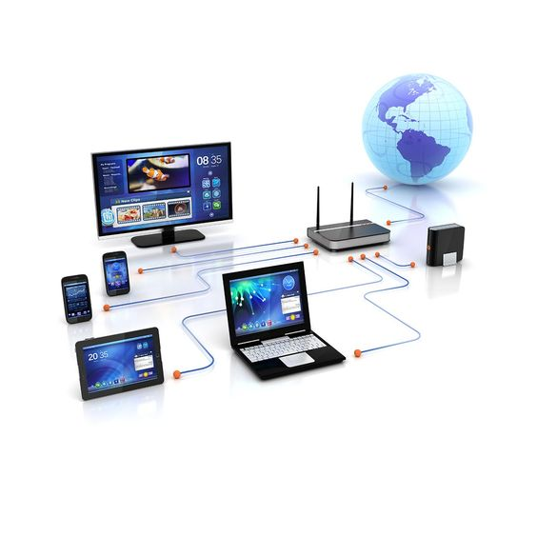


INTRODUCTION TO ICT
What is ICT ?
INFORMATION AND COMMUNOCATION TECHNOLOGIE
HARDWARE
SOFTWARE

Slide 4
THE PLAN :
INTRODUCTION TO ICT
SOME OF THE MAIN TOOL:
Microsoft office
Google services
Overleaf & LaTex
CANVA
Web Development
Git & GitHub
Impact of ICT on society

Slide 5





SOME OF THE MAIN TOOL:
1-Microsoft office:
Microsoft Word: A word processing program used for creating and editing documents. It is widely used for tasks such as writing reports, creating resumes, and drafting letters.
Microsoft Excel: A spreadsheet program that enables users to create and manipulate data in a grid of cells
Microsoft PowerPoint: A presentation program used for creating slideshows with text, graphics, and multimedia elements.

Slide 6




Microsoft Access: A database management system that allows users to create and manage databases.
Microsoft Outlook: An email client and personal information manager that includes features for email, calendar, contacts, and tasks.
Microsoft OneNote: A note-taking program that allows users to capture and organize notes in various formats, including text, images, and audio.
Microsoft Teams: A collaboration platform that integrates chat, video conferencing, file storage, and application integration. It is commonly used for team communication and collaboration.

Slide 7
THE PLAN :
INTRODUCTION TO ICT
SOME OF THE MAIN TOOL:
Microsoft office
Google services
Overleaf & LaTex
CANVA
Web development
Git & GitHub
Impact of ICT on society

Slide 8




2-Google services:
Google Search and Google Chrome: most famous search engines that allows users to search for information, images, news, videos, and more.
Gmail: Google's email service, which provides users with a free email account and features such as conversation view, labels, and integration with other Google services.
Google Meet: A video conferencing service that enables virtual meetings, webinars, and collaboration. It became particularly popular for remote work and online education
Google Drive: A cloud storage service that allows users to store and share files online.

Slide 9




OTHER GOOGLE SERVICES
Google Docs, Sheets, and Slides: for creating and editing documents, spreadsheets, and presentations
YouTube: A video-sharing platform where users
can upload, share, and view videos.
Google Translate: A language translation service that can translate text, speech, and images between different languages.

Slide 10
THE PLAN :
INTRODUCTION TO ICT
SOME OF THE MAIN TOOL:
Microsoft office
Google services
Overleaf & LaTex
CANVA
Web development
Git & GitHub
Impact of ICT on society

Slide 11

3-Overleaf & LaTeX:
offers
writing process
Which is a typesetting system commonly used for the production of scientific and mathematical documents

Slide 12
THE PLAN :
INTRODUCTION TO ICT
SOME OF THE MAIN TOOL:
Microsoft office
Google services
Overleaf & LaTex
CANVA
Web development
Git & GitHub
Impact of ICT on society

Slide 13


5- CANVA
Canva is a web-based graphic design platform

Slide 14
THE PLAN :
INTRODUCTION TO ICT
SOME OF THE MAIN TOOL:
microsoft office
Google services
Overleaf & LaTex
CANVA
Web development
Git & GitHub
Impact of ICT on society

Slide 15





4-HTML-CSS:
Their job together is to create well structured,engaging and
user-friendly web experiences.
CSS
HTML
structure web pages
Create applications
control the appearance of the web page

Slide 16
THE PLAN :
INTRODUCTION TO ICT
SOME OF THE MAIN TOOL:
microsoft office
Google services
Overleaf & LaTex
CANVA
Web development
Git & GitHub
Impact of ICT on society

Slide 17


5-Git & GitHub
Git is a version control system that allows different developers to work on the same project
GitHub is a platform that allows its users to store their Git repositories
Remote Repository on GitHub
DEVELOPER 1
DEVELOPER 2
DEVELOPER 3

Slide 18
THE PLAN :
INTRODUCTION TO ICT
SOME OF THE MAIN TOOL:
microsoft office
Google services
Overleaf & LaTex
Web development
Git & GitHub
Impact of ICT on society

Slide 19
as students we use them to write projects and organise our notes
Impact of ICT on society
speed up the transfer of information
the use of ICT to access information has brought new opportunities

