Slide 1
PostgreSQL

Slide 2
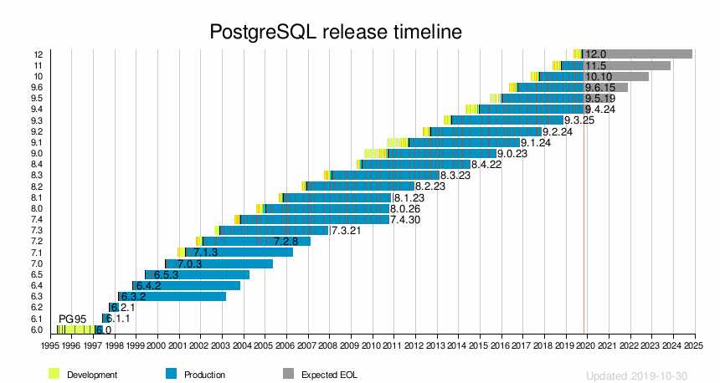
About PostgreSQL
Free open source object-relational database system
Evolved from ingres project at UC Berkeley

Slide 3
Features
User defined types
Table inheritance
Sophisticated locking mechanism
Foreign key constraints
Views, rules, subquery
Multi-version concurrency control
Asynchronous replication

Slide 4
PostgreSQL Setup
Follow instructions and download from http://www.postgresqltutorial.com/install-postgresql/
Connect to PostgreSQL database either through interactive terminal program psql or pgAdmin application (requires download) http://www.postgresqltutorial.com/connect-to-postgresql-database/

Slide 5
PostGIS
PostGIS extends PostgreSQL into a spatial database
Supports three features: spatial types, indexes, and functions
Spatial data types refer to shapes such as point, line, polygon, etc.
Multi-dimensional spatial indexing is used for efficient processing of spatial operations
Spatial functions are for querying of spatial properties and relationships

Slide 6
PostgreSQL Roles Management
PostgreSQL uses roles concept to manage database access permissions.
It is easier to manage roles as a group so that you can grant or revoke privileges from a group as a whole.
In PostgreSQL, you create a role that represents a group, and then grant membership in the group role to individual user roles.

Slide 7
PostgreSQL Queries
SELECT column_1 FROM table_name WHERE condition;
INSERT INTO table_name (column_1, column_2) VALUES (value_1, value_2);
UPDATE table_name SET column_1 = value_1, column_2 = value_2 WHERE condition;
DELETE FROM table_name WHERE condition;

Slide 8
PostgreSQL supported languages
SQL
C
pgSQL
Python
Perl
Tcl

Slide 9
PostgreSQL Database Instances with Amazon RDS
Enter the RDS Console
Create a PostgreSQL DB Instance
Download a SQL Client
Connect to the PostgreSQL Database
Delete the DB Instance
Amazon RDS makes it easy to set up, operate, and scale a relational database in the cloud.

Slide 10
Operating systems for PostgreSQL
It is the default database for macOS Servers
Linux
FreeBSD
OpenBSD
Windows

Slide 11
PostgreSQL Design
It is designed to handle a range of workloads
From single machines to data warehouses
Web services with many concurrent users

Slide 12
Storage and replication
There are a few ways to handle storage and replication
PostgreSQL has built-in binary replication
Indexing for b-tree and hash table indexes and index access methods
Schemas
Data types
User-defined objects
Inheritance

