Slide 1
EFFICIENCY-OPTIMIZED GENERATIVE PARADIGMS
FOR LARGE-SCALE BIOMOLECULAR DESIGN
BITS ZG628T Dissertation — Final Report
Akik Jana (2024AB05287)
Supervisor: Dr. Arnab Bandyopadhyay · Dr. Reddy's Laboratories
M.Tech. (AI & ML) · BITS Pilani · August 2026

Slide 2
Problem & Objective
The Problem
• Boltz-2 (AlphaFold-3 class) is SOTA for structure + binding affinity…
• …but costs high GPU latency, memory, and money per prediction.
• Full-model inference on a laptop is minutes-scale — unusable for interactive work.
• Bench scientists are compute-poor and privacy-sensitive.
The Objective
• Practical structure/affinity prediction on local hardware (Apple Silicon).
• Track A — distilled, quantized surrogate for fast on-device screening.
• Track B — acceleration techniques integrated into Boltz-2 itself.
• Privacy by design: data never leaves the device.
Boltz-Fast · Final Dissertation Report · Akik Jana (2024AB05287)
2
Notes:
Honest scope: the headline speedups in this report are for the distilled surrogate. Track A was then tested end-to-end: the ipTM reference does not rank binders, so the screening objective is not reachable through it (slides 14–18).

Slide 3
Boltz-Fast — Module Overview
1 · Memory & Parallelism
• MLA receptor KV-cache (~87.5% smaller)
• Low-rank Outer Product Mean
• Fold-CP sequence parallelism (ring attn / 2D TMU)
2 · Accelerated Denoising
• CFG distillation (single-pass student)
• Speculative flow matching
• Neural coordinate refiner
3 · Alignment & Design
• SimPO / g-DPO preference tuning
• GRPO closed-loop co-design
• Real Boltz reward formula
Deployment: distilled surrogate exported to Apple CoreAI / Neural Engine — on-device, offline, private.
Boltz-Fast · Final Dissertation Report · Akik Jana (2024AB05287)
3

Slide 4
Methodology & Pipeline
Cache target (MLA KV)
Low-rank pair representation
Accelerated sampling
Coordinate refinement
GRPO co-design loop
➔
➔
➔
➔
• Static receptor is cached once; many binder variants are screened cheaply.
• Memory-efficient pair updates keep peak memory independent of MSA depth.
• Draft/target speculative sampling + single-pass guidance cut denoising cost.
• Closed loop: sequence policy → fold/score → GRPO update on the real Boltz reward.
Boltz-Fast · Final Dissertation Report · Akik Jana (2024AB05287)
4

Slide 5
TRACK 1
Memory & Parallelism
• MLA KV-cache: compress static receptor key/values to a latent space (~87.5% cache reduction).
• Low-rank OPM: U = Σᵣ X·Y·W, r ≪ D_pair; memory-efficient backward; peak memory independent of MSA depth.
• Fold-CP: ring attention + 2D ring TMU, numerically exact vs dense (verified to ~1e-7 / 0.0).
⚠ Low-rank OPM is NOT weight-compatible with stock Boltz-2 → requires retraining.
⚠ Fold-CP is currently a single-device simulation — the speedup only materializes on real multi-GPU.
Boltz-Fast · Final Dissertation Report · Akik Jana (2024AB05287)
5

Slide 6
TRACK 2
Accelerated Denoising
• CFG distillation: single-pass student replaces double-pass guidance; wired into the live diffusion sampler (student_model hook).
– Supervised distillation trainer + checkpoint loading; validated on a synthetic teacher.
• Speculative flow matching: cheap draft proposes K steps; heavy target verifies in parallel; accept if ‖v_target−v_draft‖ < ε.
• Neural coordinate refiner: atom-level residual correction, zero-initialised to a safe identity; integrated with an SE(3)-invariant trainer.
⚠ Status: integrated and trainable; trained on synthetic/component data. Distillation against the full Boltz-2 teacher is future work.
Boltz-Fast · Final Dissertation Report · Akik Jana (2024AB05287)
6

Slide 7
Edge Deployment — CoreAI / Neural Engine
• Surrogate exported via Apple CoreAI: FP8 weight-only quant → CoreAI IR → .aimodel.
• Verified: quantization, export, IR conversion, and runtime inference all succeed.
– AOT .aimodelc compile needs the Metal coreai-build binary; the .aimodel runs directly via the runtime.
• Receptor KV-caching → screen many variants at ~O(L_binder·L_target) each.
PRIVACY BY DESIGN
On-device · offline · sequences never leave the machine
4–37 ms
surrogate latency (Apple Silicon)
0
cloud / API calls
⚠ Latencies above are the distilled surrogate on the ANE — not the full Boltz-2 model.
Boltz-Fast · Final Dissertation Report · Akik Jana (2024AB05287)
7

Slide 8
Benchmarks (Honest Framing)
100–1500×
activation-memory saving (low-rank OPM)
~7×
fewer target evals (speculative, ε=0.03)
4–37 ms
surrogate latency on Apple Silicon
99 / 100%
component tests passing
• Low-rank memory savings are large and real, and scale with sequence length — but only for a model trained around the layer (see slide 12).
• Speculative sampler reduces heavy target evaluations at low tolerance in component tests.
Boltz-Fast · Final Dissertation Report · Akik Jana (2024AB05287)
8
Notes:
Caveats: (1) low-rank Relative MSE is 84–93% at these ranks — the layer must be TRAINED to recover full-rank behaviour, and cannot be projected onto pretrained weights. (2) Latencies are the surrogate, not full Boltz-2. (3) Settings are far below Boltz defaults: 10 sampling steps vs 200, MSA depth 32 vs 8192.

Slide 9
Verification & Testing
• 99-test suite under pytest in CI, with a ruff lint gate.
• 100% local pass rate; deterministic regression test per component.
• Equivalence tests where applicable (Fold-CP, OPM S-contraction match dense to ~1e-7 / 0.0).
– Scope: component- and synthetic-level; full-model biological validation is covered by the PDB benchmark (slides 14–18).
Two defects found
• CI ran `unittest discover`
against a pytest suite —
it collected ZERO tests
and always reported green.
• Audit found unfailable
assertions and RMSD
thresholds satisfied by
random noise.
Boltz-Fast · Final Dissertation Report · Akik Jana (2024AB05287)
9

Slide 10
Honest Status — Wired vs Trained
✔ Live & lossless
• MPS compatibility (every run)
• Fold-CP (numerically exact)
• OPM memory-efficient backward
◐ Integrated, not yet trained
• CFG distillation student
• Neural coordinate refiner
• Affinity surrogate head (since distilled — negative, slide 14)
• (trainers + checkpoints built)
○ Separate model, by design
• Distilled surrogate + CoreAI path
• Is NOT full Boltz-2 accelerated
• It is a smaller, faster model
• Surrogate screens → full model confirms
⚠ Key correction: “fast surrogate” ≠ “fast Boltz-2.” The speedups are a different, smaller model — not the full model made fast.
Boltz-Fast · Final Dissertation Report · Akik Jana (2024AB05287)
10

Slide 11
Key Insight — Where the Cost Really Is
Boltz-2 latency is compute-bound (200-step diffusion + triangle attention) — not weight-bound.
• Quantization shrinks weights → helps “fit”, barely helps speed on Apple hardware.
• Only collapsing the iteration count (few-step sampling) closes the minutes→seconds gap while keeping the real model.
• Sampler distillation remains the route to minutes → seconds. Measurement has since put replicate-averaged folding on GPU ahead of it in priority (slide 18).
Boltz-Fast · Final Dissertation Report · Akik Jana (2024AB05287)
11

Slide 12
Results at a Glance
99 / 100%
tests passing under pytest in CI
87.5%
MLA KV-cache reduction (measured)
1502×
activation saving (trained low-rank only)
0.943
AUC at full settings
(0.640 at 10 steps)
56% → 88%
precision, reciprocal
best match (12 of 12)
44 / 2
receptors / panels
in-training + held-out
0.0628
ipTM run-to-run SD (24 × 4 replicates)
17 of 22
true binder ranked first
at the model's own settings
Top row — engineering delivered. Bottom row — measurement. The negatives in slides 15–30 were all taken at a tenth of the model's sampling budget: run at its intended settings the same readout ranks the true binder first 17 times in 22, at AUC 0.943 (slides 31–32). The negatives are properties of the regime, not the method.
Boltz-Fast · Final Dissertation Report · Akik Jana (2024AB05287)
12
Notes:
Settings throughout are far below Boltz defaults — 10 sampling steps vs 200, 1 recycling vs 3, MSA 32 vs full. Slides 31–32 resolve this and the confound was real: at the intended settings the effect is 3–7× larger and the true binder ranks first 17 times in 22. Everything on slides 15–30 is a lower bound.

Slide 13
Measured — Low-Rank OPM on Pretrained Weights
The ~97% activation saving is not reachable on released checkpoints. The reason is capacity, not optimisation or data.
Three experiments, each stricter — held-out error at rank 32:
• CP projection of weights (random inputs) .................... 0.77
• Fit on one target's activations (one protein) ............... 0.43
• Corpus distillation, 33 folds (at capacity) ................. 0.378
Train and held-out coincide (0.375 / 0.378) — the signature of a model at capacity, so more folding data cannot lower the floor.
Boltz-Fast · Final Dissertation Report · Akik Jana (2024AB05287)
13
Notes:
Scaling law 1.32·rank^−0.356 puts 10% error at rank ≈1414, against c_hidden² = 1024 — the low-rank form costs MORE activation memory than stock before it is accurate enough to substitute.

Slide 14
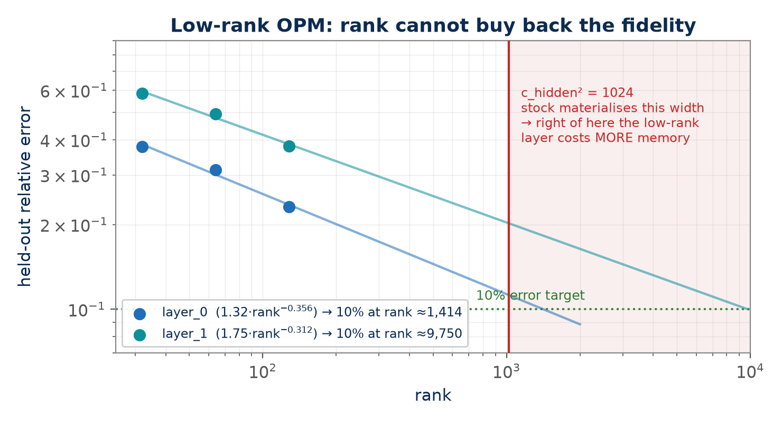
Low-Rank OPM — Rank vs Fidelity
Fitted on held-out points from the 33-fold corpus. Reaching 10% error needs rank ≈1,414 (layer_0) and ≈9,750 (layer_1) — both beyond the width stock actually materialises.
Boltz-Fast · Final Dissertation Report · Akik Jana (2024AB05287)
14

Slide 15
Measured — Does ipTM Rank Binders?
22 / 132
receptors / complexes PTM-clean panel
0.5015
cognate mean ipTM
0.4888
SCRAMBLED mean ipTM
0.4317
decoy mean ipTM
A scramble keeps composition and length exactly and destroys only order — and order is what makes a binder a binder.
• Scrambles outscore genuine binders of other receptors: AUC 0.632, p = 0.0096 (110 complexes)
• Cognate − own scramble: +0.0128, 95% CI [−0.019, +0.044] — a bound, not a zero
• Not a length artefact: the advantage survives length adjustment (intercept +0.075, p = 0.0001)
Boltz-Fast · Final Dissertation Report · Akik Jana (2024AB05287)
15
Notes:
ipTM responds largely to peptide COMPOSITION. Any sequence-order effect is at most 63% of the composition effect. A ridge regression on composition independently beat the distilled surrogate (+0.103 vs −0.034).

Slide 16
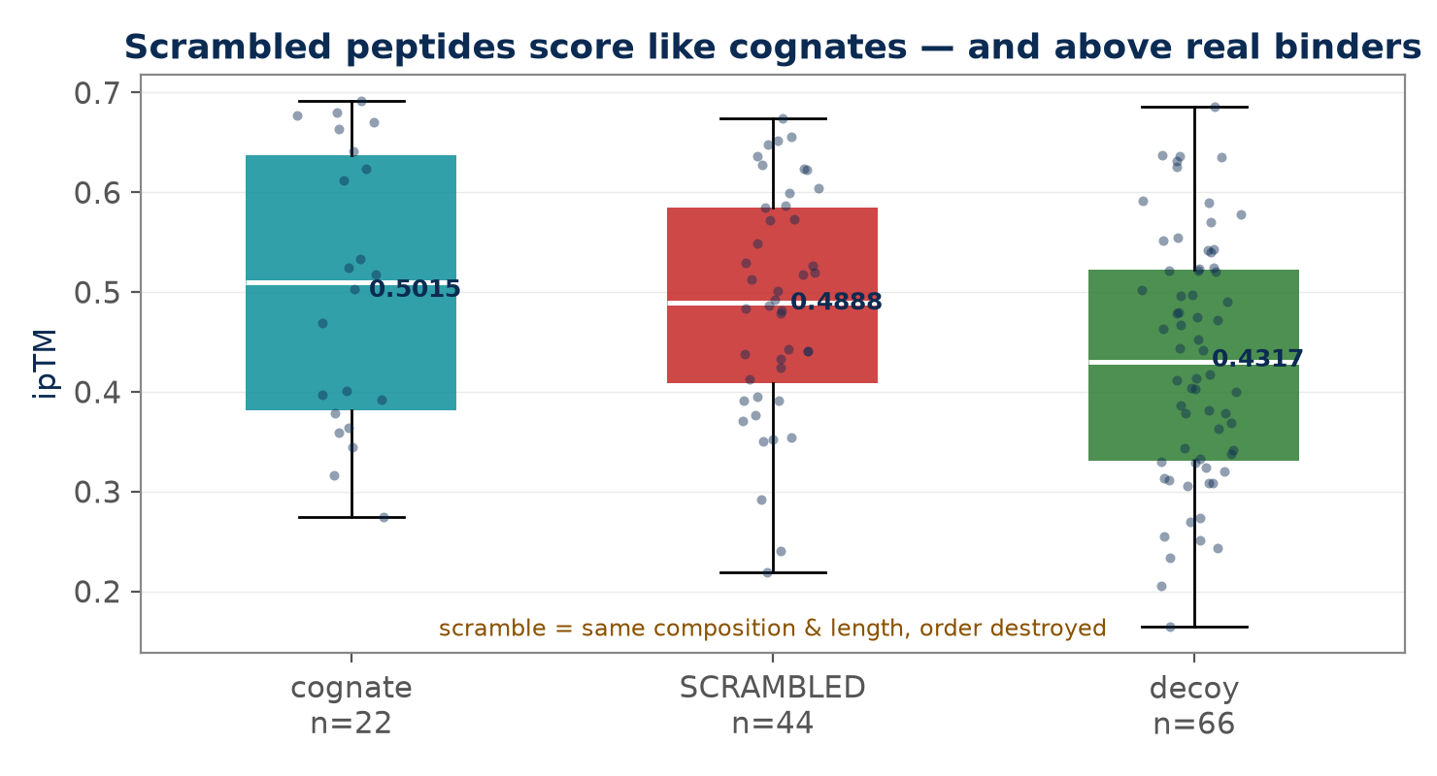
ipTM by Class — the Scramble Control
Scrambles sit level with cognates and above decoys. Composition is shared with the scramble; order is not — so the separation from decoys is compositional.
Boltz-Fast · Final Dissertation Report · Akik Jana (2024AB05287)
16

Slide 17
Measured — A Single Fold Does Not Reproduce Itself
Boltz's --seed defaults to None. Every benchmark fold was a single unseeded draw from a distribution whose width had never been measured.
24 complexes × 4 identical re-runs (96 folds), same settings:
• within-complex ipTM SD 0.0628 (median range 0.127)
• cognate − decoy +0.0698 = 1.11 × SD — comparable to noise
• per-receptor rank flips for 4 of 4; 6YOO spans #1 to #4 on identical input
• aggregate survives (mean rank 2.03) but p < 0.05 in only 49% of re-runs
Boltz-Fast · Final Dissertation Report · Akik Jana (2024AB05287)
17
Notes:
Stabilising per-receptor ranks needs ~9–16 replicate folds per complex (1,200–2,100 folds) — GPU-scale. Ranking binders on a single AlphaFold/Boltz run is common practice, and does not reproduce.
The 95% range on the aggregate mean rank is [1.77, 2.27], always below chance; the median p across simulated re-runs is 0.054.

Slide 18
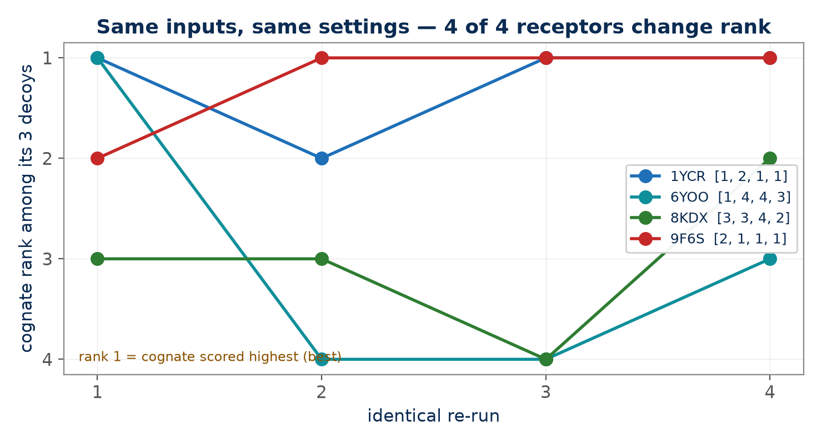
Rank Stability Across Identical Re-Runs
Four receptors, four identical re-runs each. Every one changes rank; 6YOO moves from best to worst. Per-receptor rankings are not a property of the receptor.
Boltz-Fast · Final Dissertation Report · Akik Jana (2024AB05287)
18

Slide 19
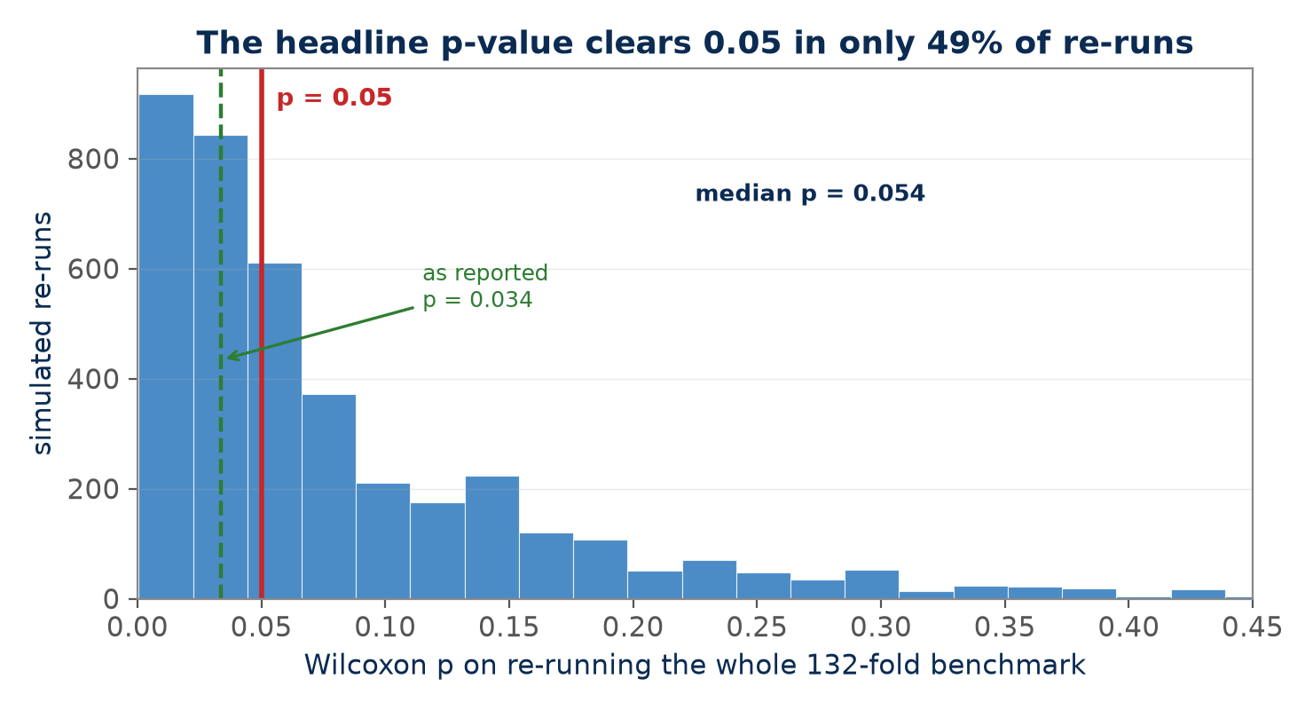
Would the Headline Survive a Re-Run?
Parametric bootstrap over the measured noise, 4,000 replications. The effect direction is robust; the significance verdict is a coin flip.
Boltz-Fast · Final Dissertation Report · Akik Jana (2024AB05287)
19

Slide 20
Measured — What ipTM Discards Is Recoverable
The negative was about ipTM, not about the structures. 132 folds were still on disk — re-scoring them cost no compute at all.
Six interface measures, same complexes, same tests.
Only one beats a cognate's OWN scramble — composition fixed, order destroyed:
• ipTM p = 0.42 • pDockQ p = 0.80 • contacts / density / SASA p = 0.05–0.45
• INTERFACE pLDDT p < 0.0001, rank 1.91 of 4 (chance 2.50)
Effect-to-noise: +3.30 / SD 1.92 = 1.72×, against ipTM's 0.20× — 8.6× better.
Boltz-Fast · Final Dissertation Report · Akik Jana (2024AB05287)
20
Notes:
pDockQ multiplies interface pLDDT by a contact term — contacts run the WRONG way here (scrambles make more: 38.5 vs 32.9), cancelling the signal. Slide 28 shows why: at 10 sampling steps the backbone is not connected, and on converged structures the contact ordering reverses. pDockQ2, which swaps the contact term for a PAE term, repairs it (p = 0.797 → 0.00026).
It also survives the reproducibility test that demoted ipTM, reproducing at p < 0.05 in 100% of simulated re-runs.

Slide 21
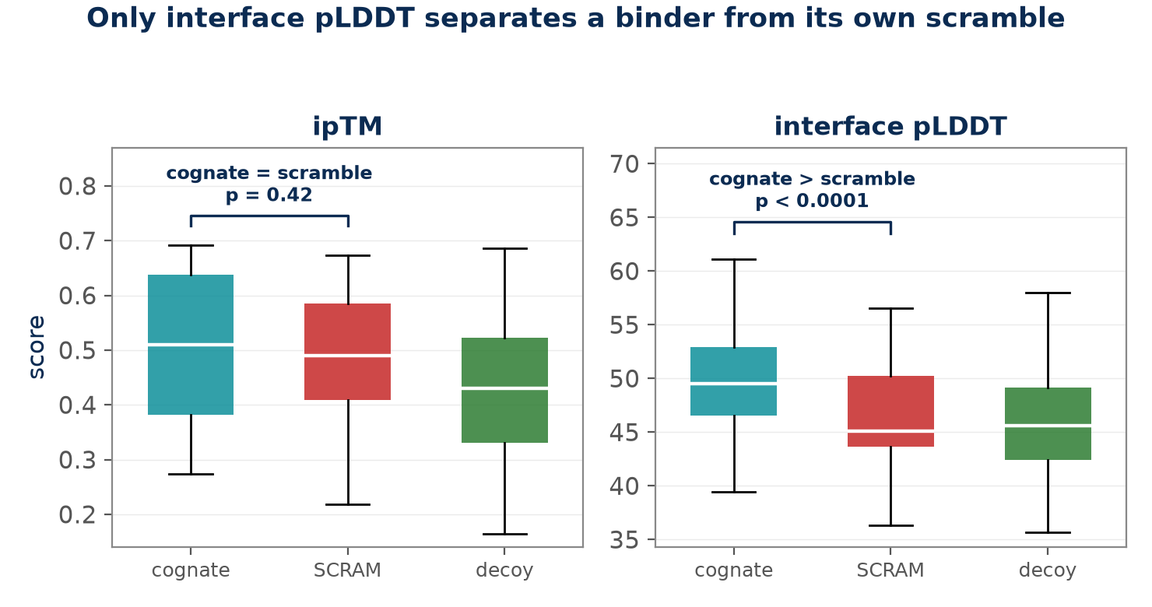
ipTM vs Interface pLDDT — the Scramble Control
Same structures, two readouts. ipTM cannot separate a cognate from its own scramble; interface pLDDT can. The information is in the prediction — ipTM discards it.
Boltz-Fast · Final Dissertation Report · Akik Jana (2024AB05287)
21

Slide 22
Measured — Where That Signal Actually Comes From
Interface pLDDT responds to sequence order. Does it respond to BINDING, or just to the peptide being better folded?
Split by chain — no new folding:
• peptide side +5.25 vs whole-chain peptide +4.87 → mostly FOLDABILITY
• RECEPTOR side +2.38 (p = 6e-5) → survives the objection
Tied to the binding site? Alanine scan, 88 folds:
• interface→Ala 36.77 vs surface→Ala 38.62 diff −1.84, p = 0.244
• right direction, not significant — 80% power needs 123 receptors
Boltz-Fast · Final Dissertation Report · Akik Jana (2024AB05287)
22
Notes:
This QUALIFIES slide 19. Half the pooled signal is peptide foldability, which slide 19 did not separate. What stands: the receptor responds to which peptide it is given. Not established: that the response is localised to the binding site.
The receptor's own residues are placed better when given the right peptide, and a disordered peptide cannot do that, which is why this term survives the foldability objection. Every alanine arm drops 7-12 pLDDT, so both may sit near a floor.

Slide 23
Measured — Few-Step Distillation Changes the Picture
Everything so far was folded at 10 steps on models built for 200. What happens on a model TRAINED for 10?
Same 132 pairs. Boltz-1 added as a de-confounding arm — DeCAF changes the base model AND the sampling regime, and only Boltz-1 shares its base.
cognate − own scramble Boltz-2 Boltz-1 DeCAF
ipTM +0.013 (p=0.42) +0.039 (p=.0043) +0.201 (p=2e-5)
interface pLDDT +3.30 (p<1e-5) +1.54 (p=0.067) +9.54 (p<1e-5)
rank vs decoys (chance 2.50) 2.00 / 1.91 1.86 / 1.91 1.77 / 1.73
DeCAF vs Boltz-1 — same base, device, step count — gives 5–6× larger effects. On DeCAF, interface pLDDT and receptor side CLEAR Bonferroni: receptor specificity is established for the first time in this work.
Boltz-Fast · Final Dissertation Report · Akik Jana (2024AB05287)
23
Notes:
Two claims weaken. Stock models are NOT signal-free — Boltz-1 separates on ipTM (p=0.0043). An earlier reading that the interface-pLDDT result is MODEL-DEPENDENT is WITHDRAWN: Boltz-1's p=0.067 was two non-binders diluting a 22-receptor panel, and goes to p=0.013 once they are removed. 'Settings explain the negatives' is too simple.

Slide 24
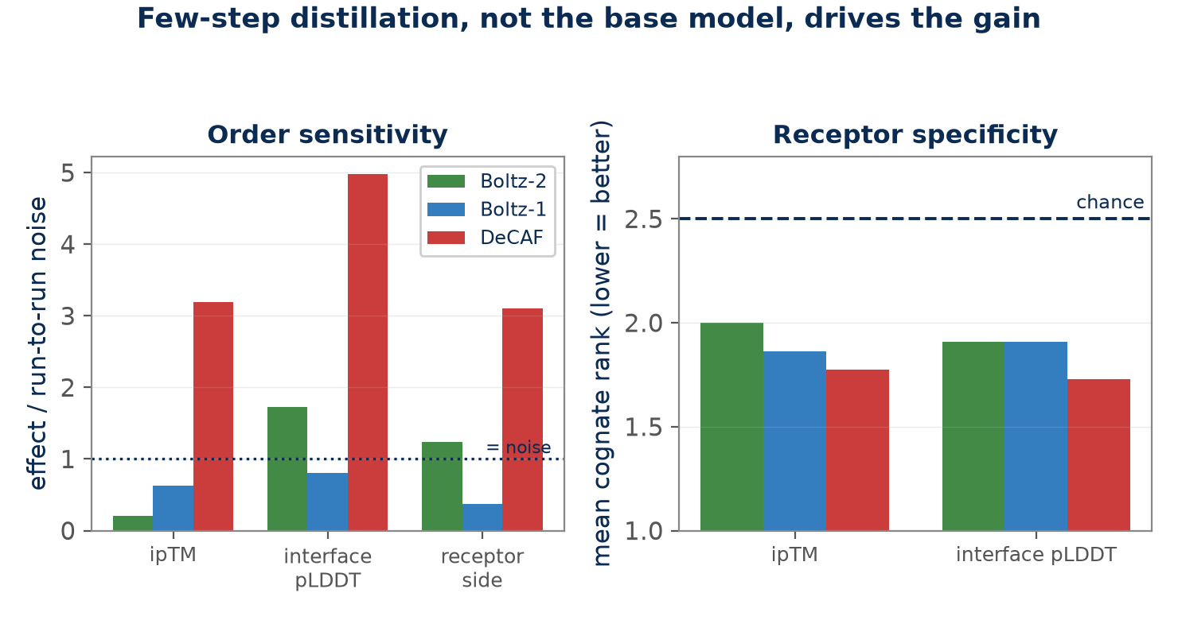
Three Arms — What Few-Step Training Buys
Boltz-Fast · Final Dissertation Report · Akik Jana (2024AB05287)
24
Notes:
Effects normalised by the run-to-run noise of Section 7.5 so metrics on different scales compare. DeCAF vs Boltz-1 isolates few-step training; the Boltz-2 arm ran on CPU, the others on MPS.

Slide 25
Measured — Held-Out Complexes Cost Half the Effect
22 receptors released after the 2021-09-30 training cutoff, screened identically. Folded five times.
+12.03 → +4.99
interface pLDDT, in-training → held out
+0.265 → +0.137
ipTM, in-training → held out
≈ 2×
how optimistic an unsplit benchmark is
Cognate rank among its own decoys (chance 2.50) — and why one draw was not enough:
 | draw 1 | draw 2 | draw 3 | draw 4 | draw 5 | mean
ipTM | 1.64 | 1.50 | 1.86 | 1.64 | 1.45 | 1.59
interface pLDDT | 2.09 | 2.05 | 1.73 | 1.73 | 1.91 | 1.82
Draw 1 said interface pLDDT collapses. Draws 1–2 said ipTM specifically survives. Draw 3 reversed it — both claims withdrawn.
Both retain roughly half; neither can be shown to degrade more than the other.
Boltz-Fast · Final Dissertation Report · Akik Jana (2024AB05287)
25
Notes:
Not homology-decontaminated, and cannot be: 0 of 22 held-out receptors clear 30% identity to the pre-cutoff PDB (median 1.000), and neither does a random sample of the whole candidate pool. What the split isolates is complex-level novelty with receptor familiarity held constant.
The methodological lesson is sharper than the scientific one: a single unseeded fold is not a measurement, and on this evidence neither are two.

Slide 26
Measured — At Ten Steps the Coordinates Are Not a Protein
A peptide bond fixes consecutive alpha-carbons at 3.80 Å. Measuring every consecutive CA–CA distance:
14.0%
Boltz-2 at 10 steps — physically plausible backbone bonds
96.2%
DeCAF, distilled FOR 10 steps — same measurement
Boltz-2: median CA–CA 5.48 Å, 56% of bonds beyond 5 Å, 99% of chains majority-broken.
DeCAF: median 3.74 Å, zero broken bonds. Residue numbering is sequential —
this is not a file-ordering artefact. The backbone is genuinely not connected.
Section 7.8 measured that distillation buys a 5–6× larger effect. This is what it bought: geometry.
Boltz-Fast · Final Dissertation Report · Akik Jana (2024AB05287)
26

Slide 27
One Cause Behind Four Separate Failures
Geometry-dependent readouts need a converged sampler. Four results now share one cause:
pDockQ's contact term ran backwards
scrambles made more contacts than cognates — reverses on converged structures (cognate 61.4, scramble 51.8)
pDockQ2 repairs it
swapping the contact term for a PAE term: scramble control p = 0.797 → 0.00026
Minimum PAE failed here but is published as best-in-class
fails on Boltz-2 (p = 0.611), among the best on DeCAF (rank 1.55) — PAE predicts geometry, and was published at full sampling
Physics rescoring returned femtomolar affinities
PRODIGY on Boltz-2 structures: garbage in, not method failure
Boltz-Fast · Final Dissertation Report · Akik Jana (2024AB05287)
27
Notes:
Physics rescoring on converged structures still does not help: PRODIGY ΔG reaches AUC 0.563 against 0.856 for interface pLDDT, and combining them costs 0.033. A sequence model trained on 96M interactions (MINT) reaches 0.614 zero-shot — structure wins here, contrary to recent affinity-regression results.

Slide 28
Measured — Require the Match in Both Directions
Section 7 always asked: for this receptor, is the cognate the best peptide?
The panel also contains the transpose: for this peptide, is its own receptor the best target?
56% → 88%
precision, one-directional → reciprocal
87% / 23%
of wrong / right calls discarded
12 of 12
combinations improved
Two panels x two readouts x five draws. Enrichment 2.3x → 3.5x, keeping 49% of calls.
A filter that only shrank the set would discard both classes in proportion — it does not.
The only intervention in this work that improved in every panel, readout and draw tested.
Boltz-Fast · Final Dissertation Report · Akik Jana (2024AB05287)
28
Notes:
Not a better score — the same scores read as a two-way competition, so its power comes from the structure of the screen, not the model, and the Section 7.9 ceiling does not apply. Costs 5-10x folds at deployment. Caveat: 7-13 calls per combination, so a reported 100% is 8 of 8.

Slide 29
Two Ways Out That Did Not Work — and What They Explain
Both used information the confidence head does not provide.
Site correctness vs the crystal — NULL
cognate 0.452, decoy 0.445, scramble 0.449 site precision. Rank 2.50 vs chance 2.50, p = 0.906. The model finds the true groove 3x better than chance — for every peptide equally.
Pose agreement across draws — NULL
peptide RMSD between draws: cognate 8.35 A, decoy 9.67 A, scramble 9.99 A. p = 0.129, and only p = 0.350 once receptor reproducibility is regressed out.
Every peptide lands in the same correct pocket, then sits 8-10 A differently within it on each draw.
Boltz-Fast · Final Dissertation Report · Akik Jana (2024AB05287)
29
Notes:
The pocket is determined by the receptor; the pose is not determined at all. That is why every contact-derived readout failed — contacts, buried area, pDockQ, PRODIGY dG, pose agreement all read a placement correct in location and arbitrary in detail. Confidence is the only axis carrying binding information.

Slide 30
Measured — The Settings Confound Was Real
Everything above: 10 sampling steps of an intended 200, 1 recycling of 3, MSA 32.
Same model, same device, settings raised. Cognate − scramble, Cohen's d:
ipTM 0.45 → 1.25 interface pLDDT 0.28 → 1.52 receptor side 0.12 → 1.45
Ranking a cognate against its own decoys — the question a screen actually asks:
 | reduced rank | full rank | first (of 22) | AUC within
ipTM | 1.86 | 1.41 | 11 → 15 | 0.684 → 0.908
interface pLDDT | 1.91 | 1.27 | 9 → 17 | 0.640 → 0.943
17 of 22
true binder ranked FIRST (chance 2.50)
0.943
within-receptor AUC (was 0.640)
106 s
cost of a full-settings fold on this laptop
The negative results are properties of the regime, not of the method.
Caveat: one model, 22 receptors, one draw — and 0.943 is an in-training figure; against measured binding it is 0.626 (slide 35).
Boltz-Fast · Final Dissertation Report · Akik Jana (2024AB05287)
30
Notes:
The CPU-era note in the runner said a full alignment was intractable — a 40-complex run did not finish one batch in an hour. On MPS, full depth is no slower than depth 32. The reduced regime outlived the constraint that justified it, and every effect size in slides 15–30 is a lower bound.

Slide 31
Delivered — the Findings as Behaviour, Not a Caveat
A local screening tool: paste a target and candidate peptides, get a ranking. Nothing is uploaded.
every candidate
folded against permutations of itself
45 s + 9 s/fold
model construction is paid once per job
≈ 2 s
to re-screen — folds are cached
Section 7.4 — a score can be blind to sequence order
so a candidate is reported as a t against its own permutations, never as a raw score; one that cannot beat its own scrambles is not a hit
Section 7.13 — reduced settings suppress the effect 3–7×
so quick mode is offered, and says in the interface what it costs: ~14% of backbone bonds physically plausible at ten steps
Section 7.5 — a single fold is not a measurement
so replicates are a control, and the replicate spread is a column in the table rather than a footnote
Candidates that cannot be scored honestly are refused, not scored badly. Building it caught two faults that would have misled a user: a two-permutation null SD reported z = +77, and a fixed cutoff on that ratio called a Gly–Ser linker a hit.
Boltz-Fast · Final Dissertation Report · Akik Jana (2024AB05287)
31

Slide 32
The Same Three Candidates, Two Targets
Identical candidate list, identical settings, opposite answers — the readout is not simply rewarding peptide-shaped sequences.
candidate | MDM2 — t | MDM2 — p | PDZ3 — t | PDZ3 — p | cognate of
SQETFSDLWKLLPEN | +3.88 | 0.002 | +0.06 | 0.477 | MDM2 (p53 helix)
KQTSV | +1.39 | 0.101 | +7.72 | <0.001 | PSD-95 PDZ3
PPPALPPKKR | −0.00 | 0.501 | +0.75 | 0.240 | c-Crk SH3
Each cognate wins on its own target and loses on the other. KQTSV is also the shortest candidate at five
residues, so the ranking is not being driven by length.
Quick mode, two replicates, three scrambles — about three minutes a target on a laptop.
Shown with its failure: on c-Crk SH3 the cognate does not separate from its own scrambles (p = 0.40), and full sampling does not rescue it. A control that destroys only order has little to detect on a composition-driven interface.
Boltz-Fast · Final Dissertation Report · Akik Jana (2024AB05287)
32

Slide 33
Measured — Which Setting Carried It, and for Which Test
Section 7.13 raised sampling steps, recycling and alignment depth together. Moving one at a time:
Arm | steps / recycle / MSA | Cohen's d | share of gain | top-1 rank
reduced | 10 / 1 / 32 | 0.28 | — | 9 of 22
sampling only | 200 / 1 / 32 | 1.13 | 69% | 13 of 22
alignment only | 10 / 1 / full | 0.18 | −8% | 8 of 22
recycling only | 10 / 3 / 32 | 0.22 | −5% | 7 of 22
all three | 200 / 3 / full | 1.52 | 100% | 17 of 22
Sampling steps alone recover 69% of the gain for a third of the cost — 33 s a fold against 106 s.
Alignment depth and recycling, moved alone, sit below the reduced baseline on every readout.
The shares sum to 25–55%, not 100%: the settings are synergistic. A deeper alignment is worth nothing on an unconverged structure.
Boltz-Fast · Final Dissertation Report · Akik Jana (2024AB05287)
33

Slide 34
Two Automated Searches — One Was Safe, One Was Not
The same machinery applied to two problems that differ in one respect: whether a candidate can be checked.
p = 0.425
readout search: the gain a permutation null also finds
max |diff| = 0
operator rewrite: verified against its own reference
Searching readouts on 22 receptors found a combination beating the headline by +0.018 AUC
a permutation null gains +0.032 on average, and the held-out panel reverses the gain to −0.029. Refused.
Searching operator rewrites found two worth 1.46× and 1.19×
bit-exact, and seeded folds before and after give identical coordinates and identical ipTM. Accepted.
Search pays where a candidate can be verified independently of the data that proposed it.
Boltz-Fast · Final Dissertation Report · Akik Jana (2024AB05287)
34

Slide 35
Measured — Against Binding That Was Actually Measured
1,320 de novo designs released by Anthropic, binding measured by two contract research organisations,
on molecules that postdate every model's training. Contamination is unavailable as an explanation.
0.943
this work, in-training panel
0.682–0.803
this work, held-out panel
0.626
interface pLDDT vs measured binding
Ten independently developed predictors all land between 0.62 and 0.67. The ceiling belongs to the task.
Interface pLDDT beats the binder's whole-chain confidence by +0.033 AUC [+0.005, +0.061] — Section 7.7's claim, on measured binding.
The held-out figure is far closer to the wet-lab figure than the headline is, and still above it. A benchmark quoted without saying whether the complexes were in training overstates a screen — this puts a number on by how much, from outside the dissertation.
Boltz-Fast · Final Dissertation Report · Akik Jana (2024AB05287)
35

Slide 36
Measured — Where the Scramble Control Stops Working
38 of those designs folded as delivered and against permutations of themselves. The prediction below was
written into the source and committed before any fold ran.
 | design | its scrambles | margin
measured binders (20) | 72.99 | 53.88 | +19.11
measured non-binders (18) | 71.15 | 53.22 | +17.93
p = 0.751
the two margins are indistinguishable
0.672 → 0.581
AUC, before and after subtracting scrambles
−0.092
change in AUC, CI [−0.170, +0.008]
A permutation of a 15-residue peptide is still a plausible ligand. A permutation of a 100-residue protein is not a protein.
So the control is sound for the case this work concerns and unsound outside it. The recommendation gains a condition rather than losing its force: use the scramble control wherever a permutation of the candidate is still a candidate.
Boltz-Fast · Final Dissertation Report · Akik Jana (2024AB05287)
36

Slide 37
The Method That Came Out of Being Wrong
Section 7.10 was written three times and two claims withdrawn — each formed after the numbers were seen.
Everything attempted afterwards fixed the test first. What that refused:
Fixed in advance | What it refused
7.15 the permutation null, built before reading the winner | a +0.018 AUC gain over this work's headline readout
7.16 the analysis, written while the arms were still folding | a half-folded arm being scored at AUC 0.917
7.17 the equivalence oracle, run before any timing | three rewrites that looked correct and were slower or inexact
7.19 the prediction, committed to source before a fold ran | the option of calling the outcome expected after the fact
The order matters more than the rigour. Each could have been done afterwards, produced the same arithmetic, and supported a weaker claim.
What pre-specification buys is not accuracy but the ability to be refused. In this work it refused an ensembling mechanism, a readout combination, a target-cropping strategy and a per-arm score — each of which looked correct when it was proposed.
Boltz-Fast · Final Dissertation Report · Akik Jana (2024AB05287)
37

Slide 38
Future Plan
1
DONE — profiled; and measured what the optimisations actually deliver on pretrained weights (slides 11–18).
2
DONE — DeCAF-Boltz, distilled for 10 steps, folds the 132-complex panel in ~20 min locally and returns 96% physically plausible backbones against 14% for a stock model run short (slides 27-28).
3
DONE, NEGATIVE — the surrogate was distilled and evaluated: ipTM does not rank binders, so no surrogate distilled from it can either.
4
Use open Boltz-2 weights only — Boltz-2.1 is closed / API-only.
5
Production GPU scaling — NO LONGER a prerequisite. MPS (~3x) plus few-step distillation let the held-out panel be folded five times on this laptop, and the third draw overturned what the first two supported. Scaling is now for extending the panel past 22 receptors, which is the binding constraint on the open questions.
Boltz-Fast · Final Dissertation Report · Akik Jana (2024AB05287)
38

Slide 39
Summary
• Implemented and integrated memory, sampling and parallelism optimisations into the Boltz pipeline; device-agnostic on Apple Silicon.
• Moved from component microbenchmarks to end-to-end measurement against pretrained checkpoints and experimentally determined structures.
• Two questions closed with negative answers, both with mechanisms: the low-rank OPM is unreachable on released weights, and ipTM tracks peptide composition rather than binding.
• A third finding generalises beyond this project: a single unseeded fold does not reproduce its own ranking.
• Delivered as a local screening tool: the scramble control, the cost of reduced settings and the replicate spread are built into what it does rather than written beside it (slides 31–32).
• Of the three inference settings raised together, sampling steps carry the effect; alignment depth and recycling carry none of it, and 69% of the gain costs a third of the compute.
• Checked against binding measured in a wet lab on 1,320 designs no model had seen: 0.626, against 0.943 on the in-training panel. The readout still beats whole-chain confidence, which was the claim.
• Next: extend the panel past 22 receptors, which is what now limits the open questions.
Thank you · Questions welcome
Boltz-Fast · Final Dissertation Report · Akik Jana (2024AB05287)
39

