Slide 2
Collaborative Filtering
Team 7
Akilan Rajendiran
Dhruv Kanakia
Under the guidance of
Prof Sri Krishnamurthy

Slide 3
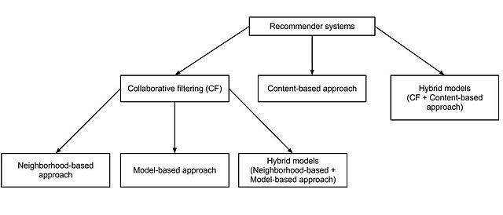
Introduction
It is the process of filtering information or patterns using techniques involving collaboration among multiple agents, viewpoints, data sources etc.
This technique is used in RECOMMENDATION SYSTEMS.

Slide 4
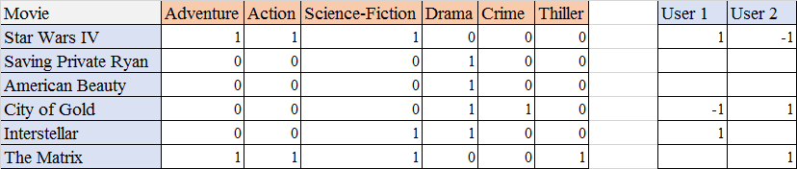
Content Based Filtering
A content based recommender works with data that the user provides, either explicitly (rating) or implicitly (clicking on a link). Based on that data, a user profile is generated, which is then used to make suggestions to the user. As the user provides more inputs or takes actions on the recommendations, the engine becomes more and more accurate
Example: Facebook pages
Disadvantages: It is not good at capturing interdependencies/complex behaviors. And it assumes that user will like the item they liked in past.

Slide 5
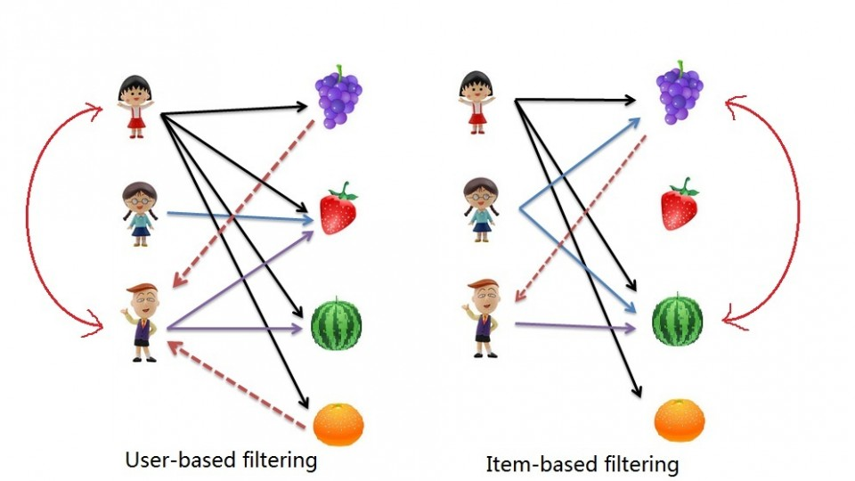
Collaborative Filtering
Collaborative filtering are of two types
  User-User based collaborative filtering
    Eg: Amazon
  Item-Item based collaborative filtering
    Eg: Products related to this item

Slide 6
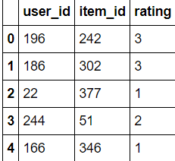
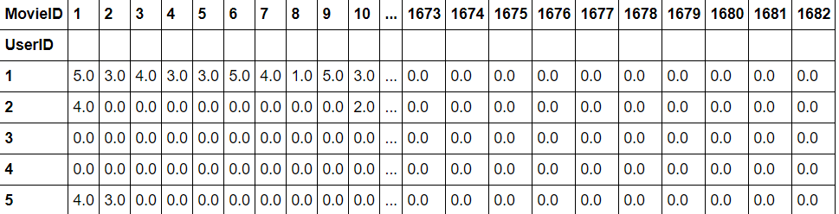
Approach
There are two main methods on how you should approach the above two methods
  Create a matrix based on the method you are following and find out similarities with other attributes/items
  Finding out the nearby elements using different algorithms/method and recommending them

Slide 7
Finding similar items
There are 4 methods to find out similarity :
  Euclidean Distance formula
  Jaccard Similarity
  Cosine Similarity
  Pearson Coefficient
  To read more about the statistics part of the above methods :
  https://www.youtube.com/watch?v=h9gpufJFF-0

Slide 8
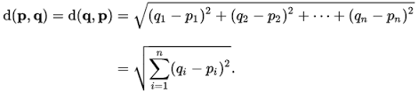
Euclidean Distance formula
Disadvantages:These measures are not sensitive to the linearity of association and can be used with either valued or binary data.

Slide 9
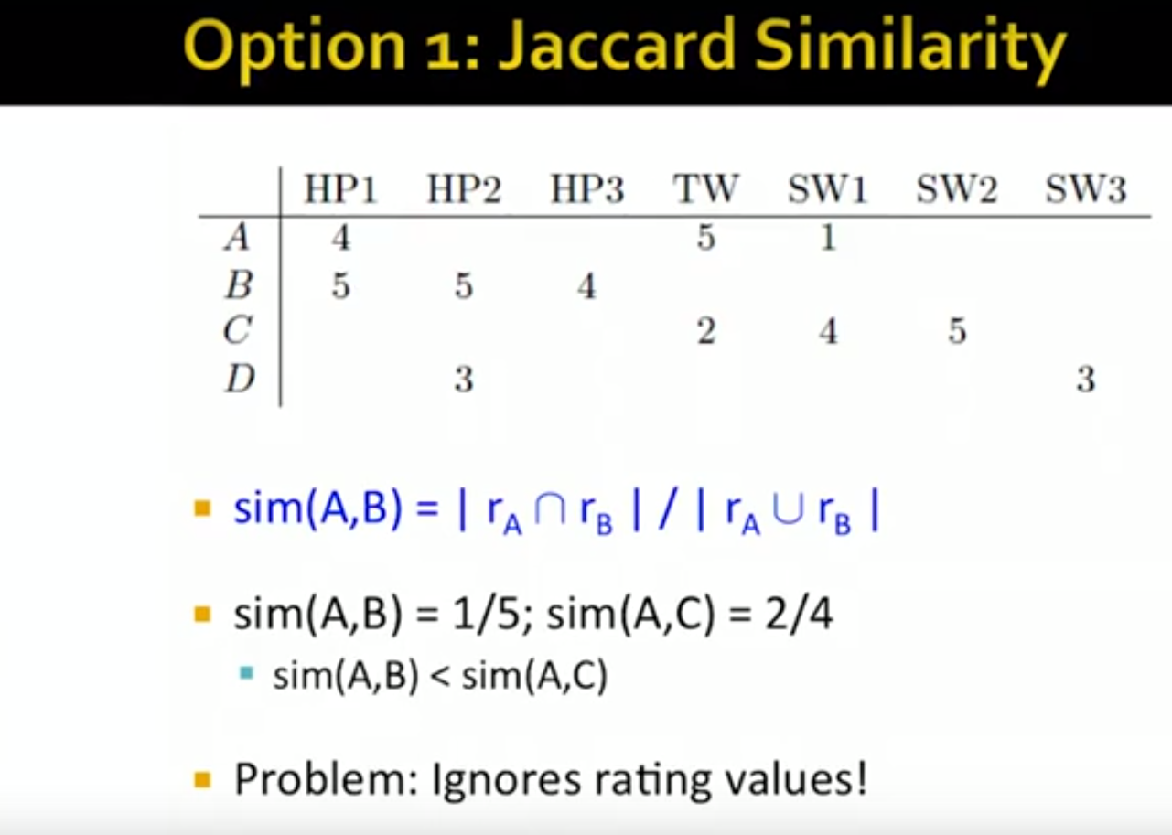
Jaccard Similarity
Similarity is based on the number of users which have rated item A and B divided by the number of users who have rated either A or B

Slide 10
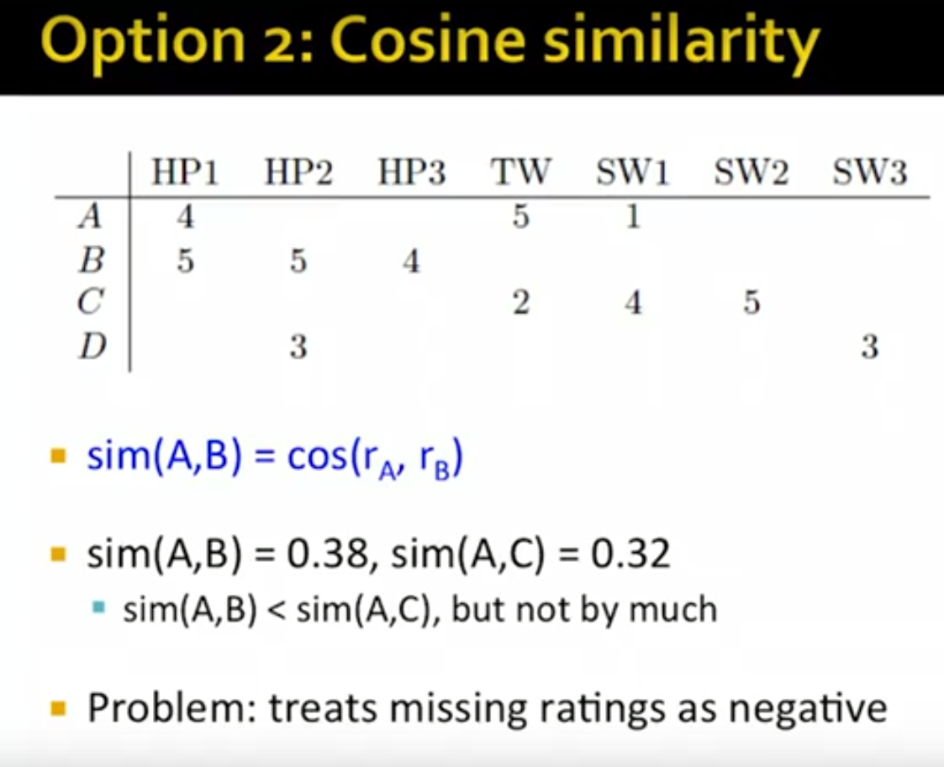
Cosine Similarity
Similarity is the cosine of the angle between the 2 vectors of the item vectors of A and B
Closer the vectors, smaller will be the angle and larger the cosine

Slide 11
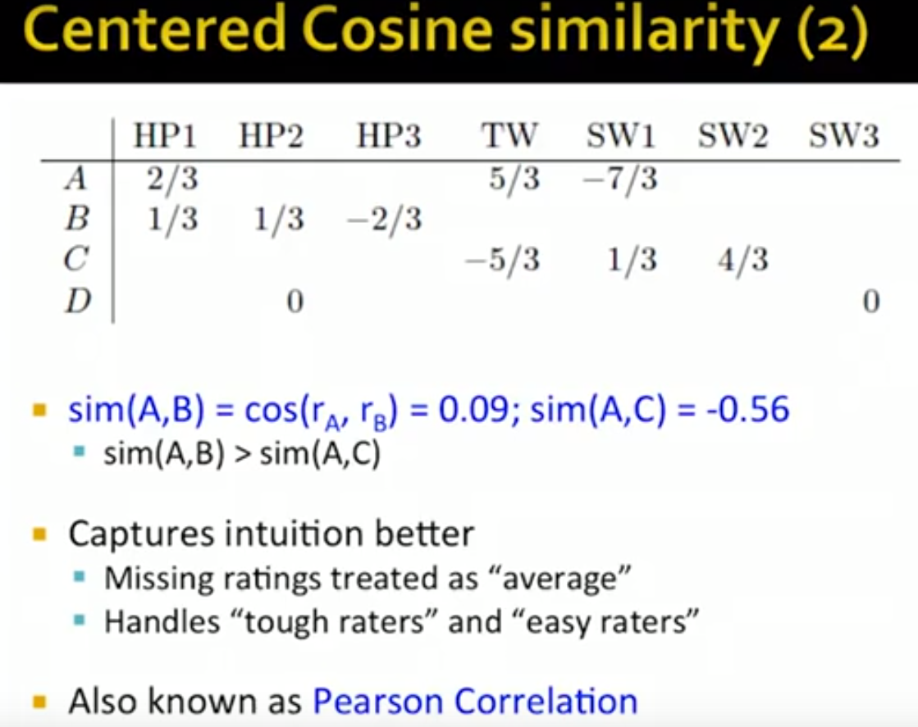
Pearson Coefficient

Slide 12
MEMORY BASED
Memory-based techniques use the data (likes, votes, clicks, etc) that you have to establish correlations (similarities?) between either users (Collaborative Filtering) or items (Content-Based Recommendation).
In the case of collaborative filtering, we get the recommendations from items seen by the users who are closest to u, hence the term collaborative.
The recommendations are provided based on the higher similarity value between the users/items which is computed based on the approaches mentioned earlier.

Slide 13
MODEL BASED
Model-based recommendation systems involve building a model based on the dataset of ratings. In other words, we extract some information from the dataset, and use that as a "model" to make recommendations without having to use the complete dataset every time. This approach potentially offers the benefits of both speed and scalability.
In model-based algorithms: the similarities between users and/or items can be calculated and then stored as a model, and then we can use the stored similarity values to predict ratings. These models can also be built using similarities between items rather than users and in fact, sometimes it is more desirable to do so.

Slide 14
Thank You!

