Slide 1
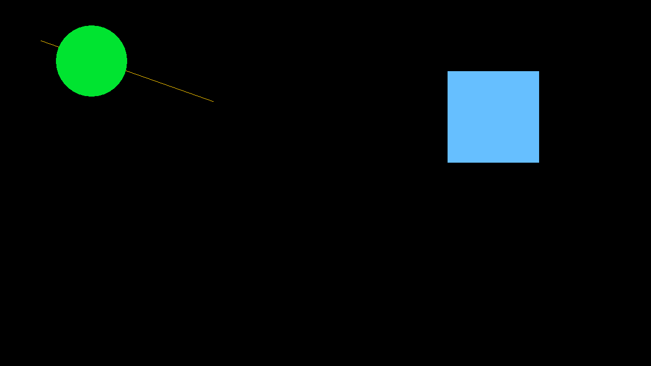
RAYLIB · CLUB INTRODUCTION
What Are We
Going to Make?
A small interactive scene built one step at a time.
By the end, you will be able to…
Your image goes here
• open a window
• draw simple shapes
• read mouse input
• build a small interactive scene
Club · Raylib Introduction
01

Slide 2
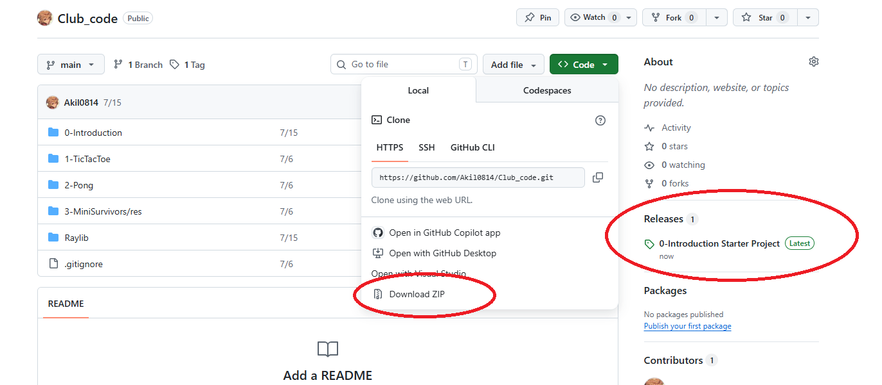
START HERE
Get the Starter Project
Recommended: Download ZIP
• Open the GitHub repository
• Click Code → Download ZIP
• Extract the ZIP file
• Open the 0-Introduction folder
Source repository
https://github.com/Akil0814/Club_code
Ready-made downloads
https://github.com/Akil0814/Club_code/releases
Club · Raylib Introduction
02

Slide 3
SETUP
Before We Start: Set Up the Environment
Choose the toolchain that matches your computer. The source code stays the same.
Windows
macOS
Linux
Visual Studio / MSVC
or MinGW-w64
Homebrew
CMake + raylib
A C++ compiler
CMake + raylib-dev
cmake -S . -B build
brew install cmake raylib
sudo apt install ...
Once the environment is ready, we start writing main.cpp together.
Club · Raylib Introduction
03

Slide 4
01 · WINDOW LIFECYCLE
A Program Can Keep Running
A window does not stay alive by itself. The loop keeps the program running until the user closes it.
1
InitWindow()
InitWindow(...);
while (!WindowShouldClose())
{
// one frame
}
CloseWindow();
Create the application window
2
WindowShouldClose()
Returns true when the loop should stop
3
CloseWindow()
Release the window resources
Club · Raylib Introduction
04

Slide 5
01 · FRAME
One Frame Starts and Ends Here
Everything that should appear in one frame belongs between these two calls.
Draw...
BeginDrawing()
EndDrawing()
start a frame
and prepare drawing
clear the background
draw shapes
draw text
present the frame
and process events
while (!WindowShouldClose())
{
BeginDrawing();
// draw here
EndDrawing();
}
Club · Raylib Introduction
05

Slide 6
02 · COORDINATES
The Window Uses Coordinates
Raylib places objects using pixel coordinates. The origin is in the top-left corner.
(0, 0)
x →
y ↓
(400, 220)
Club · Raylib Introduction
06

Slide 7
02 · DRAWING
Draw Simple Shapes
Start with a few primitives. Each function describes one thing to draw.
ClearBackground(BLACK); //paint the wall
DrawLine(80, 80, 420, 200, GOLD);
DrawCircleV({180, 120}, 70.0f, GREEN);
DrawRectangle(880, 140, 180, 180, SKYBLUE);
DrawLine()
connects two points
DrawCircleV()
center + radius
DrawRectangle()
position + size
ClearBackground() resets the frame before the other draw calls.
Club · Raylib Introduction
07

Slide 8
03 · MOUSE STATE
Read the Mouse Position
GetMousePosition() gives us the cursor location for the current frame.
const Vector2 mouse_position= GetMousePosition();
DrawCircleV(mouse_position,70.0f, GREEN);
the circle follows the cursor
This is a state we can read every frame.
Club · Raylib Introduction
08

Slide 9
03 · MOUSE EVENT
React to a Mouse Click
A click is different from a position: it happens once, on the frame where it is pressed.
if (IsMouseButtonPressed(MOUSE_BUTTON_LEFT))
{
std::cout << "Mouse clicked";
}
POSITION
continuous state
CLICK
one-time event
The terminal output makes the invisible input event visible.
Club · Raylib Introduction
09

Slide 10
WRAP-UP
What We Learned
A small raylib program has a simple, repeatable shape:
Window lifecycle
Frame loop
01
02
initialize → loop → close
begin → draw → end
Drawing
Mouse input
03
04
coordinates + simple shapes
state + click event
We are not introducing Input → Update → Render yet.
Club · Raylib Introduction
10

Slide 11
OPTIONAL · ONLY IF WE HAVE TIME
Optional Challenge: Complete Example
const int font_size = 30;
const char* FollowText = "Raylib“ const int text_width = MeasureText(FollowText, font_size);
const int text_x = (window_width - text_width) / 2;
const int text_y = (window_height - font_size) / 2;
While(…)
{
…
DrawText(FollowText, text_x, text_y, font_size, RAYWHITE);
EndDrawing(); }
Reference: reference/Ex.cpp
Club · Raylib Introduction
11

