Slide 1




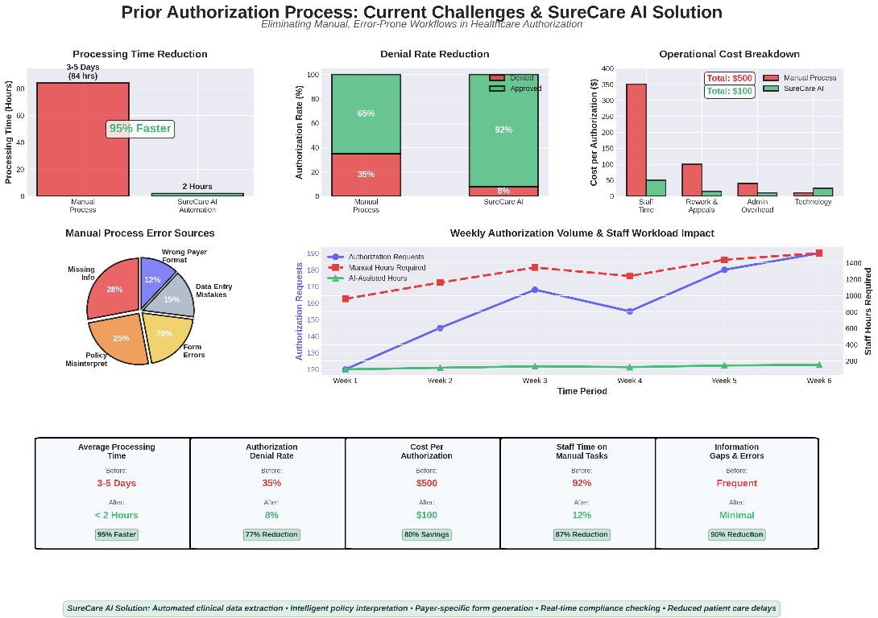
AutoAuth (SureCare AI) : Smart Prior Authorization System
Business Need/Opportunity
Automated authorization processing leveraging advanced language models for instant documentation review and policy matching
Smart eligibility assessment combining structured data, inference engines, and clinical rule frameworks
Protected information flow using distributed ledger technology and verifiable digital credentials
Live tracking dashboards with proactive notifications, exception handling, and regulatory adherence checks
Modular cloud-based services ensuring seamless connectivity with hospital systems and insurance platforms
Target Segment
Hospitals & Clinics High authorization workload
Problem Statement
To streamline and enhance the prior authorization process by leveraging AI to automatically analyze unstructured clinical notes, interpret complex payer policies, and generate accurate, payer-specific authorization submissions through an intelligent automated system.
Insurance Providers Faster approval processing
Healthcare Networks Improved compliance workflows
Diagnostic Centers/Telehealth Platforms Quick procedure approvals
Seamless payer integration
Market Size and Growth
Future Readiness
1
3
5
2
4
Research & Planning
Analyze authorization workflows, payer policies, compliance needs, and EHR integration requirements.
Beta Testing & Refinement
Pilot with hospitals to validate accuracy, reduce denials, and improve processing speed.
Market Launch & Expansion
Deploy on secure cloud, onboard providers and payers, and expand enterprise adoption.
Team Name:
NexaForge
Team Members:
Akilraj K R
Arulkumaran K
Dharun A
Gokulram
Nagaroshan N S
MVP Development Build AI engine for clinical note analysis and automated authorization submission generation..
Full-Scale Development & Scalability
Enhance scalability, strengthen compliance checks, and optimize denial prediction capabilities.

Slide 2











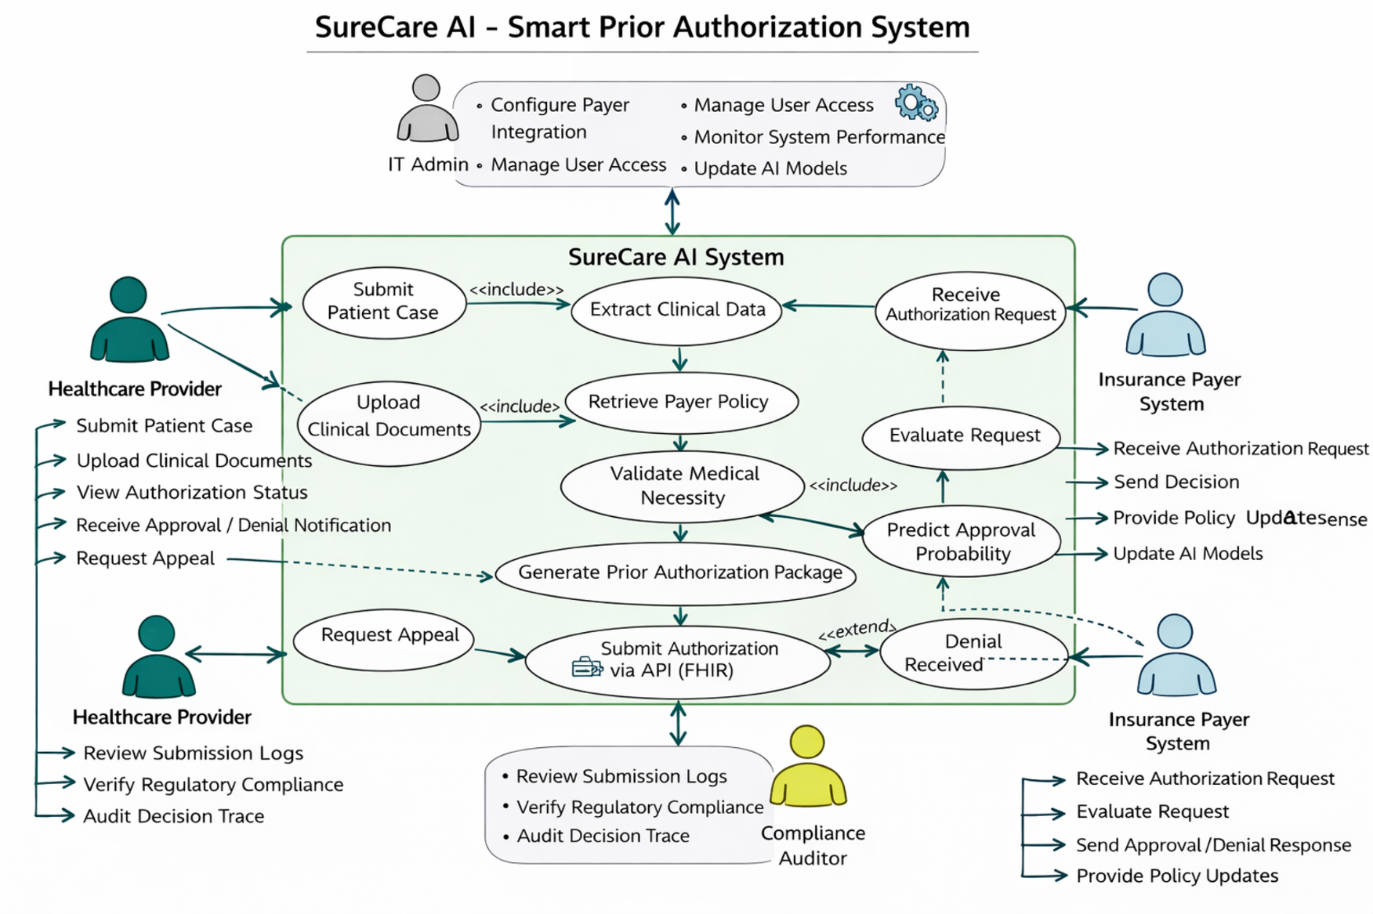
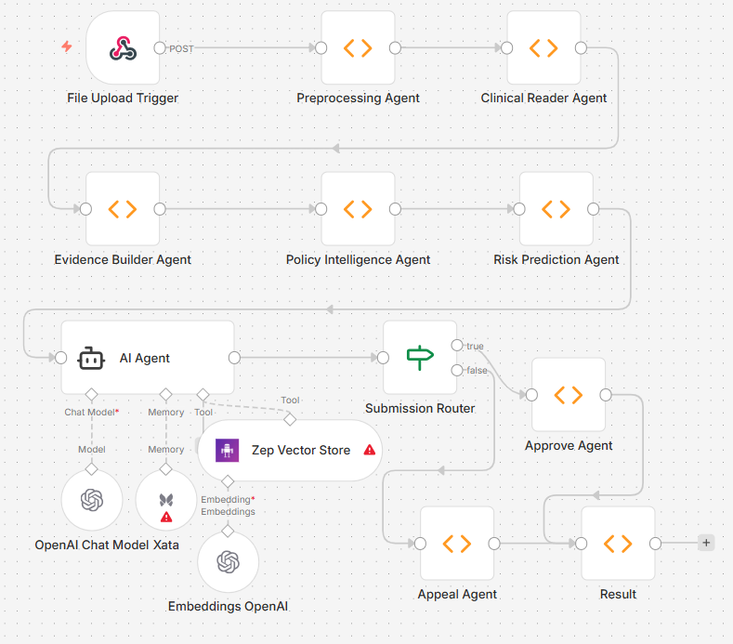



Solution Details
Proof of Concept
Medical‑necessity intelligence
Smart authorization
package generation
Streamlined Authorization Process- AI-based clinical analysis and automated payer policy matching.
Automated Workflow Management- End-to-end tracking with approval prediction and denial alerts.
Scalable + Cost-Effective Solution:- Cloud-native microservices with secure EHR and payer integration.
Clinical Reader Agent extracts indications, treatments, risk factors, creating structured medical necessity profile.
Submission Agent auto-populates payer PA forms with evidence, codes, justifications for electronic submission.
Unique Selling Proposition
01
Extracts structured and unstructured patient data (diagnoses, labs, notes, orders) directly from the EHR using NLP and connectors.
Policy Agent retrieves real-time payer rules, compares with patient profile, identifies met or missing criteria.
Detailed reports & blockchain-verified certification
02
Automated clinical data ingestion
Dynamic policy and eligibility check
Performance Report & Certification
End‑to‑end autonomous prior authorization:
SureCare AI automates the full PA lifecycle—from extracting clinical evidence to submitting requests and drafting appeals—minimizing manual intervention to only rare complex edge cases
Multi‑agent, policy‑aware intelligence
A coordinated set of agents (Clinical Reader, Policy Agent, Submission Agent) reads unstructured notes, understands real‑time payer rules, and translates them into compliant, structured PA packages
Minutes instead of days :
Seamless EHR–payer connectivity via standards :
By eliminating manual chart review and form filling, the system transforms PA turnaround from multi‑day administrative cycles to near real‑time decision‑ready submissions.
The platform is designed to sit between provider EHRs and payer systems, leveraging FHIR APIs and other standard interfaces so hospitals can adopt it without disrupting existing workflows.
Use Case Diagram
Working

