Slide 1
Cloud Architecture for Flick Platform
Akilandeshwari Srinivasan

Slide 2
Introduction
The Flick platform is an innovative streaming solution designed to deliver personalized, seamless user experiences. Leveraging cutting-edge cloud technologies, it offers a vast library of global content, including movies, TV shows, and exclusive originals.

Slide 3
Mission
Revolutionizing entertainment with a personalized, accessible platform connecting audiences to engaging stories.'

Slide 4
Objectives
Ensure content diversity and quality.
Deliver personalized user experiences.
Enable seamless streaming across devices.
Enhance user engagement and satisfaction.
Provide global accessibility.

Slide 5
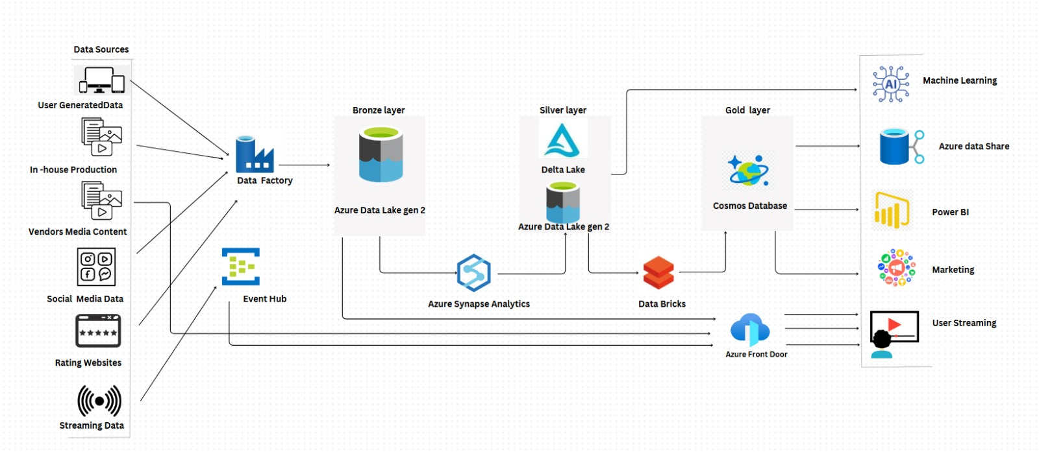
Architectural Diagram

Slide 6
Architecture Overview
The data flow in the Flick platform begins with data ingestion from multiple sources, including user-generated data, in-house production, vendor media content, social media platforms, rating websites, and streaming data. Azure Data Factory orchestrates the extraction, transformation, and loading (ETL) of this raw data into the Bronze Layer of Azure Data Lake Gen2. Event Hub processes streaming data for real-time analytics. The data is then transformed and cleaned in the Silver Layer using Delta Lake to enable structured analytics. Advanced processing and transformations are performed with Azure Synapse Analytics and Databricks, refining the data further into the Gold Layer for high-quality insights. This refined data is stored in Cosmos DB and made available for downstream applications like machine learning models, Power BI dashboards, marketing systems, and user-facing platforms through services such as Azure Data Share and Azure Front Door. This ensures seamless, scalable delivery of personalized content and actionable insights.

Slide 7
Proposed Data Pipeline
1. Data Ingestion: Azure Data Factory and Event Hub.
2. Storage: Bronze Layer in Azure Data Lake Gen2.
3. Processing: Silver Layer (Delta Lake), analytics via Synapse and Databricks.
4. Refinement: Gold Layer stored in Cosmos DB.
5. Delivery: Integrated with AI/ML, dashboards, and user platforms.

Slide 8
Failed Pipeline Strategy
Early Failure Detection: Immediate alerts for issues.
Retry Mechanisms: Automatic retries for transient errors.
Fallback and Graceful Degradation: Service availability during failures.
Post-Mortem Analysis: Root cause identification for improvement.

Slide 9
Benefits and Applications
Scalability and high availability.
Real-time insights and personalization.
Enhanced user satisfaction and engagement.
Optimized business performance.

Slide 10
Conclusion
The Flick platform's cloud architecture exemplifies modern data engineering practices with Azure technologies. This project demonstrates scalable, resilient solutions, enriching your Azure Data Engineering portfolio.

