Slide 1
Final pRoject
Akila Selvaraj
DSC 530: Data Exploration and Analysis
Aug 12, 2022

Slide 2
Statistical Question/Hypothesis
Statistical/Hypothetical Question I took for this project is
Does increase in glucose level leads to stroke?
For this, I took the health care dataset with eleven clinical features for predicting stroke risk.
https://www.kaggle.com/datasets/fedesoriano/stroke-prediction-dataset

Slide 3
Variables used for analysis
Columns in the dataset
id: unique identifier
gender: "Male", "Female" or "Other"
age: age of the patient
hypertension: 0 if the patient doesn't have hypertension, 1 if the patient has hypertension
heart_disease: 0 if the patient doesn't have any heart diseases, 1 if the patient has a heart disease
ever_married: "No" or "Yes"
work_type: "children", "Govt_jov", "Never_worked", "Private" or "Self-employed"
Residence_type: "Rural" or "Urban"
avg_glucose_level: average glucose level in blood
bmi: body mass index
smoking_status: "formerly smoked", "never smoked", "smokes" or "Unknown"*
stroke: 1 if the patient had a stroke or 0 if not

Slide 4
Five variables selected for analysis
Variables I chose for explorations are as follows:
bmi: body mass index
age: This variable tells the age of the patient.
hypertension: If the variable contains 0, then it means that the patient doesn't have hypertension, If it is 1, then the patient has hypertension
avg_glucose_level: This column contains the average glucose level in blood of the patients.
smoking_status: "formerly smoked", "never smoked", "smokes" or "Unknown"*

Slide 5
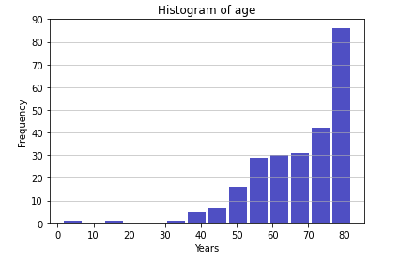
Histogram of five variables
Histogram of AGE
Looking at the histogram of age, common age people affected by stroke is 80.
Distribution is not normalized and it is skewed for age. It is obvious that stroke affects older age people.
Rows with age less than 30 are very less. We can say that age values with less than 25 are outliers.
Mean of age 67.72819277108434
Variance of age 161.9872035755927
STD of age 12.727419360404241
Mode of age 0 78.0

Slide 6
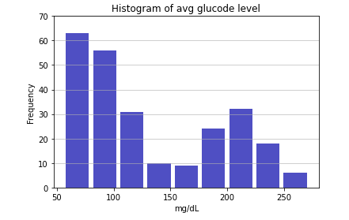
Histogram of five variables
Histogram of avg_glucose_level
Average glucose level among stroke affected patients is not normally distributed.
Blood sugar level 140 mg/dL is considered to be normal. Glucose level more than 200 mg/dL is high diabetic.
From the histogram, frequency of glucose level less than 100 is more.
Average sugar level starts from 50. So, we can say that value less than 50 can be considered as outliers.
Mean of Avg Glucose Level 132.54473895582322
Variance of Avg Glucose Level 3834.217124225938
STD of Avg Glucose Level 61.92105558068223
Mode of Avg Glucose Level 0 101.45

Slide 7
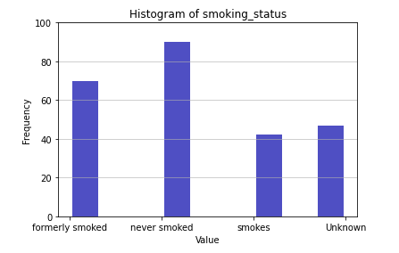
Histogram of five variables
Histogram of smoking status
Smoking status has been divided into four categories, formerly smoked, never smoked, smokes and unknown.
Frequency is more for the patients who never smoked. However there is no much difference between never smoked and formerly smoked.
Identifying outliers is also not possible in this variable. However, if the records with value of unknown is more, predicting the stroke based on this variable would be meaningless.

Slide 8
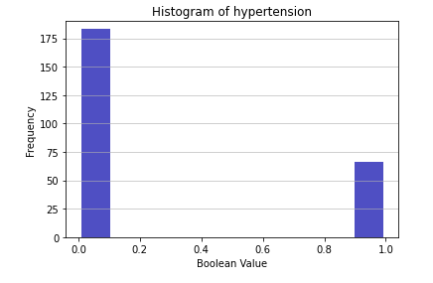
Histogram of five variables
Histogram of hypertension
Hypertension is again a Boolean variable which says if the patient has hypertension or not.
Value 1 indicates that patient has hypertension and 0 means that patient has no hypertension.
Frequency of records with no hypertension is more compared to patients with hypertension.
Again, identifying outliers is not possible in this case.

Slide 9
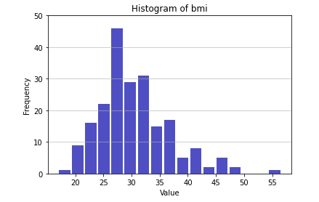
Histogram of five variables
Histogram of BMI
Histogram of BMI looks slightly normal.
BMI between 18 to 25 is considered as healthy range. BMI value of 25 to 30 is overweight and above 30 is in obese range.
From the histogram, frequency of overweight BMI is more compared to obese.
We can say that records with BMI less than 15 are outliers.
Mean of BMI 30.47129186602871
Variance of BMI 40.061960342289275
STD of BMI 6.3294518200464465
Mode of BMI
0 27.3
1 31.4

Slide 10
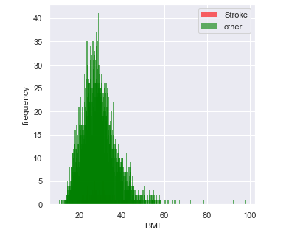
Probability mass function
PMF of BMI
Figure shows the PMF of BMI for stroke patients and others, using bar graphs.
As the volume is huge, we can see lot of noise in the graph.
Also, stroke data is completely hidden.

Slide 11
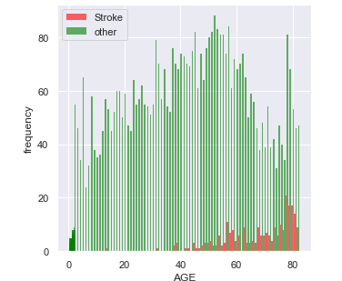
Probability mass function
PMF of Age
Figure shows the PMF of Age for stroke patients and others, using bar graphs.
Data volume is huge for age as well. We can see that patients who gets stroke are greater than 40.
Also, the frequency is high after 70 which says that chances of getting stroke is high after age 70.

Slide 12
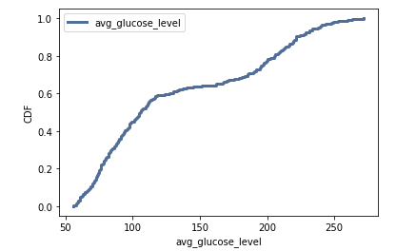
Cumulative distribution function
CDF of Avg Glucose Level
Figure shows the CDF of avg glucose level for stroke patients.
Looks like 60% of stroke affected patients are having avg glucose level less than 130.
90% of stroke affected patients are having glucose level of 250.
As common values appear as steep or vertical sections of the CDF, mode at 101 glucose level is apparent here.

Slide 13
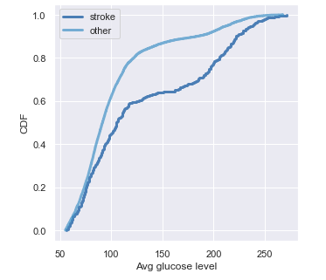
Comparing Cumulative distribution function
Comparing CDF of Avg Glucose Level
Figure shows the CDF of avg glucose level for stroke patients and for other patients.
This comparison clearly shows the difference between the stroke patients and other.
We can see that discrepancy between the data is increasing drastically from 130 glucose level.

Slide 14
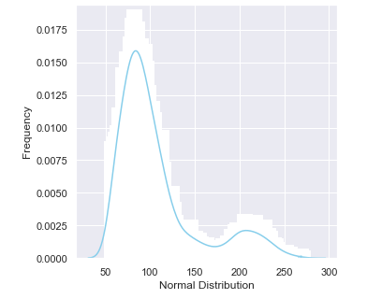
Analytical distribution
Normal Distribution of avg_glucose_level
Figure shows the Normal Distribution of avg glucose level.
We can see the spike at the mean value of 106.
From the figure, we can tell that the distribution is skewed on right with long tail.
We can see the distribution is high for patients with more glucose level.

Slide 15
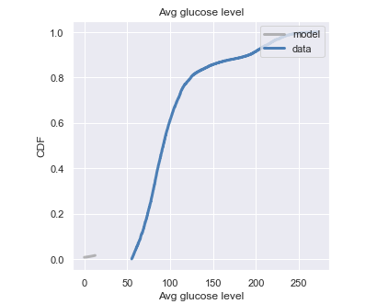
Analytical distribution
CDF of Normal Distribution of avg_glucose_level
Figure shows the empirical CDF of avg glucose level of all the patients and the CDF of a normal distribution with the same mean and variance.
The difference between the model and the data is very small.
I believe it is appropriate to use normal distribution for this.

Slide 16
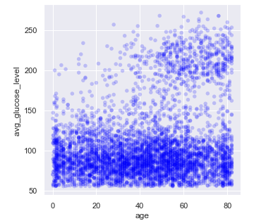
Scatter plot
Scatter plot of Age vs Avg_glucose_level
Figure shows the scatter plot of age vs avg glucose level.
We can see that the avg glucose level is going beyond 200 for most of the people who is beyond the age of 50.
We can also tell that there is no linear relationship between age and glucose level.
Correlation coefficient of 0.235 says that there is very little correlation between these two variables.
Spearman's correlation which measures the strength and direction of monotonic association is also 0.14 which is very minimal.

Slide 17
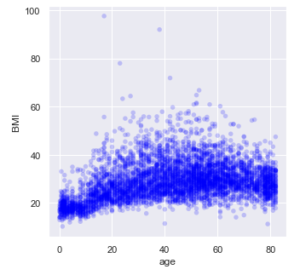
Scatter plot
Scatter plot of Age vs bmi
Figure shows the scatter plot of age vs bmi
It shows older you get, the higher your body mass index will be and bmi slightly decreases when people gets very old after 70.
The relationship is not so linear in this case as well.
Pearson correlation of age vs bmi is 0.3 which is less.
Spearman correlation is 0.37 which is little higher than Pearson correlation. Spearman correlation indicates the direction of monotonic association between these two variables is less.

Slide 18
Hypothesis test
Permutation test has been done on avg glucose level values of patients affected by stroke against glucose level values of patients who are not affected by stroke.
P-value of this test is zero. This means that in 1000 trials, we didn’t see a correlation, under the null hypothesis, that exceeded the observed correlation.
That means that the p-value is probably very minimal.
As the p-value is less than the significance level, we reject the null hypothesis.

Slide 19
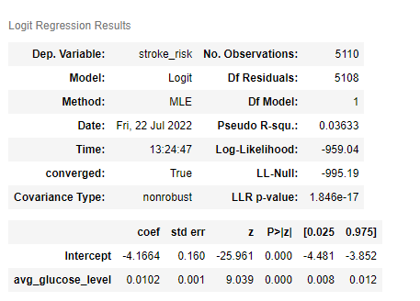
Regression analysis
Reg Analysis on one dependent variable
Stroke prediction in health dataset is categorical variable and the results are in binary. So, used logistic regression to predict the possibility of stroke.
The image on the right shows logistic regression results by having one dependent variable avg_glucose_level.
P-value is 1.846e-17 which is very less that indicates that we can reject the null hypothesis.
Pseudo – R2 value is 0.03633,which means the variable in our model avg glucose level predicts 3% of variability in avg glucose level.

Slide 20
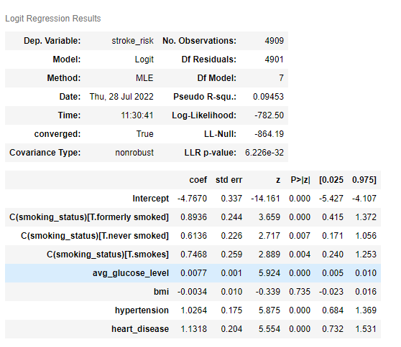
Regression analysis
Reg Analysis on many dependent variables
The image on the right shows logistic regression results by having multiple dependent variables avg_glucose_level.
P-value is 1.846e-32 which is very less that indicates that we can reject the null hypothesis.
Pseudo – R2 value is 0.09453,which means the explanatory variables in our model with avg glucose level predicts only 9% of variability in avg glucose level.

Slide 21
Regression analysis
Reg Analysis on many dependent variables
The image on the right shows logistic regression results by having multiple dependent variables avg_glucose_level.
P-value is 1.846e-32 which is very less that indicates that we can reject the null hypothesis.
Pseudo – R2 value is 0.09453,which means the explanatory variables in our model with avg glucose level predicts only 9% of variability in avg glucose level.

Slide 22
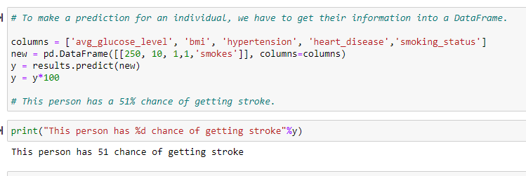
Regression analysis
Reg Analysis on many dependent variables
The image on the right shows logistic regression results by having multiple dependent variables avg_glucose_level.
Accuracy here is 0.957 which is higher than the baseline.
To make a prediction in the dataset, we have to get their results. There are 51% of getting stroke for the values I have passed below.

