Slide 1
CAPSTONE PROJECT
TENTITIVE PRICE PREDICTION OF A COMPUTER
AKILA BAMUNUSINGHA ARACHCHI

Slide 2
INTRODUCTION
There are many ways to buy a computer or a laptop.
But how to identify the prices according to the features?
This project is facilitating the customer to predict the price of the computer or laptop according to the selected features.

Slide 3
OBJECTIVES
The objectives of this project is to,
Identify the features of customer selected model
Build a price prediction model that perform
Classify the customer’s selection
Based on the model performance, will predict the price from the given data set.

Slide 4
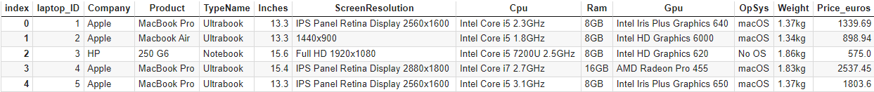
DATA
There are 1303 rows and 15,636 attributes available.
DATA SET PREVIEW & PREPARATION

Slide 5
DATA ANALYSIS
For Analysis purposes there are standard methods used
Linear Regression()--->>>0.7035099716052827
Lasso()--->>>0.7028709335163869
Decision Tree Regressor()--->>>0.656680922226371
Random Forest Regressor()--->>>0.7818170743480807
Best Model Accuracy 79%

Slide 6
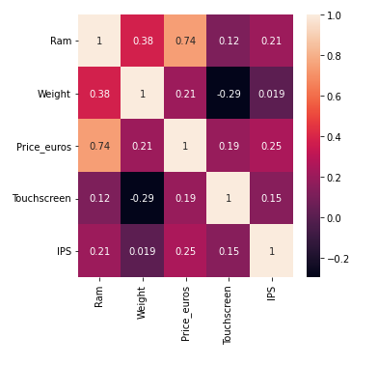
EXPLOTARY DATA ANALYSIS
Correlation Matrix is used to determine that doesn’t affect to predicted price.

Slide 7
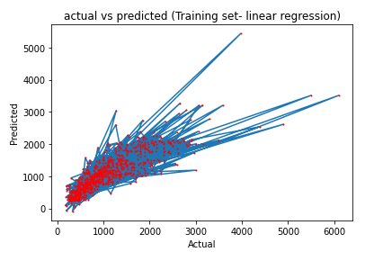
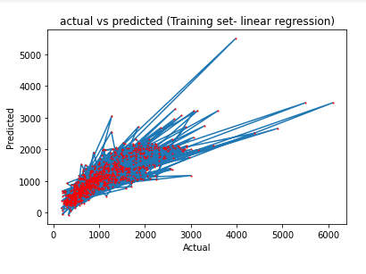
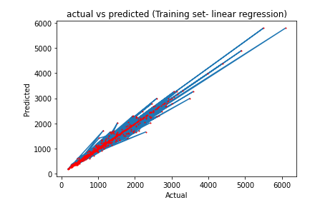
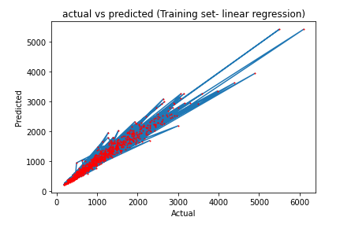
MODEL TRAINING
Variation of Price prediction on Linear , Lasso, Decision Tree, Random Forest
Linear Regression
Lasso
Random Forest Regression
Decision Tree Regression

Slide 8
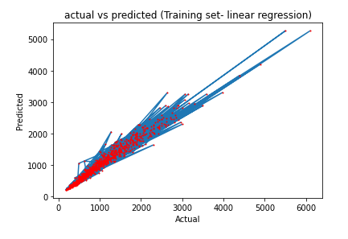
RESULTS
Best Model hyperparameter tuning
0.789800779628387
79%

