Slide 1

COURT CASE HANDLING SYSTEM(CCHS)
Group No: 1
A.A.T.G.Abeysinghe 2014CS001
Devanarayana.S. 2014CS022
K.C.Edirisinghe 2014CS029
D.T.Fernando 2014CS034
K.Kirishjajini 2014IS043
H.N.A.Nilakshi 2014IS056
Supervisor- Dr. D. N. Ranasinghe
Mentors- Mr. R. N. Rajapaksha
Mr. S. A. Karunarathna
Client- Registrar of Colombo District Courts
Notes:
Glølkl.gb

Slide 2
Introduction
Colombo District Court handles civil cases.
Civil Cases
Money Related
Land Cases
Family Problems

Slide 3

Money Related Cases
Money related cases –
a large number
most important type
complicated procedure
CCHS will handle money related cases.

Slide 4
Project Description
Common types of money related cases
Money recovery cases
Hire purchase cases
Money Recovery cases are filed by a plaintiff against a defendant, in order to recover money which the defendant debts to the plaintiff.
Hire Purchase cases are cases filed regarding ownership of items purchased on an installment plan.

Slide 5
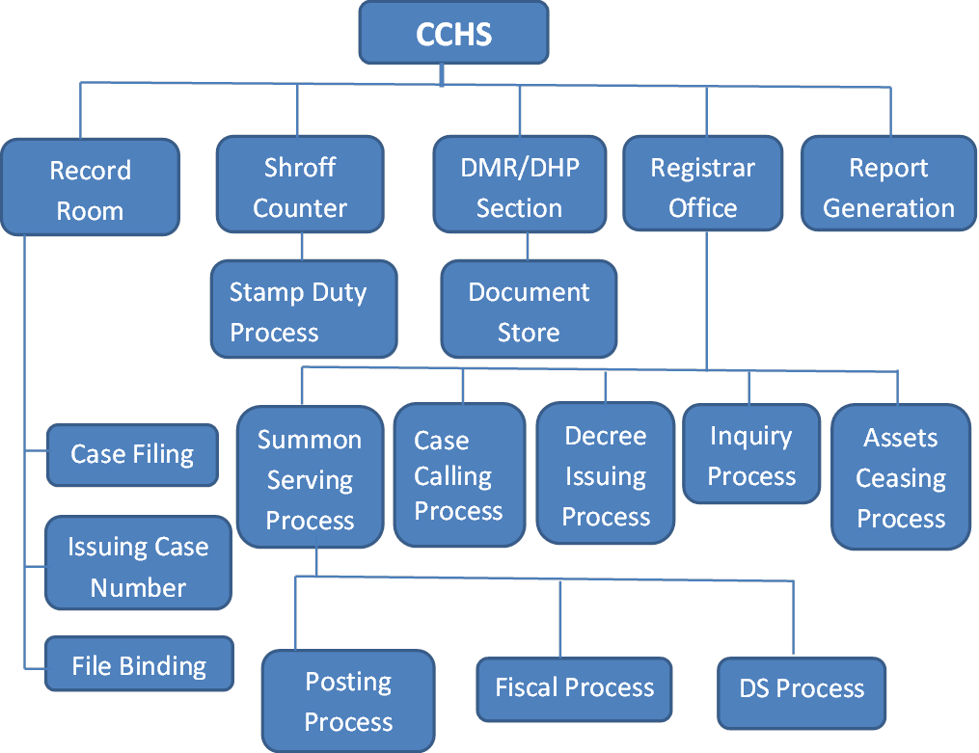
Organisation

Slide 6
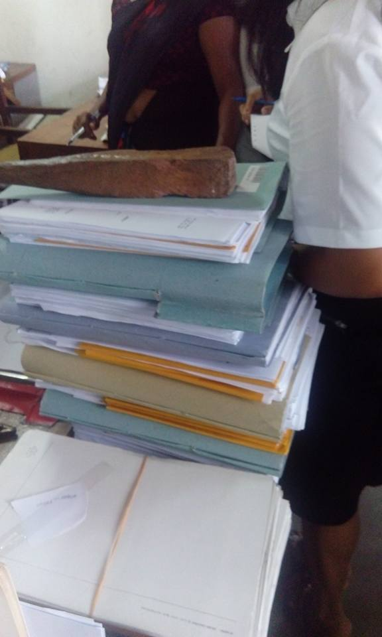
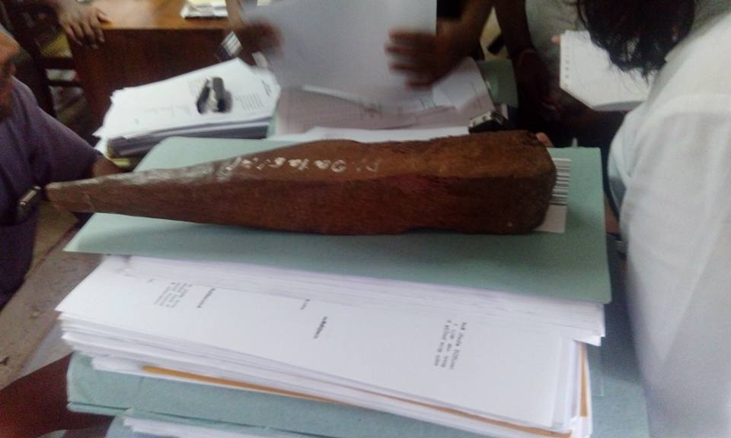
Reasons for Automation
Currently, the process takes place manually
Large number of case files
Increasing number of court cases
Difficult to find case files
Case file loss at unexpected situations
Time consuming and difficult report preparation

Slide 7
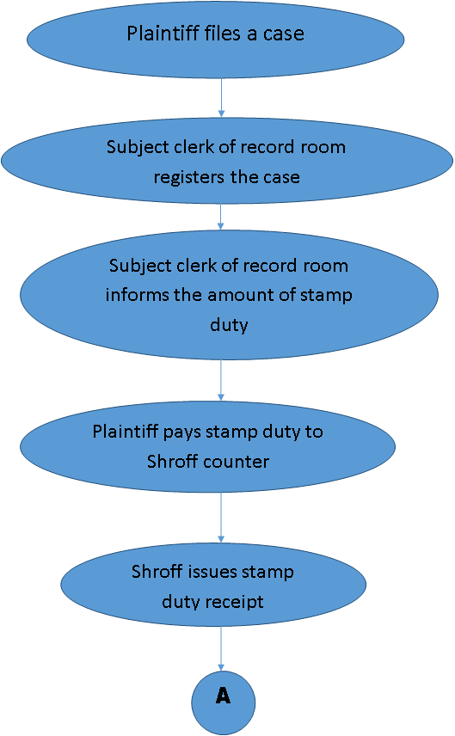


Overview of Current Operations

Slide 8
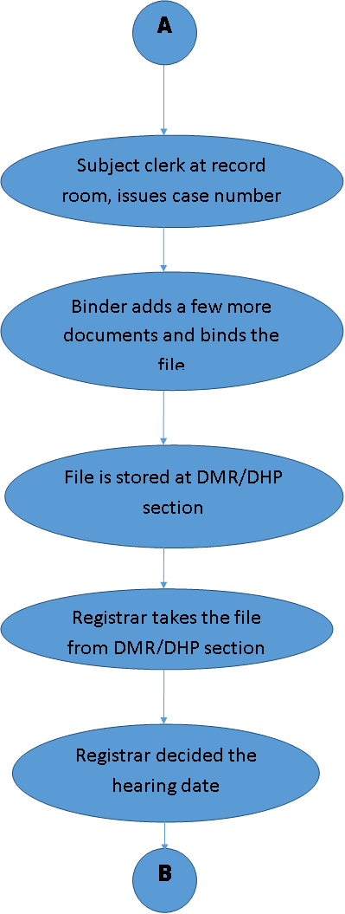

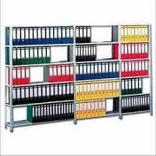

Slide 9
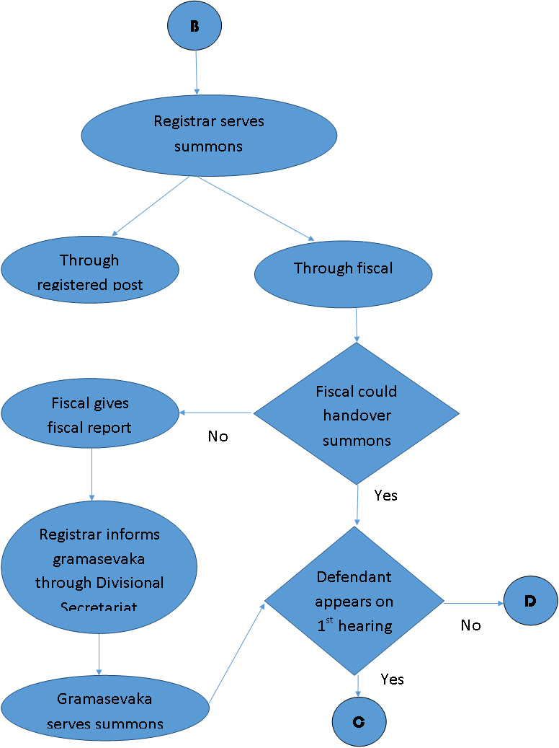




Slide 10
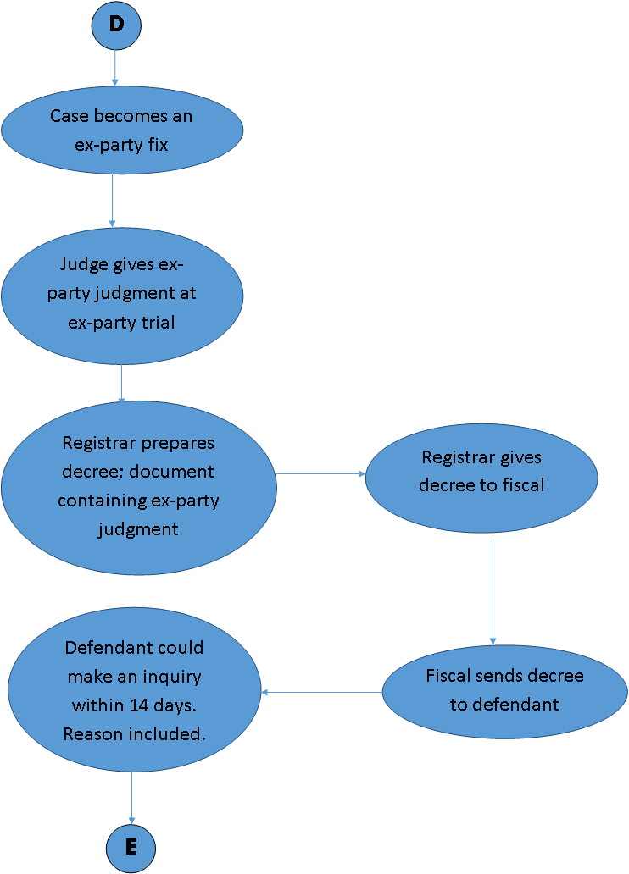



Slide 11
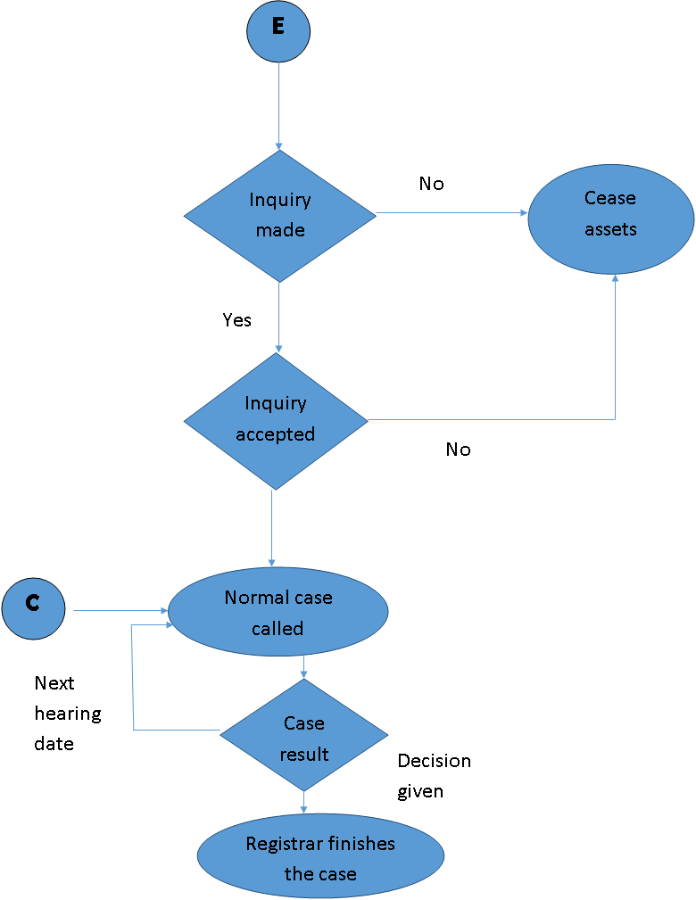



Slide 12

REPORTS
Reports for Judicial Services Commission
Interpreter prepares two reports on behalf of the judge.
Statistical Report-
Contains no.of cases, no.of final judgements
monthly, quarterly, annually
Decision Report- Copies of all decisions

Slide 13
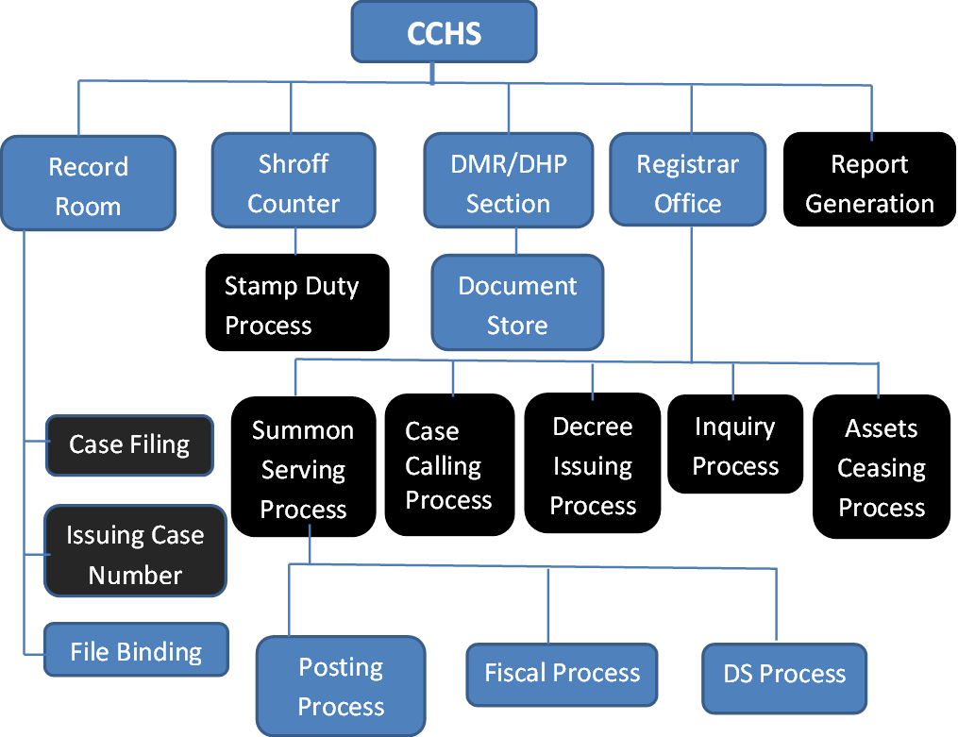
Scope

Slide 14
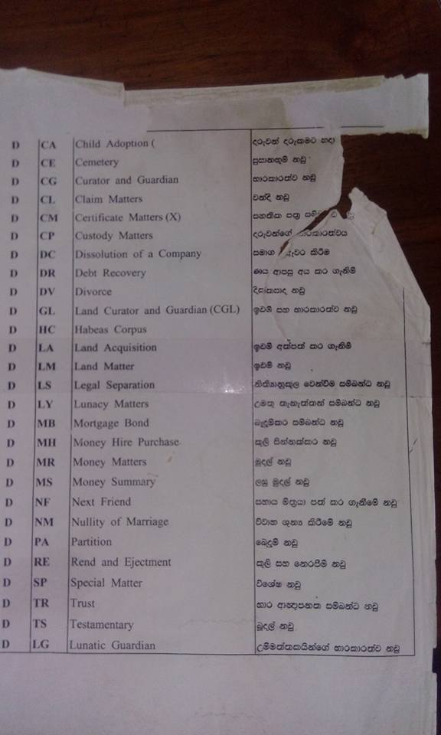
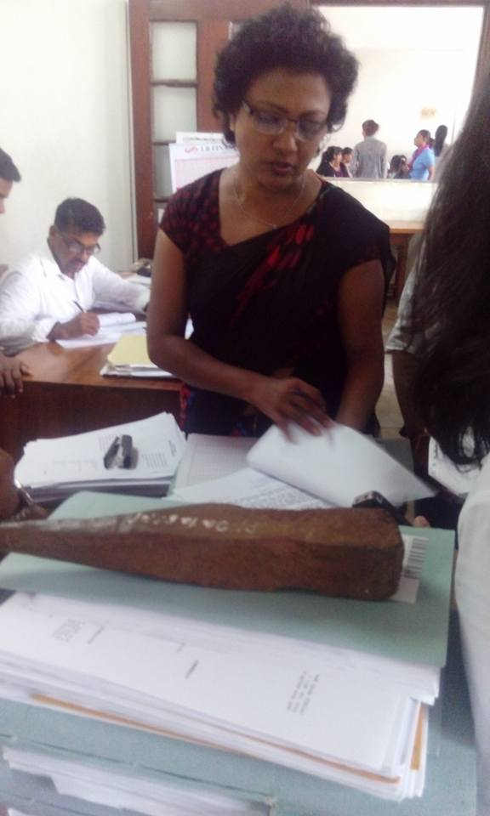
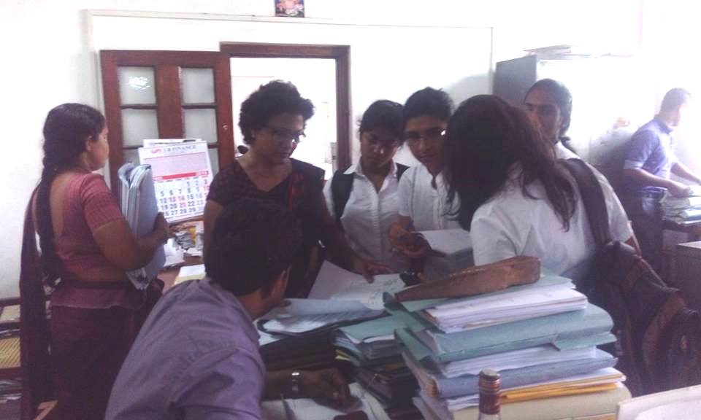
Feasibility Study
Fact Finding Methods
Site visit
Interviews
Sampling of existing documentation
Observation of work environment

Slide 15


Operational Feasibility
Automated CCHS will be helpful for the court staff.
Address all the requested requirements.
All cases will be handled from the time of plaint until final judgment.
Provide many reports than requested.
Cultural Feasibility
The current process is done manually
Full of files
Time consuming
Space consuming
Staff finds it troublesome to handle
Staff is willing to adjust themselves for an automated system.
As long as the staff receives a training ,getting used to an automated system is not an issue.
Notes:
Staff is fed up

Slide 16

Technical Feasibility
We wish to use Java SE for development
Database Management System – MySQL
Generation of reports – JasperReports
Above technologies are
free and open source
easy to learn
having resources to take advices and help

Slide 17
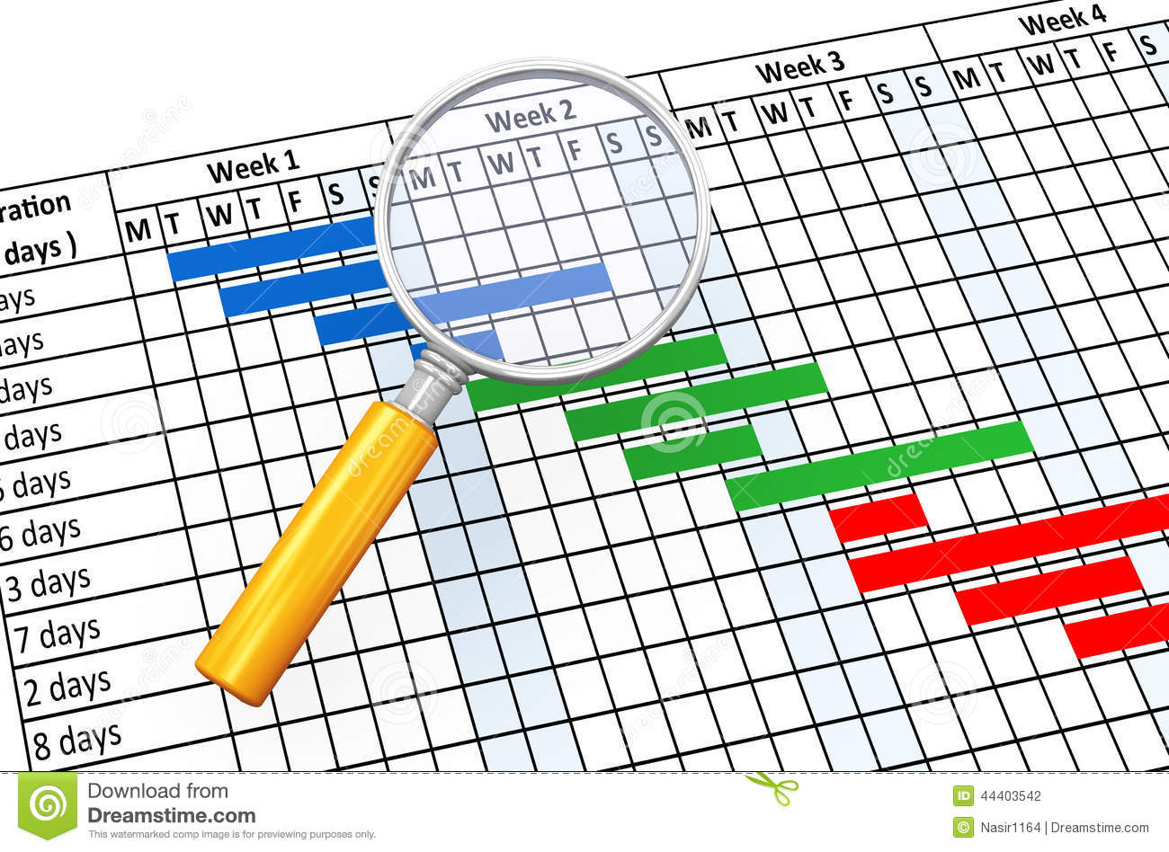
Schedule Feasibility
Total time period – 1 year
Has mandatory deadlines
Questions
How long will it take to get the technical expertise?
Not hiring technical expertise
Will learn the necessary details before implementation starts
Did we take into account the national holidays and weekends?
Holidays and weekends will be working days
They are included into the project schedule

Slide 18
3. What are the real constraints on project deadlines(mandatory/desirable)?
Iterative development
Client did not place mandatory deadlines
Client is supportive ; university project
4. Can the solution be designed and implemented within an acceptable time period?
Wish to deliver by end December 2016
Client meetings depend on client’s schedule

Slide 19

Economic Feasibility
Non profit motive
Development using open source software
Coding by students
Less costs
During implementation
Host computers
Server computer
LAN connection cables add to the cost

Slide 20

Legal Feasibility
Client is Colombo District Courts
Functional requirements are legal
Free and open source software for development-
No issues regarding copyright
Secure Database
No access for 3rd parties
Team will protect privacy and confidentiality of information
System development by team during academic period-
No contract programmers/employees
No issues regarding ownership of code

Slide 21
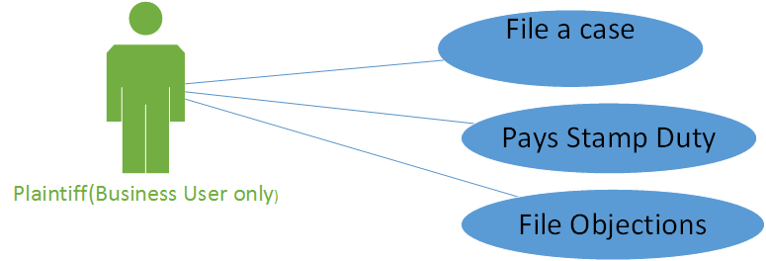
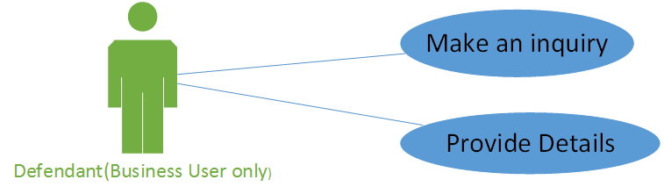
Use Cases

Slide 22
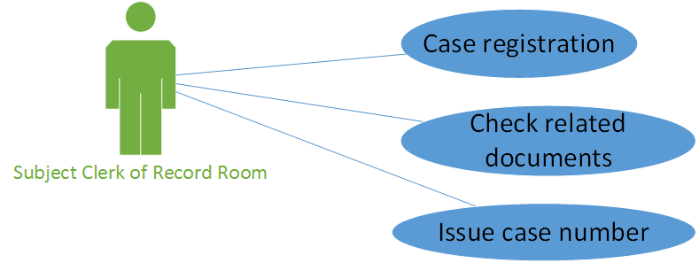
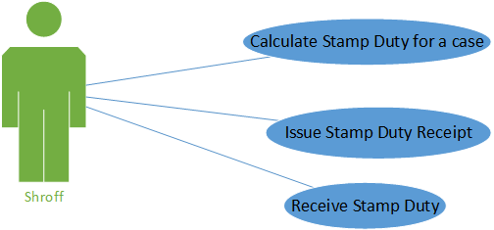
Use Cases

Slide 23
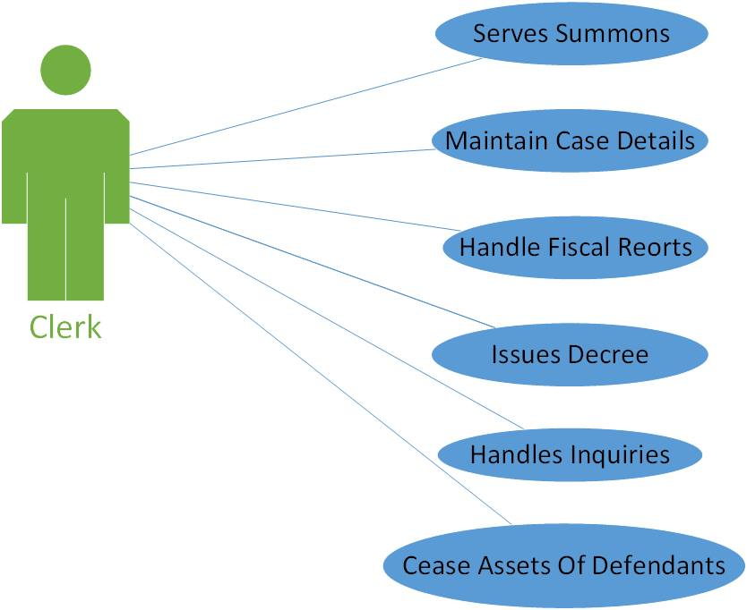
Use Cases

Slide 24
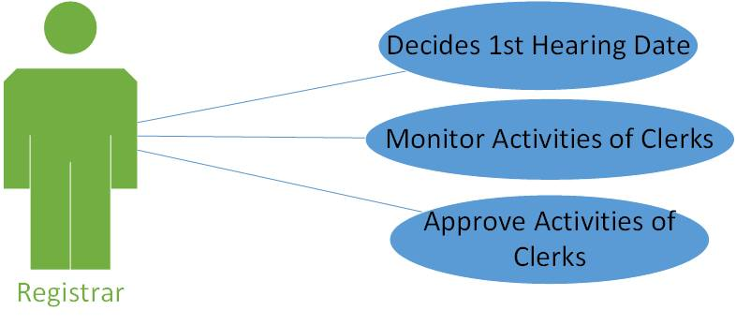
Use Cases

Slide 25
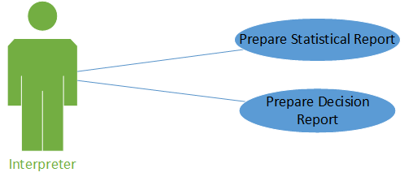
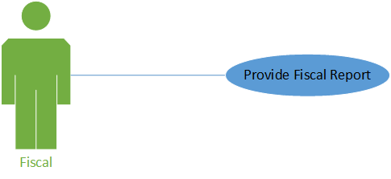
Use Cases

Slide 26

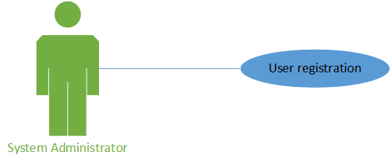
Use Cases

Slide 27
Functional Requirements
Case registration
Issuing a case number
Calculate stamp duty for a case
Issue stamp duty receipt
Update case details
eg-next hearing date, decision, defendant details
Serve summons
Handle fiscal report details
Issue decree
Handle inquiries
Handle ceasing of assets
Prepare reports such as statistical reports, decision reports
Retrieve case details.

Slide 28
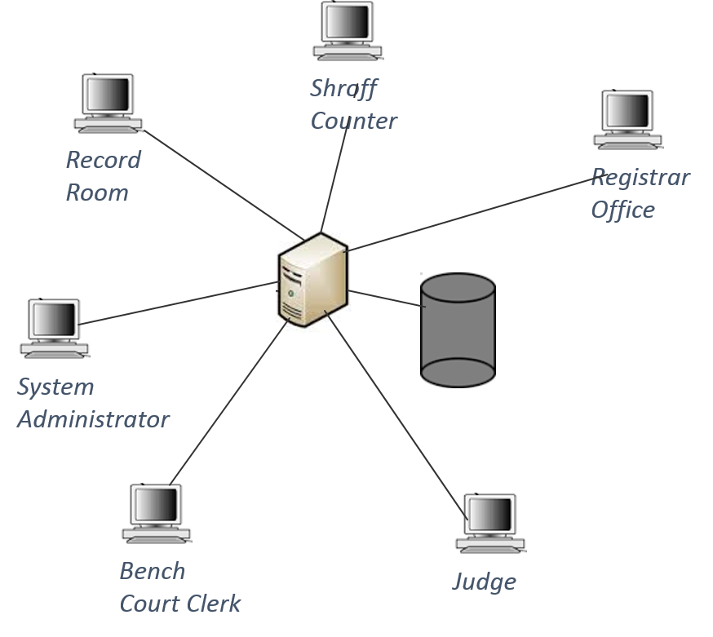
High Level System Architecture

Slide 29



Technologies
Development-
Wish to use JavaSE
Provides high-level classes that are used for
Networking
Security
Database access
Graphical user interface (GUI) development
Database Management System- MySQL
Report Generating Tool- JasperReports

Slide 30

Project Schedule/Delivery Plan
Current system is a very old system.
Well defined requirements.
Requirements do not change drastically over time.
But the current system is manual.
Difficult to gather all the requirements at the beginning of the project.
Waterfall model can not be used.
Wish to follow incremental development;
Component wise development
Priority to most important requirements.

Slide 31
 | May | June | July | Aug | Sep | Oct | Nov | Dec | Jan
Requirement Analysis and Design Document Submission
Database Design
Design and Development of record room process
Design and Development of Shroff counter process
Design and Development of summon serving process
Interim presentation
Design and Development of case calling process
Design and Development of decree issuing process
Design and Development of inquiry process
Design and Development of asset ceasing process
Report generation
Final presentation and Demonstration

Slide 32


