Slide 1
23CSE452 BUSINESS ANALYTICS
Early Warning for Severe Air-Pollution Days in Delhi-NCR: Predicting Risk and Identifying Weather and Calendar Triggers to Support Business Planning
Final Project Presentation
GROUP - 11
Akilan J - CB.SC.U4CSE23002
Isha Sri Prakash - CB.SC.U4CSE23029
M Nandan Reddy - CB.SC.U4CSE23431
Jei Akash M A -CB.SC.U4CSE23518
V Sanjana - CB.SC.U4CSE23751
Faculty: Rohini S, Assistant Professor
Presentation date: 05.11.2026
01
Notes:
Suggested time: 20 seconds. Replace bracketed prompts with your project evidence. Present actual results only. Target 15 minutes including the live demonstration. Cover the whole project. Review 2 assessment primarily focuses on two Unit 3 methods.

Slide 2
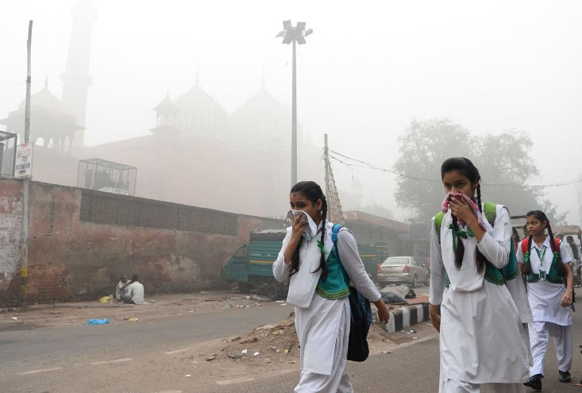
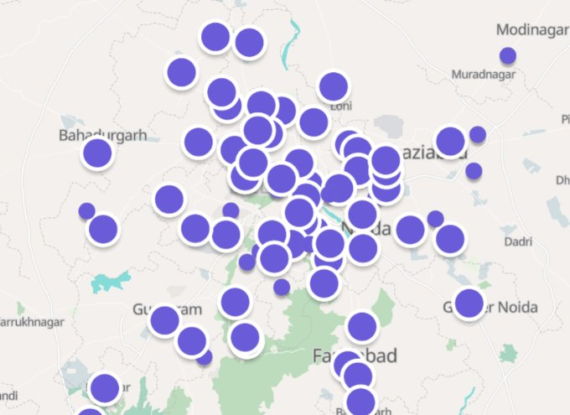
PROJECT OVERVIEW
Business problem and objectives
Problem statement:
Severe air-pollution days in Delhi-NCR bring GRAP restrictions that disrupt construction, logistics and delivery, schools and event organisers. Firms often learn of a bad-air day too late to reschedule work, staff or events, which leads to idle labour, delayed deliveries and last-minute cancellations. Businesses need a clear, advance signal of whether a day will be "very poor or severe" (AQI above 300), and an understanding of which conditions usually lead to such days.
02
Notes:
Suggested time: 40 seconds. Replace bracketed prompts with your project evidence. Present actual results only.

Slide 3
Objectives:
Forecast Delhi PM2.5 1, 2 and 3 days ahead, and flag days likely to be high-pollution (PM2.5 ≥ 120.5 µg/m³, which is AQI > 300 in a PM-only calculation).
Find which weather and calendar conditions come before a high-pollution day, using association rules.
Show when each sector (construction, logistics, schools, events) should start preparing.
Weigh the cost of a false alarm against a missed high-pollution day to suggest an alert threshold.
Put all of this in a dashboard that others can use.

Slide 4
Business objective:​
​
Provide advance warning of high-pollution days in Delhi-NCR.​
Support proactive planning for:​
  Construction activities​
  Deliveries and logistics​
  School schedules​
  Events and outdoor activities​
Reduce business losses caused by sudden GRAP restrictions and cancellations.​
Measure model performance using:​
  Recall: How many high-pollution days are correctly detected.​
  False alarms: How often the model incorrectly predicts a high-risk day.​
  Lead time: How many days in advance the warning is provided.​
​
​

Slide 5
Existing methods: ​
​
- Official AQI reporting (CPCB National AQI): reports current air quality from pollutant readings but is not a forward-looking planning tool for businesses. ​
[https://app.cpcbccr.com/ccr_docs/FINAL-REPORT_AQI_.pdf]​
[https://airquality.cpcb.gov.in/ccr/#/]​
- Official forecasts and GRAP: CAQM invokes GRAP stages using forecasts from IMD/IITM. These support government action, not company-level planning, and are not tailored to different business risk levels. ​
[https://caqm.nic.in/landingpage/pages/grap/grap-orders]​
- Machine-learning AQI forecasting studies: most predict the AQI value and report R-squared or RMSE. ​
Abirami, S., & Chitra, P. (2021). Regional air quality forecasting using spatiotemporal deep learning. Journal of Cleaner Production, 300, 125341.[https://www.sciencedirect.com/science/article/pii/S0959652620353865?via%3Dihub]​
Daily scale air quality index forecasting using bidirectional recurrent neural networks: Case study of Delhi, India. (2024). Environmental Pollution, 351, 124040.​
[https://www.sciencedirect.com/science/article/pii/S0269749124007541?via%3Dihub#sec4]​

Slide 6
Research gap: ​
​
Existing air-quality forecasting studies predominantly formulate the problem as continuous AQI prediction, evaluating models using metrics such as RMSE, MAE and R², while categorical/event-based prediction is less central to the modelling objective.​
Existing evaluations primarily emphasize overall forecasting performance, with comparatively less emphasis on identifying high-pollution events using event-oriented measures such as recall for AQI >300 days.​
Forecasting studies demonstrate predictive capability but generally focus on the model and statistical performance, rather than converting predictions into simple, interpretable conditions that a business manager can directly use for operational planning.​
Different businesses have different tolerance levels for risk. A construction company may prefer an early warning even if there are some false alarms, whereas another business may prefer fewer false alarms. This motivates our adjustable alert threshold.​
​
​

Slide 7
Proposed Approach | Addresses Research Gap
1. Data collection: OpenAQ PM2.5/PM10 + Open-Meteo weather + festival/season calendar | Existing studies often focus mainly on AQI history; combining pollution, weather and calendar/context features provides richer predictors for high-pollution events.
2. Feature engineering: Previous-day AQI, 3/7-day averages, wind, humidity, temperature, month & festival flags | Moves beyond predicting only the AQI number by identifying temporal, weather and calendar conditions associated with AQI >300.
3. Classification: Predict whether AQI will exceed 300 in the next 1–3 days + compare with “tomorrow = today” baseline | Directly addresses the gap of continuous AQI prediction vs. an actionable yes/no high-risk decision, while testing whether the model can identify high-pollution days rather than relying on persistence.
4. Interpretability: Association rules for weather/calendar triggers | Addresses the lack of plain-language, actionable explanations by identifying combinations of conditions associated with high-risk days.
5. Dashboard: 3-day risk indicator + adjustable alert threshold | Addresses the gap around fixed alerts and different business risk levels, allowing users to adjust the threshold according to their operational needs.
6. Time-series forecasting: Forecast actual AQI alongside classification | Provides the numerical forecast used in existing literature while complementing it with the more decision-oriented AQI >300 classification.

Slide 8
Expected output:
Prediction: 1–3 day PM2.5 forecasts with an alert. On the held-out test (Jan 2025–Sep 2026), average error is 15.7 / 19.5 / 19.6 µg/m³ for days 1, 2 and 3, against 18.8 / 24.7 / 27.5 for “tomorrow = today”.
Insight: a ranked table of weather/calendar rules. For example, post-monsoon season + low wind + no rain + high pressure + mid humidity was followed by a high-pollution day 93% of the time, against about 29% on an average day.
Recommendation: a preparation playbook by sector. It includes a suggested alert threshold of about 115 µg/m³ if a missed day is judged to cost 3× a false alarm.
Note: rules show association, not cause. The alert is a planning signal, not an official GRAP stage.

Slide 9
UNITS 1 TO 3
Complete project workflow
Stage | Your implementation | Status
Unit 1 | Collection, validation, preprocessing and EDA | Completed
Unit 2 | Predictive models and evaluation | Completed
Unit 3 | Time Series Analysis and Association Rule Mining (FP-Growth) | Completed
Final application | Interactive dashboard or website and recommendations | Completed
Completion status: 100% implementation and integration done
03
Notes:
Suggested time: 30 seconds. Replace bracketed prompts with your project evidence. Present actual results only.

Slide 10
Overall dataset description
Date | temp_mean (°C) | wind_speed_mean | pm25_target | high_risk
01-01-2018 | 13.13333333 | 1.65 | 370 | 1
02-01-2018 | 13.43333333 | 1.609167 | 383 | 1
03-01-2018 | 12.225 | 2.14017 | 306 | 1
Source and collection:
  Pollution: OpenAQ v3 API, daily PM2.5 and PM10 from stations within 25 km of central Delhi (97,220 raw sensor-days).
  Weather: Open-Meteo archive, hourly values for central Delhi summarised to daily.
  Calendar: team-built table with the Diwali dates.
Final dataset size: 3,195 records × 31 variables. 2,923 days have a PM2.5 target, and 792 days are high-risk.
Coverage: daily, 1 Jan 2018 – 30 Sep 2026, Delhi. The target comes from one reference station, with the city average used on 87 days when it was missing. Training is 2018–2024 and testing is Jan 2025 – Sep 2026.
Notes:
Suggested time: 45 seconds. Replace bracketed prompts with your project evidence. Present actual results only. Document original collection or generation. Pre-built datasets from Kaggle, UCI, GitHub or similar repositories are not permitted under the project requirements.

Slide 11
FINAL PROJECT DATA
Sample dataset and key variables
Date | temp_mean (°C) | wind_speed_mean | pm25_target | high_risk
01-01-2018 | 13.13333333 | 1.65 | 370 | 1
02-01-2018 | 13.43333333 | 1.609167 | 383 | 1
03-01-2018 | 12.225 | 2.14017 | 306 | 1
Unit mapping: ​
  Unit 1: collection, cleaning, description and EDA.​
  Unit 2: feature engineering and predictive models.​
  Unit 3: time-series forecasts of pm25_target and association rules linking weather/calendar to next-day high_risk.​
05
Notes:
Suggested time: 35 seconds. Replace bracketed prompts with your project evidence. Present actual results only.

Slide 12
Linked datasets and method-specific subsets:
Forecasting (Unit 3, time series): uses the daily pm25_target series plus past-day PM2.5 and yearly cycle terms. One model is fitted per forecast day. Weather enters only as observed on the forecast day, never as a future value.
Association rules (Unit 3): weather and calendar values are grouped into categories. The cut-points use 2018–2024 data only, and the rules predict the next day’s high_risk.
Held-out test: 2025–2026 data is used only to check results, not to build models or rules.
Missing days: 272 days have no target. They are left blank, not filled in, and are not scored.
Variable | Meaning | Type | Unit
date | Day of the record | date | YYYY-MM-DD
pm25_target | Daily PM2.5 at the reference station (city average on 87 fallback days); the forecast target | numeric | µg/m³
high_risk | 1 if PM2.5 ≥ 120.5 (AQI > 300 in a PM-only calculation), else 0; blank when the target is missing | binary | 0 / 1
target_source | Where the target came from: reference, city fallback or missing | category | –
temp_mean | Mean daily temperature | numeric | °C
wind_speed_mean | Mean daily wind speed | numeric | m/s
humidity_mean | Mean daily relative humidity | numeric | %
pressure_mean | Mean daily surface pressure | numeric | hPa
precip_sum | Total daily rainfall | numeric | mm
season, days_from_diwali, is_festival_window | Calendar context | category / integer / binary | – / days / 0 / 1

Slide 13
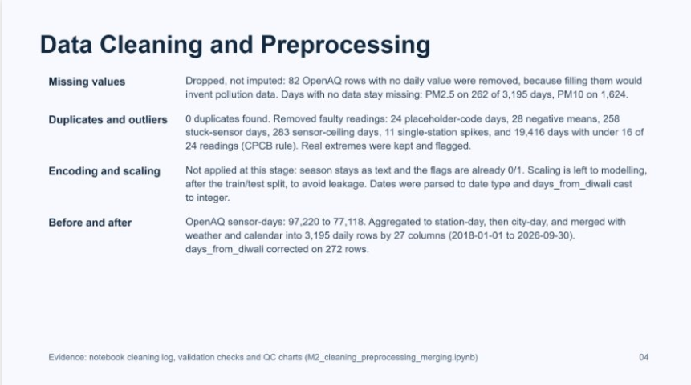

Slide 14
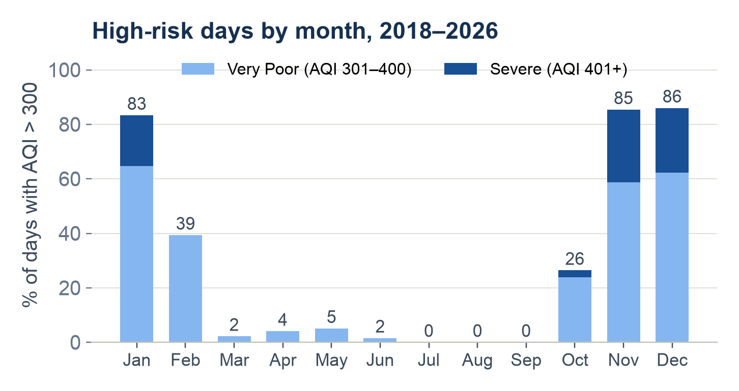
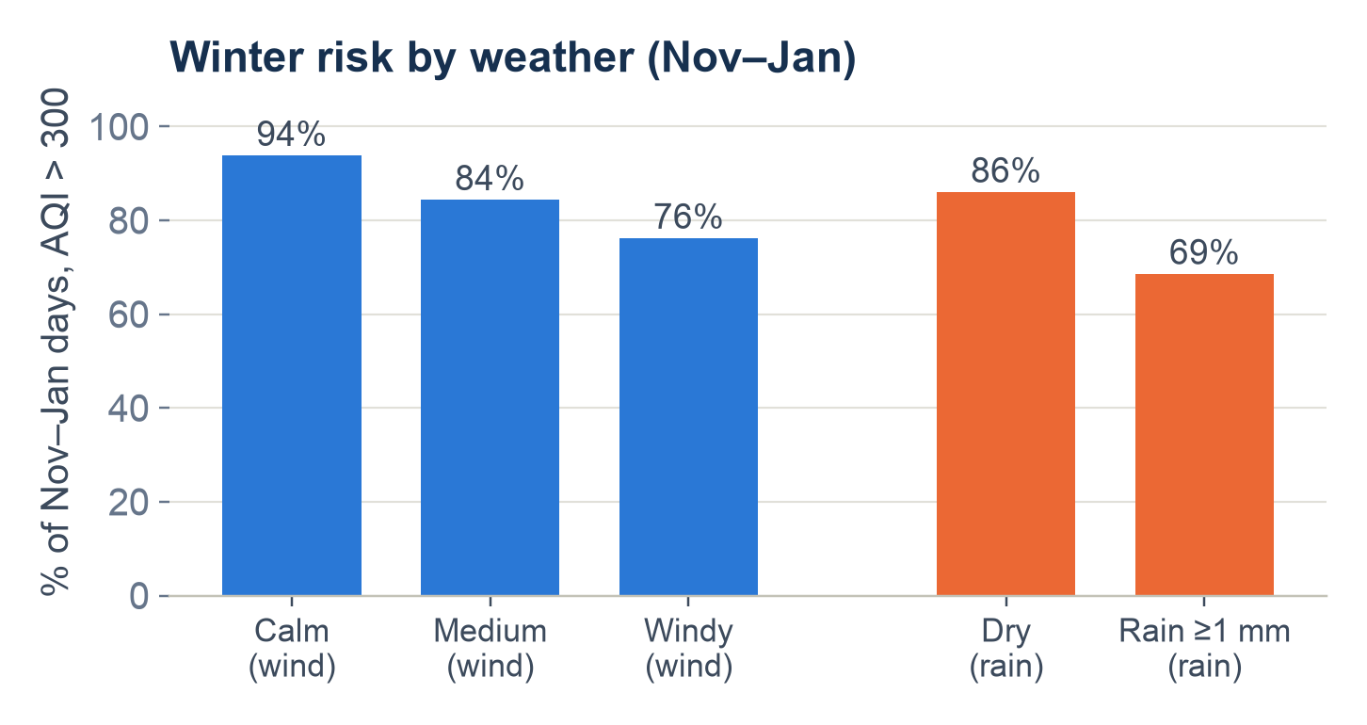
UNIT 1
Exploratory analysis and preprocessing
Key findings
Season drives risk: 83–86% of Nov–Jan days exceed PM2.5-based AQI 300; Jul–Sep have none.
Inside winter, weather decides: calm days 94% vs windy 76%; rain lowers it from 86% to 69%; Diwali raises median PM2.5 by 74%.
Preparation
Target: team's final pm25_target and high_risk (PM2.5 ≥ 120.5 µg/m³); 272 days with no target (8.5%) excluded, never imputed.
Feature evidence: kept real extreme episodes (skew 1.6); recent PM2.5 (lag-1 r = 0.88), month, wind, rain and Diwali are strong; weekday and humidity add little.
07
Notes:
About 1 minute. All numbers are from M3_EDA.ipynb on the team's final dataset (3,195 days, 2018 to Sep 2026).
Left chart: high-risk days (PM2.5-based AQI above 300) are concentrated in November to January, 83 to 86 percent of days, and a large part of that is Severe. July to September have none.
Right chart: inside winter, calm days are high-risk 94 percent of the time against 76 percent on windy days, and rain lowers it from 86 to 69 percent. Diwali raises median PM2.5 by 74 percent compared with the week before.
Preparation: I used the same target as the models, pm25_target and high_risk at 120.5. The 272 days with no target were left out, never filled in. Extreme values were kept because they are real episodes. The EDA also showed which features matter: recent PM2.5, month, wind, rain and the Diwali window; weekday and humidity add little. That is how the model features were chosen.

Slide 15
Feature Engineering
Target: high_risk = 1 when PM2.5 >= 120.5 ug/m3 (AQI > 300, Very Poor / Severe).
PM2.5-only: PM10 is 50.8% missing (100% in 2023-24), so it is kept as a feature with an availability flag, not in the target.
~97 engineered features across 8 families:
Lag (27): t-1 / t-2 / t-3 of PM2.5, PM10, weather & AQI.
Rolling (24): 3- and 7-day mean & std.
Day-over-day change (5): deltas of PM2.5, temp, humidity, wind, pressure.
Weather interactions: temp_range, wind x humidity, temp x pressure, plus cold_calm_dry / low_wind flags.
Calendar: cyclical month & day-of-year, winter & post-monsoon flags, Diwali within 3 / 7 / 14 days.
Persistence: prev_high_risk and counts of high-risk days in the past 3 & 7 days (from M3 autocorrelation).
PM10 & season: pm10_available flag, pm25_pm10_ratio, and 4 season one-hot dummies.
No leakage: all lag / rolling use shift(1); temporal split - Train 2018-2024, Test 2025-Sep 2026.
Output: 97 model-ready features for M5 (m4_train.csv, m4_test.csv, m4_feature_list.csv).

Slide 16
UNIT 2
Predictive modelling and final evaluation
Model | Acc. | Prec. | Recall | F1
Baseline | 0.946 | 0.867 | 0.867 | 0.867
Logistic Reg. | 0.940 | 0.804 | 0.930 | 0.862
Random Forest | 0.934 | 0.779 | 0.938 | 0.851
Gradient Boosting | 0.948 | 0.837 | 0.922 | 0.877
Results: Gradient Boosting selected: 118 of 128 high-risk days caught, 23 false alarms.
Interpretation: Recall is above 0.92 for all models and they catch the start of episodes, which the baseline cannot. The F1 gain over the baseline is small, and it is a 1-day warning only.
Business findings: After a very poor day, plan for another one. Season, rain, humidity and Diwali timing signal new episodes (late Oct – early Feb). Use it as a next-day alert for construction, logistics, schools and events.
08
Notes:
Suggested time: 65 seconds. Replace bracketed prompts with your project evidence. Present actual results only. Evaluate predictive models on held-out records from the final validated project dataset. Fit preprocessing only on training data. Compare models on the same test records. Choose task-appropriate metrics.

Slide 17
UNIT 3
Selected advanced analytics methods
Selected method | Business question | Data used
Method 1: Time Series Analysis It forecasts daily PM2.5 for the next 1, 2 and 3 days and flags a high-risk day when the forecast is at or above 120.5 µg/m³ (AQI > 300 in a PM-only calculation). | How many days ahead can we expect a high-pollution day in Delhi, so construction, logistics, schools and events can prepare earlier? | Target: pm25_target Label: high_risk Weather inputs: temperature, humidity, wind, pressure, rain, cloud, dew point and gusts, observed on the forecast day. Calendar inputs: month, weekday, Diwali distance and yearly-cycle terms.
Method 2: Association Rule Mining (FP-Growth) Finds weather & calendar patterns on a day that flag a high-risk PM2.5 day the next day, as interpretable, statistically validated If-Then rules. | Which weather and calendar conditions today reliably signal a high-risk (AQI 301+) PM2.5 day tomorrow, so teams can act 24 hours ahead? | Terciled weather (temp, humidity, wind, pressure, rain) + season + calendar (month, weekday, Diwali) + prior-day risk flag; 2,792 day-pairs (2018-2026).
09
Notes:
Suggested time: 30 seconds. Replace bracketed prompts with your project evidence. Present actual results only.

Slide 18
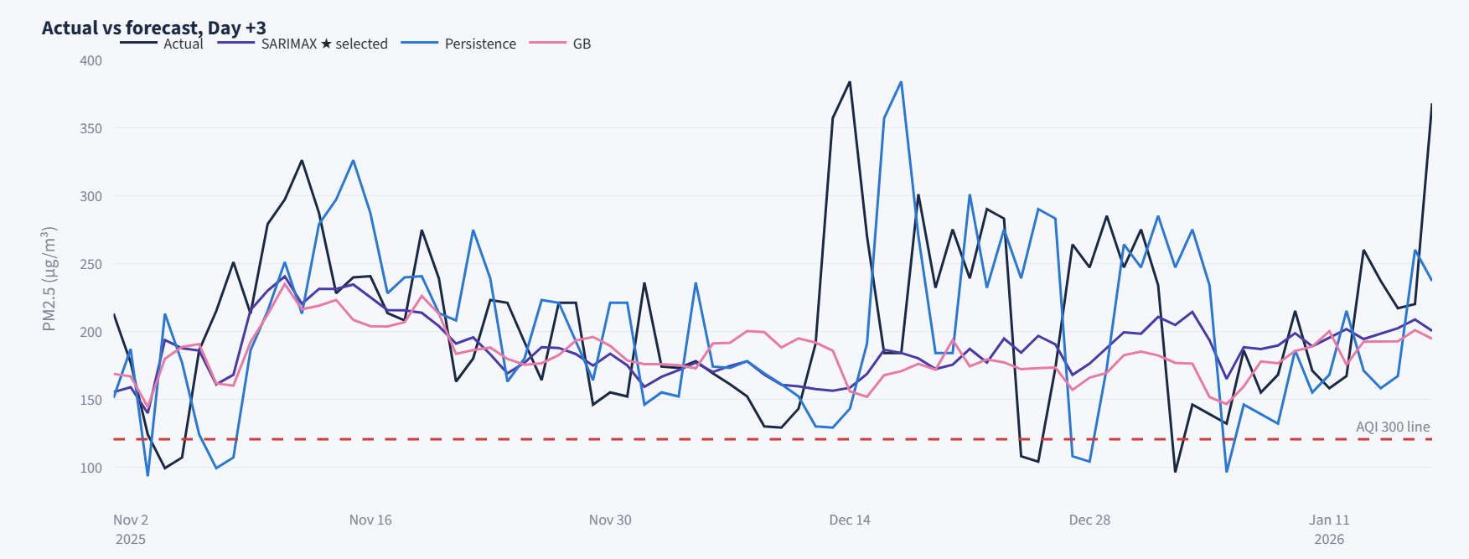
UNIT 3
Method 1 implementation
Selected method:
Time Series Analysis
It forecasts daily PM2.5 for the next 1, 2 and 3 days and flags a high-risk day when the forecast is at or above 120.5 µg/m³ (AQI > 300 in a PM-only calculation).
10
Notes:
Suggested time: 45 seconds. Replace bracketed prompts with your project evidence. Present actual results only. For time series, explain frequency and time split. For text, explain cleaning and representation. For association rules, explain transactions and thresholds.

Slide 19
Review 1 - Feedback
why did we choose these features, and what does each one add?
Selected feature | Purpose
PM2.5 lags 1–7 | Capture recent pollution
Log PM2.5 | Reduce skewness
Input age & fill flag | Track missing-data handling
Feature selection: Inputs must be informative and available when forecasting.
Data quality: Missing inputs are filled for up to 2 days; targets remain unchanged. Leakage and inconsistent sources are excluded.
Notes:
Suggested time: 65 seconds. Replace bracketed prompts with your project evidence. Present actual results only. Evaluate predictive models on held-out records from the final validated project dataset. Fit preprocessing only on training data. Compare models on the same test records. Choose task-appropriate metrics.

Slide 20
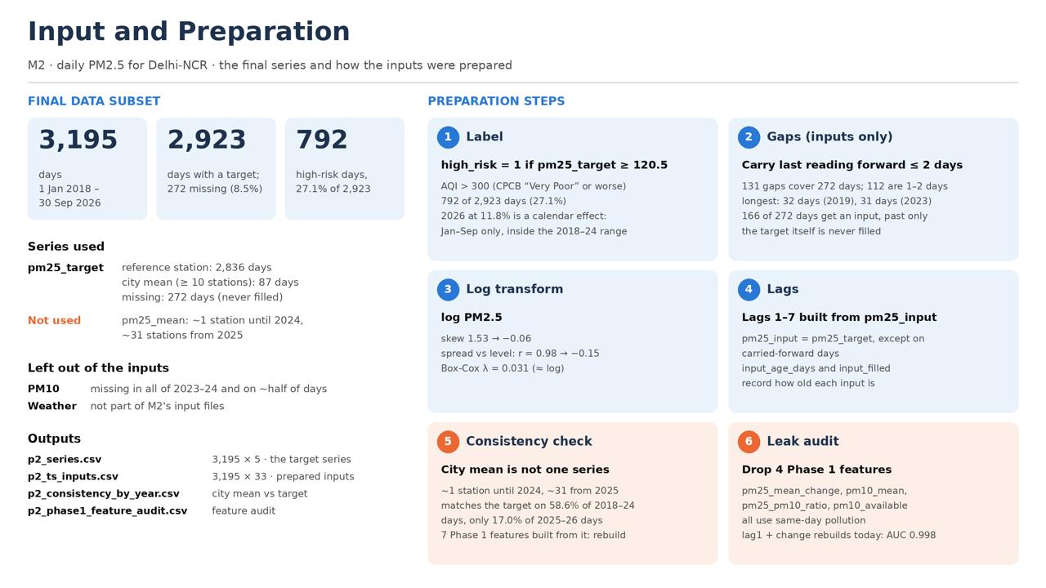

Slide 21
Implementation:
SARIMAX: ARMA(2,0,1) errors, 6 pairs of yearly-cycle terms, and weather lagged by the forecast horizon.
Gradient boosting: a regressor on log PM2.5, with a small tuned grid (learning rate, depth, iterations, leaf size).
Baselines: persistence (“tomorrow = today”), 7-day seasonal naive, climatology, and damped-anomaly persistence.
Selection rule: chosen on validation only. Gradient boosting wins only if it takes at least 2 of 3 folds by more than 0.25 µg/m³; otherwise SARIMAX stays.
Tools: Python, statsmodels, scikit-learn.
Output: ​
A PM2.5 forecast for each of the next 3 days, plus a high-risk alert.​
Selected models: gradient boosting for day 1, SARIMAX for days 2 and 3.​
​

Slide 22
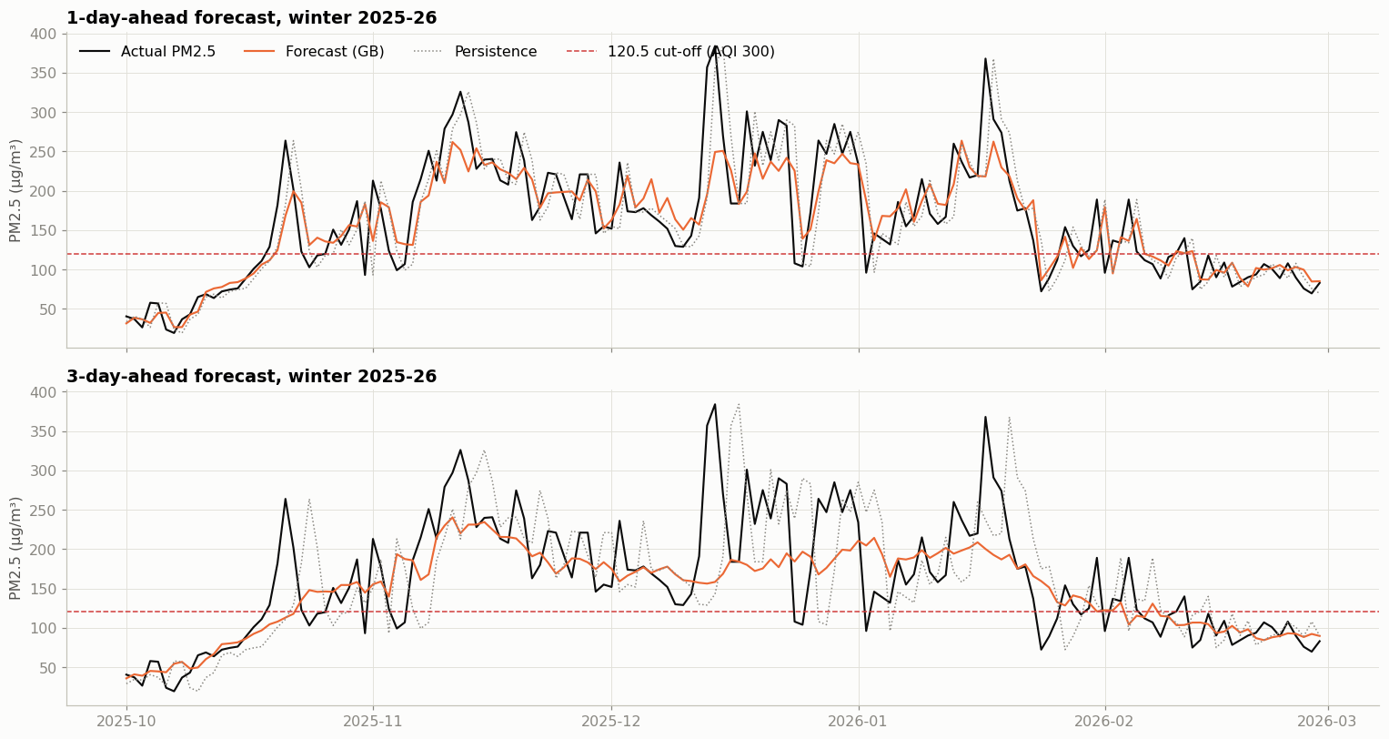

Slide 23
UNIT 3
Method 1 evaluation and comparison
Approach / configuration | MAE, µg/m³ (day 1 / 2 / 3) | RMSE, µg/m³ (day 1 / 2 / 3) | Alert recall (day 1 / 2 / 3)
A. Persistence (tomorrow = today) | 18.8 / 24.7 / 27.5 | 30.7 / 40.0 / 43.5 | 0.88 / 0.82 / 0.80
B. Selected model (GB day 1; SARIMAX days 2, 3) | 15.7 / 19.5 / 19.6 | 25.6 / 31.7 / 32.1 | 0.92 / 0.91 / 0.91
Evaluation data:​
Test set held-out Jan 2025 – Sep 2026, 635 scored days, of which 128 are high-risk.​
Winter: Nov–Jan is scored separately, 121 days with 106 high-risk.​
​
​
11
Notes:
Suggested time: 65 seconds. Replace bracketed prompts with your project evidence. Present actual results only. Compare alternatives within the same task using consistent data and conditions. Forecasting: MAE / RMSE on future held-out periods. Text classification: precision, recall, F1 and confusion matrix on test messages. Association rules: support, confidence and lift on final transaction data. Explain any threshold comparison. Do not compare unrelated tasks directly.

Slide 24
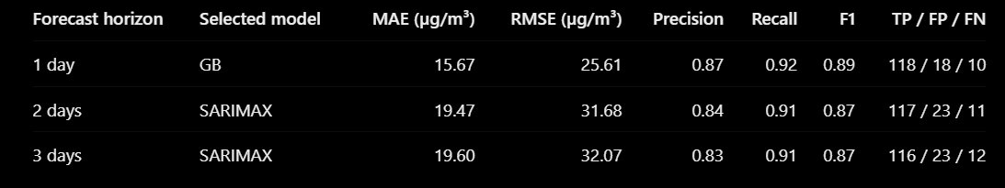
Interpretation:
Selected approach: gradient boosting for day 1 and SARIMAX for days 2–3, chosen on validation before the test set was touched.
Business meaning: the forecast gives 1–3 days of lead time. Error against “tomorrow = today” falls by 3.0 µg/m³ on day 1, 5.1 on day 2 and 7.8 on day 3, and the gain is statistically clear.
Limitation 1: the gain over the simple damped baseline is only about 0.3–1.0 µg/m³. The alert itself scores about F1 0.87 whether you use the model or seasonal climatology.
Limitation 2: the model catches 91–92% of high-risk days but raises 18–23 false alarms (precision 0.84–0.87).
Limitation 3: one reference station defines the target, and in winter almost every day is high-risk (106 of 121 test days), so the winter alert adds little.
Treatment: use the forecast as an early-planning signal, and check official AQI and GRAP notices before acting.

Slide 25
UNIT 3
Method 2 implementation
Selected method: Association Rule Mining (FP-Growth) - mines interpretable "If weather/calendar today -> high-risk PM2.5 tomorrow" rules with provable statistical confidence.
Input and preparation: 2,792 clean day-pairs (t -> t+1, 2018-2026); weather cut into frozen training terciles + binary rain + season + calendar; Set A (weather only) and Set B (adds "yesterday high-risk").
Implementation: mlxtend FP-Growth (support >=5%, conf >=60%, lift >=1.20x) -> 113 final rules after redundancy pruning; validated by Benjamini-Hochberg FDR + 7-day moving-block bootstrap (B=1,000).
Output: 113 significant rules (Set A: 64 weather-only, Set B: 49 persistence-synergy), each an If-Then rule with confidence, lift and 95% CI - e.g. Cold + High pressure + Low wind + No rain -> next-day high-risk (90.7% conf, 3.08x lift).
12
Notes:
Suggested time: 45 seconds. Replace bracketed prompts with your project evidence. Present actual results only. For time series, explain frequency and time split. For text, explain cleaning and representation. For association rules, explain transactions and thresholds.

Slide 26
UNIT 3
Method 2 evaluation and comparison
Approach / configuration | Train Conf. | Test Conf. | Test Lift
Set A - Weather/calendar only (64 rules) | 93.3% | 100% (N=14) | 5.02x
Set B - adds "yesterday high-risk" (49 rules) | 98.4% | 100% (N=13) | 3.34x
Evaluation data: 633 unseen 2025-26 day-pairs (base rate 19.9%); all 113 rules pass Benjamini-Hochberg FDR and lifts carry 7-day block-bootstrap 95% CIs. Table metrics are each set's top-rule values.
Interpretation: Set B reaches near-certainty (98.4%, +11.5% over the 86.9% "yesterday" floor); Set A fires from weather alone with higher lift. 85 rules stayed stable in 2025-26, 28 drifted. Limitation: rules show association, not causation, and some rest on few test days.
13
Notes:
Suggested time: 65 seconds. Replace bracketed prompts with your project evidence. Present actual results only. Compare alternatives within the same task using consistent data and conditions. Forecasting: MAE / RMSE on future held-out periods. Text classification: precision, recall, F1 and confusion matrix on test messages. Association rules: support, confidence and lift on final transaction data. Explain any threshold comparison. Do not compare unrelated tasks directly.

Slide 27
BUSINESS OUTCOMES
Combined insights and recommendations
Evidence from the project | Recommended action | Expected benefit / limitation
Method 1 forecasts flag high-PM2.5 days 1-3 days out; Method 2 rules name the weather/calendar triggers behind them (post-monsoon, low wind, high pressure, no rain). | Issue a combined 24-hr early warning: the forecast gives the number, the matching rule gives the reason and a GREEN/YELLOW/RED action tier. | Earlier, explainable preparation; alerts catch ~91-92% of high-risk days. Assumes IMD/CPCB data feeds stay reliable.
Both rule sets validate out-of-sample on 2025-26; stagnation + "yesterday high-risk" (Set B) reaches 98.4% confidence, +11.5% over persistence. | RED on Set B lock-in (GRAP, N95, indoor/electric delivery); YELLOW on Set A cold + low wind (pre-filter, pre-dispatch); GREEN in monsoon/high wind. | Converts risk into concrete operational steps. Limitation: rules are associational, and 28 of 113 drifted in a warm, windy winter.
Business objective addressed: Enterprises in Delhi-NCR get reliable, explainable 24-hour advance warning of severe-pollution days - protecting supply chains, logistics and workforce and supporting GRAP compliance.
14
Notes:
Suggested time: 55 seconds. Replace bracketed prompts with your project evidence. Present actual results only.

Slide 28
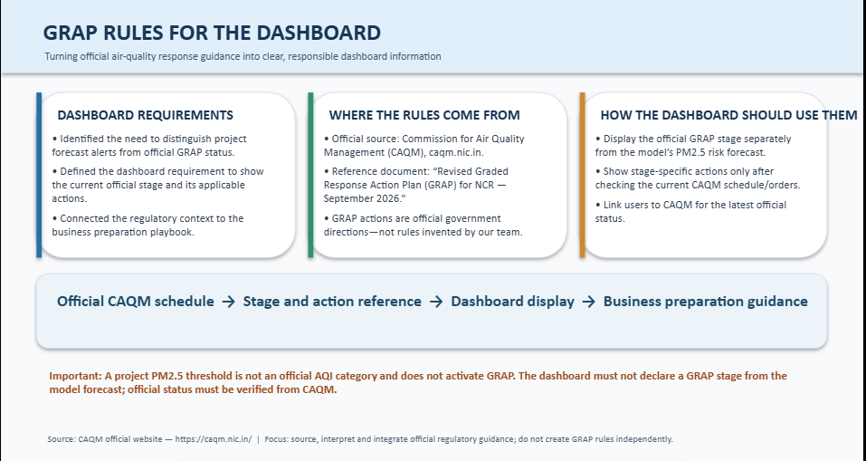

Slide 29
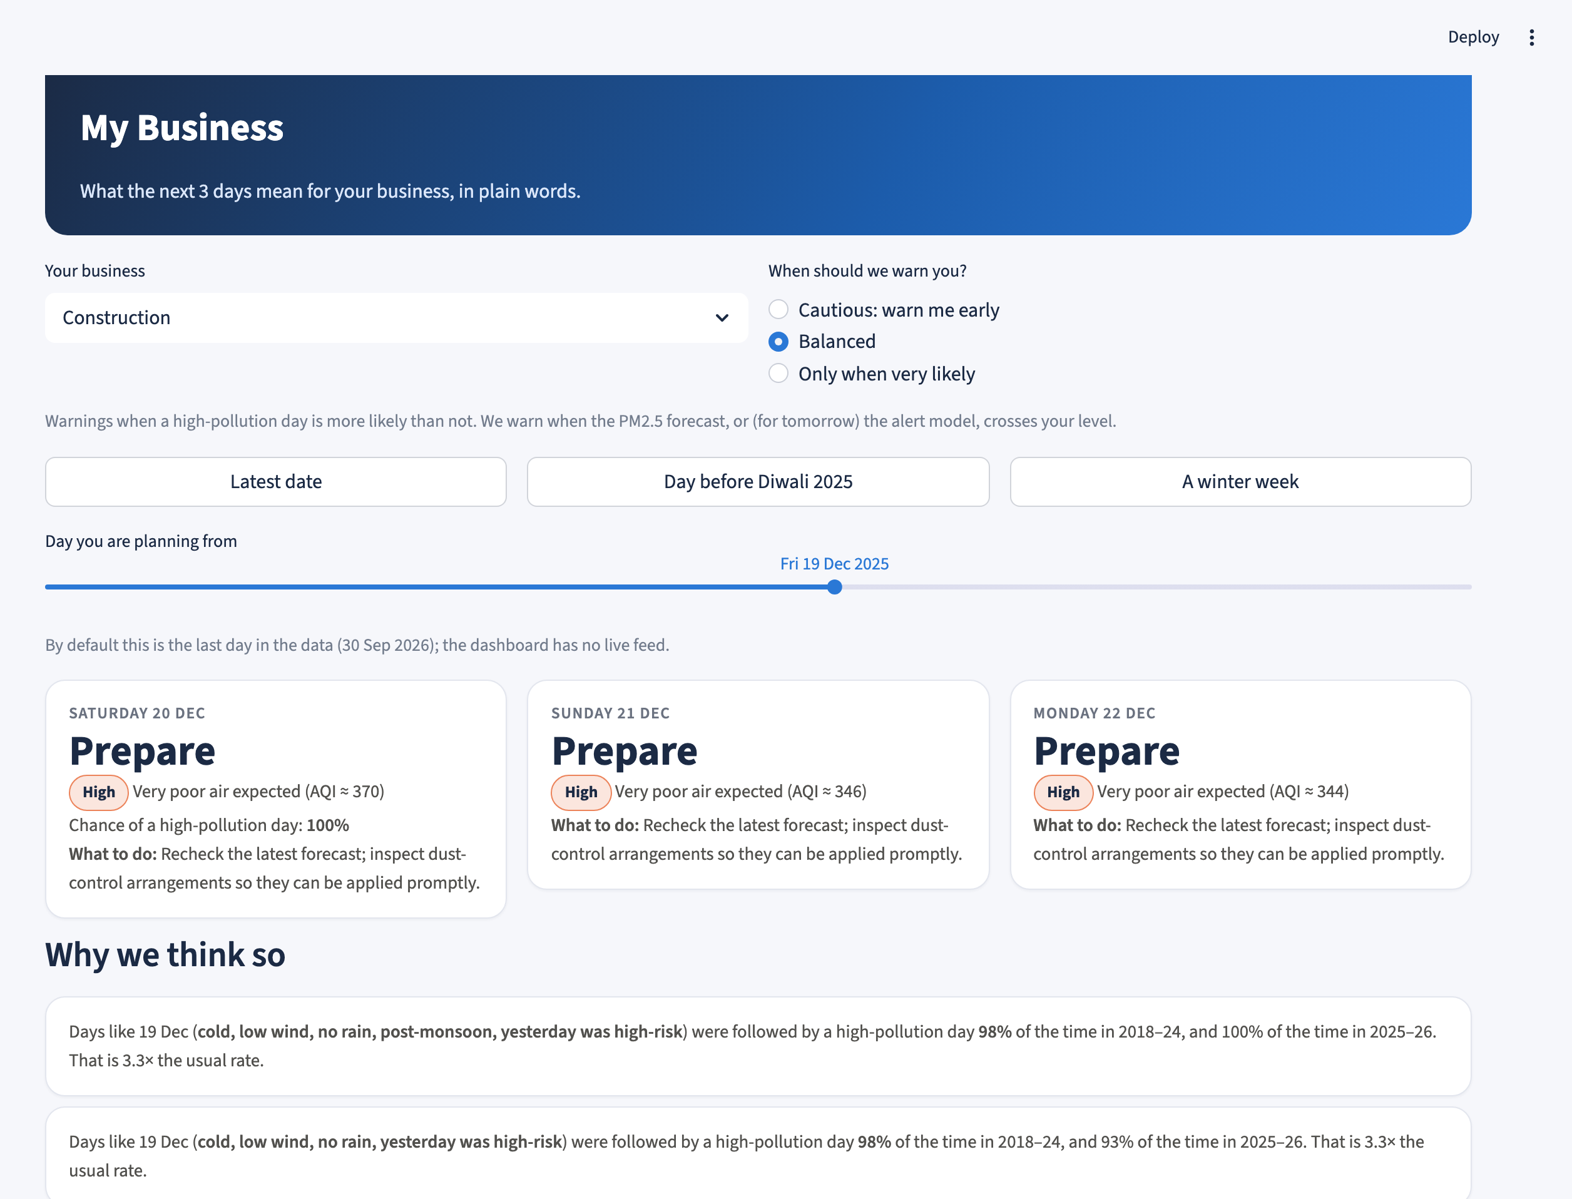
MANDATORY LIVE DEMONSTRATION
Interactive dashboard or website
Application: Delhi Air-Risk Planner, Streamlit + Plotly, 6 pages: Overview, Dataset, Forecast, Rules, Insights, My business.
Run: cd dashboard → streamlit run app.py (GitHub main). Live link: https://delhi-air-risk-planner.streamlit.app/
Live demo: on Insights, move the alert level from 120.5 to 140 µg/m³ or change the cost ratio: caught days, false alarms, total cost and the 120.5 vs 140 table update.
Business scenario: a construction firm planning from 19 Dec 2025 sees “Prepare” for the next 3 days (very poor air, AQI ≈ 344–370). Matching rule: cold, low wind, no rain, post-monsoon, high-risk yesterday → high-pollution day 98% of the time. Checklist: inspect dust control now.
15
Notes:
About 2 minutes, live.
This is the Delhi Air-Risk Planner, built in Streamlit and Plotly. It runs on the team's final dataset and every member's results: M3's forecasts, M4's 113 rules and the Phase 1 model.
Demo 1, Insights: alerts are based on M3's PM2.5 forecast. Moving the alert level from 120.5 to 140 cuts false alarms but misses more high-risk days; with a missed day costing three false alarms, 120.5 is cheaper on all three days, as in our cost analysis.
Demo 2, Rules: raising the minimum lift filters the rules, and Set B shows how much yesterday's status adds.
Demo 3, My business: a construction firm picks its sector and how cautious to be. On 19 December 2025 it sees Prepare for three days, the matching rule in plain words, and the playbook checklist. The page also says this is a project alert, not an official GRAP stage.
If asked: no live data feed, so it shows the last date in the data; rules are associations, not causes.

Slide 30
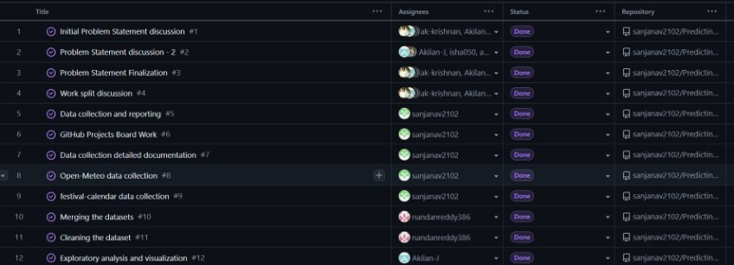
Tool and board link: https://github.com/users/sanjanav2102/projects/2

Slide 31
100% PROJECT IMPLEMENTATION
Completion and individual contribution
Team member | Completed responsibility | Evidence / project-board task
Isha Sri Prakash CB.SC.U4CSE23029 | Predictive modelling, Data Input and Preparation | https://github.com/users/sanjanav2102/projects/2
Akilan J CB.SC.U4CSE23002 | EDA and Dashboard | https://github.com/users/sanjanav2102/projects/2
M Nandan Reddy CB.SC.U4CSE23431 | Integrated official GRAP rules into dashboard. | https://github.com/users/sanjanav2102/projects/2
Jei Akash M A CB.SC.U4CSE23518 | Feature Engineering, Association Rule Mining (Method 2) | https://github.com/users/sanjanav2102/projects/2
V Sanjana CB.SC.U4CSE23751 | Data collection, Time Series Analysis | https://github.com/users/sanjanav2102/projects/2
Project board: https://github.com/users/sanjanav2102/projects/2
Repository / deliverables: https://github.com/sanjanav2102/Predicting-Risk-and-Identifying-Weather-and-Calendar-Triggers-to-Support-Business-Planning
16
Notes:
Suggested time: 45 seconds. Replace bracketed prompts with your project evidence. Present actual results only. Delete the fifth member row for a four-member team. Confirm all Units 1–3 components, final evaluation and interactive application are complete. Use activity history and task evidence to support individual contribution.

Slide 32
FINAL PROJECT OUTCOME
Conclusion and limitations
Main outcome:
The completed project delivers a Delhi PM2.5 early-warning workflow.
It has 1–3 day forecasts, with the model that won validation chosen per day: gradient boosting for day 1 and SARIMAX for days 2 and 3.
It has a ranked set of weather and calendar rules linked to next-day high-pollution days.
It has an interactive dashboard and a sector playbook.
It was built on 3,195 daily records (2018 – Sep 2026) and tested on the held-out Jan 2025 – Sep 2026 period.
Business value:
The evidence supports earlier preparation, not exact prediction.
Forecast error is 15.7 / 19.5 / 19.6 µg/m³ for days 1, 2 and 3, against 18.8 / 24.7 / 27.5 for “tomorrow = today”. That is a clear gain that grows with horizon.
The alert catches 91–92% of high-risk days.
The rules show which conditions to watch: post-monsoon, low wind, no rain, cold, high pressure.
17
Notes:
Suggested time: 40 seconds. Replace bracketed prompts with your project evidence. Present actual results only. Core implementation must be complete. Future scope should describe extensions, not unfinished mandatory components. Keep detailed references, additional charts and code explanations in optional backup slides. Reserve panel questions for after the presentation.

Slide 33
Limitations:
Data: one reference station defines the target, with a city-average fallback on 87 days, and 272 days have no target. The test period is only 21 months, and winter is just 121 days from under two winters.
Rules and application:
Rules show association, not cause. The strongest ones rest on few test days.
The dashboard replays history rather than running live.
Future scope:
Add weather forecasts. Perfect weather would help only a little in our tests, but real forecasts are untested.
Add several stations and probability or interval forecasts.
Calibrate the alert threshold with real sector cost estimates.
Add a live data feed with a “last updated” time.
Re-check drifting rules on new data.
Map the alert to the official CAQM stages once their details are added.

