Slide 1
B AKILAN 71772117L01
Final Project

Slide 2
PROJECT TITLE
Kitchen Review Summarizer

Slide 3


AGENDA
Automate the process of summarizing and analyzing kitchen food reviews.
Provide users with a convenient tool to make informed decisions about food purchases.
Offer a streamlined solution to navigate through the overwhelming variety of food options available.
Enhance user experience by presenting concise summaries of food reviews.
Enable users to quickly grasp the key aspects of different food items.
3/21/2024Annual Review

Slide 4

PROBLEM STATEMENT
When people want to order food from a kitchen, they often face a problem with too many reviews to read. These reviews can be hard to understand, and they take a lot of time to go through. Without a summary, it's tough for new customers to know what's good or bad about the food. So, there's a need for a tool that gives a quick summary of reviews to help new customers order food more easily.
3/21/2024 Annual Review

Slide 5

PROJECT OVERVIEW
Leverage NLTK library to preprocess text and conduct sentiment analysis with VADER, distinguishing positive and negative sentiments.
Segregate insights into positive and negative sentiments separately to provide a comprehensive understanding of customer feedback.
We utilize GPT-3.5 turbo to condense reviews, enabling succinct summaries for presentation and analysis.

Slide 6

WHO ARE THE END USERS?
Customers: People looking to order food from a kitchen, who want quick summaries of reviews to make informed decisions about what to order.
Kitchen Owners: Owners or managers of kitchens who want to understand customer feedback and preferences better to improve their offerings.
Application Platform Owners: Developers or administrators of platforms that facilitate food ordering, who want to provide value-added features like review summarization to enhance user experience and increase customer satisfaction.

Slide 7

YOUR SOLUTION AND ITS VALUE PROPOSITION
The Kitchen review summarizer automates the analysis and summarization of kitchen food reviews.
Provides users with concise summaries of positive and negative aspects of food items.
Saves users time and effort by eliminating the need for manual review analysis.
Empowers users to make informed decisions about food orders based on summarized insights.
Enhances user experience by presenting information in an easily digestible format.

Slide 8

THE WOW IN YOUR SOLUTION
Personalized summaries tailored to individual user preferences and requirements.
Real-time analysis and summarization of the latest mobile phone reviews.
Interactive chatbot interface for seamless user interaction and engagement.
Ability to handle a large volume of reviews and provide accurate summaries efficiently.
Continuous improvement through feedback integration and algorithm refinement.
3/21/2024Annual Review

Slide 9
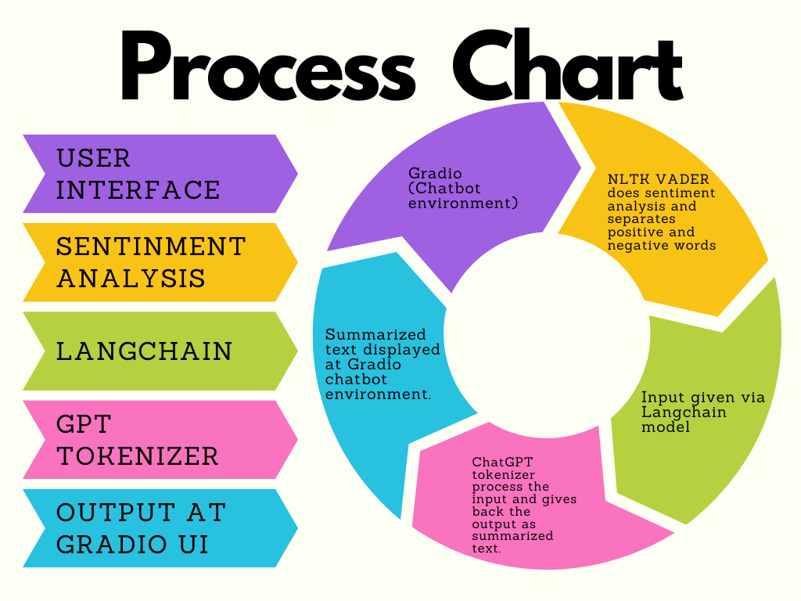
MODELLING

Slide 10
RESULTS
Successfully developed a functional kitchen food review summarization system.
Achieved high accuracy in extracting key insights and sentiments from kitchen food reviews.
Received positive feedback from users regarding the efficiency and usefulness of the summarization tool.
Demonstrated the ability to handle a diverse range of food items and reviews from various sources.
Continuously improving the system based on user feedback and performance metrics to enhance user experience.
Code Link
Kitchen_Review_Summarizer/Kitchen_Review_Summary.ipynb at main · megavannanmd7/Kitchen_Review_Summarizer (github.com)
10

