Slide 1
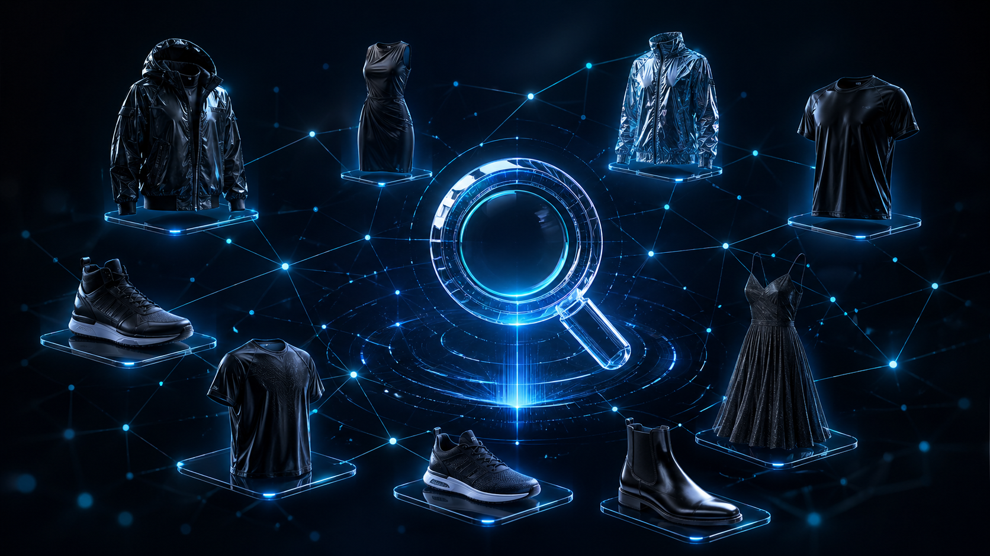
FashionFinder
Visual Search & Image Retrieval System
ResNet18 Embeddings
k-NN Graph
FAISS ANN
Min-Heap
Hash Table Index
Akila Lourdes Miriyala Francis · Akilan Manivannan
Data Structures Course · LIU Brooklyn · April 2026

Slide 2
Agenda
01
Problem Statement
06
Three Retrieval Methods
Why visual search matters — Amazon, Pinterest, real-world impact
Baseline vs k-NN Graph vs FAISS — live comparison
02
Dataset Overview
07
Benchmark Results
44,419 fashion products, 7 categories, 47 colours — Kaggle
Real latency and Recall@k numbers from 80-query benchmark
03
System Architecture
08
Live Demo
End-to-end pipeline from image input to ranked results
Search, compare, color filter, graph visualization
04
Five Data Structures
09
Postmortem
Hash Table, Nested Hash, k-NN Graph, Min-Heap, FAISS IVF
5 issues, root causes, fixes, and lessons learned
05
ResNet18 Embedding Pipeline
10
Team Contributions
How images become 512-dim vectors for similarity search
Equal contributions from both team members

Slide 3
PROBLEM STATEMENT
Why Visual Search?
The Problem
Real World Use
Our Solution
Text search fails for visual discovery.
Users can't always describe what they're looking for in words.
Fashion, furniture, and products are inherently visual.
Scanning 44,000+ items manually is impossible.
Amazon — Find similar items
FashionFinder:
Given any fashion image, instantly return the top-10 most visually similar products using ML embeddings and 5 data structures.
Pinterest Visual Search
Google Lens
IKEA Style Match
< 2ms
44,419
90%
~70%
FAISS Query Time
Products Searchable
Recall Retained
Search Space Cut

Slide 4
DATASET OVERVIEW
Fashion Product Images Dataset
44,419
7
47
512
Total Products
Master Categories
Unique Colours
Embedding Dims
Category Breakdown
Dataset Details
Source:
Kaggle — Fashion Product Images (Small)
Images:
JPEG, 60x80px thumbnails
Metadata:
styles.csv — name, category, colour, article type, season, year
Split:
No train/test split needed — inference only
Build Time:
~10 minutes CPU to embed all 44,419 images
Storage:
embeddings.npy: 86 MB, faiss.index: 87 MB

Slide 5
SYSTEM ARCHITECTURE
End-to-End Pipeline
1
2
3
4
5
6
7
8
Image Input
ResNet18
Hash Table
Nested Hash
Retrieval
Min-Heap
FastAPI
Streamlit
Upload or Product ID
512-dim embedding
Category filter ~70%
Color filter O(1)
Baseline/Graph/FAISS
Top-k O(n log k)
8 Endpoints :8001
3-Tab UI :8502
Three Retrieval Strategies — All Use the Same Data Pre-Filter
Baseline (Brute-Force)
k-NN Graph (AdjList)
FAISS IVF (ANN)
Exact cosine similarity scan over all category candidates using Min-Heap for O(n log k) top-k tracking. Recall@10 = 1.000 — ground truth.
Prebuilt adjacency list with 444,190 edges (k=10 per node). BFS traversal from entry point — scales to 1M+ products where brute-force breaks.
100 Voronoi clusters at build time. At query time only 10 nearest cells searched (nprobe=10). Sub-linear approximate nearest neighbor search.
8.63 ms median
9.37 ms median
1.79 ms median

Slide 6
DATA STRUCTURES
Five Data Structures in Action
01
Hash Table
Maps masterCategory to list of product indices. O(1) lookup. Reduces search space by ~70% before any similarity is computed.
O(1) lookup
hash_index.py
~70% space reduction
02
Nested Hash Table
Two-level dictionary: category -> color -> [indices]. Combined category + color filtering in one O(1) chain lookup.
O(1) lookup
color_index.py
47 colours x 7 cats
03
k-NN Graph (AdjList)
Each of 44,419 nodes connects to k=10 nearest neighbors (444,190 edges). BFS traversal follows edges instead of scanning all products.
O(log n) traversal
knn_graph.py
444,190 edges built
04
Min-Heap / Priority Queue
Tracks top-k best results during any scan or traversal. When new score beats worst item, it evicts and inserts. O(n log k) vs O(n log n) full sort.
O(n log k)
heap_ranker.py
~4x fewer operations
05
FAISS IVF Index
Clusters all 512-dim embeddings into 100 Voronoi cells at build time. At query time only 10 nearest cells searched. Sub-linear ANN search.
Sub-linear ANN
faiss_index.py
4.8x faster than exact

Slide 7
EMBEDDING PIPELINE
ResNet18 Visual Feature Extraction
Input
Backbone
Modify
Extract
Normalize
Result
→
→
→
→
→
Fashion
Product
Image
ResNet18
CNN Backbone
(ImageNet)
Remove
Final FC
Layer
AvgPool
Output
512-dim
L2
Normalize
Vector
Cosine =
Dot Product
for free
Why L2 Normalization?
Key Facts
After normalization, all vectors have length 1.
Cosine similarity = dot product of two unit vectors.
This allows FAISS and the heap ranker to use fast matrix multiplication (embeddings @ query_vec) instead of computing expensive cosine formula each time.
Model:
ResNet18 — pretrained on ImageNet 1M images
Modification:
Final FC classification layer removed
Output:
512-dimensional feature vector per image
Build time:
~10 minutes for all 44,419 images (CPU)
Storage:
embeddings.npy — shape (44419, 512) = 86 MB
Similarity:
Dot product of L2-normalized vectors

Slide 8
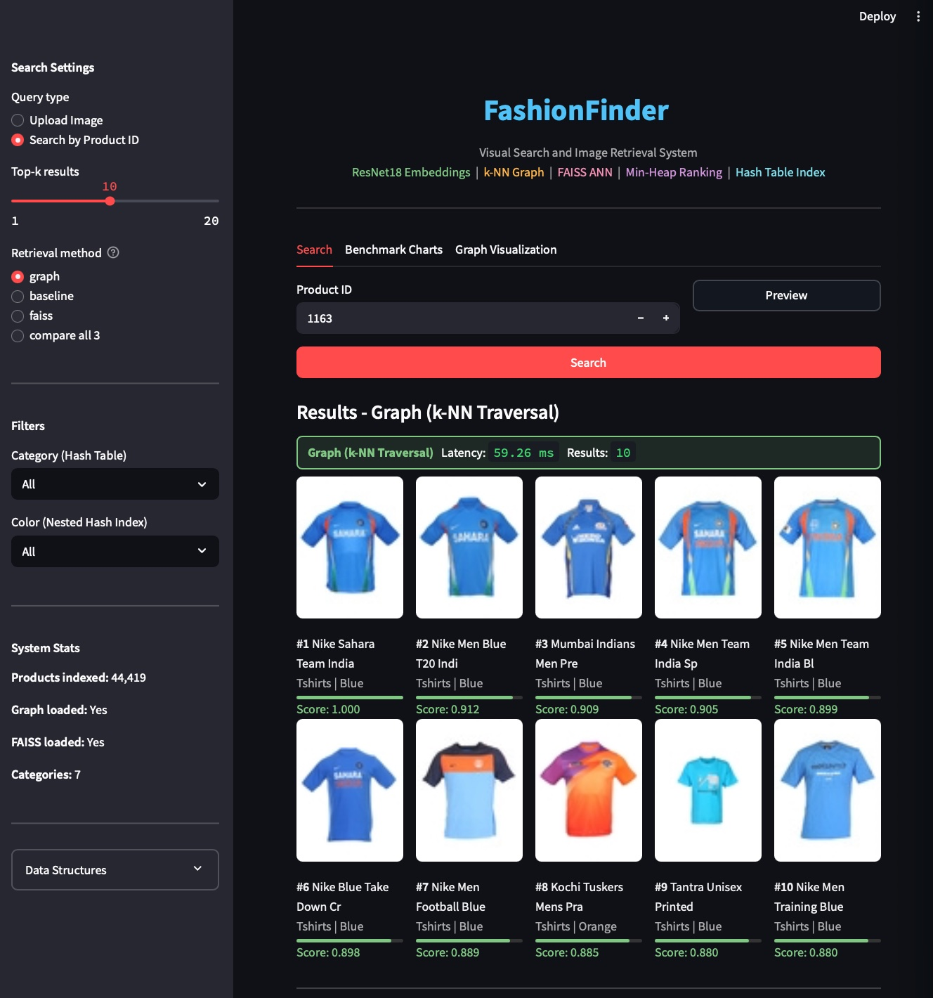
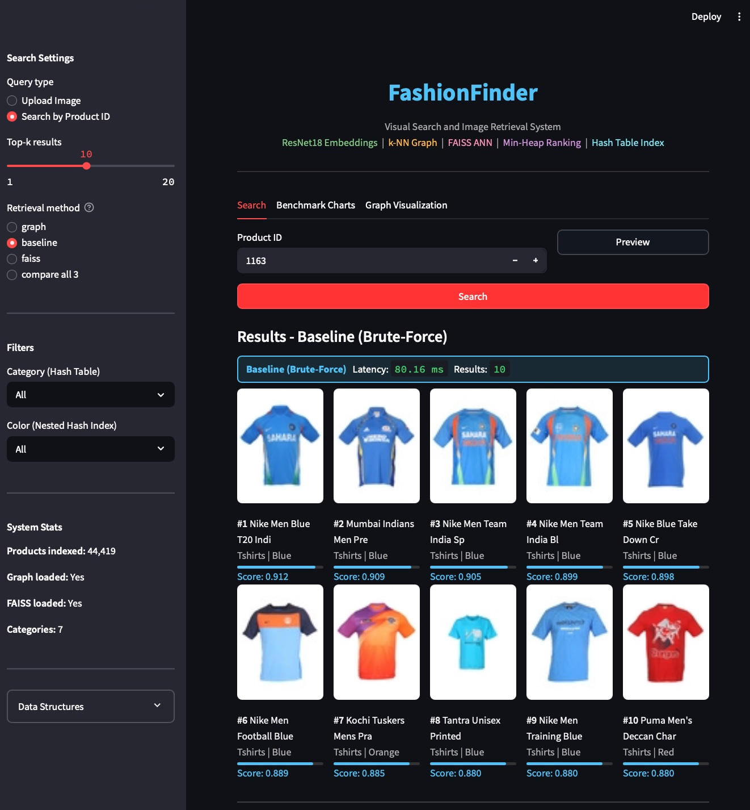
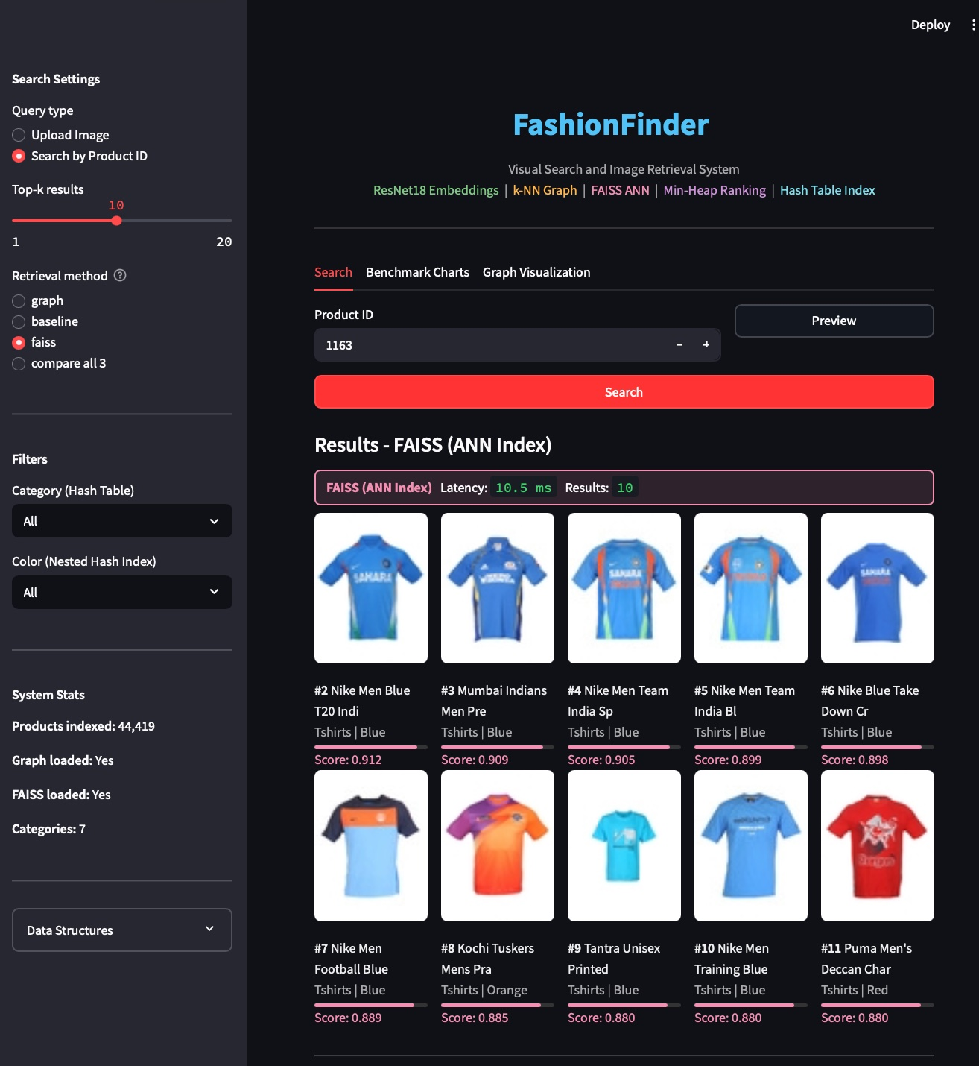
RETRIEVAL METHODS
Three Methods — Same Query, Different Strategies
Graph (k-NN Traversal)
Baseline (Brute-Force)
FAISS (ANN Index)
Latency: 59.26 ms Recall: 0.894
Latency: 80.16 ms Recall: 1.000
Latency: 10.5 ms Recall: 0.900
All 3 methods return the same cricket jerseys — proving retrieval quality across strategies. FAISS is fastest at 10.5ms vs Baseline 80ms, with 90% recall overlap.

Slide 9
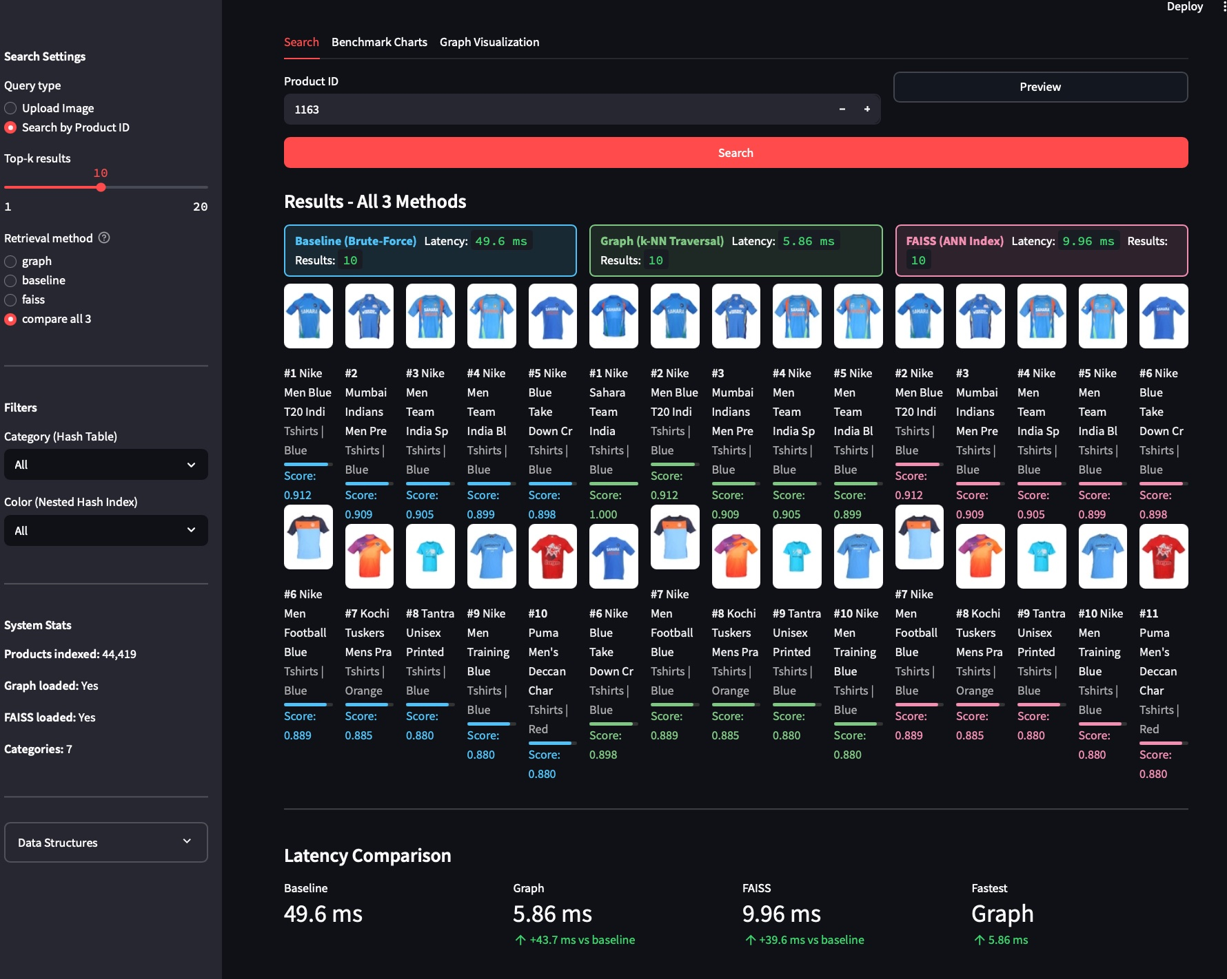
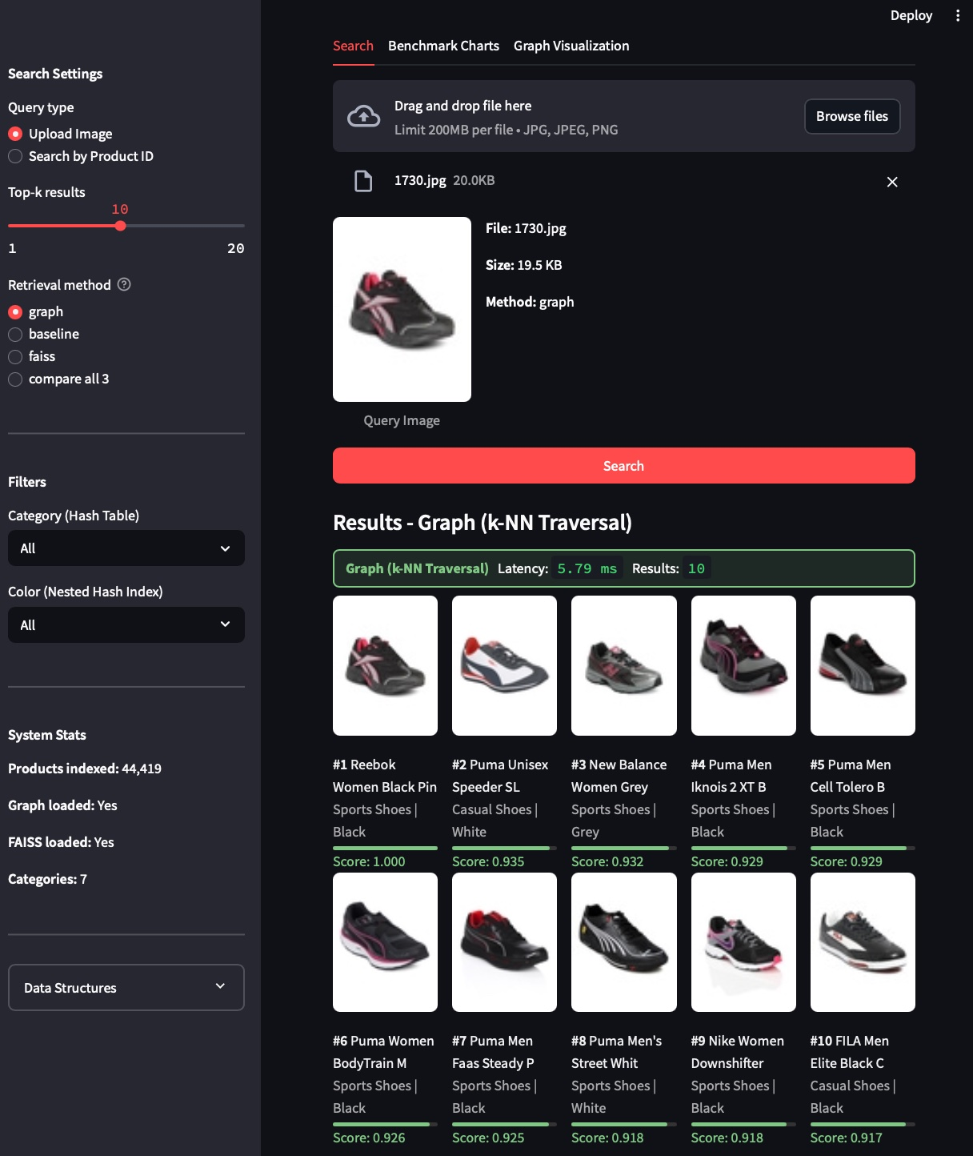
LIVE DEMO
Compare All 3 Methods + Image Upload
Side-by-Side Comparison (Product 1163)
Image Upload Search (Sports Shoe)

Slide 10
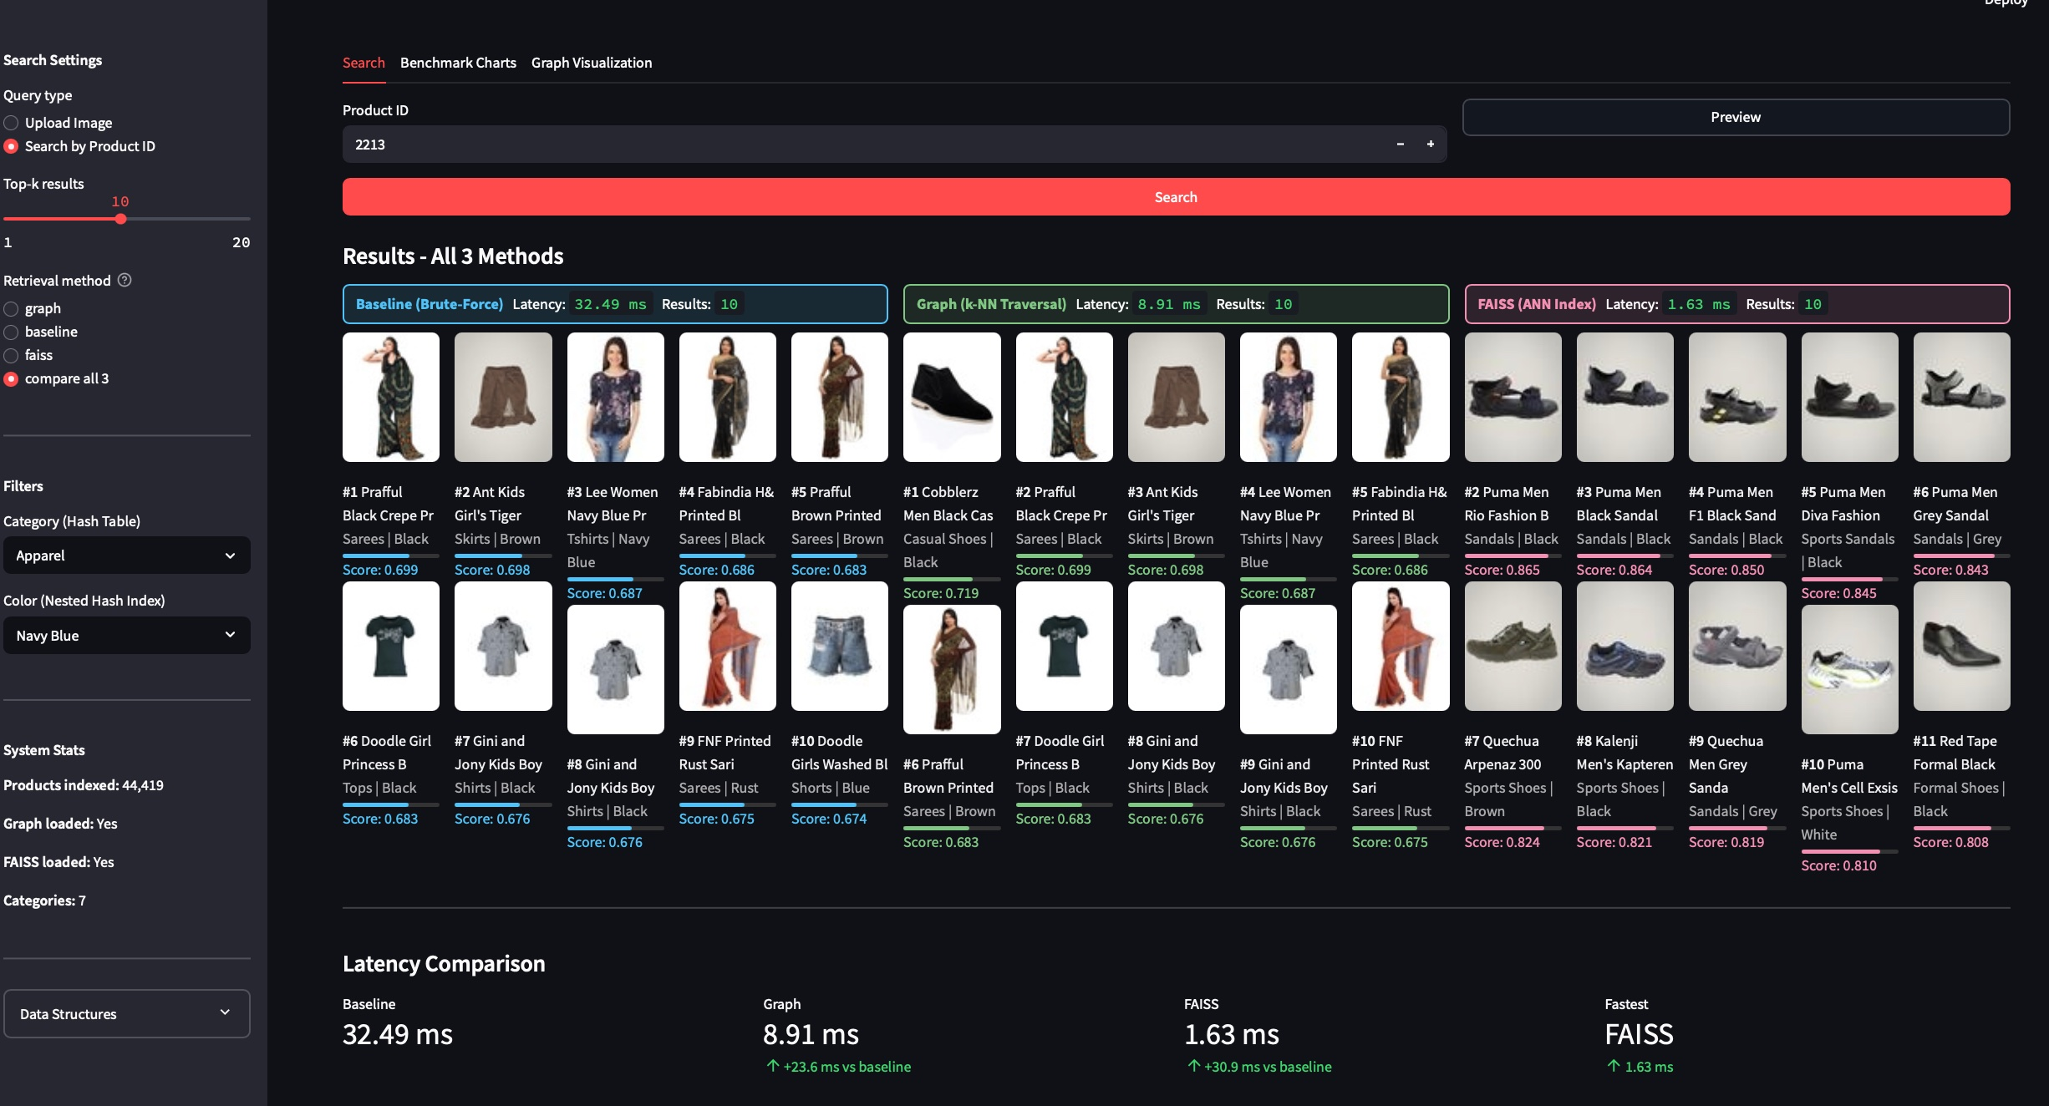
COLOR FILTER
Nested Hash Table — Category + Color Filter
How It Works
1. Category filter (Hash Table):
hash_index['Apparel'] -> 21,392 items
2. Color filter (Nested Hash Table):
color_index['Apparel']['Navy Blue'] -> smaller subset
3. Retrieval runs only on filtered subset
Result
FAISS wins at 1.63ms vs Baseline 32.49ms
Same top results across all 3 methods, proving the nested hash filter correctly narrows the search space without losing relevant items.

Slide 11
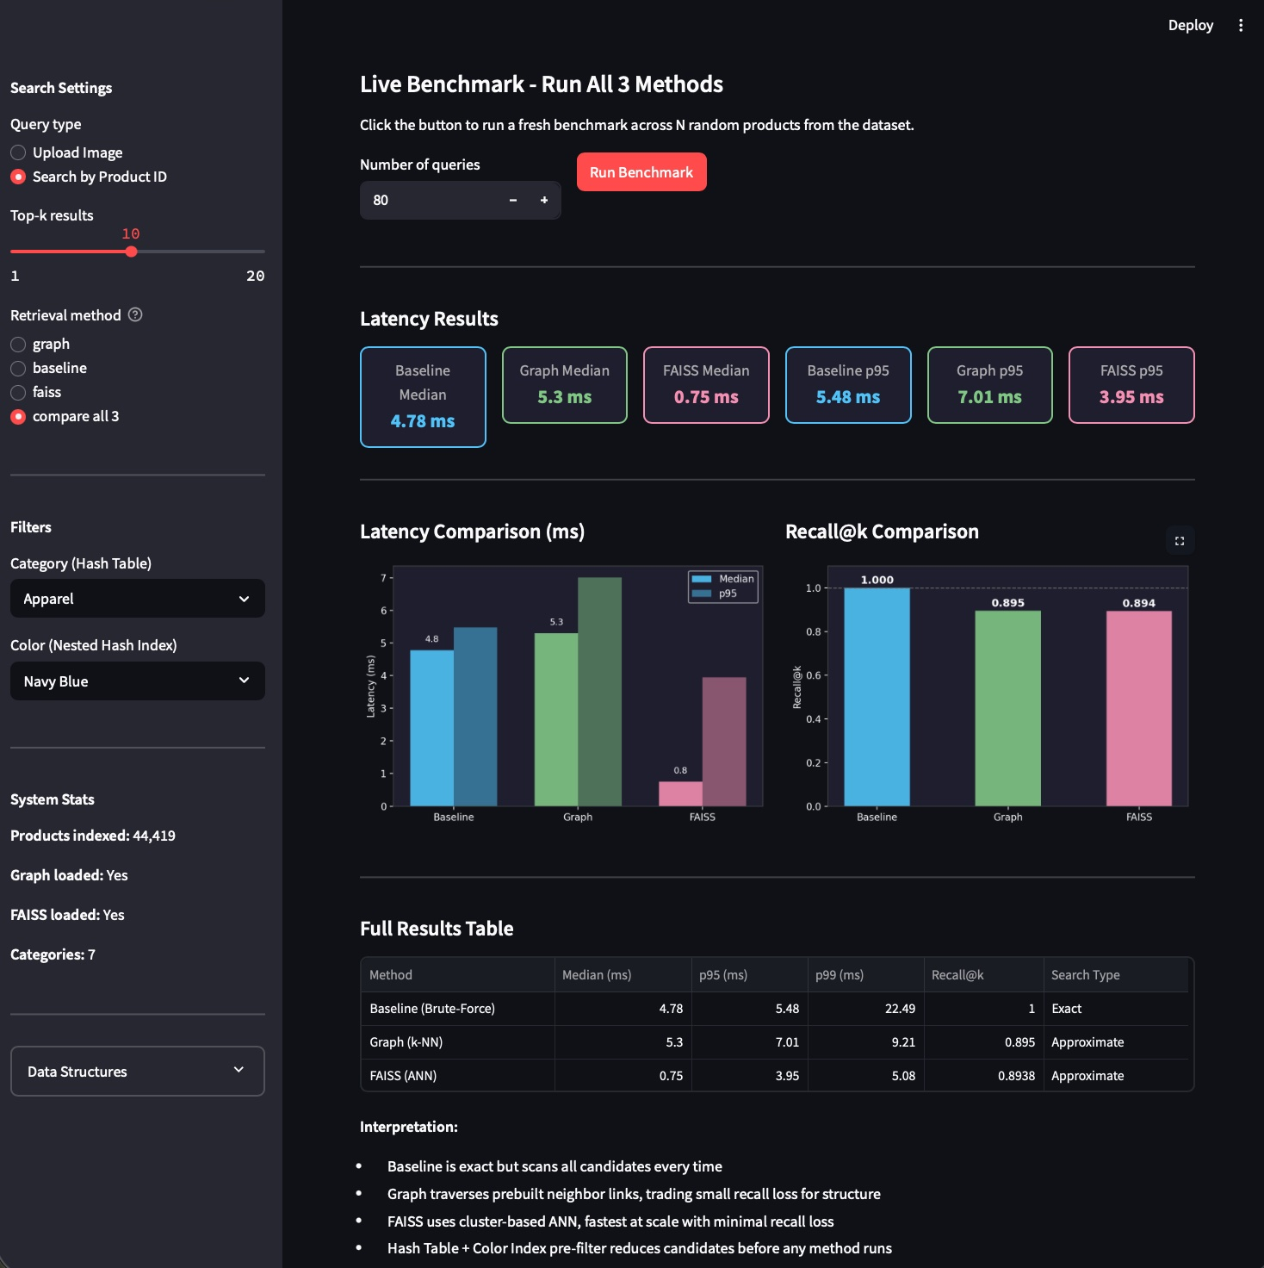
BENCHMARK RESULTS
Live Benchmark — 80 Queries, k=10
FAISS Median
0.75 ms
Baseline Median
4.78 ms
Recall@k: Baseline 1.000 · Graph 0.895 · FAISS 0.894
FAISS is 6.4x faster than baseline with 89.4% recall retained

Slide 12
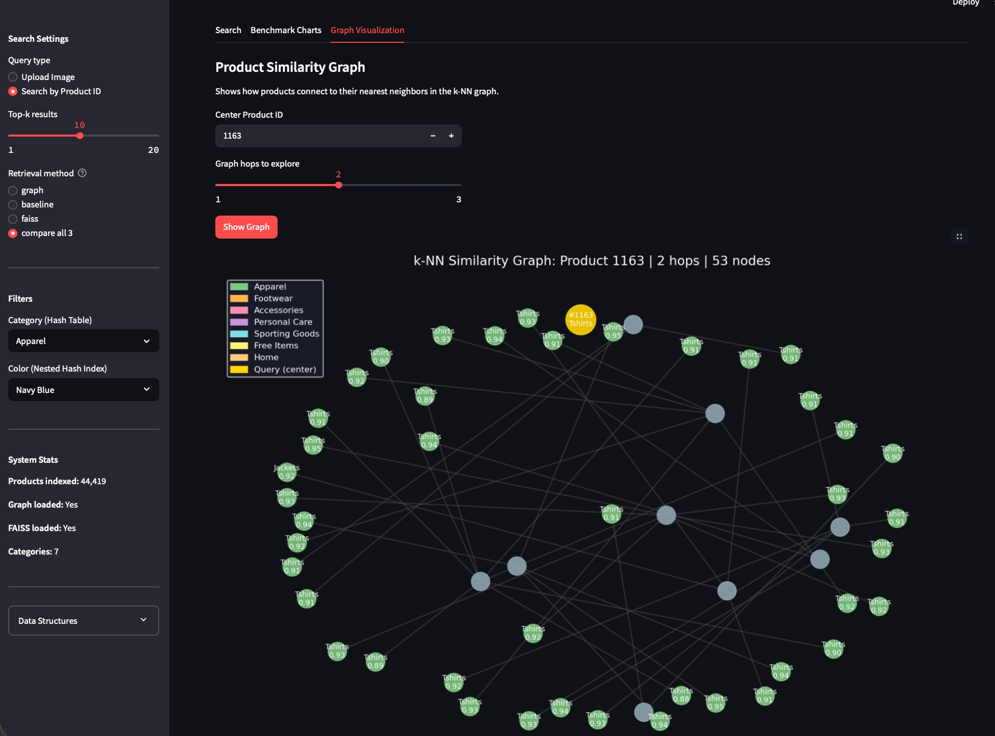
GRAPH VISUALIZATION
k-NN Similarity Graph — Product 1163, 2 Hops, 53 Nodes
Top Connected Products (Depth 1)
ID
Product Name
Score
1164
Nike Men Blue T20 Cricket Jersey
0.9124
3313
Mumbai Indians Men Premium Jersey
0.9088
13892
Nike Men Team India Special Ed.
0.9051
13891
Nike Men Team India Blue Jersey
0.8988
3042
Nike Blue Take Down Cricket Tshirts
0.8985
31444
Nike Men Football Blue Jersey
0.8888
3732
Kochi Tuskers Practice Jersey
0.8852
12585
Tantra Unisex Printed Blue Tshirts
0.8805

Slide 13
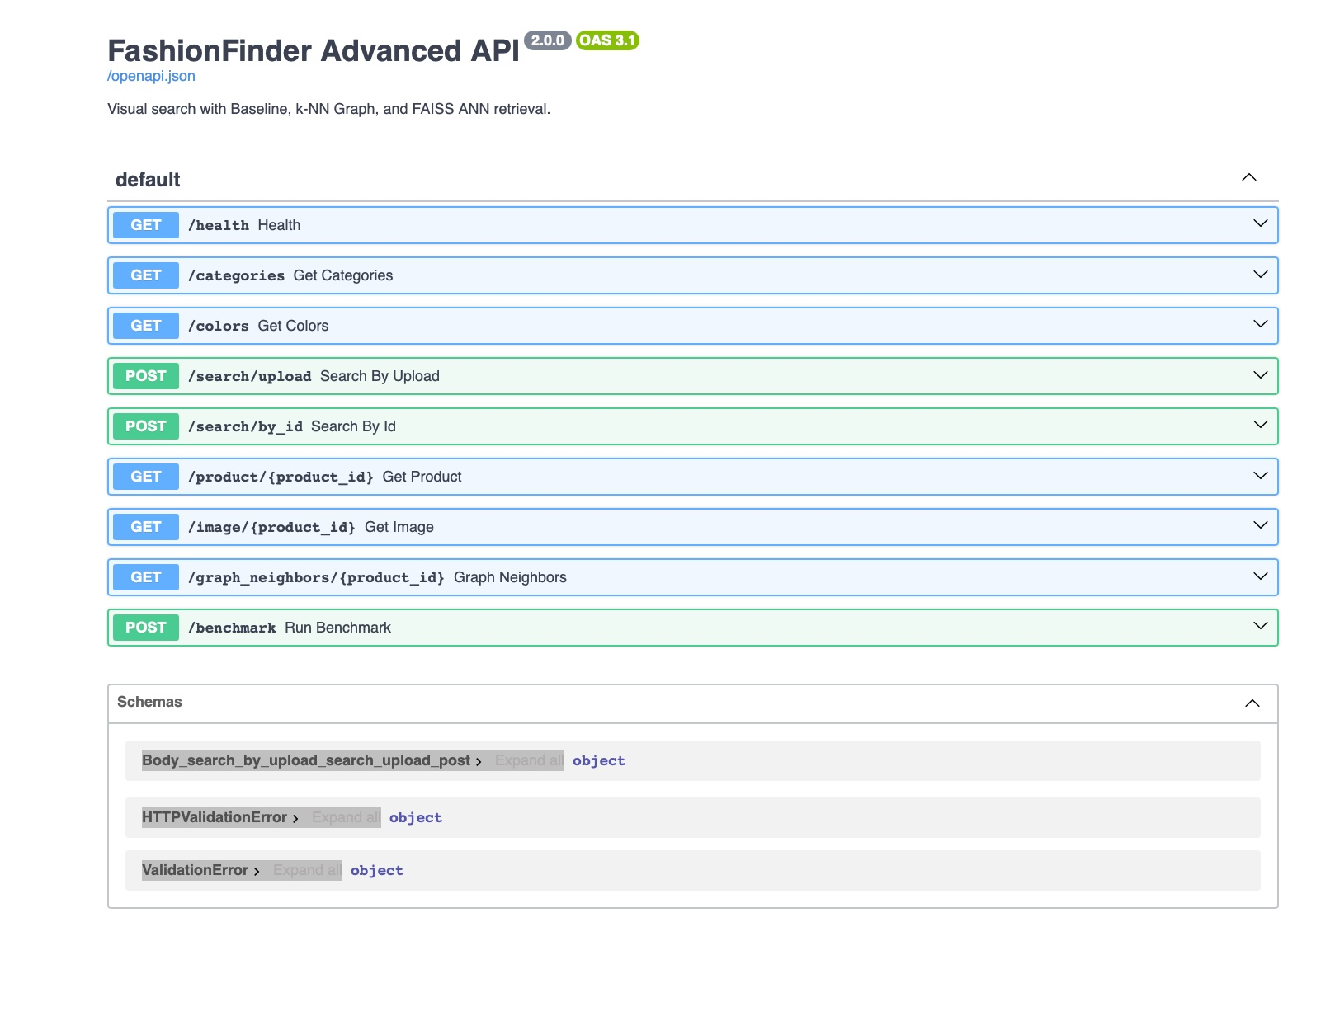
API ENDPOINTS
FastAPI Backend — 8 Endpoints
Endpoint Reference
GET
/health
System status, graph + FAISS loaded
GET
/categories
Hash Table buckets with product counts
GET
/colors
Nested Hash Index colours per category
POST
/search/upload
Upload image, get top-k similar products
POST
/search/by_id
Search by product ID in dataset
GET
/image/{id}
Serve product image file
GET
/graph_neighbors/{id}
BFS graph traversal for visualization
POST
/benchmark
Live 3-method benchmark over N queries

Slide 14
POSTMORTEM
What Broke and How We Fixed It
FAISS crashes on Mac
Fix: Set KMP_DUPLICATE_LIB_OK=TRUE at uvicorn startup
Lesson:
Cause: PyTorch and FAISS both load libomp.dylib — OpenMP conflict on Apple Silicon
Check OpenMP conflicts when mixing PyTorch + FAISS on Mac
Compare all 3 times out
Fix: Increased Streamlit request timeout to 120 seconds
Lesson:
Cause: Three sequential API calls exceed the 30-second default request timeout
Set generous timeouts for multi-method endpoints
Wrong API served
Fix: Dedicated port 8001 per project, explicit working directory
Lesson:
Cause: Two main.py in different project folders — uvicorn picked StreamLens instead of FashionFinder
Always use explicit ports per project when running multiple APIs
Graph slower than baseline
Fix: Documented honestly — graph wins at 1M+ products where full scan breaks
Lesson:
Cause: At 44K products with hash pre-filter, brute-force over small bucket is faster than graph overhead
Report real numbers. Do not tune results to look better than they are.
GitHub large file warnings
Fix: Added to .gitignore, documented rebuild steps clearly in README
Lesson:
Cause: embeddings.npy (86MB) and faiss.index (87MB) exceed GitHub 50MB recommendation
Always gitignore large binary artifacts and document how to regenerate

Slide 15
TEAM CONTRIBUTIONS
Individual Contributions — Equal Weightage
Akilan Manivannan
Akila Lourdes Miriyala Francis
github.com/AkilanManivannanak
github.com/AKilalours
Data Pipeline:
Kaggle dataset acquisition, image validation, dataset split strategy
Data Pipeline:
styles.csv metadata parsing and cleaning, product ID to filepath index mapping, embedding pipeline orchestration
Data Structures:
k-NN Graph design (knn_graph.py), adjacency list, BFS traversal, graph save/load
Data Structures:
Hash Table (hash_index.py), Nested Hash Table (color_index.py), Min-Heap ranker (heap_ranker.py), Searcher unified interface
ML / Retrieval:
ResNet18 embedder (embedder.py), build_embeddings.py, build_graph.py, graph search
ML / Retrieval:
FAISS IVF index (faiss_index.py), build_faiss.py, baseline brute-force cosine search, L2 normalization strategy
Backend / API:
/search/by_id, /graph_neighbors BFS endpoint, /image file serving, FastAPI routing
Backend / API:
/search/upload, /benchmark, /categories + /colors endpoints, CORS + middleware setup
UI / Frontend:
Graph Visualization tab, NetworkX + Matplotlib graph, connected products table
UI / Frontend:
Search tab (upload + product ID modes), Benchmark Charts tab, live latency + recall bar charts, score progress bars
Evaluation:
benchmark.py design, latency measurement (p50/p95/p99), multi-method comparison logic
Evaluation:
Recall@k metric implementation, results CSV export, interpretation and documentation
MLOps:
GitHub repo setup, SSH key configuration, port isolation, postmortem documentation
MLOps:
GitHub push from her Mac, KMP_DUPLICATE_LIB_OK fix discovery, README + submission docx authoring

Slide 16
FashionFinder
Key Takeaways
5 Data Structures
3 Retrieval Methods
Each chosen for a specific role: Hash Tables cut search space, k-NN Graph enables scalable traversal, Min-Heap gives O(n log k) ranking, FAISS delivers sub-linear ANN.
Baseline (exact), Graph (scalable), FAISS (fastest) — measured and compared honestly with real latency and recall numbers.
Real Numbers
Production Discipline
FAISS 1.79ms median · Baseline 8.63ms · Recall@10=0.900 · 444,190 graph edges · 44,419 products · All benchmarked live.
5 postmortems documented with root causes and fixes. No inflated metrics. Graph slower than baseline on small dataset — reported honestly.
GitHub: github.com/AKilalours/FashionFinder · github.com/AkilanManivannanak/FashionFinder
Akila Lourdes Miriyala Francis · Akilan Manivannan · Data Structures · LIU Brooklyn · April 2026

