Slide 1
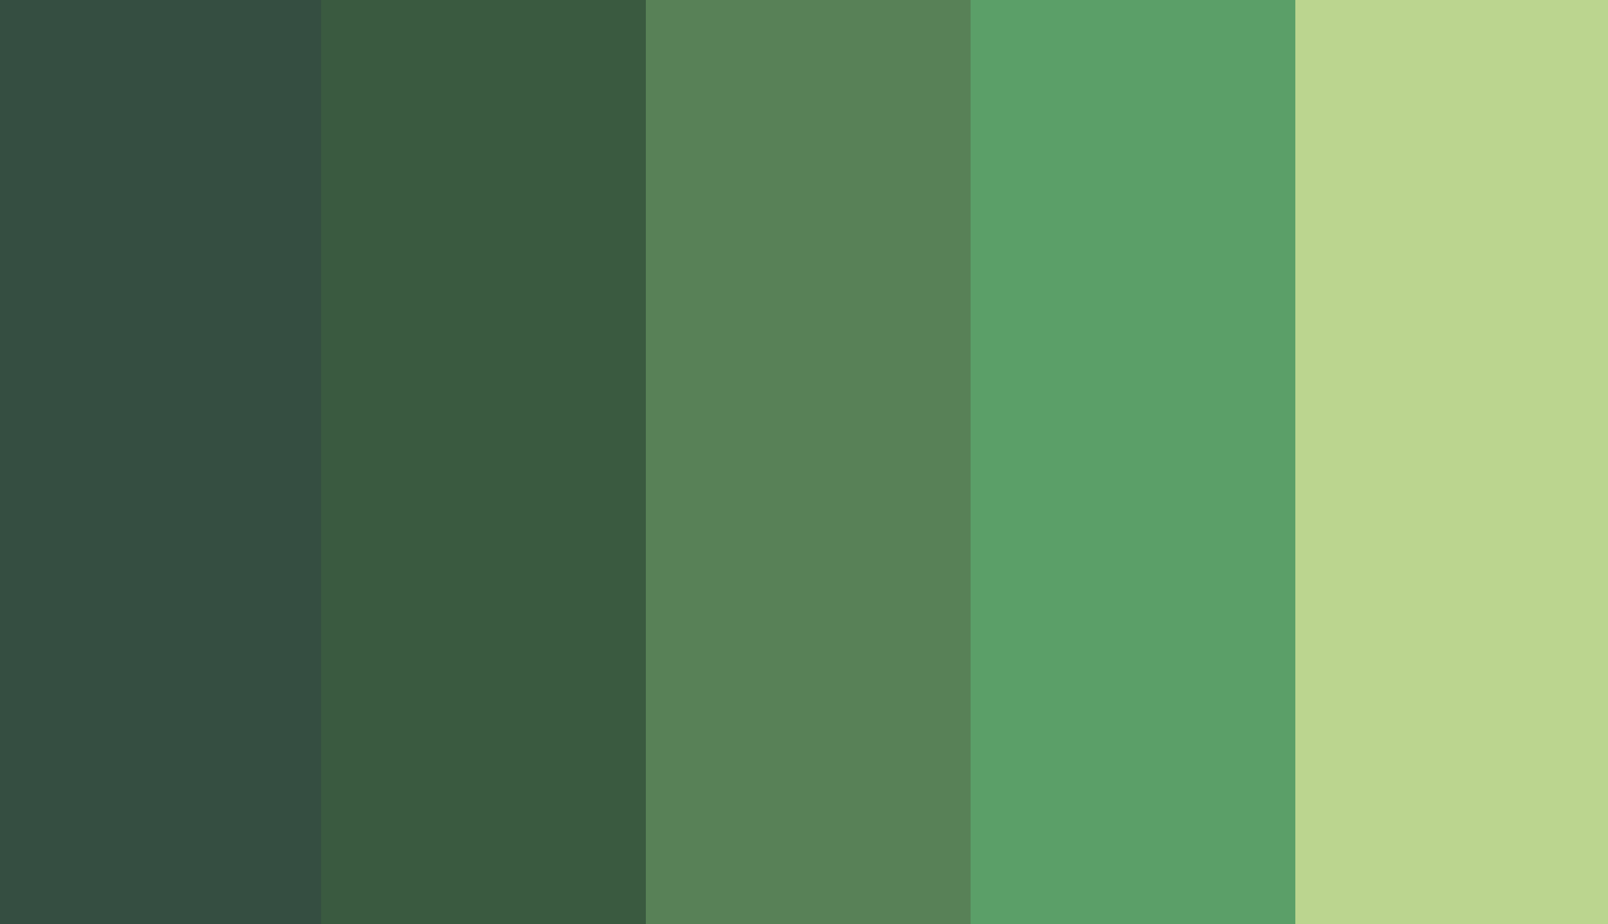

Green Destination: Attrition Report
Akilesh Jadhav

Slide 2
Contents
Analysis on the Employee Database enlisting records about employee details.
Identifying parameters for the analysis.
Interpreting visualisations made in Tableau.
Trends and patterns of attrition across various parameters.
Conclusion

Slide 3
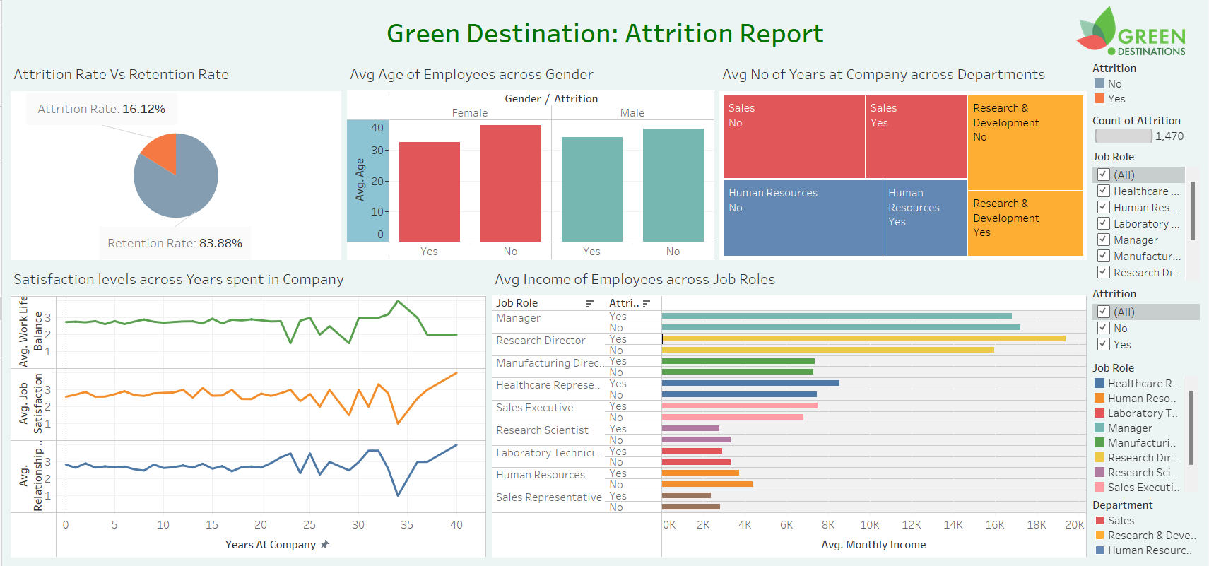

Slide 4
Attrition Rate
Out of the total number of 1470 employees in the database , 237 employees have resigned while 1233 employees are still retained in the company.
The attrition rate is 16.12%

Slide 5
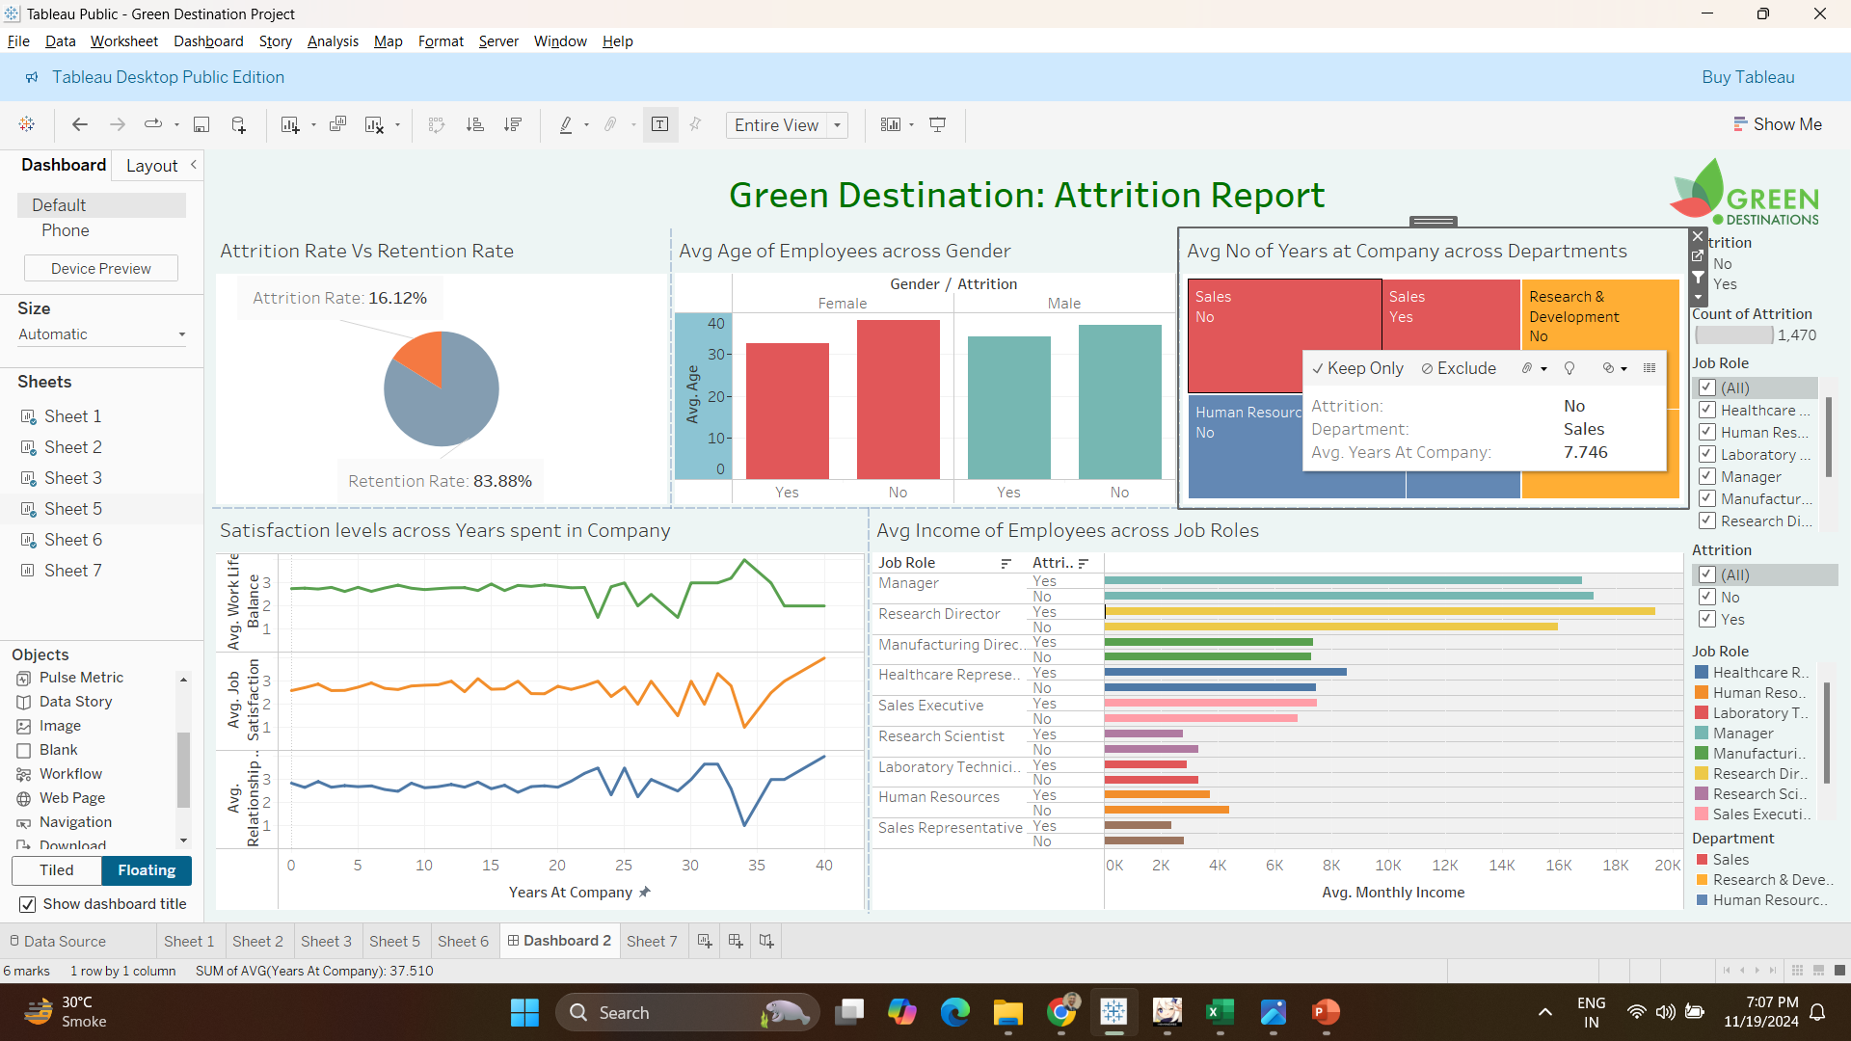
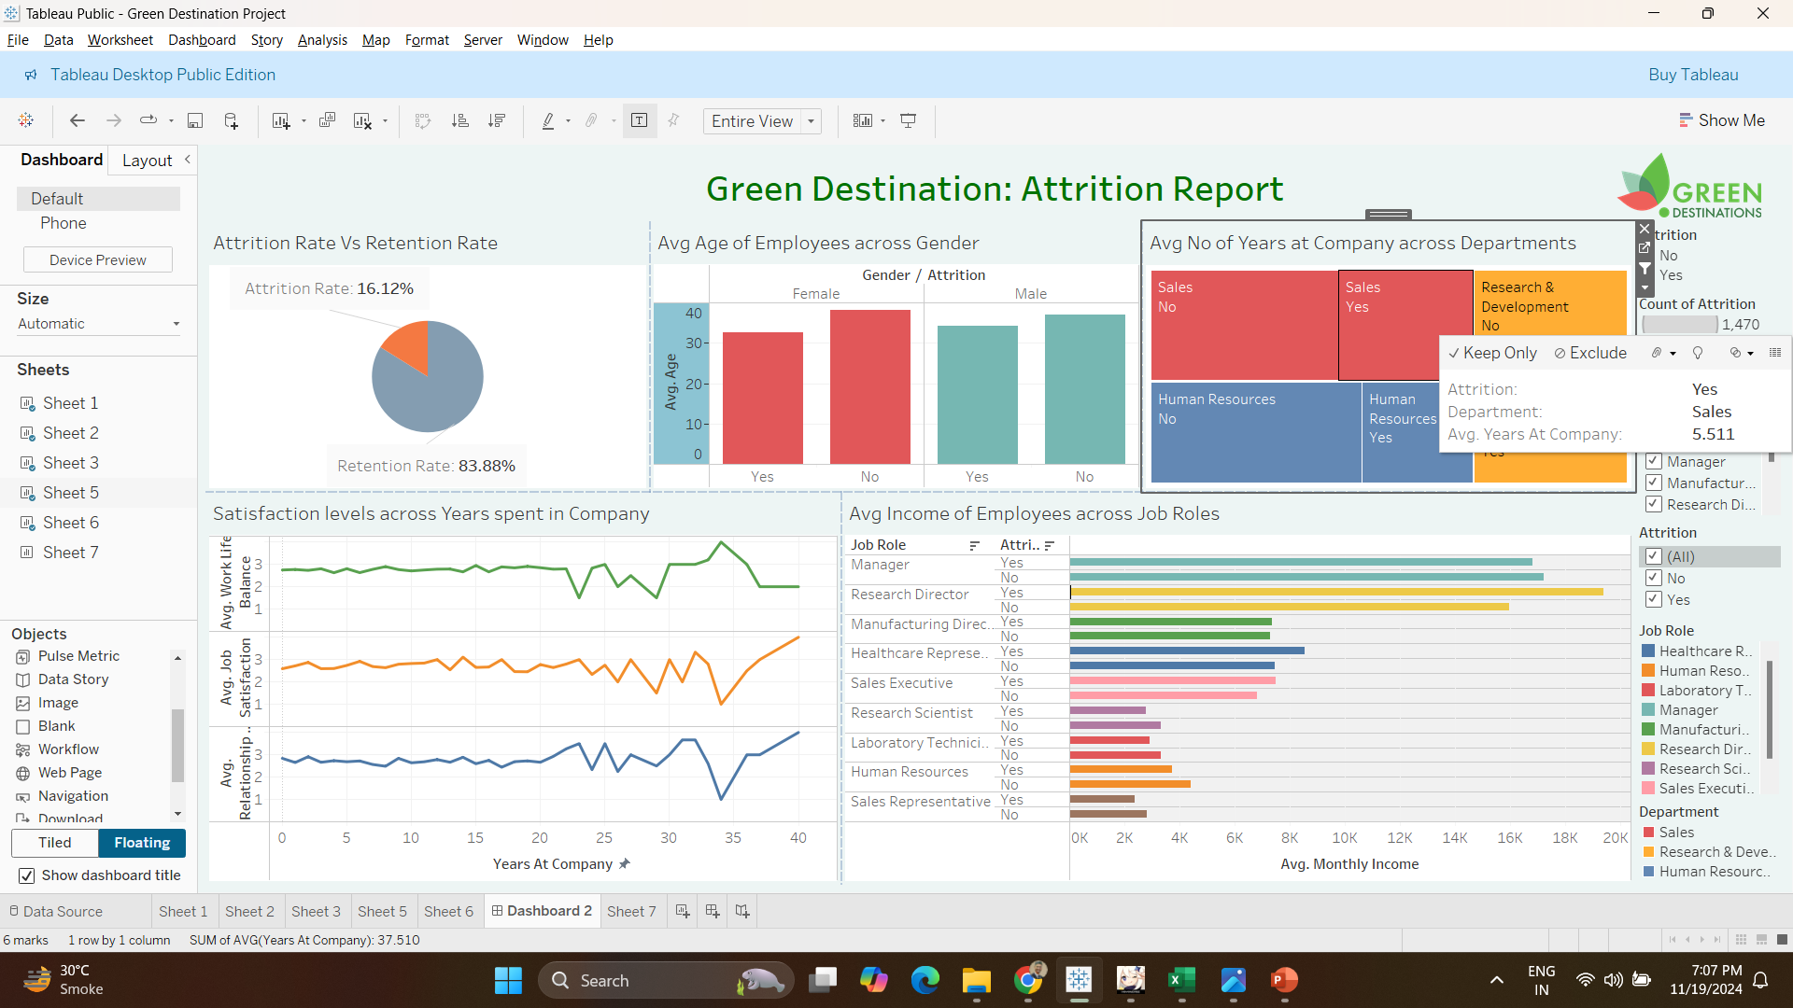
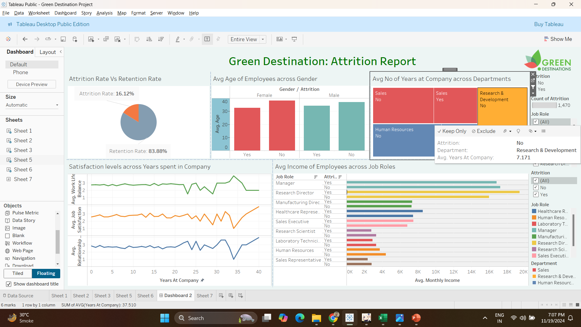
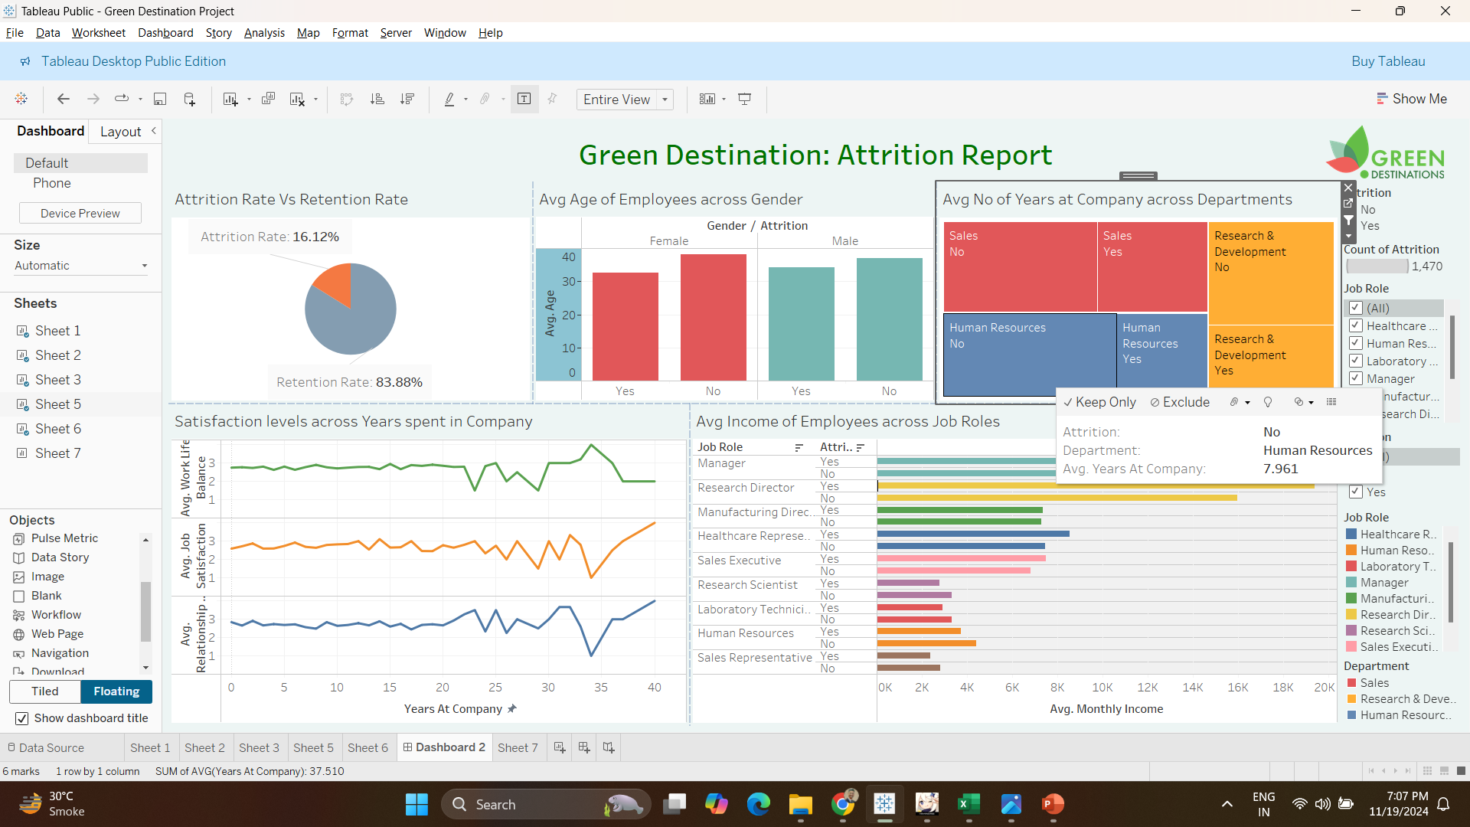
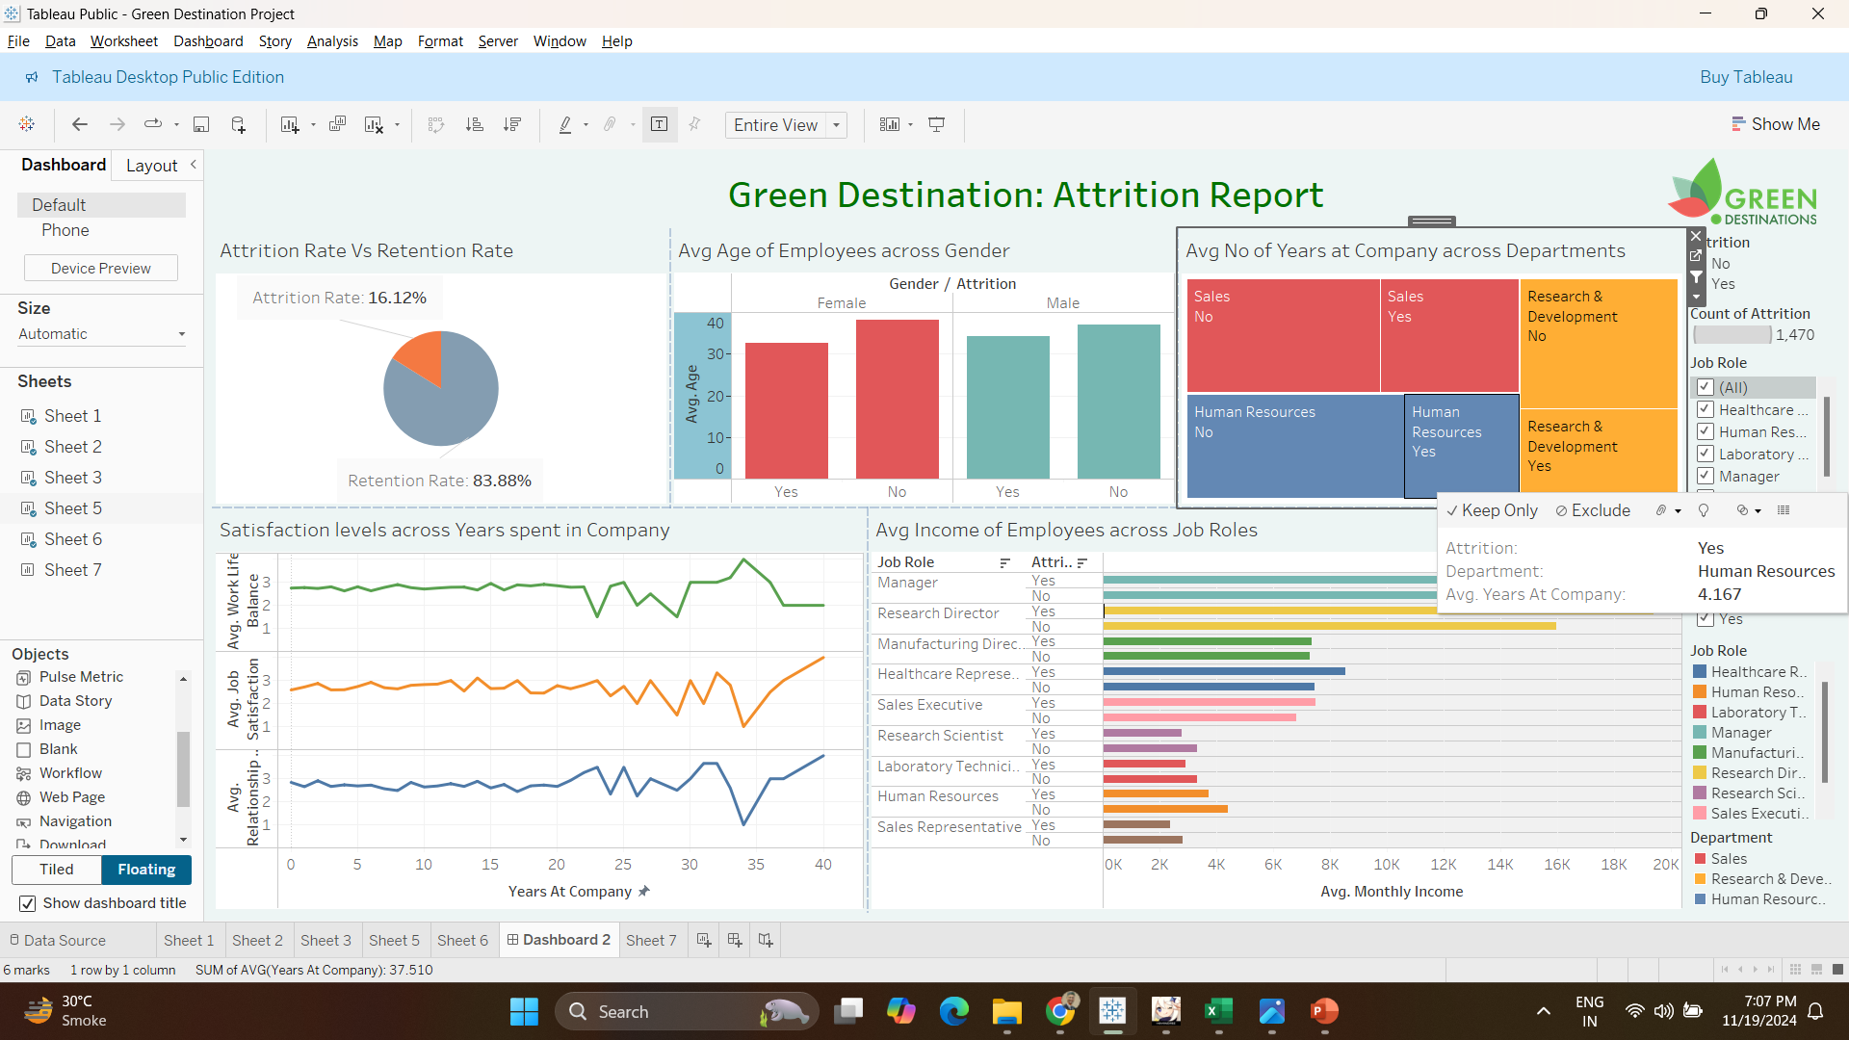
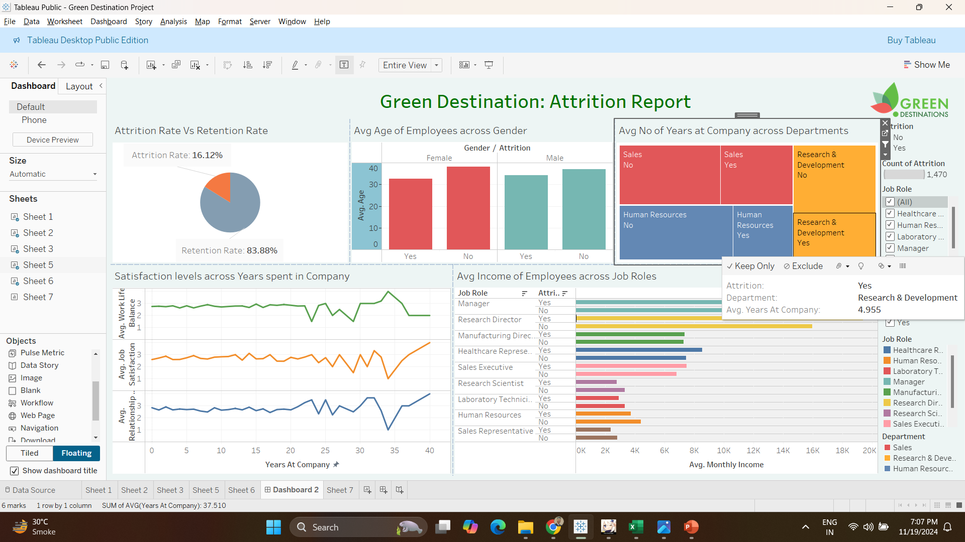
Factors: Age and Years at work
38.156
37.154
32.575
34.207

Slide 6
Income factor and Satisfaction Levels

Slide 7
Conclusion
The attrition rate of Green Destinations Company as of now is 16.12%
Considering Age factor, we can observe that those who left the company had lower average age among both the genders compared. We can infer that young employees are likely to resign than older ones.
Looking at years spent at the company, those who have left have spent on an average lesser time in the company across all departments.
Analysing the average Monthly Income, those with higher monthly income have left when they have spent long time in their roles while on the contrary those with lesser monthly income and who have spent less time in their roles have left.
Comparing job satisfaction levels, work-life balance and relationship satisfaction, those who stayed in the company for upto 20-22 years had stable satisfaction levels than those stayed in the company for more than 22 years.

Slide 8


