Slide 1
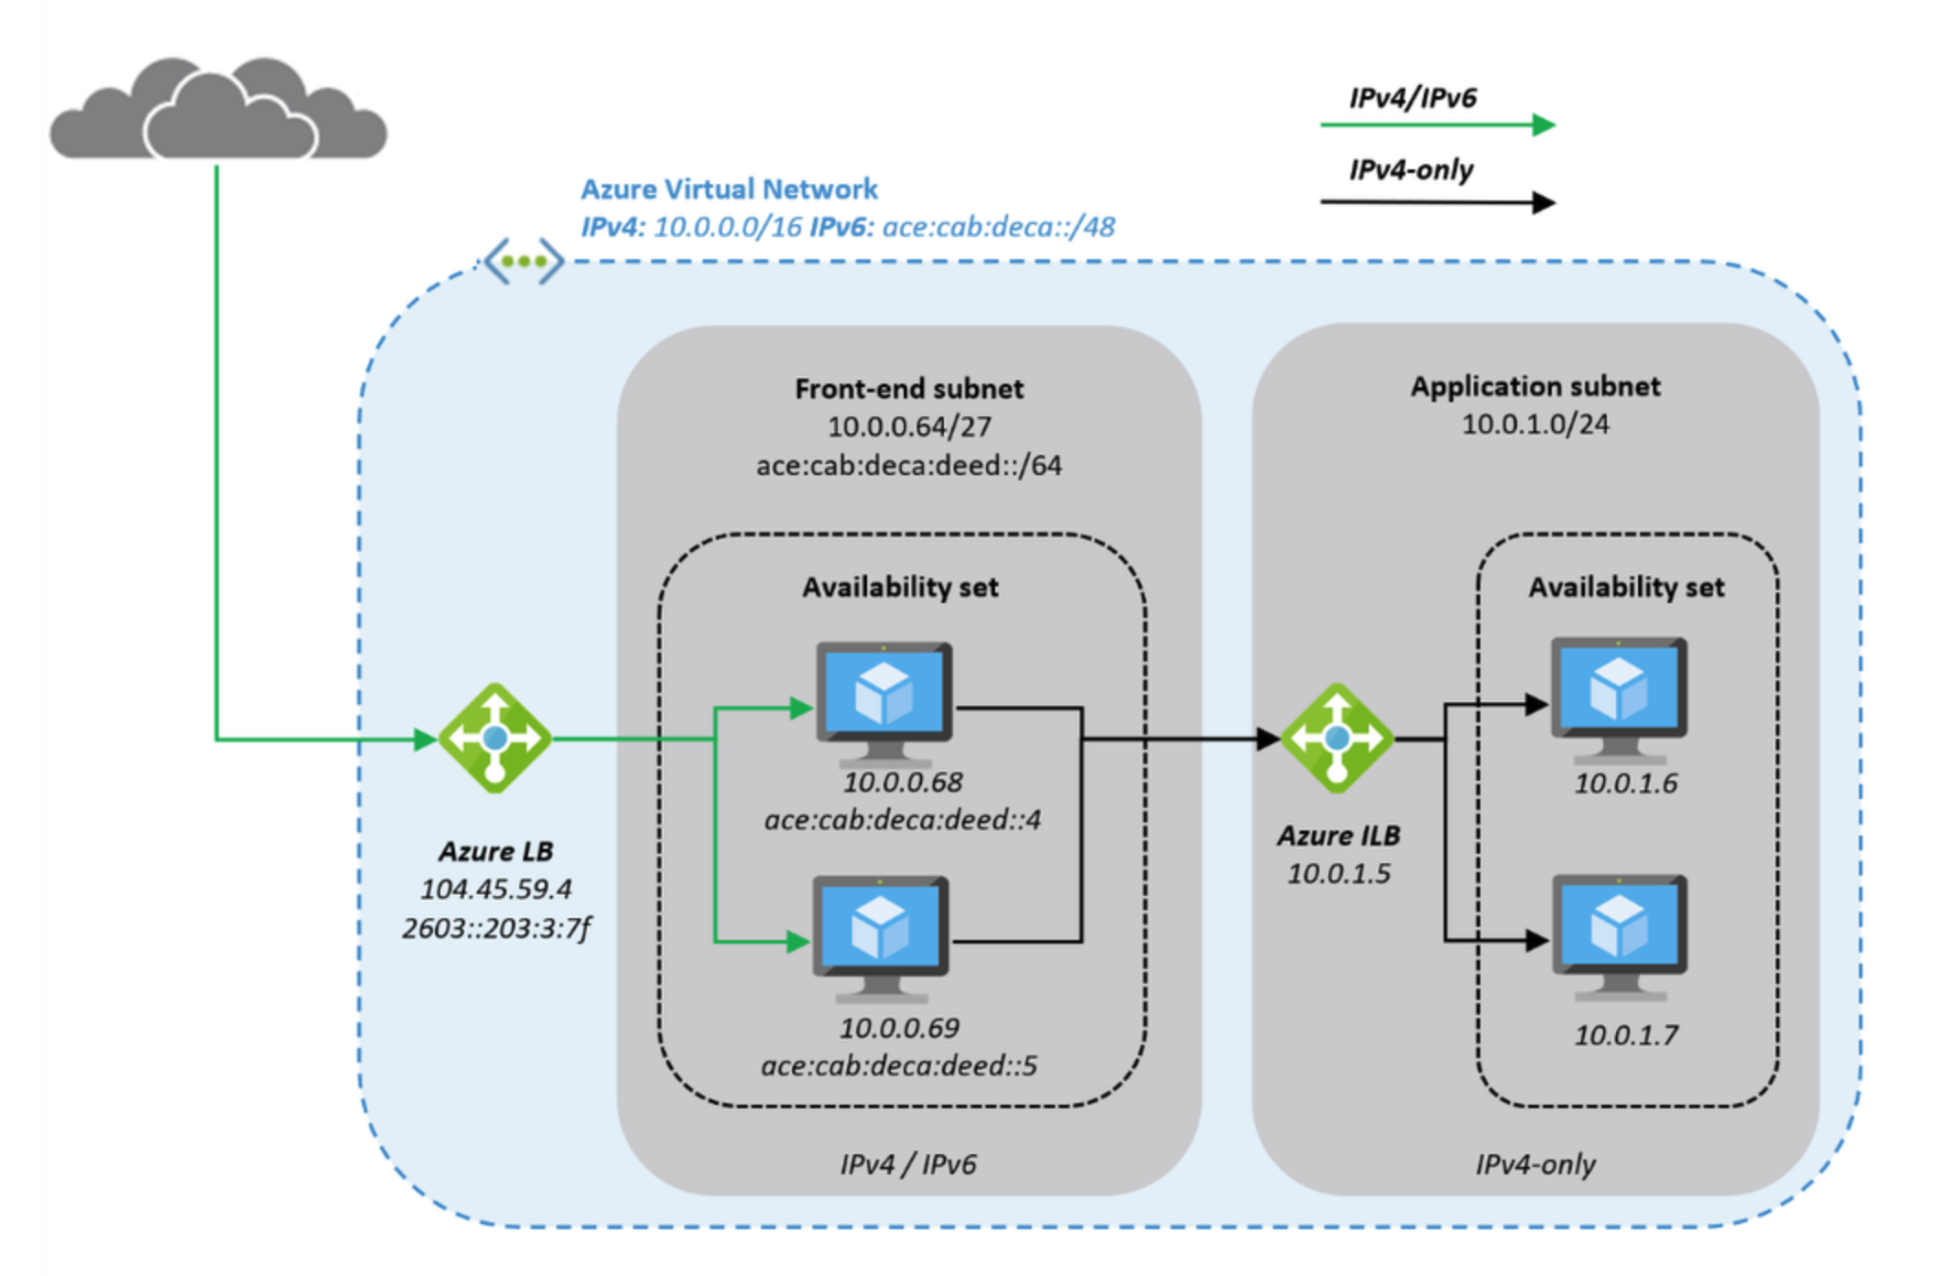
VMSS Flex
VMSS Flex

