Slide 1
NCT & PubMed Research Intelligence Platform
Clinical Research Monitoring, Analysis & Trial Comparison
Python
FastAPI
SQLite
BeautifulSoup
Groq
Notes:
WHAT IS ON THE SLIDE
Project name, subtitle, and the tech stack line.
WHAT TO SAY
Hello, I'm presenting the NCT & PubMed Research Intelligence Platform. It helps researchers see what changed on clinical trial pages, understand PubMed papers, and compare clinical trials. I built it with Python, FastAPI, SQLite and the Groq API.
POSSIBLE INTERVIEWER QUESTION
Why did you choose this project structure / stack?
SIMPLE ANSWER
The assignment named Python, FastAPI and SQLite, so I used those. I kept everything simple so I can explain every part: plain Python for the logic and an LLM only where it adds value.

Slide 2
Problem Statement
1
Researchers manually review ClinicalTrials.gov and PubMed
"Updated" is not enough.
Researchers need to know what changed.
2
Trial pages change over time
3
Hard to see exactly what changed
4
Comparing many trials by hand is slow
5
Papers hold lots of unstructured information
Notes:
WHAT IS ON THE SLIDE
Five pain points researchers face with ClinicalTrials.gov and PubMed.
WHAT TO SAY
Researchers manually review ClinicalTrials.gov and PubMed. Trial pages change over time, but the site only says 'updated' - it does not show exactly what changed. Comparing many trials by hand is slow, and papers contain a lot of unstructured text. My project automates these four things.
POSSIBLE INTERVIEWER QUESTION
Who is the user of this system?
SIMPLE ANSWER
A clinical researcher or analyst who monitors a drug or disease area and wants a quick, structured view instead of opening dozens of pages.

Slide 3
Project Objective
1
2
3
NCT Change Tracking
PubMed Research Intelligence
Clinical Trial Comparator
Version history and an exact change log: field, old value, new value, date
Search, store and summarize articles and figures
Drug + indication in, side-by-side trial table out
Notes:
WHAT IS ON THE SLIDE
Three modules: NCT change tracking, PubMed research intelligence, clinical trial comparator.
WHAT TO SAY
The platform has three modules inside one FastAPI application. Module 1 tracks versions of an NCT page and lists exact changes. Module 2 searches PubMed, stores articles and uses AI to summarize them. Module 3 takes a drug and an indication and shows a side-by-side comparison of trials.
POSSIBLE INTERVIEWER QUESTION
Are the three modules connected?
SIMPLE ANSWER
They share one database, one UI and one AI service. Module 1 and 3 both use ClinicalTrials.gov data and the same field names, so a trial can be tracked and compared.

Slide 4
Proposed Solution
NCT change log
ClinicalTrials.gov
NCT Parser
SQLite
Version Comparison
Change Log
PubMed intelligence
PubMed
Article Extraction
SQLite
Groq AI
Research Summary
Trial comparator
ClinicalTrials.gov
Trial Extraction
SQLite
Groq Understanding
Trial Comparison
Plain Python (no AI)
Groq AI
Notes:
WHAT IS ON THE SLIDE
Three pipelines: NCT change log, PubMed AI summary, trial comparison. Violet boxes use Groq AI; teal boxes are plain Python.
WHAT TO SAY
Each module is a pipeline. For NCT: download, parse, store in SQLite, compare, show the change log - no AI. For PubMed: extract article data, store it, then Groq produces the summary. For trials: extract in Python, store, Groq explains each trial, and the comparison table is built by Python.
POSSIBLE INTERVIEWER QUESTION
Why store data in a database instead of just comparing live?
SIMPLE ANSWER
To keep history. To say 'what changed' I must have the older version saved, and storing parsed data also avoids calling the APIs again and again.

Slide 5
Overall Architecture
User
HTML / JS UI
FastAPI
Plain Python (no AI)
Groq AI
NCT Module
PubMed Module
Trial Module
ClinicalTrials.gov
PubMed API
ClinicalTrials.gov
SQLite database (SQLAlchemy models)
Groq Service - summaries, trial understanding, figure analysis
Notes:
WHAT IS ON THE SLIDE
User, HTML/JS UI, FastAPI, three modules, external sources, SQLite, Groq service. Legend shows AI vs non-AI.
WHAT TO SAY
The user works in a plain HTML/JavaScript UI. It calls FastAPI. FastAPI routes the request to a module, which calls ClinicalTrials.gov or PubMed, saves results in SQLite, and only when needed calls the Groq service. Teal means plain Python, violet means AI. All AI code is in one file.
POSSIBLE INTERVIEWER QUESTION
Why is all Groq code in one file?
SIMPLE ANSWER
It keeps the AI layer replaceable and easy to test - I can swap the model or provider by changing one file, and tests can fake it.

Slide 6
Technology Stack
Layer | Technology
Language | Python
Backend | FastAPI
Database | SQLite local / PostgreSQL (Supabase)
ORM | SQLAlchemy
Validation | Pydantic
HTML Parsing | BeautifulSoup
Research API | PubMed (E-utilities)
Trial Data | ClinicalTrials.gov API
AI | Groq API
Frontend | HTML / CSS / JavaScript
Deployment | Render + Supabase
Kept simple on purpose
No Docker, Redis, Celery or React.
Every library has one clear job.
Groq is called with plain HTTP, so the request is easy to explain.
Notes:
WHAT IS ON THE SLIDE
Table of layers and technologies, plus a note on simplicity.
WHAT TO SAY
Python and FastAPI for the backend, SQLAlchemy with SQLite locally and PostgreSQL on Supabase in the cloud, Pydantic for validation, BeautifulSoup for HTML parsing. Data comes from the official PubMed and ClinicalTrials.gov APIs. Groq provides the LLM. The frontend is plain HTML, CSS and JavaScript, deployed on Render.
POSSIBLE INTERVIEWER QUESTION
Why SQLite?
SIMPLE ANSWER
SQLite needs no server, so it is ideal for local development and tests. For the cloud I use Supabase PostgreSQL by changing only DATABASE_URL, because SQLAlchemy hides the difference.

Slide 7
NCT Change Detection
Previous HTML
Parser
Normalized JSON
Compare
(Python function)
added
removed
modified
Eligibility
Previous:
Age 18–65
Current:
Age 18–70
MODIFIED
Current HTML
Parser
Normalized JSON
Layout, whitespace and case differences are ignored. Only real content changes are reported.
Notes:
WHAT IS ON THE SLIDE
Both HTML versions go through the parser to normalized JSON, then compare. Example: eligibility age changed from 18-65 to 18-70 - MODIFIED.
WHAT TO SAY
Both versions are parsed into the same dictionary shape. Parsing removes banners, scripts and layout, collapses whitespace and ignores case. Then my compare function flattens the dictionaries and labels each field added, removed or modified, with the old value, new value, time and version numbers. This is plain Python - no AI.
POSSIBLE INTERVIEWER QUESTION
How do you avoid false changes when only the layout changed?
SIMPLE ANSWER
I compare extracted, normalized text rather than HTML. In my sample, the second page has different tags and banners, but only the 9 real changes are reported.

Slide 8
PubMed Module
Search Query
PubMed API
Article Metadata
SQLite
Groq
Summary + Findings
Python does
esearch: query to PMIDs
efetch: PMIDs to XML
Parse title, authors, abstract, DOI
Download PMC figures
Groq does
Summary and key findings
Study type, population, method
Figure analysis: image + caption, or caption only (labelled)
Notes:
WHAT IS ON THE SLIDE
Pipeline: search, PubMed API, article metadata, SQLite, Groq, summary and key findings. Note on figures.
WHAT TO SAY
I search with the official NCBI E-utilities: esearch returns article IDs and efetch returns XML. I parse the XML in Python and save publications, authors and figures in SQLite. Groq then summarizes the abstract. For open-access articles I also download figures; if the image is available the model sees the image plus caption, otherwise only caption and context, and the UI says which one was used.
POSSIBLE INTERVIEWER QUESTION
Can the AI really read images?
SIMPLE ANSWER
Groq's Llama 4 Scout model accepts images, so yes when I have the image file. When I don't, I do not pretend - the result is labelled caption/context-based.

Slide 9
Clinical Trial Comparator
Drug + Indication
ClinicalTrials.gov
Relevant Trials
Structured Data
Groq
Comparison Table
Python extracts
Drugs, doses, arms, phase, design
Criteria, outcomes, duration
Sites, sponsor, age, sex, dates
Table + highlights differences
Groq answers 7 questions
What is it investigating?
Which drug, indication, population?
Primary objective
What is different? Which stage?
Notes:
WHAT IS ON THE SLIDE
Pipeline from drug + indication to comparison table, and what Python extracts versus what Groq answers.
WHAT TO SAY
The researcher enters a drug and an indication. I call the ClinicalTrials.gov API, and Python extracts drugs, doses, arms, phase, design, criteria, outcomes, duration and locations. Groq only answers seven standard questions such as what the trial investigates and what makes it different. The table and the highlighting of differences are also plain Python.
POSSIBLE INTERVIEWER QUESTION
Why not let the AI extract the trial fields too?
SIMPLE ANSWER
Structured fields are better and cheaper to extract with normal code - it is exact, testable and does not hallucinate. AI is for interpretation, which code cannot do.

Slide 10
Database Design
NCT tracking
PubMed
Trials
NCTStudy
Publication
ClinicalTrial
NCTVersion
Author
TrialAnalysis
NCTChange
Figure
AIAnalysis
One study has many versions and changes · one publication has many authors, figures and AI analyses · one trial has analyses. Images are files; the database stores only the path.
Notes:
WHAT IS ON THE SLIDE
Tables grouped by module with one-to-many relationships.
WHAT TO SAY
Module 1: one study has many versions and many changes. Module 2: one publication has many authors, figures and AI analyses. Module 3: one trial has analyses. Images are saved as files and the database only keeps their path. Full parsed trials are stored as JSON text plus a few real columns for filtering.
POSSIBLE INTERVIEWER QUESTION
What is a one-to-many relationship?
SIMPLE ANSWER
One row in a table is linked to many rows in another - for example one NCT study has many versions. It is implemented with a foreign key such as study_id.

Slide 11
API Architecture
Method | Endpoint | What it does
POST | /api/nct/compare | Two HTML files in, change log out
POST | /api/nct/fetch | URL in, stores a version and compares
GET | /api/pubmed/search | Searches PubMed and saves articles
POST | /api/pubmed/analyze | Abstract to Groq summary
GET | /api/trials/search | Drug + indication to trials
POST | /api/trials/analyze | Groq explains the selected trials
POST | /api/trials/compare | Builds the comparison table
All endpoints return JSON. Errors return a friendly message with the right status code. Try them live at /docs.
Notes:
WHAT IS ON THE SLIDE
Table of the main endpoints, with method, path and purpose.
WHAT TO SAY
FastAPI exposes REST endpoints. POST /api/nct/compare takes two HTML files and returns the change log. GET /api/pubmed/search searches PubMed. POST /api/pubmed/analyze sends an abstract to Groq. GET /api/trials/search finds trials, and POST /api/trials/compare returns the comparison table. /docs shows all of them interactively.
POSSIBLE INTERVIEWER QUESTION
What is the difference between GET and POST?
SIMPLE ANSWER
GET only reads data. POST sends data, such as files or JSON, for the server to process.

Slide 12
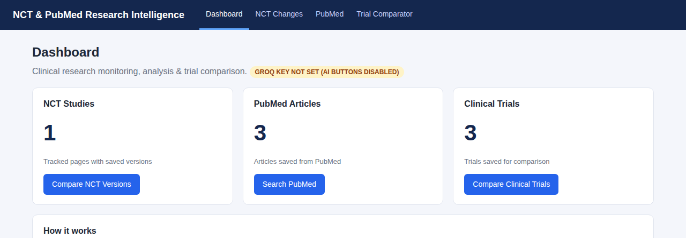
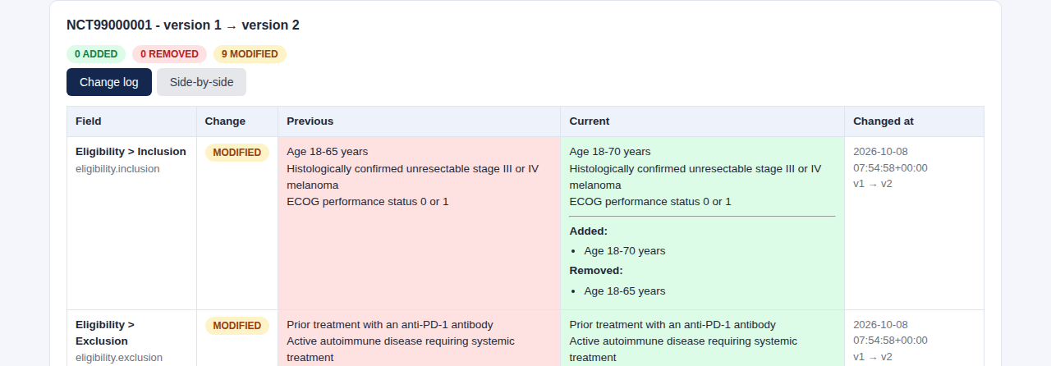
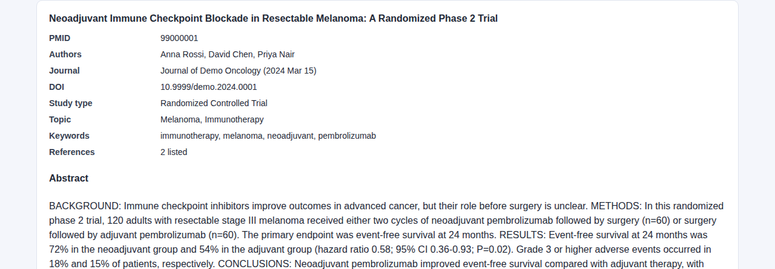
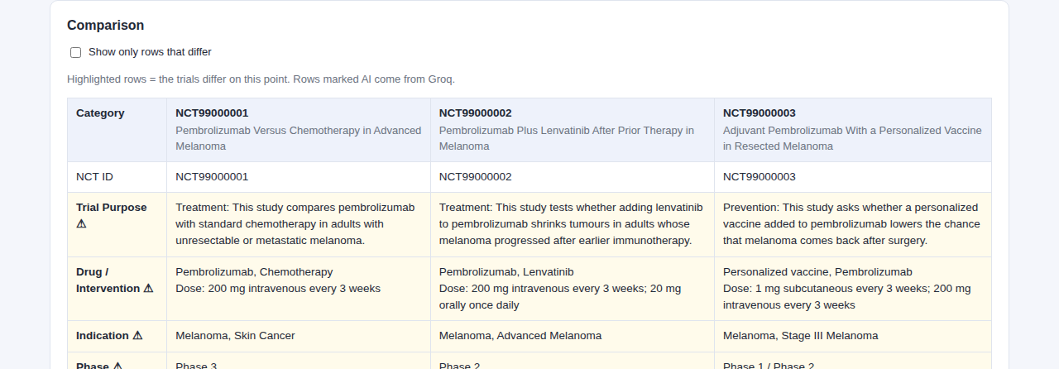
User Interface
Dashboard - Counts and shortcuts to each module
NCT change log - Old vs new value, change type, version
PubMed article - Abstract, AI summary, figures
Trial comparison - Differing rows highlighted
Notes:
WHAT IS ON THE SLIDE
Four real screenshots: dashboard, NCT change log, PubMed article detail, trial comparison.
WHAT TO SAY
The UI is plain HTML, CSS and JavaScript served by FastAPI. The dashboard shows counts and shortcuts. The NCT page shows a change table with side-by-side view. The PubMed page shows the abstract, AI summary and figures. The trial page shows a comparison table where rows that differ are highlighted.
POSSIBLE INTERVIEWER QUESTION
Why not use React?
SIMPLE ANSWER
The UI is simple, and plain JavaScript keeps the project easy to understand and deploy as one app. React would add tooling without much benefit here.

Slide 13
AI Usage
Without AI (plain Python)
HTML parsing
Data extraction
Normalization
Version comparison
API calls
Database storage
Filtering
Comparison table
With Groq
Article summarization
Research interpretation
Trial understanding
Key findings generation
Figure / caption interpretation
The core logic is deterministic Python. The LLM is an extra layer.
Notes:
WHAT IS ON THE SLIDE
Two columns: what is done without AI (Python) and what is done with Groq.
WHAT TO SAY
This is the key slide. Parsing, extraction, normalization, version comparison, API calls, database work, filtering and the comparison table are normal Python. Groq is used only for article summaries, research interpretation, trial understanding, key findings and figure interpretation. The core engineering is deterministic code; the LLM is an extra intelligence layer.
POSSIBLE INTERVIEWER QUESTION
How do you control AI mistakes?
SIMPLE ANSWER
The prompt says to use only the given text and answer 'Not stated' if unsure; the output has fixed keys; results are labelled AI-generated; and the important comparison never depends on AI.

Slide 14
Demo Flow
Demo 1
Demo 2
Demo 3
Upload two NCT HTML files
Search PubMed
Drug + Disease
Previous → Current → Detected changes
Article → Abstract → Groq summary
Trial A vs Trial B vs Trial C
Notes:
WHAT IS ON THE SLIDE
Three demos in order: NCT comparison, PubMed summary, trial comparison.
WHAT TO SAY
Demo 1: compare two NCT versions and show the detected age change. Demo 2: search PubMed, open an article and get the Groq summary. Demo 3: search pembrolizumab with melanoma and compare three trials side by side. Everything also works offline with sample data.
POSSIBLE INTERVIEWER QUESTION
What if the internet fails during a demo?
SIMPLE ANSWER
I included sample NCT, PubMed and trial data, and a 'use sample data' option, so the demo runs without external APIs.

Slide 15
Future Enhancements
S3 / R2 file storage
Supabase Storage
Scheduled NCT monitoring
Email alerts
Better image analysis
Authentication
Advanced search
Trial similarity discovery
Cloud deployment
Analytics dashboard
Notes:
WHAT IS ON THE SLIDE
Ten possible improvements.
WHAT TO SAY
Next steps are S3, R2 or Supabase Storage for images, scheduled NCT monitoring with email alerts, better image analysis, authentication, advanced search, similarity-based trial discovery, cloud deployment and an analytics dashboard. I would also run the live APIs for a longer period and harden the parsers.
POSSIBLE INTERVIEWER QUESTION
What is the biggest limitation today?
SIMPLE ANSWER
The live external APIs need a networked test run and AI output needs human review. Files such as figure images are on Render's temporary disk and need S3-style storage; the data itself is safe in Supabase.

