Slide 1


PUBLISHED AT: RISEABOVELEARNING.ELEDONTA.COM AMBER KIMBERLING UNIVERSITY OF LA VERNE FALL 2018 COMPUTER SCIENCE AND COMPUTER ENGINEERING WITH A CONCENTRATION IN INTERNET PROGRAMMING UNIVERSITY PROJECT ADVISOR: PROF. JOZEF GOETZ

Slide 2

OVERVIEW
personal background
abstract
introduction
background/literature review
analysis and requirements
design
implementation
test and integration
demo
conclusion

Slide 3

PERSONAL BACKGROUND
associates degree in graphic design at FIDM
worked with 4eign design for a few months
working under a fine artist for 2 years part time as developer
working as a freelance web developer for 2 years

Slide 4
ABSTRACT
purpose: is to develop a web application that allows teachers to quiz students on different topics for practice.
relational database management system, MySQL.
database is organized in a way that a user is related to quizzes and categories and each category is related to many quizzes.
the users consist of students and teachers who are differentiated by their permissions.
Teachers permissions: manage all user permissions, quizzes(add/edit/delete), and categories (add/edit/delete)
Students permissions add a category and take quizzes
password protected administration capabilities that include: viewing, adding, editing, and deleting quizzes or categories.
includes a variety of other pages(home page, about, Q&A, and a contact page)
developed using HTML, CSS, PHP, JavaScript, and jQuery.

Slide 5
INTRODUCTION
Problem: there isn’t a current user-friendly web application for teachers to test their students with the material specific to a class.
there are a lot of applications that test students but fail to be consistent with specific material and the level of difficulty.
goal: of this project is to develop a web application that provides quizzes and categories, provides results, and allows user to take as much as they wish.

Slide 6
BACKGROUND/LITERATURE REVIEW
used books from courses at La Verne:
CMPS 320: PHP & MySQL Novice to Ninja by Tom Butler and Kevin Yank
CMPS 218: Web Development and Design Foundations by Terry Felke-Morris
had previous knowledge of web development languages

Slide 7
ANALYSIS AND REQUIREMENTS
web Page Design
The website conforms to the Web Design Best Practices Checklist http://terrymorris.net/bestpractices
website Navigation
The navigation is consistent throughout every page
A text based navigation is implemented in the footer for users who are disabled
page Layout Design
The website appeals to the audience who would be viewing it
Pertinent page information is located in the footer
Optimized layout for mobile use as follows:
Single column design
Limit scrolling to one direction
Use heading elements
Use lists
*all the requirements have been met

Slide 8
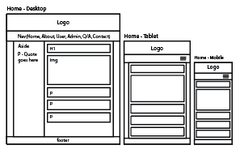
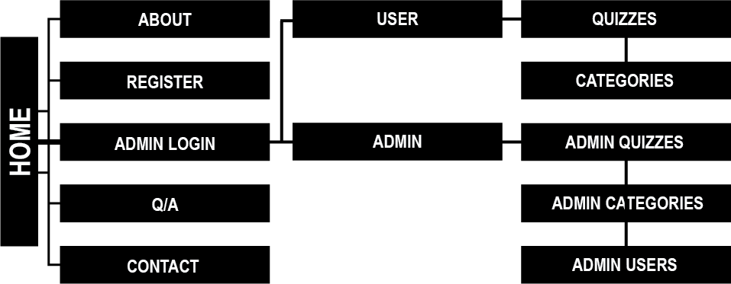
DESIGN
sitemap
sample wireframes

Slide 9



responsive web design
desktop
tablet
mobile

Slide 10
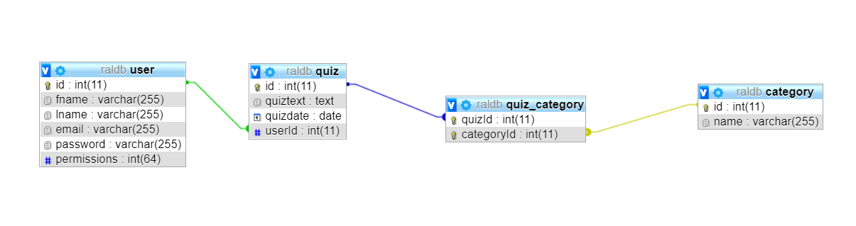
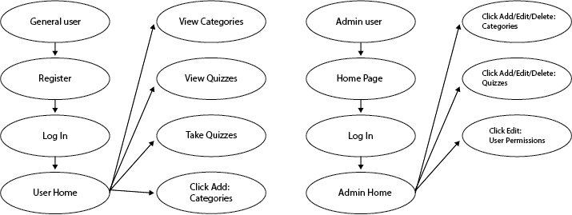
database relationship table
user case diagram

Slide 11
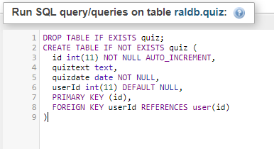
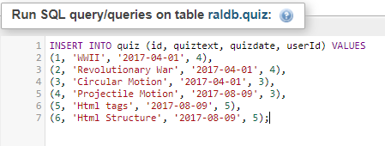
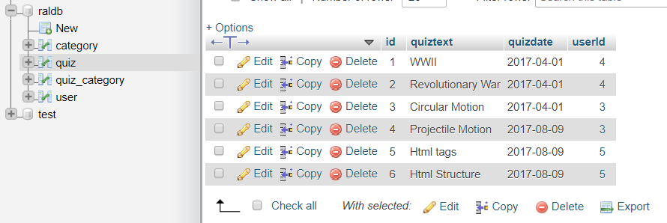
IMPLEMENTATION
database implementation

Slide 12
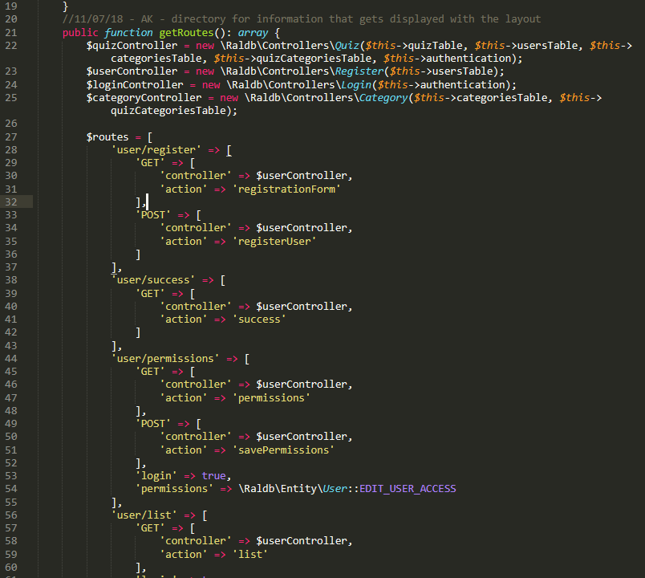
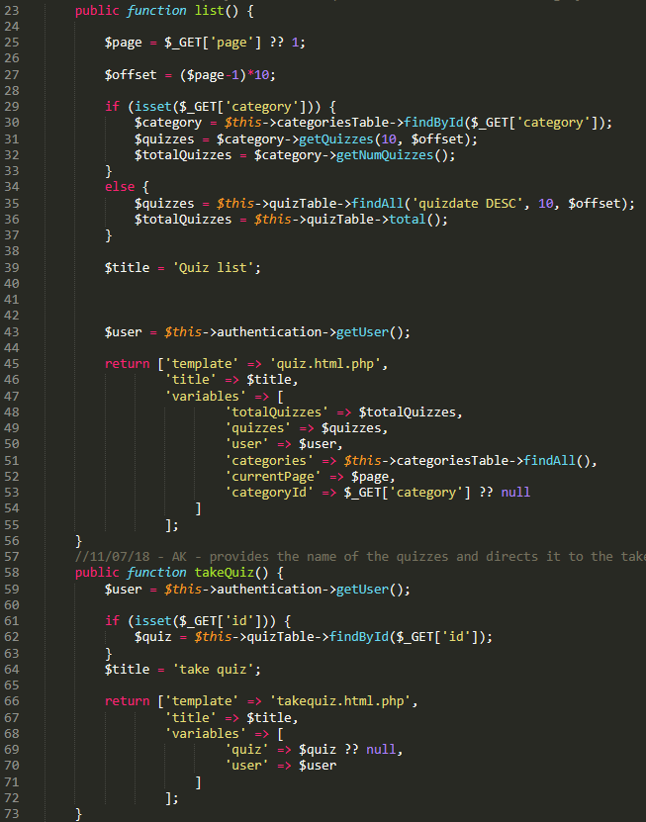
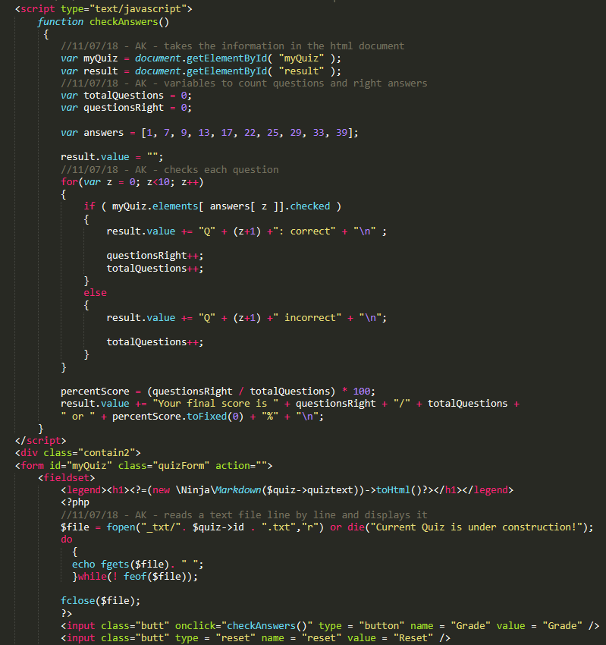
key source code
RaldbRoutes.php
Quiz.php
takequiz.html.php

Slide 13
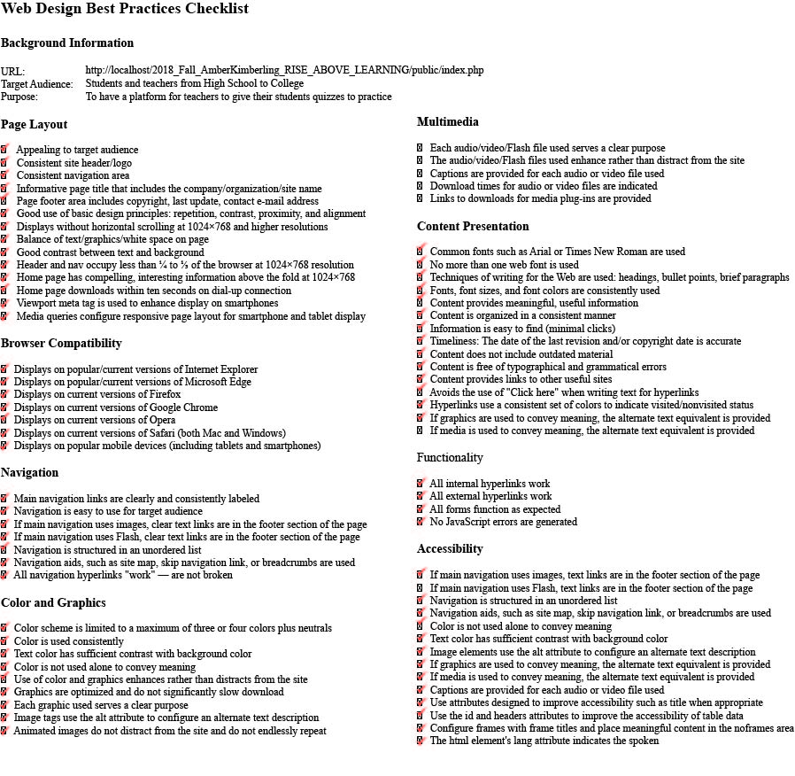
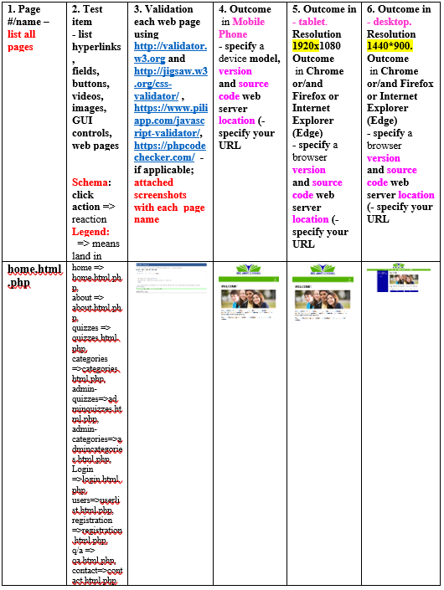
TEST AND INTEGRATION
best practices
testing table

Slide 14

DEMO
http://riseabovelearning.eledonta.com/public/index.php

Slide 15
CONCLUSION
What courses helped me:
CMPS 320 internet apps
what I learned:
how important it is to understand error handling with php
the importance of allowing others to test you web apps
knowing my limitations with time management
what I would have done differently:
started the sorting out the details of the project before the semester was done
proposed a project I could have done within the time frame then added extras
future students in senior project:
begin thinking about what you want to do and research it way before
plan everything out
Thank you to the department of computer science and engineering and all the faculty especially Professor Jozef Goetz.

