Slide 1
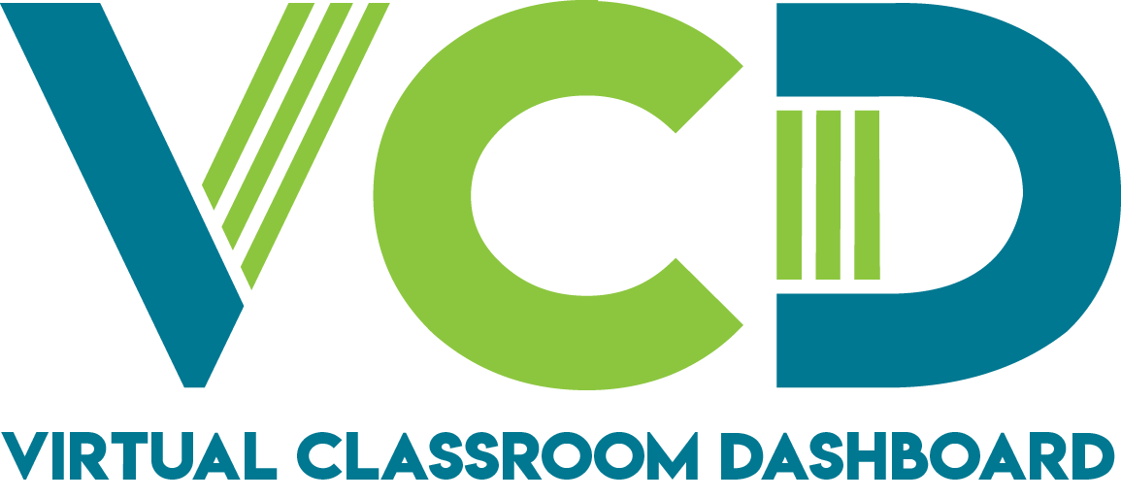
Master’s Project Presentation
Submitted By: Amber Kimberling
CPSC-597
Fall 2021
Advisor: Dr. Sampson Akwafuo
Department of Computer Science
California State University-Fullerton

Slide 2
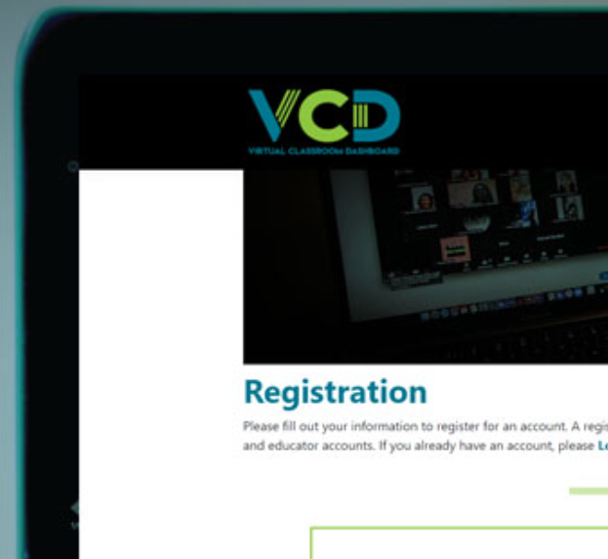
OVERVIEW
Introduction
Literature Review
Problem
Methodology
Objectives
Demo
Testing Results
Future Features
Conclusion
Acknowledgements
Questions

Slide 3
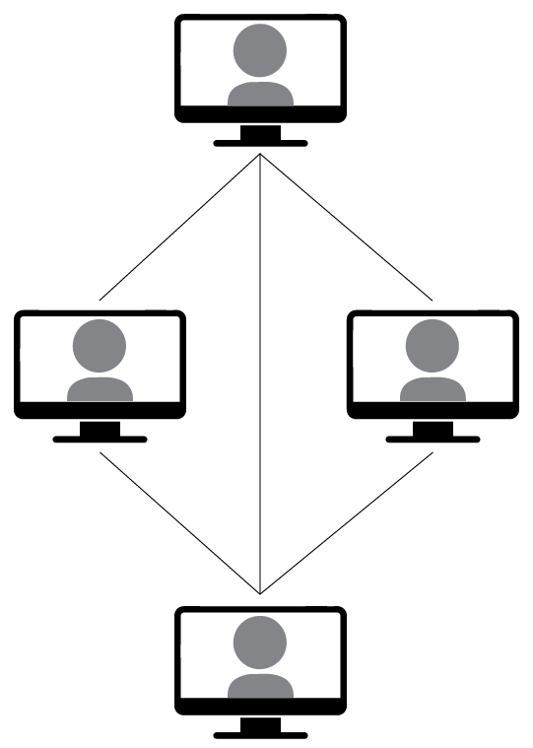
INTRODUCTION
Learning Management Systems
COVID-19
Education is crucial
Accessibility of education
Various learning tools
Personal connection
Visual Studio 2019, GitHub, Azure Database and a web server hosted in a cloud provider such as Azure
Notes:
Learning Management Systems are of utmost importance in our technological world for educating young minds in the courses they are passionate about.
The recent pandemic has only shown us how utilizing an online platform for learning and integrating it within the classroom has become vital.
Education is crucial because it provides us with the tools and knowledge to move through our careers and life.
Accessibility is vital for students and professors who have disabilities to access their education.
Moving forward from this challenging time, we will need various learning tools that we can provide to students and use as educators.
My dream is to have the privilege of presenting this information dynamically once I am a professor.
The tools used to develop this web application were Visual Studio 2019, GitHub, Azure Database and a web server hosted in a cloud provider such as Azure.

Slide 4
LIT REVIEW
Learning Management Systems can aid in the assistance of educators not only in the physical classroom but also virtually with quite a few activities such as quizzes, group works, and turning in assignments.
Narrowing the focus means that developers are focusing more on creating software geared towards what students and teachers require to have a successful learning/teaching experience
These systems have been improved over the years by focusing on user experience development.
E-learning is the interconnection between training education, teaching on digital platforms, and the class format (in person or online) .
Over the years, LMS’s have been enhanced with features such as authorization, authentication, monitoring materials, and so much more.
Notes:
Learning Management Systems can aid in the assistance of educators not only in the physical classroom but also virtually with quite a few activities such as quizzes, group works, and turning in assignments
The core of online or hybrid learning is utilizing web-based tools given to you within an LMS.
These systems have been improved over the years by focusing on user experience development.
Narrowing the focus means that developers are focusing more on creating software geared towards what students and teachers require to have a successful learning/teaching experience
E-learning is the interconnection between training education, teaching on digital platforms, and the class format (in person or online).
This way of learning may benefit the students by increasing their drive to learn because it caters to more than average students.
Online learning targets the students who need exceptionally engaging education by learning through gaming or puzzles.
The in-person classes target the students who need better clarification or attention from a teacher.
Over the years, LMS’s have been enhanced with features such as authorization, authentication, monitoring materials, and so much more.
Moodle is one of the top LMS’s due to its flexibility, modifiability, and open-source format.
With these improvements in LMS’s, there are significant advantages for the students and the teachers.

Slide 5

PROBLEM
Learning Management Systems have been around for several years.
Each type of system contains some unique and similar sets of features.
Each year new technology arises as well as new tools for learning.
With these developments come changes to the educational system in a more technological way.
Switching how students are taught is not easy because they had to find a suitable LMS and video-conferencing application.
There is a need for a uniform, all-in-one easy to use platform where teachers can video chat, communicate, provide material, submissions, and assessments.
Notes:
Learning Management Systems have been around for several years.
Each type of system contains some unique and similar sets of features.
Each year new technology arises as well as new tools for learning.
With these developments come changes to the educational system in a more technological way.
In 2020 the world was hit with the Covid-19 pandemic leaving institutions with no choice but to turn to online learning.
Switching how students are taught is not easy because they had to find a suitable LMS and video-conferencing application.
Having multiple tools and platforms can prove to be difficult, especially for lower levels of educations.
Why can’t these tools be all in one? There is a need for a uniform, all-in-one easy to use platform where teachers can video chat, communicate, provide material, submissions, and assessments.
“The best online learning combines elements where students go at their own pace, on their own time, and are set up to think deeply and critically about subject matter combined with elements where students go online at the same time and interact with other students, their teacher and content”
Education is a crucial asset to providing us with the tools to move through our lives and careers.
If the world were to move to hybrid or e-learning applications, they would need to be equipped with the best tools and be flexible. As we move toward the future, learning will be an ongoing issue, especially if there is another pandemic or outbreak.

Slide 6
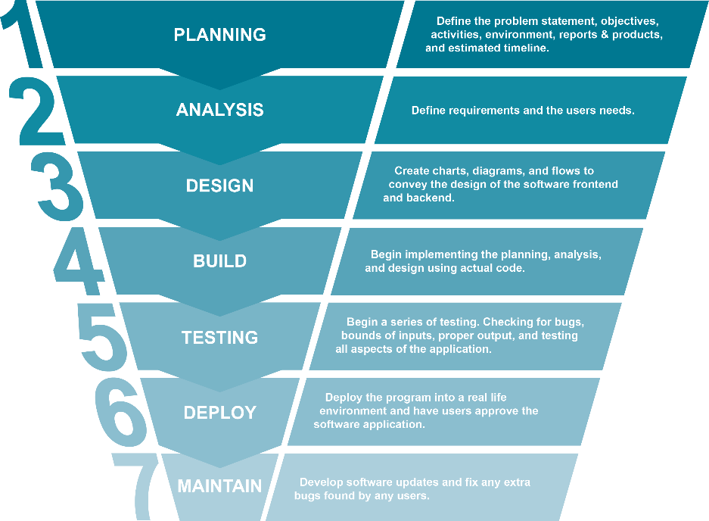
METHODOLOGY
Phase 1: Planning, Analysis, Research, and Design
Phase 2: Build and Testing
Phase 3: Deploy and Maintain
Phase 4: Documents and Demonstrations

Slide 7
OBJECTIVES
Project
A deployable application completed by December 2021 with over 200 hours of work.
Design a full-stack application that provides a multi-tier platform for users such as educators, students, and administrators.
Develop a final report with a full explanation of the development and software.
Develop three user manuals.
Technical
Design a cross-browser compatible application.
Design a responsive app for all devices.
Develop a secure app using authentication, authorization, limit access, and encryption tactics.
Develop an accessible application that is easy to use and adheres to the guidelines for accessibility.
Design an application with high modifiability and testability with separation of concerns using the Model View Controller (MVC) framework.

Slide 8
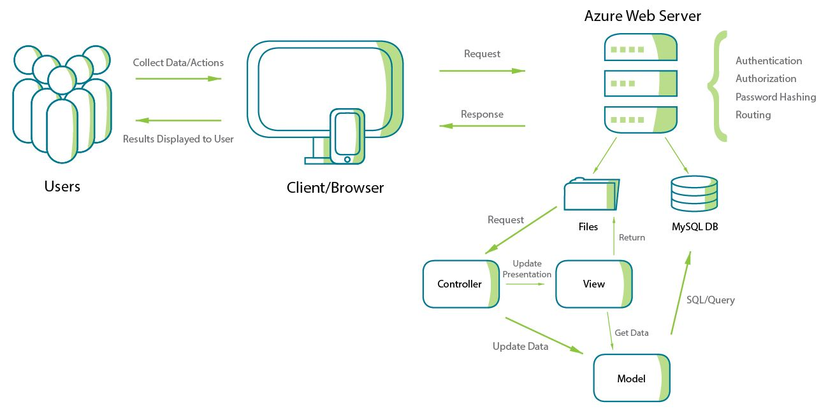
DEMO
https://virtualclassroomdashboard.azurewebsites.net/

Slide 9
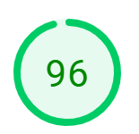
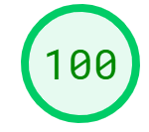
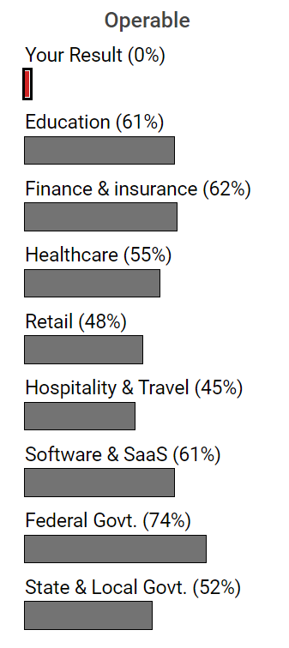
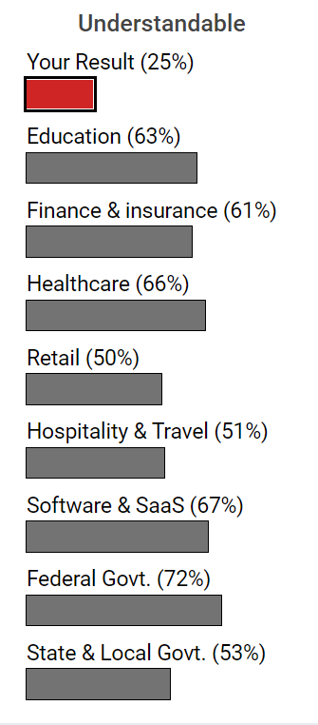
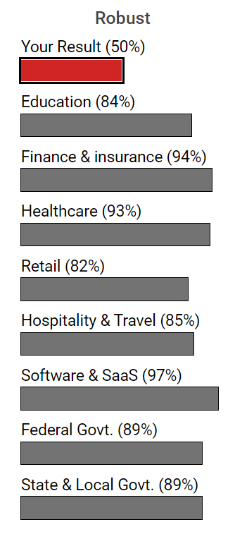
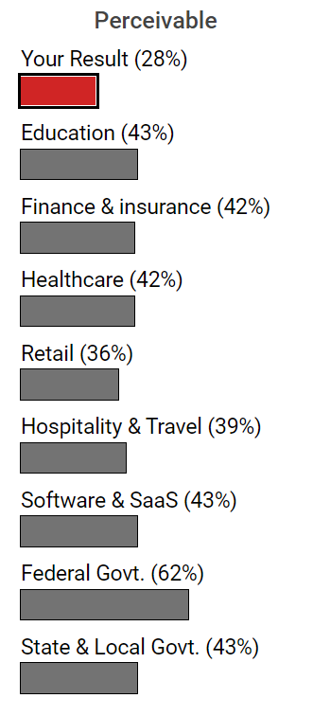
TESTING RESULTS
Performance: Low - High -
Accessibility:

Slide 10
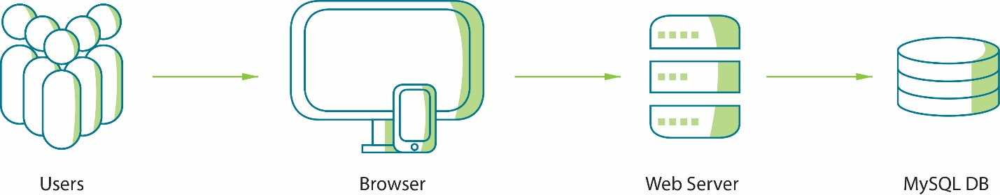
TESTING RESULTS
Usability: Overall the web application has high usability
Security: Authorization, Authentication, Encryption, SQL Injection, and Cross-site attack
Functionality: All pages use verification and validation, links work, buttons work, and contact page does not send email
Notes:
There is a single web page that is causing issues with the functionality of the web application.
The Contact page does not send an email and it does not show the confirmation page.
The navigation among all the webpages is very user friendly. Between each user type all information is easy to find and easy to see.

Slide 11
FUTURE FEATURES
Zoom and other virtual communications embedded within the application
Grading system including automation and manual grading
Access to exams and quizzes
Plagiarism tools
Cheating tools
Access to assessments
Interactive learning tools
Authentication with user personal email accounts
The implementation of AI and Machine Learning to help gear academics to personal user needs
More tools to ensure the teacher or students do not need outside applications to aid them in their courses
A setting menu to include contrasting interfaces, different font sizes, text to speech, and speech to text

Slide 12
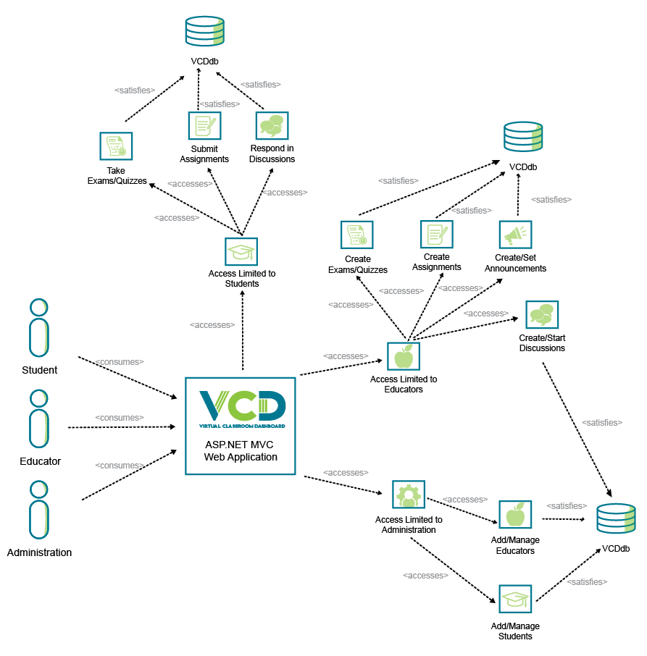
CONCLUSION
Learning Management Systems
COVID-19
Virtual Classroom Dashboard
Accessibility
New features
Research
AI
Machine Learning
Notes:
Learning Management Systems are the future of education and having a software or application that is flexible and heavily geared towards its users is eminent.
User experience is the for front of the future of technology meaning the way we interact with the applications we use needs to be our focus.
Covid-19 has shown us how providing flexibility in our education can help connect each other no matter where we are in the world and provide more diverse learning environments.
LMS’s can help extend the learning process beyond the physical classroom.
This project is to show how this is possible, provide understanding into an LMS, provide key features in a user driven product, and most importantly provide a system that can be easily manipulated so it can be upgraded with ease.
With the possibility of another pandemic or the inclusion of worldwide education the topic of virtual learning and in class learning will become more popular.
Online learning has the potential to be more inclusive for disabilities, different learning styles, and for different teaching styles.
Having a virtual leaning platform in the form of a learning management system can help aid students with disabilities by providing high contrasting elements, text to speech, speech to text, and any other tools that are available.
If all these elements of learning are in one platform, that would reduce the need for more applications and provide students with lower capacity computing devices to be able to use the application.
Virtual Classroom Dashboard was developed to have high accessibility and modifiability.
This application has the potential to grow and be easily manipulated by future developers.
The goal of this project was to create an all-inclusive learning management system that can be used by any type of user.
With more time, research, and developers this application can surpass its potential and even have the possibility to be one of the top learning applications.
The research that can help elevate this project would include virtual reality, learning games, machine learning, and artificial intelligence tools.
Utilizing the modern technology within a learning application can help elevate learning and motivate students and teachers.

Slide 13
ACKNOWLEDGEMENTS
I would like to thank the following:
California State University, Fullerton
Dr. Sampson Akwafuo
Dr. Mikhail Gofman
Dr. Michael Falkow
Dr. Kanika Sood
Ray Ahmadnia
Seta Whitby
Dr. Jozef Goetz
Hakon Engvig
And the many others have helped shape my educational path

Slide 14
QUESTIONS?

Slide 15
REFERENCES
S. HUILAN et al., "Educational management in Critical Thinking Training Based on Bloom’s Taxonomy and SOLO Taxonomy," International Conference on Information Science and Education (ICISE-IE), pp. 518-520, 2020 Y. Rahim, O. Mohd, M. Sahari, N. Safie and Z. Rahim, "A Study On The Effects Of Learning Material Handling Procedures Towards Information Integrity In Moodle Learning Management System (LMS)," 2nd International Conference on Electrical Engineering and Informatics (ICon EEI), pp. 81-85, 2018. Meyliana, H. Widjaja, S. Santoso, Surjandy and E. Fer, "Improving the Quality of Learning Management System (LMS) based on Student Perspectives Using UTAUT2 and Trust Model," 4th International Conference on Informatics and Computational Sciences, pp. 1-5, 2020. E. Brito and G. P. Dias, "LMS accessibility for students with disabilities: The experts’ opinions," in 2020 15th Iberian Conference on Information Systems and Technologies (CISTI), Seville, Spain, 2020. B. o. I. Accesibility, "Bureau of Internet Accesibility," [Online]. Available: https://www.boia.org/. [Accessed 04 12 2021].

