Slide 1
Computational Materials Theory and Methods
Lecture 3:
Quantum Mechanics
Alexey V. Akimov
University at Buffalo, SUNY

Slide 2


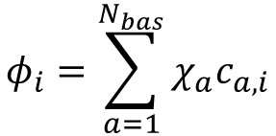



Basics of the Molecular Orbital Theory
$$φ_{i}=\sum_{a=1}^{N_{bas}}{χ_{a}c_{a,i}}$$
Basis set expansion
$$N_{mo}$$
Orbitals:
Molecular, crystal, etc.
$$N_{mo}$$
$$N_{bas}$$
=
$$N_{bas}$$
Basis functions:
Atomic orbitals, plane-waves, etc.
In general
$${N_{bas}≥N}_{mo}$$

Slide 3
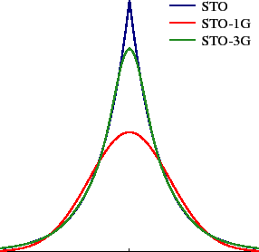
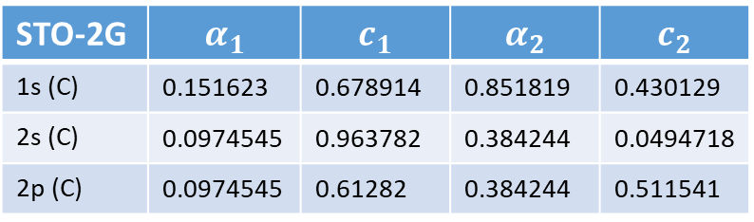
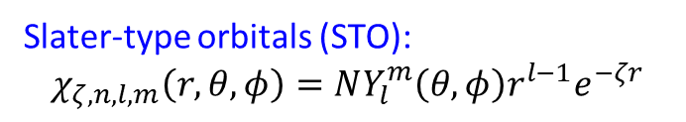
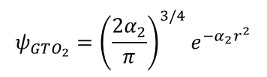
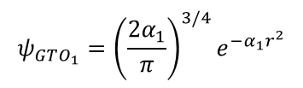

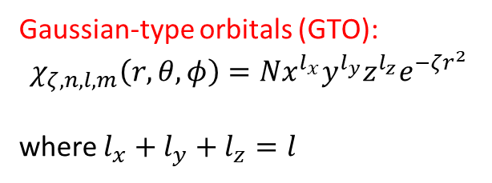
Atomic orbitals
Slater-type orbitals (STO):
$$χ_{ζ,n,l,m}\left(r,θ,φ\right)=NY_{l}^{m}\left(θ,φ\right)r^{l−1}e^{−ζr}$$
Gaussian-type orbitals (GTO):
$$χ_{ζ,n,l,m}\left(r,θ,φ\right)=Nx^{l_{x}}y^{l_{y}}z^{l_{z}}e^{−ζr^{2}}$$
where $l_{x}+l_{y}+l_{z}=l$
STO-2G: $ψ_{STO}=c_{1}ψ_{GTO_{1}}+c_{2}ψ_{GTO_{2}}$
Energy of electron in H atom
$$ψ_{GTO_{1}}={\left(\frac{2α_{1}}{π}\right)}^{3/4}e^{−α_{1}r^{2}}$$
$$ψ_{GTO_{2}}={\left(\frac{2α_{2}}{π}\right)}^{3/4}e^{−α_{2}r^{2}}$$
Basis set | Energy [hartree]
STO-3G | -0.49491
STO-4G | -0.49848
STO-5G | -0.49951
STO-6G | -0.49983
Exact | -0.5
STO-2G | $$α_{1}$$ | $$c_{1}$$ | $$α_{2}$$ | $$c_{2}$$
1s (C) | 0.151623 | 0.678914 | 0.851819 | 0.430129
2s (C) | 0.0974545 | 0.963782 | 0.384244 | 0.0494718
2p (C) | 0.0974545 | 0.61282 | 0.384244 | 0.511541
Just for the radial component of wavefunction

Slide 4
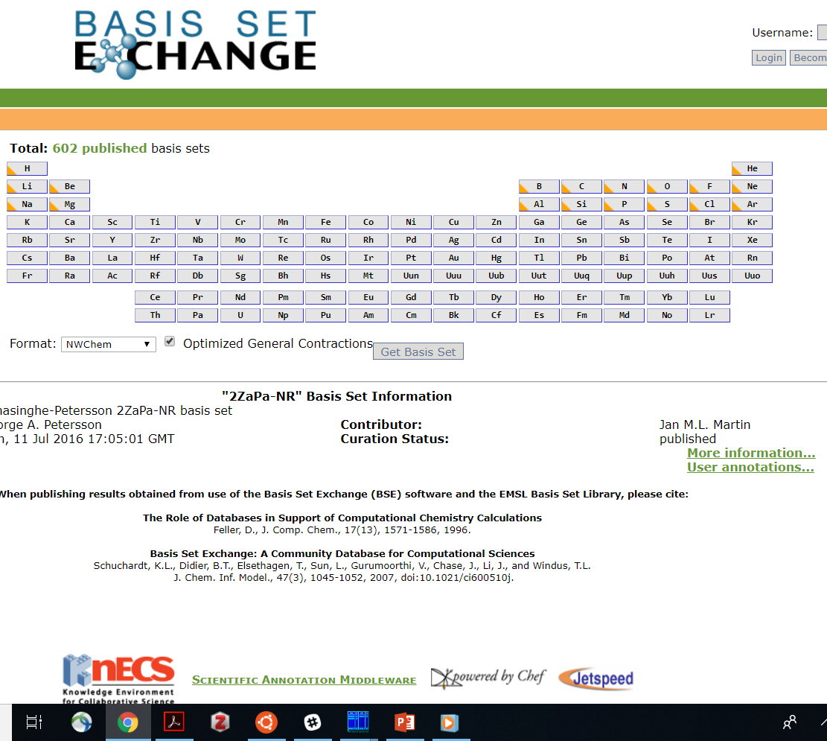
Atomic orbitals
Where to get
Potential problems
https://bse.pnl.gov/bse/portal
Basis set superposition error
Dissociation
Linear dependence
Pulay forces

Slide 5
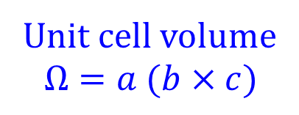
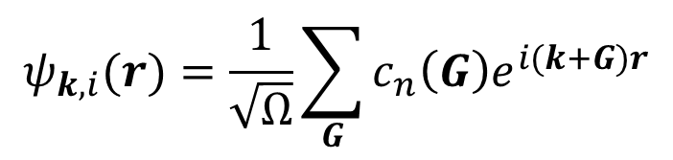
Plane waves (PW)
Reciprocal space unit cell
Real space unit cell
The bigger the size in real space, the smaller its counterpart in the reciprocal
Unit cell volume
$$Ω=a (b×c)$$
Real space coordinate
$$ψ_{k,i}(r)=\frac{1}{\sqrt{Ω}}\sum_{G}{c_{n}\left(G\right)e^{i(k+G)r}}$$
k-point vector
(crystal momentum vector)
Reciprocal space
grid points
Band (“orbital”) index

Slide 6

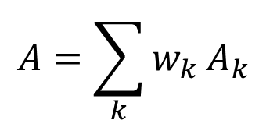

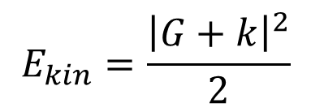

Plane waves (PW)
k-points convergence
pw convergence
In DFT, many properties are given by:
Kinetic energy of free electrons
$$A=\sum_{k}{w_{k}}A_{k}$$
$$E_{kin}=\frac{{\left|G+k\right|}^{2}}{2}$$
$$E_{kin}≤E_{cut}$$
$$k$$
$$k$$

Slide 7
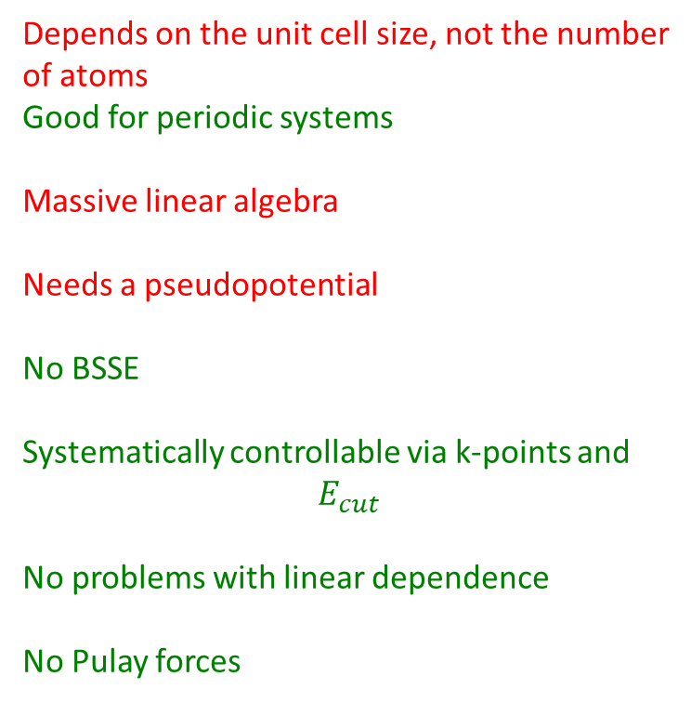
Basis set comparisons
Atomic basis
PW basis
Doesn’t depend on the unit cell size
Good for finite systems (clusters/molecules)
Analytic integrals
All-electron
Basis set superposition error
Not systematically controllable
Linear dependence for large sets
Pulay forces
Depends on the unit cell size, not the number
of atoms
Good for periodic systems
Massive linear algebra
Needs a pseudopotential
No BSSE
Systematically controllable via k-points and
$$E_{cut}$$
No problems with linear dependence
No Pulay forces

Slide 8

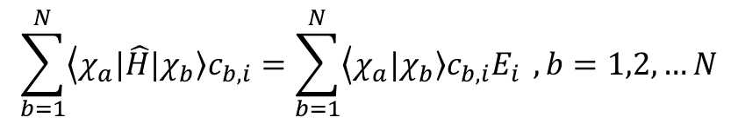







Schrodinger equation
$$\sum_{b=1}^{N}{\left\langle χ_{a}\right.|\hat{H}\left.|χ_{b}\right\rangle c_{b,i}}=\sum_{b=1}^{N}{\left\langle χ_{a}\right.\left.|χ_{b}\right\rangle c_{b,i}E_{i}} , b=1,2,…N$$
$$\hat{H}φ=Eφ$$
Variational principle
$$H$$
$$C$$
$$S$$
$$C$$
$$E$$
=
$$N_{bas}$$
$$N_{mo}$$
Diabatic Hamiltonian
(non-interacting basis)
Adiabatic Hamiltonian
(interacting basis)

Slide 9
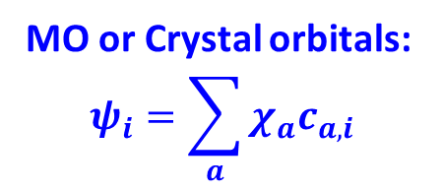

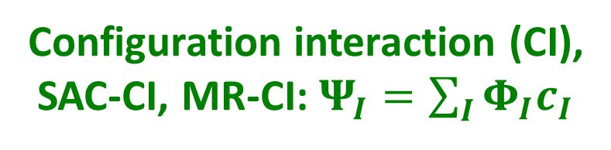
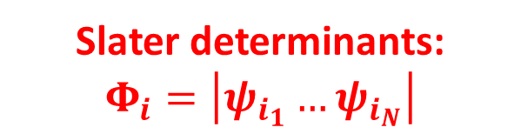
Hierarchy of wavefunctions
AO or PW ($χ_{i}$)
Primitive mathematical basis
MO or Crystal orbitals:
$$ψ_{i}=\sum_{a}{χ_{a}c_{a,i}}$$
Solution to the mean-filed SE
(1-electron functions)
Slater determinants:
$$Φ_{i}=\left|ψ_{i_{1}}…ψ_{i_{N}}\right|$$
Account for anti-symmetry
(exchange/fermionic statistics)
Configuration interaction (CI),
SAC-CI, MR-CI: $Ψ_{I}=\sum_{I}{Φ_{I}c_{I}}$
Account for correlation,
proper spin symmetry

Slide 10
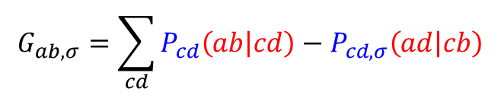


Constructing the Hamiltonian
(in the AO basis)
Fock (mean-filed) Hamiltonian
$$F_{ab,σ}=H_{ab}+G_{ab,σ}$$
Core Hamiltonian
Coulomb and Exchange Hamiltonian
(does not depend on charge/spin density)
(depends on charge/spin density)
$$G_{ab,σ}=\sum_{cd}{P_{cd}\left(ab | cd\right)−P_{cd,σ}\left(ad | cb\right)}$$
$$P=COC^{T}$$
Density matrix
Molecular integrals
(depends on the solution of SE)

Slide 11
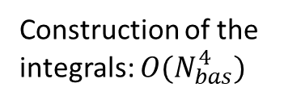
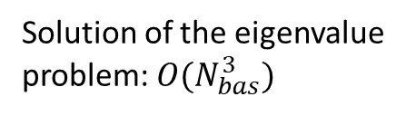
Dealing with the complexity of SE
Scaling
considerations
Approximations
Keep only the core part
Solution of the eigenvalue
problem: $O(N_{bas}^{3})$
Replace the core with
a special formula
(TB- or extended Hückel)
One-shot solution
Construction of the
integrals: $O(N_{bas}^{4})$
Semiempirical methods:
Simplify the 2-electron 4-center
integrals, neglect some
(CNDO, INDO, MNDO, etc. PMn)
Need self-consistent solution
Akimov, A. V.; Prezhdo, O. V. Chem. Rev. 2015, 115, 5797–5890.

Slide 12

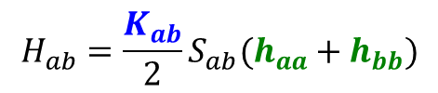



Extended Hückel theory (EHT)
Hoffmann, R. J. Chem. Phys. 1963, 39, 1397–1412.
Simple math, efficient
Clear meaning of parameters
Consider it a Tight-Binding
General-purpose (analog of UFF)
No SCF required: 1-shot
$$χ_{a}=c_{1}N_{1}\exp\left(−ζ_{1}r\right)+c_{2}N_{2}\exp\left(−ζ_{2}r\right)$$
$$S_{ab}=\left\langle χ_{a} | χ_{b}\right\rangle$$
$$H_{ab}=\frac{K_{ab}}{2}S_{ab}(h_{aa}+h_{bb})$$
Fancier schemes: SC-EHT
Charge-dependent VSIP
$$h_{aa}=h_{aa}^{0}−Aq_{a}$$
Energy
$$h_{aa}=−{VSIP}_{a}$$
$$χ_{a}$$
Akimov, A. V.; Prezhdo, J. Math. Chem. 2015, 53, 528–550.

Slide 13
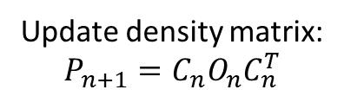

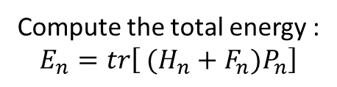
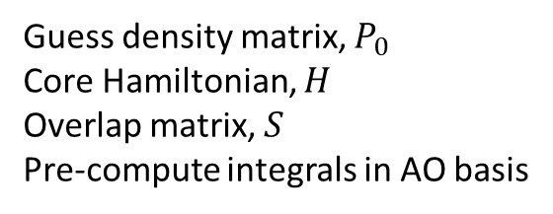
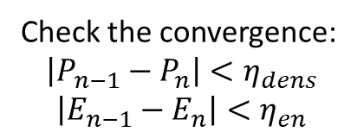
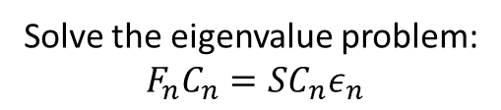
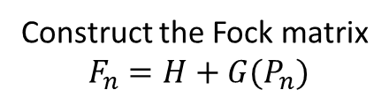
Self-consistent field (SCF)
Guess density matrix, $P_{0}$
Core Hamiltonian, $H$
Overlap matrix, $S$
Pre-compute integrals in AO basis
Density matrix, $P_{n}$
Construct the Fock matrix
$F_{n}=H+G(P_{n})$
Solve the eigenvalue problem:
$F_{n}C_{n}=SC_{n}ε_{n}$
Update density matrix:
$$P_{n+1}=C_{n}O_{n}C_{n}^{T}$$
Compute the total energy :
$$E_{n}=tr\left[ (H_{n}+F_{n})P_{n}\right]$$
Check the convergence:
$$\left|P_{n−1}−P_{n}\right|<η_{dens}$$
$$\left|E_{n−1}−E_{n}\right|<η_{en}$$
Done

