Slide 1


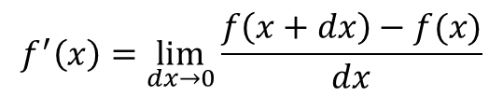
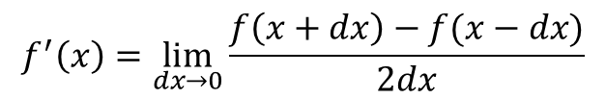


$$f^{′}\left(x\right)=\lim_{dx→0}{\frac{f\left(x+dx\right)−f(x)}{dx}}$$
$$f^{′}\left(x\right)=\lim_{dx→0}{\frac{f\left(x+dx\right)−f(x−dx)}{2dx}}$$
$$dx$$
$$f(x+dx)$$
$$f(x)$$
$$f(x−dx)$$

Slide 2



$$x_{n+1}=4rx_{n}(1−x_{n})$$
$$x_{0} →x_{1}→x_{2}→x_{3}…$$
$$0<r<1$$

Slide 3

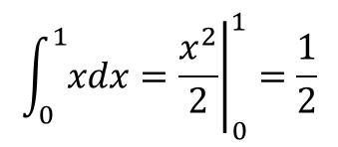
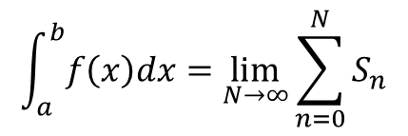



$$\int_{a}^{b}{f\left(x\right)dx}=\lim_{N→∞}{\sum_{n=0}^{N}{S_{n}}}$$
$$x_{n}=a+n ∗dx$$
$$dx=\frac{b−a}{N}$$
$$Midpoint: S_{n}=f\left(\frac{x_{n}+x_{n+1}}{2}\right)dx$$
$x_{0}$ $x_{1}$ $x_{N}$
$$\int_{0}^{1}{xdx}={\left.\frac{x^{2}}{2}\right|}_{0}^{1}=\frac{1}{2}$$
a b

Slide 4
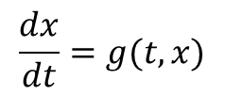
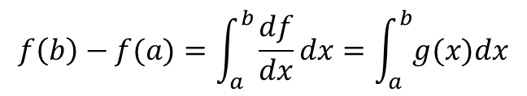
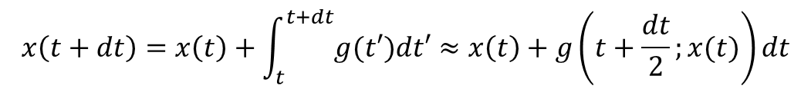
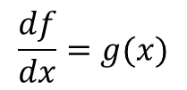
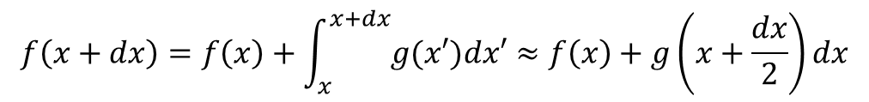
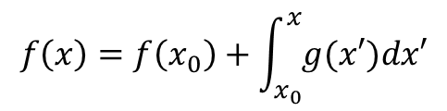
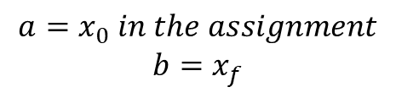
$$\frac{df}{dx}=g(x)$$
$$a=x_{0} in the assignment$$
$$b=x_{f}$$
$$f\left(b\right)−f(a)=\int_{a}^{b}{\frac{df}{dx}dx}=\int_{a}^{b}{g(x)dx}$$
$$f\left(x\right)=f\left(x_{0}\right)+\int_{x_{0}}^{x}{g(x′)dx′}$$
$$f\left(x+dx\right)=f\left(x\right)+\int_{x}^{x+dx}{g(x′)dx′}≈f\left(x\right)+g\left(x+\frac{dx}{2}\right)dx$$
$$\frac{dx}{dt}=g(t,x)$$
$$x\left(t+dt\right)=x\left(t\right)+\int_{t}^{t+dt}{g(t′)dt′}≈x\left(t\right)+g\left(t+\frac{dt}{2};x(t)\right)dt$$

Slide 5
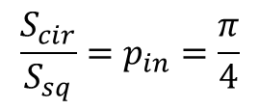

$$A=πr^{2}$$
$$\frac{S_{cir}}{S_{sq}}=p_{in}=\frac{π}{4}$$
0 2

