Slide 1

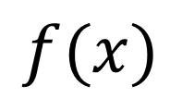


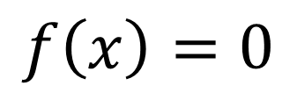
$$f(x)$$
$$\left|x_{left}−x_{right}\right|<ε$$
$$\left|f(x_{left})−f(x_{right})\right|<ε′$$
$$x$$
$$f\left(x\right)=0$$

Slide 2
Population
1
Energy
HOMO LUMO

Slide 3

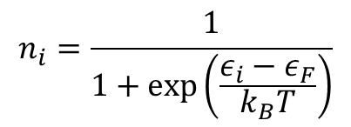
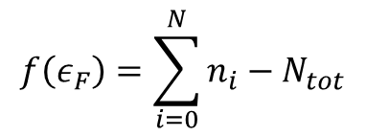
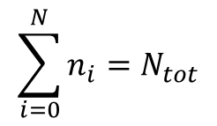
$$n_{i}=\frac{1}{1+\exp\left(\frac{ε_{i}−ε_{F}}{k_{B}T}\right)}$$
$$\sum_{i=0}^{N}{n_{i}=N_{tot}}$$
Population
1
0.5
Energy
HOMO LUMO
$$ε_{F}$$
$$f\left(ε_{F}\right)=\sum_{i=0}^{N}{n_{i}}−N_{tot}$$
def fermi_energy([0.0. 0.1, 0.2, 0.21, 0.35, 0.42], 2, kT )

