Slide 1
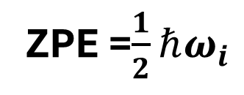
Energy
Guess geometries
Optimized geometry
Interatomic distance
Vibrational frequency
ZPE =$\frac{1}{2}ℏω_{i}$

Slide 2
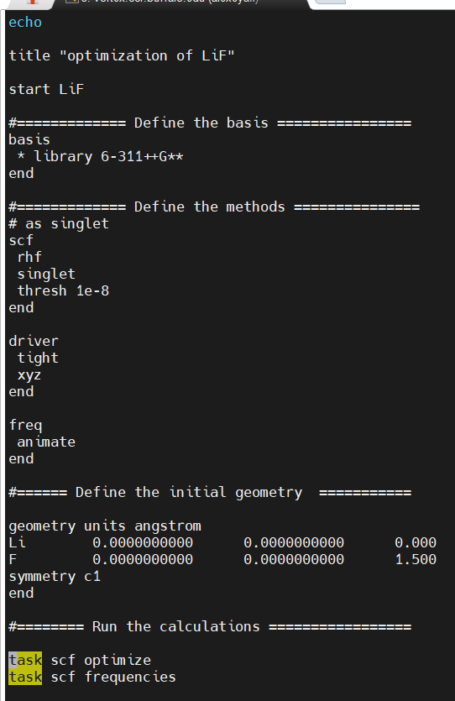
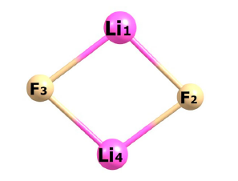
(a) (b)

Slide 3
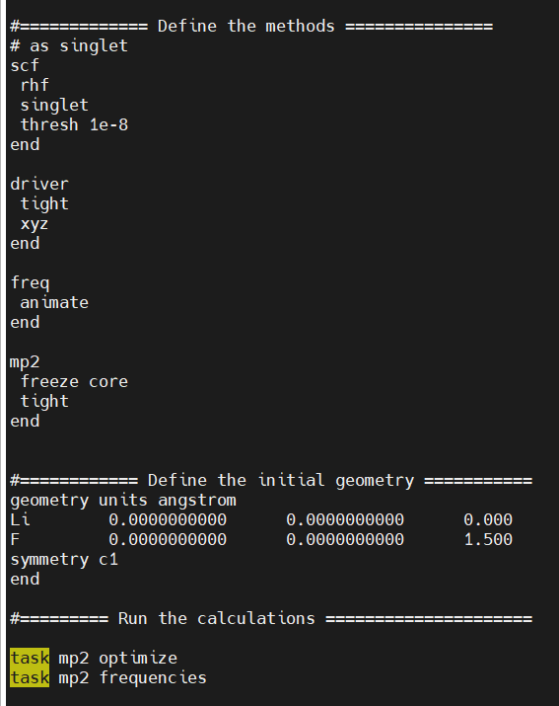
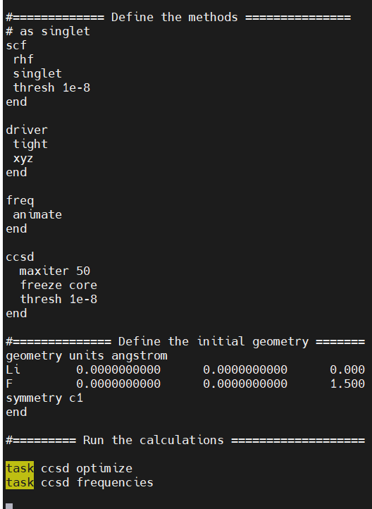
(a) (b)

Slide 4
