Slide 1
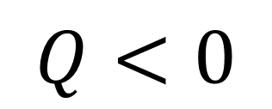
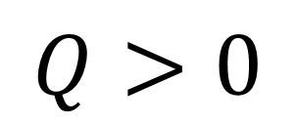

Work done on system
W>0
Heat added to system
Heat released by system
$$ΔU$$
$$Q>0$$
$$Q<0$$
W<0
Work done by system

Slide 2






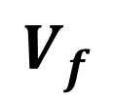
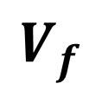


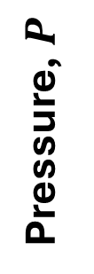
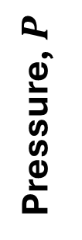

Isothermal expansion of ideal gas
Reversible
Irreversible
$$P_{int}V=nRT$$
$$P_{ext}=const$$
Pressure, $P$
$$P_{ext}=P_{int}$$
Pressure, $P$
$$\left|W\right|=\int_{V_{i}}^{V_{f}}{P_{ext}dV}$$
$$\left|W\right|=\int_{V_{i}}^{V_{f}}{P_{ext}dV}$$
Volume, $V$
Volume, $V$
$$V_{i}$$
$$V_{f}$$
$$V_{i}$$
$$V_{f}$$

Slide 3
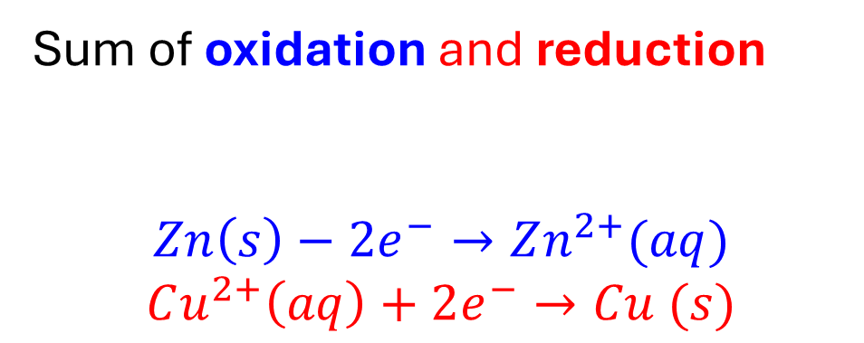




Cell reaction: written assuming that the right-hand electrode (as it appears in cell diagram) is the cathode
This means:
$$Zn\left(s\right)\left|ZnSO_{4}\left(aq\right)\right||CuSO_{4}(aq)|Cu(s)$$
Oxidation (Anode)
Reduction (Cathode)
$$Zn\left(s\right)−2e^{−}→Zn^{2+}(aq)$$
$$Cu^{2+}\left(aq\right)+2e^{−}→Cu (s)$$
Net reaction
$$Zn\left(s\right)+Cu^{2+}\left(aq\right)→Zn^{2+}\left(aq\right)+Cu(s)$$
Sum of oxidation and reduction
$$Zn\left(s\right)−2e^{−}→Zn^{2+}(aq)$$
$$Cu^{2+}\left(aq\right)+2e^{−}→Cu (s)$$
Difference of reduction half-reactions:
Right (cathode) – Left (anode)
-
$$Cu^{2+}\left(aq\right)+2e^{−}→Cu (s)$$
(Right)
+
$$Zn^{2+}\left(aq\right)+2e^{−}→Zn\left(s\right)$$
(Left)

