Slide 1
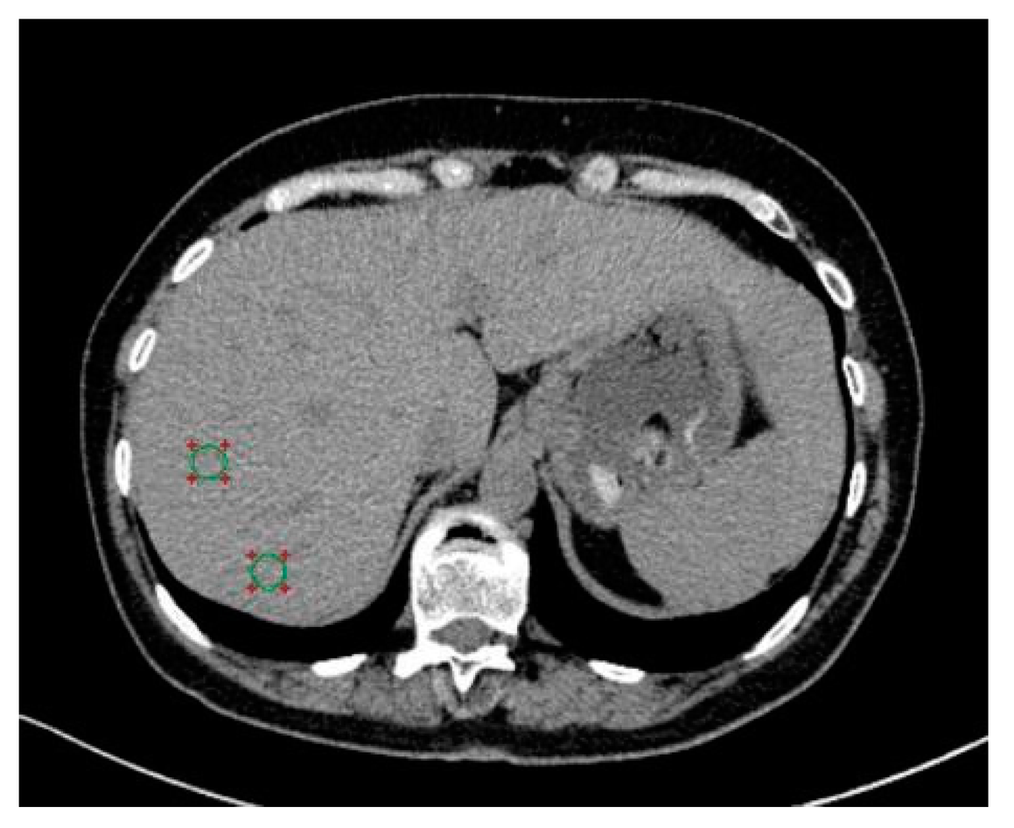
Name: Akimuddin Shaikh Student ID:x22123245
Analysis of Scalable and Efficient Approaches for Liver Disease Detection
This presentation explores an innovative approach to liver disease detection using machine learning and deep learning techniques.
Notes:
1

Slide 2
Introduction: The Need for Automated Liver Disease Detection
Rising Cases
Manual Analysis
Automated Approach
Growing number of liver disease cases worldwide.
Time consuming, costly and prone to errors.
Leveraging Machine Learning and deep learning.
Notes:
2

Slide 3
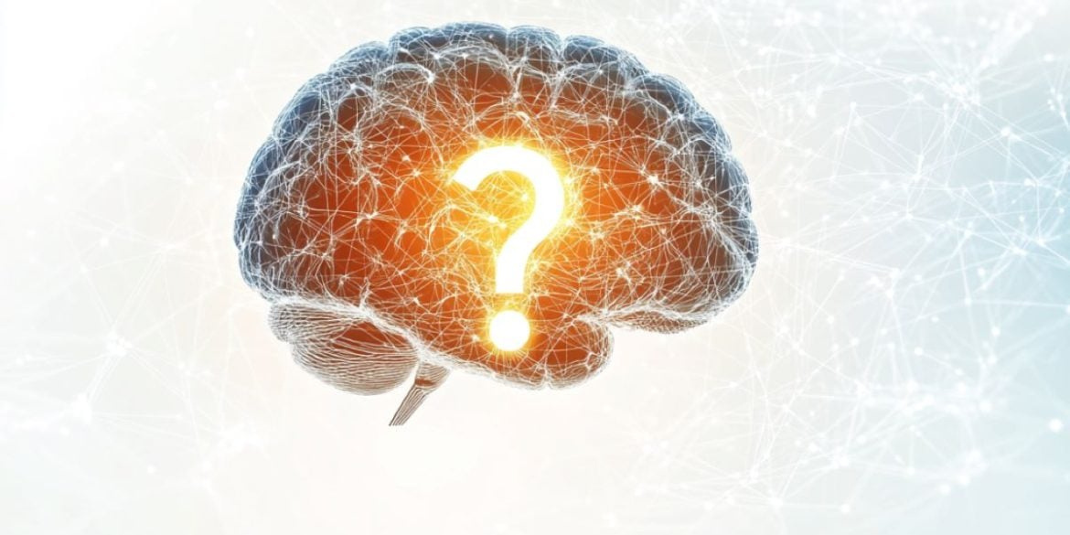
Motivation and Research Questions
Unlabeled Data
Feature Effectiveness
Addressing the challenge of leveraging unlabeled datasets.
Exploring the effectiveness of texture and deep features in classification..
Clustering Insights
Feature Integration
Can clustering uncover patterns in unlabeled data?
Impact of integrating features on model performance?
Notes:
3

Slide 4
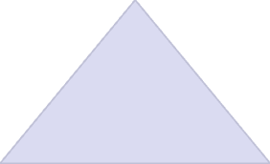

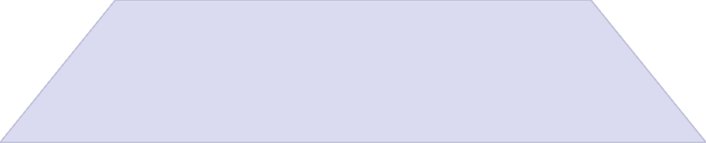
Objectives: A Comprehensive Approach
Pipeline Development
1
Integrating GLCM and ResNet50 features.
2
Clustering Evaluation
Assessing KMeans, DBSCAN, and Agglomerative methods.
3
Supervised Model Assessment
Evaluating RF, SVM, and XGBoost on feature sets.
Notes:
4

Slide 5
Dataset Overview: Leveraging Public Resources
Dataset Source
Image Format & Labeling detail
Total Number of Images
https://www.kaggle.com/datasets/anassbenfares/liver-images/data
JPG, UNLABEL
19,261 images in 130 subfolders.
Notes:
5

Slide 6

Exploratory Data Analysis
Data Inspection
Image Count Validation
Pixel Intensity Analysis
Data Visualization
Notes:
7

Slide 7

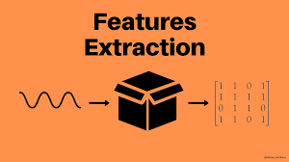
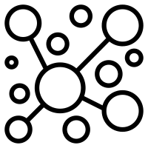
Methodology Overview: A Detailed Pipeline
Data Preprocessing:
1
Duplicate removal, resizing, normalization, batching.
Feature Extraction:
2
GLCM for texture features and ResNet50 for deep features.
Clustering:
3
KMeans, Agglomerative, and DBSCAN (pseudo-label generation).
Notes:
6

Slide 8
Data Preprocessing Highlights: Ensuring Data Integrity
Image Consolidation
Duplicate Removal
Merged 130 subfolders into one for efficient processing.
Verified unique images through file hash comparisons.
Normalization
Batching
Scaling pixel values to (0,1) for consistent range.
Saving preprocessed images in batches of 500 for efficiency.
Notes:
7

Slide 9
Feature Extraction Details: Combining Texture and Deep Features
GLCM Features
ResNet50 Features
Extracting Contrast, Energy, Homogeneity, dissimilarity and Correlation.
Utilizing transfer learning for high-dimensional feature vectors
Notes:
8

Slide 10
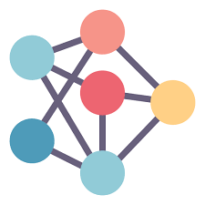
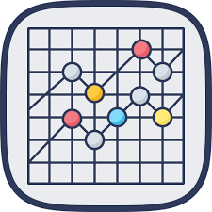


Clustering Insights: Uncovering Patterns in Unlabeled Data
KMeans
Balanced clusters with clear separations (PCA visualization).
Agglomerative
More effective for smaller clusters (t-SNE visualization).
DBSCAN
Ineffective due to the high dimensionality of the data.
Notes:
9

Slide 11
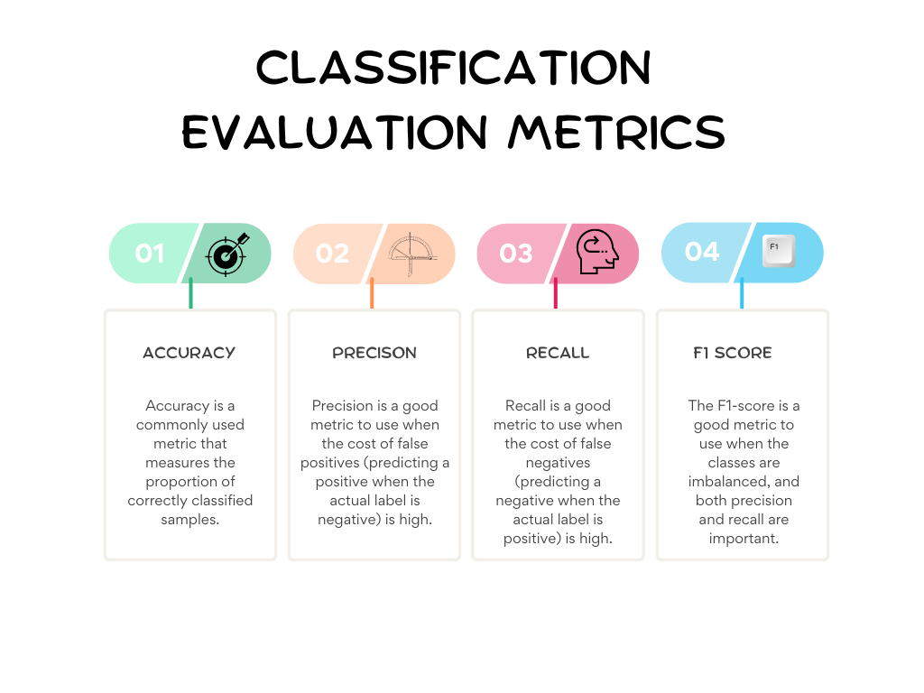
Classification Performance: Evaluating Model Accuracy
1
ResNet50 + KMeans
2
ResNet50 + Agglomerative
RF: 88%, SVM: 87%, XGBoost: 100%.
RF: 99%, SVM: 99%, XGBoost: 100%.
3
GLCM + KMeans
4
GLCM + Agglomerative
RF: 100%, SVM: 100%, XGBoost: 100%.
RF: 100%, SVM: 100%, XGBoost: 100%.
Notes:
10

Slide 12
FINAL INTEGRATION (GLCM + RESNET50) AGAINST CLUSTERS
Kmeans Target Variable
Agglomerative Target Variable
1
2
RF: 97%, SVM: 99%, XGBoost: 98%.
RF: 78%, SVM: 81%, XGBoost: 80%.

Slide 13


Conclusion & Future Work
Integration
High Accuracy
Future Directions
Successfully bridged the gap between texture analysis and deep learning.
Achieved high accuracy using clustering based pseudo-labels.
GMM and Domain specific fine-tuning of ResNet50.
Hybrid Clustering Methods.
Domain Adaptation Techniques

Slide 14
Image source used in this ppt.
https://www.google.com/url?sa=i&url=https%3A%2F%2Fmedium.com%2F%40pattukk%2Fdemystifying-exploratory-data-analysis-for-data-science-and-machine-learning-unveiling-insights-2c3c066b3e25&psig=AOvVaw0UY3oNVrpB4ZU0PJ83FnVG&ust=1733755810155000&source=images&cd=vfe&opi=89978449&ved=0CBQQjRxqFwoTCJCAo-21mIoDFQAAAAAdAAAAABAE
https://www.google.com/imgres?q=KMEANS%20cluster%20icon%20png&imgurl=https%3A%2F%2Fcdn.getmidnight.com%2F171293841d3fdd4af2e12426ce202ac9%2F2022%2F09%2Fdsfmlogo-1.png&imgrefurl=https%3A%2F%2Fdatascience.fm%2Fk-means-clustering%2F&docid=aga_cMuuWwlE0M&tbnid=_74-q29xxq9pyM&vet=12ahUKEwjh7MycmJiKAxWWRkEAHfN8EbUQM3oECHwQAA..i&w=512&h=512&hcb=2&ved=2ahUKEwjh7MycmJiKAxWWRkEAHfN8EbUQM3oECHwQAA
https://images.app.goo.gl/JwvPqiDJiQXQfqdY7
https://images.app.goo.gl/UeedVXF7dtaAFdjQ8
https://www.google.com/imgres?q=data%20preprocessing%20MACHINE%20LEARNING%20icons&imgurl=https%3A%2F%2Fcdn-icons-png.freepik.com%2F256%2F8438%2F8438966.png%3Fsemt%3Dais_hybrid&imgrefurl=https%3A%2F%2Fwww.freepik.com%2Ficons%2Fdata-processing&docid=8HjUnGw0t2D-sM&tbnid=5m7Qr--T4Zk5yM&vet=12ahUKEwiwiuKXlpiKAxXWTUEAHWxcAKoQM3oECBUQAA..i&w=256&h=256&hcb=2&ved=2ahUKEwiwiuKXlpiKAxXWTUEAHWxcAKoQM3oECBUQAA
https://www.google.com/imgres?q=DBSCAN%20cluster%20icon%20png&imgurl=https%3A%2F%2Ficons.labex.io%2Fdbscan-clustering-algorithm.png&imgrefurl=https%3A%2F%2Flabex.io%2Ftutorials%2Fml-dbscan-clustering-algorithm-49102&docid=2kWENuSBGNSjJM&tbnid=l9m5938EBfJV2M&vet=12ahUKEwj0oJnrmJiKAxX0UkEAHWi2M5MQM3oECBoQAA..i&w=512&h=512&hcb=2&ved=2ahUKEwj0oJnrmJiKAxX0UkEAHWi2M5MQM3oECBoQAA
https://www.google.com/imgres?q=FEATURE%20EXTRACTION%20MACHINE%20LEARNING%20icons&imgurl=https%3A%2F%2Fmiro.medium.com%2Fv2%2Fresize%3Afit%3A1200%2F1*hhQJtmL25JdYA0FkweKFRg.png&imgrefurl=https%3A%2F%2Fmatteogambera.medium.com%2Fhow-to-extract-features-from-signals-15e7db225c15&docid=390V-6cAgbHtlM&tbnid=63QP_jUxVauFEM&vet=12ahUKEwiYsdrGlpiKAxUZVUEAHbHuADAQM3oECCMQAA..i&w=1200&h=675&hcb=2&ved=2ahUKEwiYsdrGlpiKAxUZVUEAHbHuADAQM3oECCMQAA
https://www.google.com/url?sa=i&url=https%3A%2F%2Fmedium.datadriveninvestor.com%2Funderstanding-evaluation-metrics-for-machine-learning-models-with-chatgpt-f930ce8b8e4b&psig=AOvVaw1Lk-SUjEbxKue1q68yJUuS&ust=1733748389646000&source=images&cd=vfe&opi=89978449&ved=0CBQQjRxqFwoTCKjsyrWamIoDFQAAAAAdAAAAABAE
https://www.google.com/imgres?q=cluster%20icon%20png&imgurl=https%3A%2F%2Fstatic.thenounproject.com%2Fpng%2F1455009-200.png&imgrefurl=https%3A%2F%2Fthenounproject.com%2Fbrowse%2Ficons%2Fterm%2Fcluster%2F&docid=OXUFT5okaTXOKM&tbnid=ko0dyR2Vv90sDM&vet=12ahUKEwiIhuuMl5iKAxUcWkEAHYm6AMUQM3oECEsQAA..i&w=200&h=200&hcb=2&ved=2ahUKEwiIhuuMl5iKAxUcWkEAHYm6AMUQM3oECEsQAA
https://www.google.com/imgres?q=thank%20you&imgurl=https%3A%2F%2Fmedia.gettyimages.com%2Fid%2F1213707743%2Fvideo%2Fmodern-thank-you-line-icon-animation-on-white-background.jpg%3Fs%3D640x640%26k%3D20%26c%3DsJbSVpsvJ4UsxqvdFUjbjOdS6F6jFfEhm4K4zwDLhNg%3D&imgrefurl=https%3A%2F%2Fwww.gettyimages.ie%2Fvideos%2Fthank-you&docid=BvvJCTUfbvSVGM&tbnid=VTeCAr3nIDJL4M&vet=12ahUKEwihhK3onZiKAxVcUEEAHQVXAW4QM3oECFYQAA..i&w=768&h=432&hcb=2&ved=2ahUKEwihhK3onZiKAxVcUEEAHQVXAW4QM3oECFYQAA
https://www.google.com/url?sa=i&url=https%3A%2F%2Flabex.io%2Ftutorials%2Fml-agglomerative-clustering-metrics-49061&psig=AOvVaw3fLZ_hR7ziQ12Gl6OUx_Bi&ust=1733747874388000&source=images&cd=vfe&opi=89978449&ved=0CBQQjRxqFwoTCPiH_vyYmIoDFQAAAAAdAAAAABAE

Slide 15


