Slide 1



NREGA
National Rural Employment Guarantee Act
Data analyst: Akinkunmi Oyeyemi
June, 2024

Slide 2


Table Of Contents
01
02
03
04
01. ABOUT NREGA
02. ABSTRACT
03. PROBLEM STATEMENT
04. DATASET INFO.
INSIGHTS
RECOMMENDATIONS
CONCLUSION

Slide 3
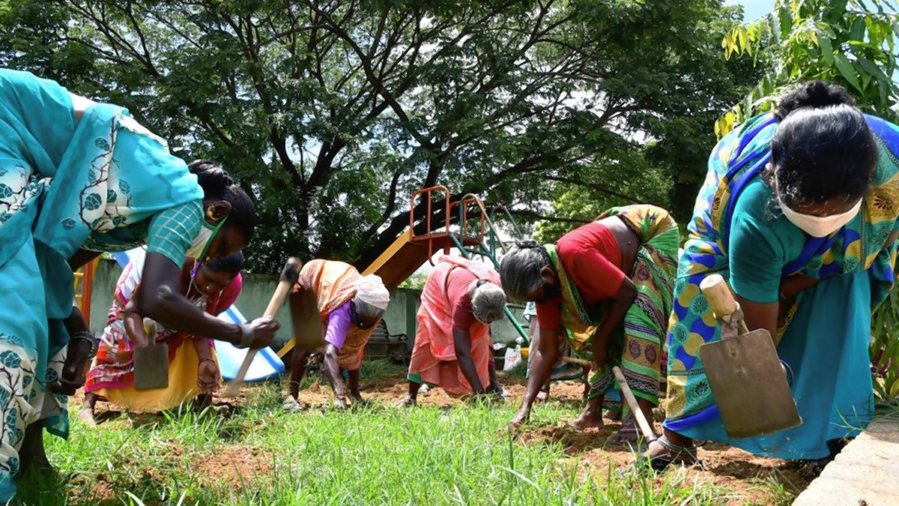
About NREGA
The National Rural Employment Guarantee Act (NREGA) is an important Indian government scheme that was launched in 2005. In 2009, it was renamed as Mahatma Gandhi National Rural Employment Guarantee Act (MGNREGA). It guarantees 100 days of wage employment annually to rural households.

Slide 4
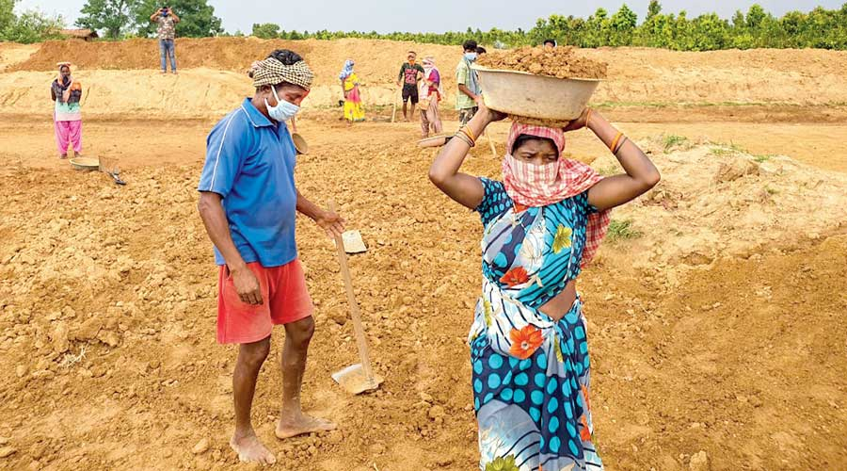

Abstract
This project delves into the analysis of data related to the National Rural Employment Guarantee Act
(NREGA), a transformative government scheme aimed at providing rural households with guaranteed
wage employment opportunities. The dataset used for this analysis encompasses a wide range of
parameters, including the number of job cards issued, the workforce engaged, budget allocation, work
completion statistics, and much more. Through the application of data analytics techniques, we aim to
gain valuable insights into the implementation and impact of NREGA across different states and districts
in India.

Slide 5
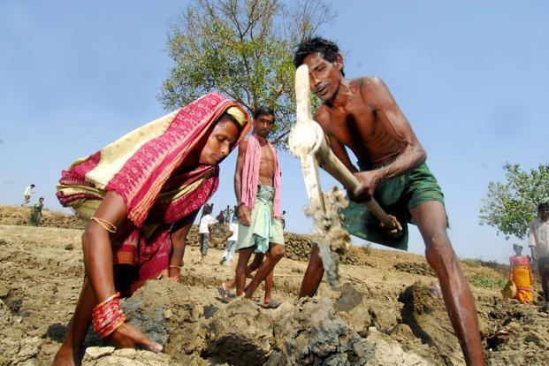
Problem Statement
NREGA is a vital initiative to alleviate rural unemployment and poverty. This project seeks to address several key questions and challenges associated with NREGA:
● How effective is NREGA in providing employment opportunities to rural households?
● Are there regional disparities in the implementation and outcomes of the scheme?
● What is the utilization of the allocated budget, and how does it correlate with
employment generation?
● What are the key factors contributing to the completion of NREGA works, and are there
any roadblocks to its success?
● Can data-driven insights guide policymakers and administrators in optimizing the
scheme's impact?

Slide 6

Dataset Information
The dataset used for this analysis is sourced from official government records and contains information related to NREGA implementation across various states and districts in India. It comprises 28 columns, encompassing data on job cards, worker details, budget allocation, work completion statistics, expenditure, and more. This dataset offers a comprehensive view of the progress and challenges faced by the NREGA program

Slide 7
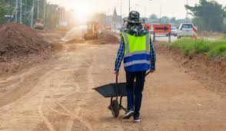
Part 02
INSIGHTS

Slide 8
INSIGHTS
NREGA WITH REGARDS TO STATE, DISTRICT, APPROVED BUDGET AND EXPENDITURE
34
2bn
No. of States
involved
Total Approved
Budget
736
73.44%
Number of districts
Total Expenditure
on Wage (%)
2.07%
24.49%
Total Admin.
Expenditure (%)
Total Expenditure
on Material

Slide 9
INSIGHTS
NREGA PERFORMANCE WITH REGARDS TO EMPLOYMENT
175M
58.19%
Total Active Workers
Total Rural Household
Employed (%)
63M
20.02%
Total Individuals Worked
Total Social Caste
Workers (%)
428k
16.47%
Total HHs completed
100 days of wage
Total Social Tribe Workers (%)

Slide 10

INSIGHTS
NREGA WITH REGARDS TO WORKS AND % EXPENDITURE ON EACH SECTOR
17M
38.59%
Total Works taken up
Expenditure on
Agriculture
77.87%
53.20%
Ongoing Works (%)
Expenditure on
Category B Works
22.13%
26.41%
Expenditure on
NRM Works
Completed Works (%)

Slide 11
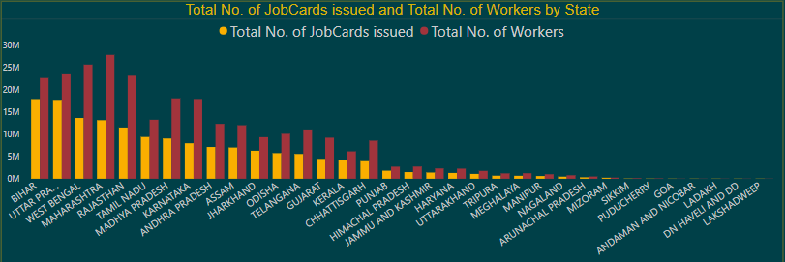
INSIGHTS
NREGA EFFECTIVENESS IN PROVIDING JOB OPPORTUNITY TO RURAL HOUSEHOLD
58.19%
Total Rural Household
Employed (%)

Slide 12
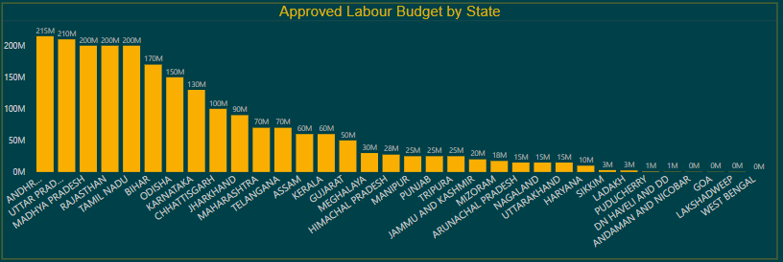
INSIGHTS
APPROVED LABOUR BUDGET BY STATES
This chart shows approved labour budget by state. There is disparity in the allocation of resources. On 9 states (26.5%) got allocation above 100M while the other states have budget allocation to be less than 100M. This in turn affected the work completion rate and the labour employement capability of these states.

Slide 13
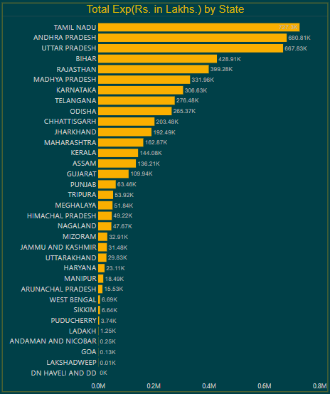
INSIGHTS
UTILIZATION OF ALLOCATED BUDGET
This chart shows total expenses of each state. The expenses are corelative to the respective approved labour budget of each state.

Slide 14
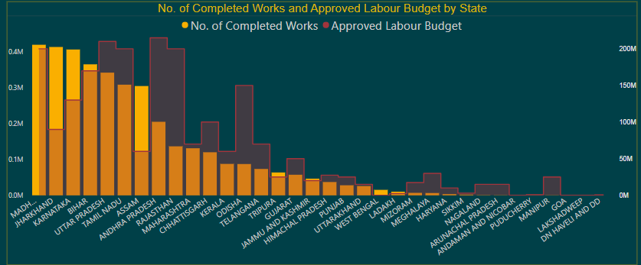
INSIGHTS
KEY FACTORS CONTRIBUTING TO THE COMPLETION OF WORKS.
From this chart, it is seen that states with high amount of approved labour budget have higher number of completed works.

Slide 15
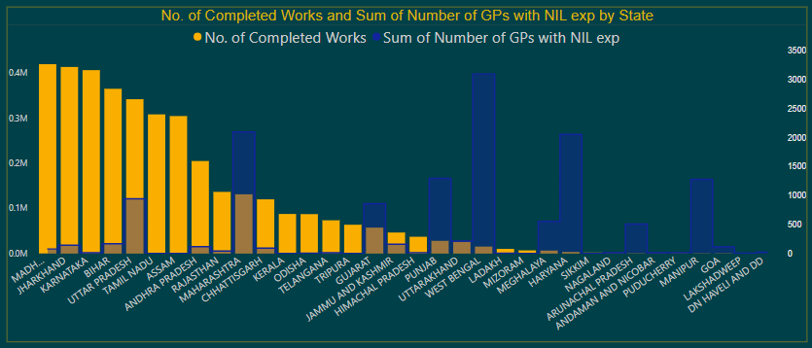
INSIGHTS
KEY FACTORS STAND AS ROADBLOCKS TO THE COMPLETION OF WORKS.
According to this chart, it is seen that states with high Gram Panchayats with Nil expenditure have less works completed. Administrative expenses are therefore correlative to the number of works completed.

Slide 16
Part 03
RECOMMENDATIONS

Slide 17
RECOMMENDATIONS
APPROVE LABOUR BUDGET
Each state should be given budget allocation for labour according to the following metrics:
1. The number of districts
2. The number of works taken up
3. The number of employees in the state.

Slide 18
RECOMMENDATIONS
RURAL HOUSEHOLD EMPLOYED
Since the scheme is all about rural household employment, it is important to employ more rural households. The overall rural households should go beyond 58% on the average.

Slide 19
RECOMMENDATIONS
WAGE PER DAY FOR EMPLOYEES
The total expenditure should cater more for wages and less for materials as local materials can be sourced.

Slide 20
THANK YOU
Presented by: Akinkunmi Oyeyemi
June, 2024

