Slide 1

EVALUATION OF USABILITY OF WORNONTV.NET
Akın Kemal DOĞANGÜN
202028009

Slide 2
EDMS Heurıstıc Walkthrough
1 USER ROLES
5 Hours
10 EDMS PAGES

Slide 3
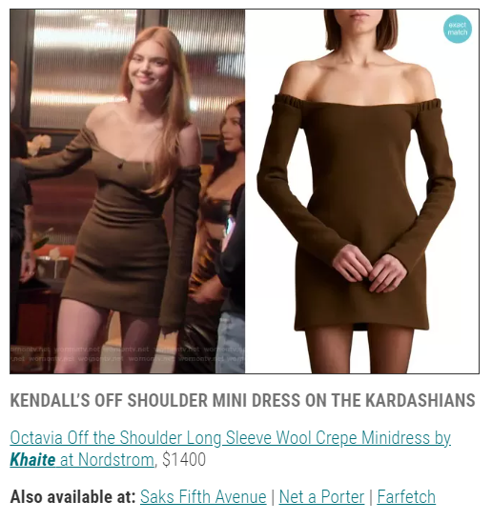


WORNONTV.NET
It shows pictures of popular clothes on the home page of the website. However, the texts just below the clothing pictures do not give confidence to the user. Clicking on the blue line on the text gives the impression that you may encounter any problems.
The solution can change the font further. Links can be displayed in a separate button, not in the text.

Slide 4
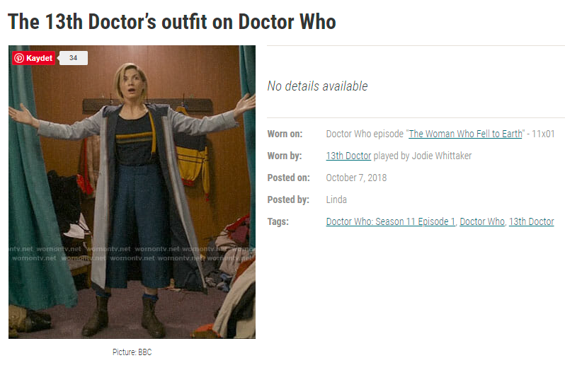

WORNONTV.NET
The website does not allow us to zoom in on the clothes that the users are wearing by the players. For this reason, users cannot make a comprehensive review. It restricts the freedom of the user.
The solution could be a zoom button in the lower right corner of the clothing images. So, users can enlarge images of clothes.

Slide 5
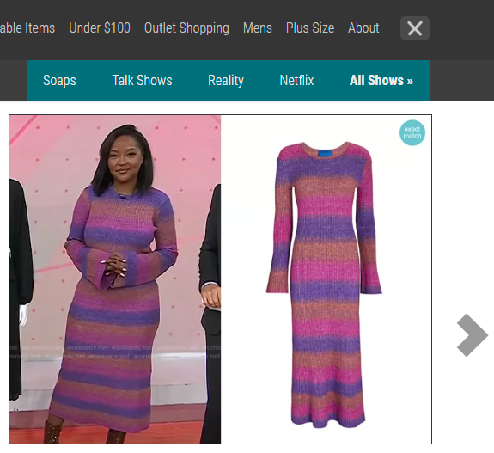
WORNONTV.NET
While one of the buttons with the same feature opens a new page, the other buttons do not.
The solution is to change the color of the buttons.

Slide 6
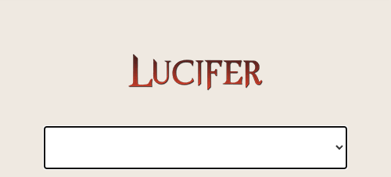
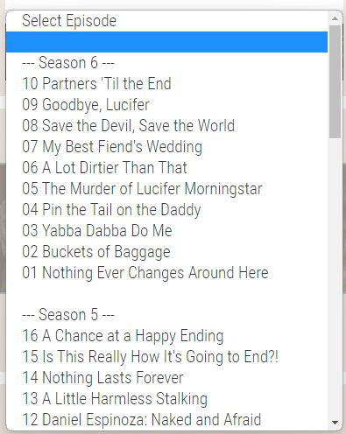
WORNONTV.NET
There is a blank line in the 'Select Episode' section and the user is not prevented from clicking that line.
The solution is to detect and fix the error in the code.

Slide 7
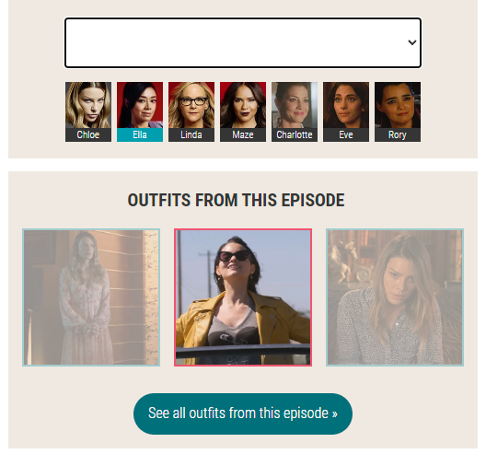
WORNONTV.NET
The color to choose anything on their website is blue. In some cases, the selection color appears as red. In this case, it creates an inconsistency on the website.
The solution is to set a single selection color and use it site-wide.

Slide 8
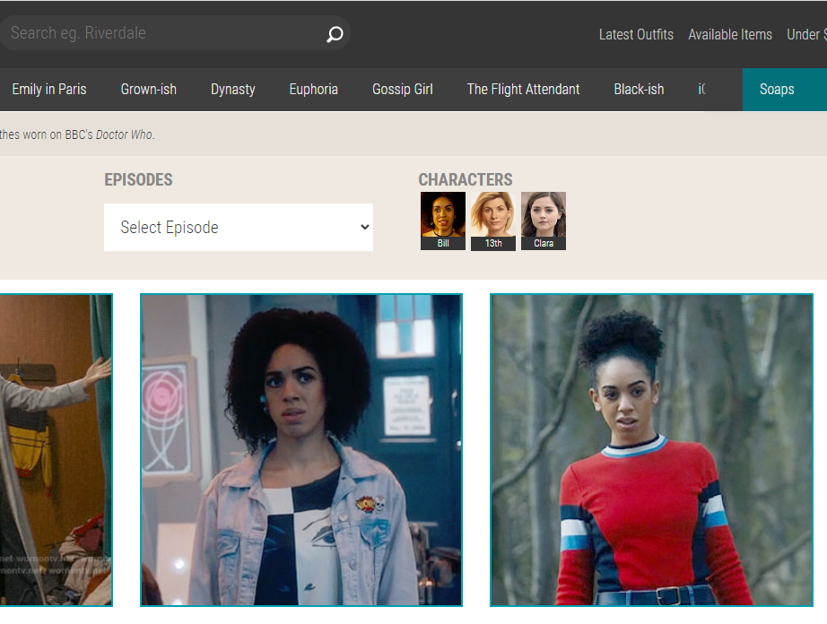

WORNONTV.NET
It can find the clothes that the user wants to find in the best condition with at least 4 clicks.
The solution is that the search section gives better results.

Slide 9
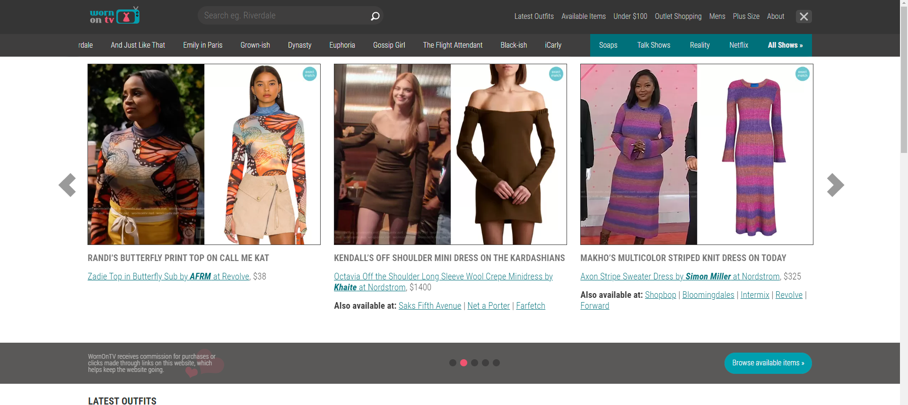
WORNONTV.NET
The homepage is too complex for users. When the user clicks on any product, the website can send the user to other websites. It may take some time for the user to get used to the interface. The color harmony of the website is determined to keep the user on the site for a long time.
Solution, A simpler design can be made. The color palette can be changed.

Slide 10
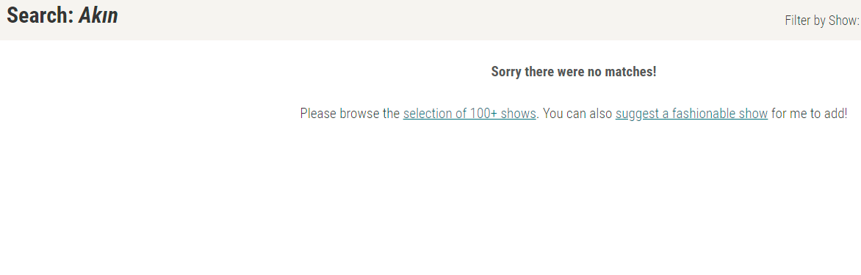
WORNONTV.NET
It does not properly inform the user when it cannot find content that is not registered in the system. It doesn't make suggestions instead of content that can't be found.
The solution is to improve the artificial intelligence of the website.

Slide 11


WORNONTV.NET
The website does not recommend the products that the user has viewed before to the user. This causes the user to search more.
The solution is to store the user's website usage history and products viewed.

Slide 12
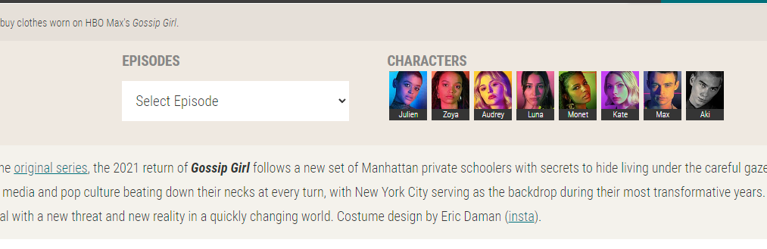

WORNONTV.NET
On the page of the website where the program details are displayed, the buttons showing both the pictures and the names of the players are very small.
On the page where the player's outfit is listed, the 'pinterest' button is small.
The solution is that the size of the buttons can be increased.

Slide 13
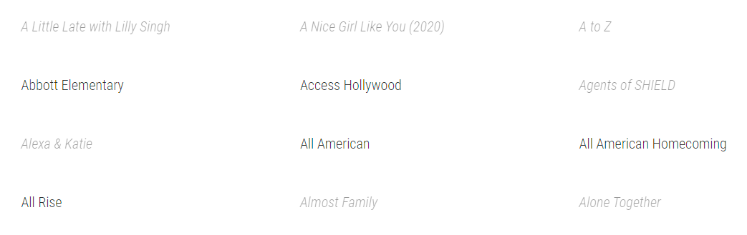
WORNONTV.NET
On the page where all the programs are listed, the text color of some programs is different. Some texts are dimmer.
The solution is to fix the fonts and colors of the pages.

Slide 14
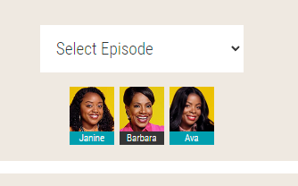
WORNONTV.NET
The actor that is currently selected on the screen and the actor we can choose are expressed with the same color. This can cause confusion.
Solution, another color should be used for selection.

Slide 15
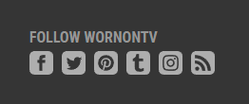
WORNONTV.NET
One of the buttons at the bottom of the site has been selected as an incorrect design. The button, which is understood as internet sharing, leads to the open source code of the site.
The solution is to replace the button.

Slide 16
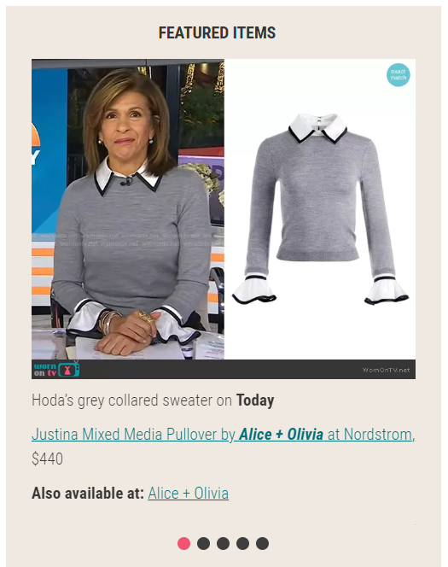


WORNONTV.NET
In the 'FEATURED ITEMS' section, we can only switch with the buttons below. These buttons are not suitable for switching. It may confuse the user.
The solution can be done to the left and right of the button images to switch between images.

Slide 17

WORNONTV.NET
Other digital platforms that are currently actively producing content are not integrated into the website.
The solution should be signed agreements with other digital platforms.

Slide 18
THANK YOU!
Akın Kemal DOĞANGÜN
doftdare company

