Slide 1
Customer & Sales Rep Analysis
Agro Bar Magen Nigeria LTD Akinbami Oluwashola

Slide 2
Executive summary — Key numbers
Metric | Value
Total customers on record | 2,273
Active sales representatives | 31
Geographic locations covered | 20+

Slide 3
Top 3 reps by customer count:
Customer Office — 341 customers (administrative allocation)
Ian — 232 customers across 31 locations (widest geographic spread)
Peter — 209 customers across 22 locations (heavily concentrated)

Slide 4
Key findings
Geographic concentration: Over 31% of all customers are in Ibadan/Oyo alone.
Ian has the widest territorial spread but moderate concentration — his top 3 locations hold ~54% of his portfolio.
Peter is heavily concentrated — Ibadan/Oyo alone holds 55% of his customers.
Ian and Peter share 7 locations, but actual competitive overlap is minimal — in each shared location, one rep dominates.
Data quality: 9.5% of customer records lack a street address; 4.9% are missing phone numbers.

Slide 5
Data source & scope
Source: Company customer database export (Excel)
Scope: All customers mapped to their assigned sales representatives.
Raw data: 2,604 rows x 11 columns (all character type)
After cleaning: 2,273 rows x 7 columns
Cleaning steps applied:
Removed header/metadata rows (company name, timestamp, report title)
Dropped near-empty columns (Address Line 2, State, Fax Number — ~100% missing)
Standardised sales rep names to consistent casing
Grouped cities/counties into cleaner location labels
Converted Customer Number and Sales Rep Number to numeric

Slide 6
Data quality summary
Column | Missing count | Missing %
Street Address | 247 | 9.5%
Phone Number | 127 | 4.9%
City/County | 126 | 4.8%
Sales Rep Number | 11 | 0.4%
Customer Number | 6 | 0.2%
Customer Name | 0 | 0.0%

Slide 7
Recommendation: Prioritise filling in missing street addresses and phone numbers to improve customer reachability and delivery accuracy.

Slide 8
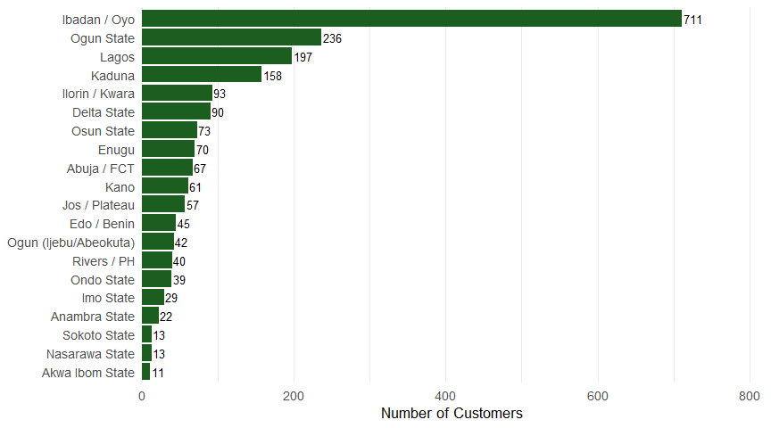
Top 20 customer locations
Figure 1: Customer count by location (Top 20)

Slide 9
Location analysis — Key takeaways
Ibadan/Oyo dominates with 711 customers (31% of all customers) — both an opportunity and a concentration risk.
Top 5 locations (Ibadan/Oyo, Ogun, Lagos, Kaduna, Ilorin/Kwara) account for roughly 62% of all customers.
Southern Nigeria is heavily represented; northern presence is limited mainly to Kaduna and Kano.
Implications for leadership:
Revenue is geographically concentrated — disruptions in Ibadan/Oyo would disproportionately affect the business.
There may be untapped growth opportunities in under-represented regions (e.g., Abuja/FCT, northern states).

Slide 10
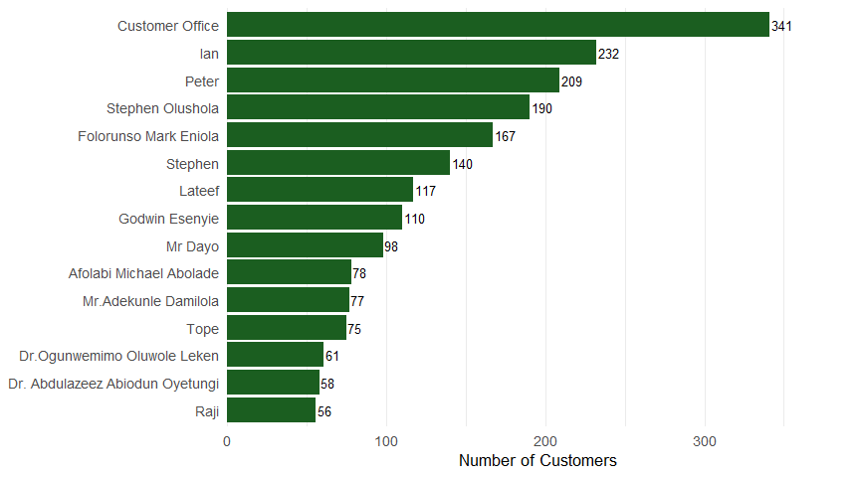
Sales reps ranked by customer count (Top 15)
Figure 2: Top 15 sales reps by customer count

Slide 11
Sales rep performance — Key takeaways
Customer Office (341 customers) is an administrative allocation, not a single sales rep.
Ian (232) and Peter (209) are the top two individual performers by customer count.
There is a steep drop-off after the top 5 reps: the top 5 account for a disproportionate share of the customer base.
11 reps have fewer than 30 customers each — these may be newer hires, part-time, or underperforming.
Recommendations:
Investigate why Customer Office holds so many accounts — consider redistributing to named reps.
Review workload balance: top reps may be stretched too thin while others are underutilised.

Slide 12
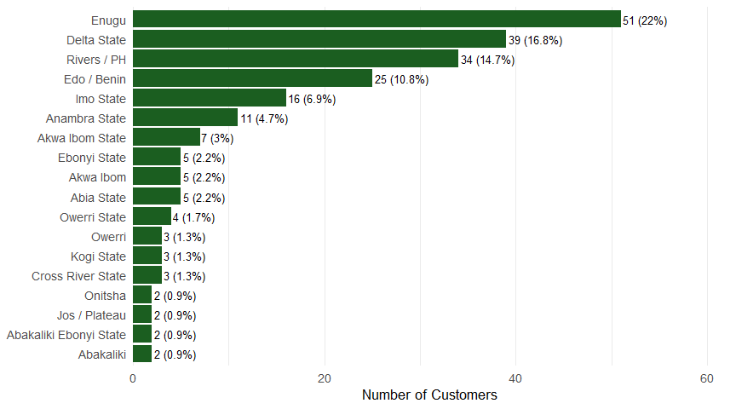
Ian’s customer distribution by location
Figure 3: Ian’s 232 customers across 31 locations (Top 15 shown)

Slide 13
Ian — Analysis & risk assessment
Strengths:
Widest geographic coverage of any rep — 31 locations
No single location exceeds 22% of his portfolio
Strong presence across the South-East and South-South (Enugu, Delta, Rivers, Edo)
Risks:
His top 3 locations (Enugu, Delta, Rivers/PH) hold ~54% of his customers — moderate concentration
Managing 31 locations may strain his ability to service all customers effectively
If Ian were to leave, the company would lose coverage in numerous locations simultaneously
Recommendations:
Develop a succession plan for Ian’s territory
Consider assigning a junior rep to shadow Ian in his top locations
Monitor customer satisfaction in Ian’s lower-volume locations

Slide 14
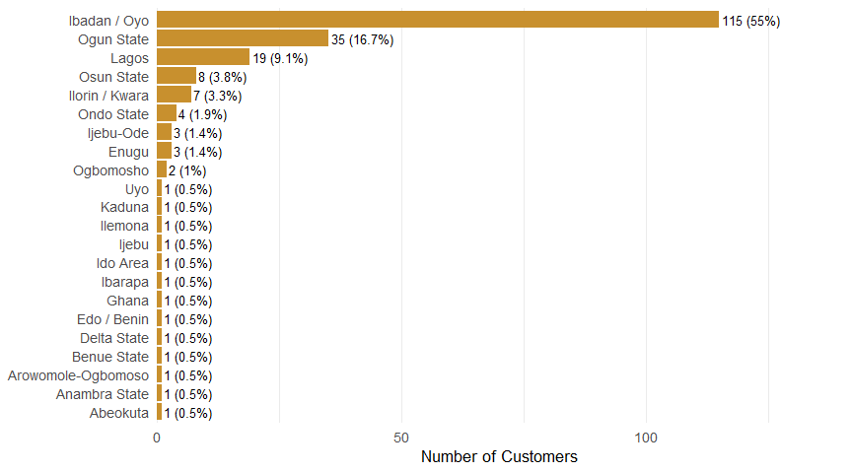
Peter’s customer distribution by location
Figure 4: Peter’s 209 customers across 22 locations (Top 15 shown)

Slide 15
Peter — Analysis & risk assessment
Strengths:
Second-highest individual customer count (209)
Dominant presence in the company’s largest market — Ibadan/Oyo
Critical risk — Geographic concentration:
55% of Peter’s customers are in Ibadan/Oyo alone
His top 2 locations (Ibadan/Oyo + Ogun) account for 72% of his portfolio
If Peter loses access to Ibadan/Oyo (e.g., he relocates, becomes ill, or resigns), 115 customers are immediately at risk
Recommendations:
Urgent: Assign a backup rep for Ibadan/Oyo to reduce single-person dependency
Gradually redistribute some Ibadan/Oyo accounts to reduce Peter’s concentration
Encourage Peter to develop his presence in less-saturated markets

Slide 16
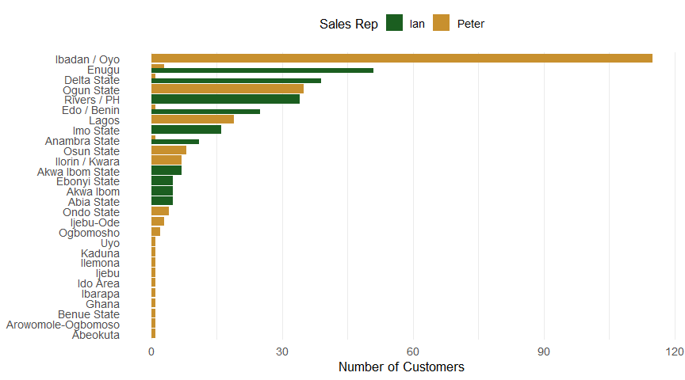
Ian vs Peter — Side-by-side top 10 locations
Figure 5: Top 10 locations for Ian and Peter (side by side)

Slide 17
Ian vs Peter — Comparison summary
Metric | Ian | Peter
Total customers | 232 | 209
Locations covered | 31 | 22
Top location share | 22% (Enugu) | 55% (Ibadan/Oyo)
Top 3 locations share | ~54% | ~81%

Slide 18
Key contrast: Ian is a spread rep — wide coverage, moderate concentration. Peter is a depth rep — deep penetration in fewer markets. Both strategies have merit, but Peter’s concentration poses higher business continuity risk.

Slide 19
Overlap analysis
Ian and Peter share 7 locations out of 46 unique locations combined.
55.6% of Ian’s customers and 20.6% of Peter’s customers fall in shared locations.
However, actual competitive overlap is minimal — in each shared location, one rep dominates while the other has only 1–3 customers.

Slide 20
Concentration risk summary
Risk factor | Severity | Affected customers
Peter’s Ibadan/Oyo concentration | HIGH | 115
Company-wide Ibadan/Oyo dependence | HIGH | 711
Ian’s broad but thin coverage | MEDIUM | 232
Customer Office unassigned accounts | MEDIUM | 341
Data quality gaps (addresses, phones) | MEDIUM | 247+ records
Bottom 11 reps with <30 customers | LOW | <330 combined

Slide 21
Recommendations — Immediate (0–3 months)
Assign a backup rep for Peter’s Ibadan/Oyo territory to mitigate single-person dependency.
Audit the 341 Customer Office accounts — redistribute to named sales reps.
Launch a data cleanup initiative to fill missing addresses and phone numbers.

Slide 22
Recommendations — Medium-term (3–6 months)
Develop a succession plan for Ian — his 31-location coverage is a key-person risk.
Rebalance workloads — top reps are overloaded while others are underutilised.
Evaluate underperforming reps (fewer than 30 customers) for coaching or reassignment.

Slide 23
Recommendations — Strategic (6–12 months)
Explore geographic expansion into under-served northern regions.
Implement a CRM system for better territory management and reporting.

Slide 24
Dashboard Overview — Key Metrics
Total Customers: 1,932
Total Sales Reps: 30
Locations Served: 127
Top Rep: Ian (232 customers)
The top 5 reps handle 48.6% of all customers.

Slide 25
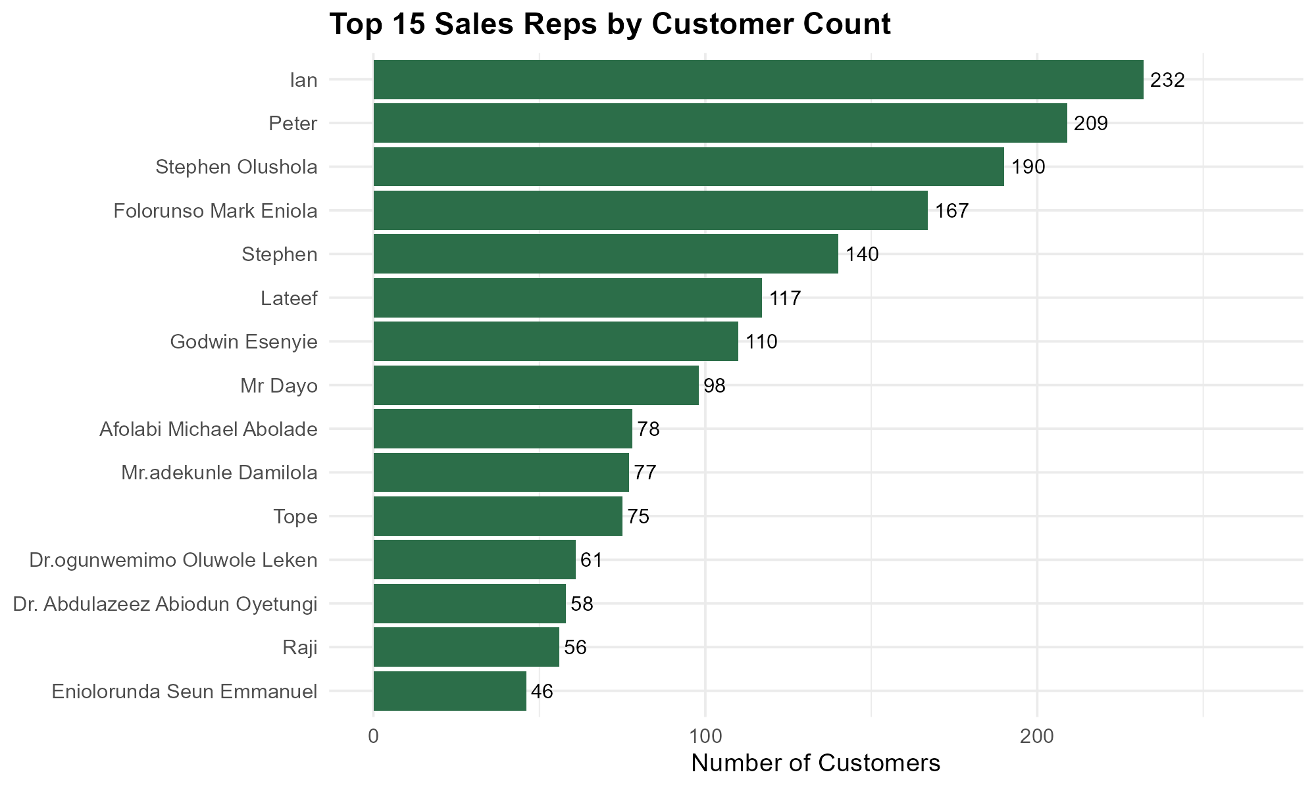
Top 15 Sales Reps by Customer Count

Slide 26
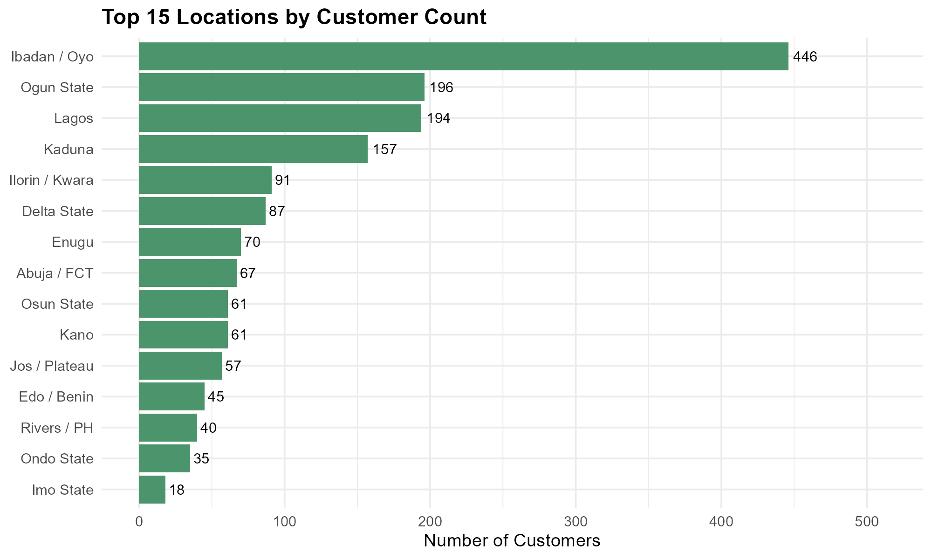
Top 15 Locations by Customer Count

Slide 27
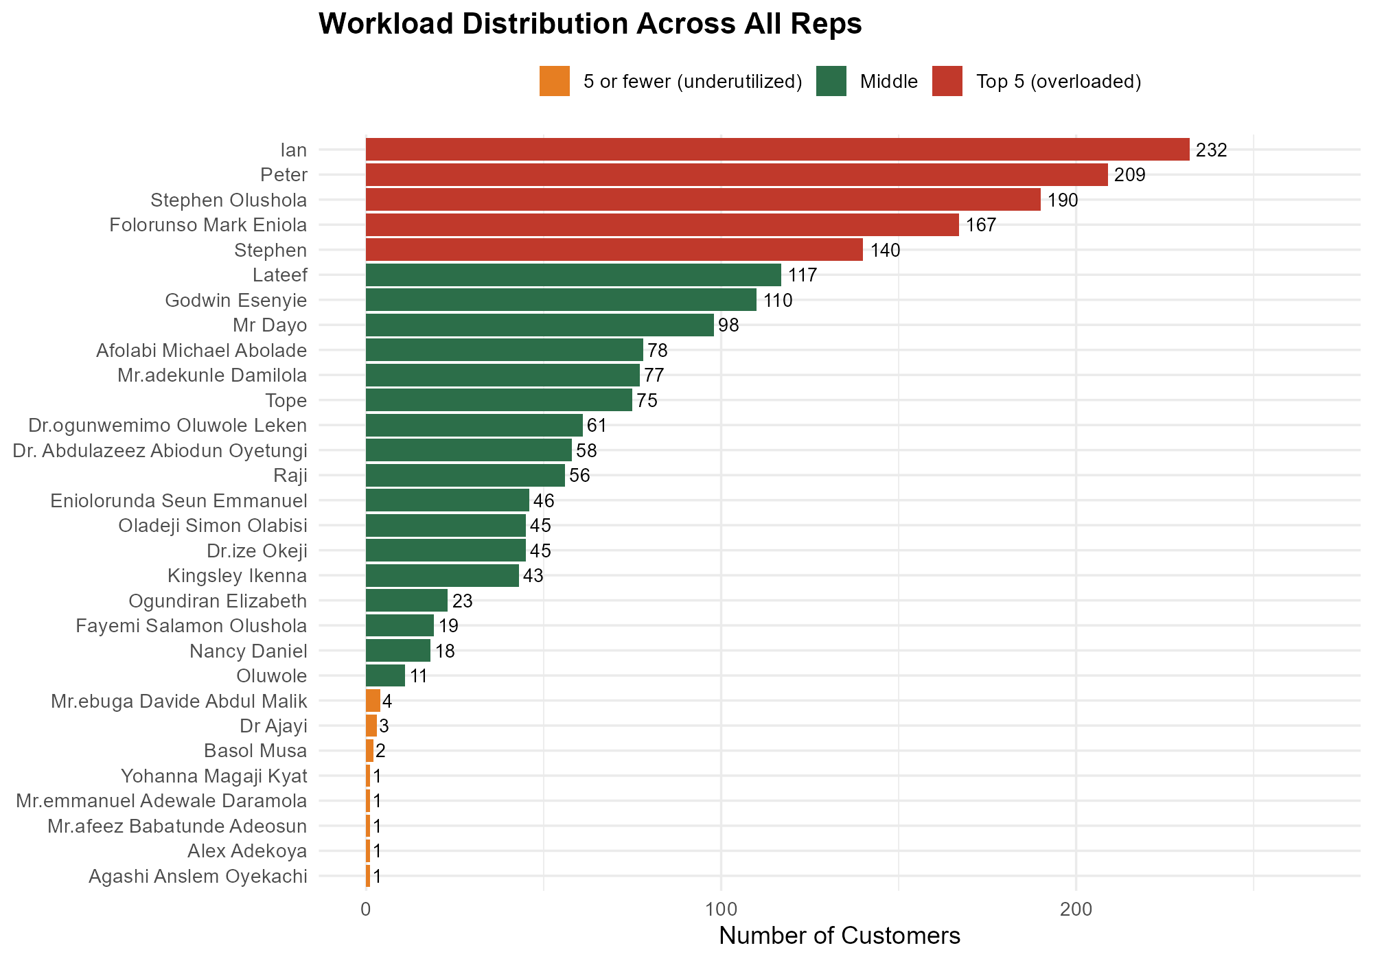
Workload Distribution — All Reps

Slide 28
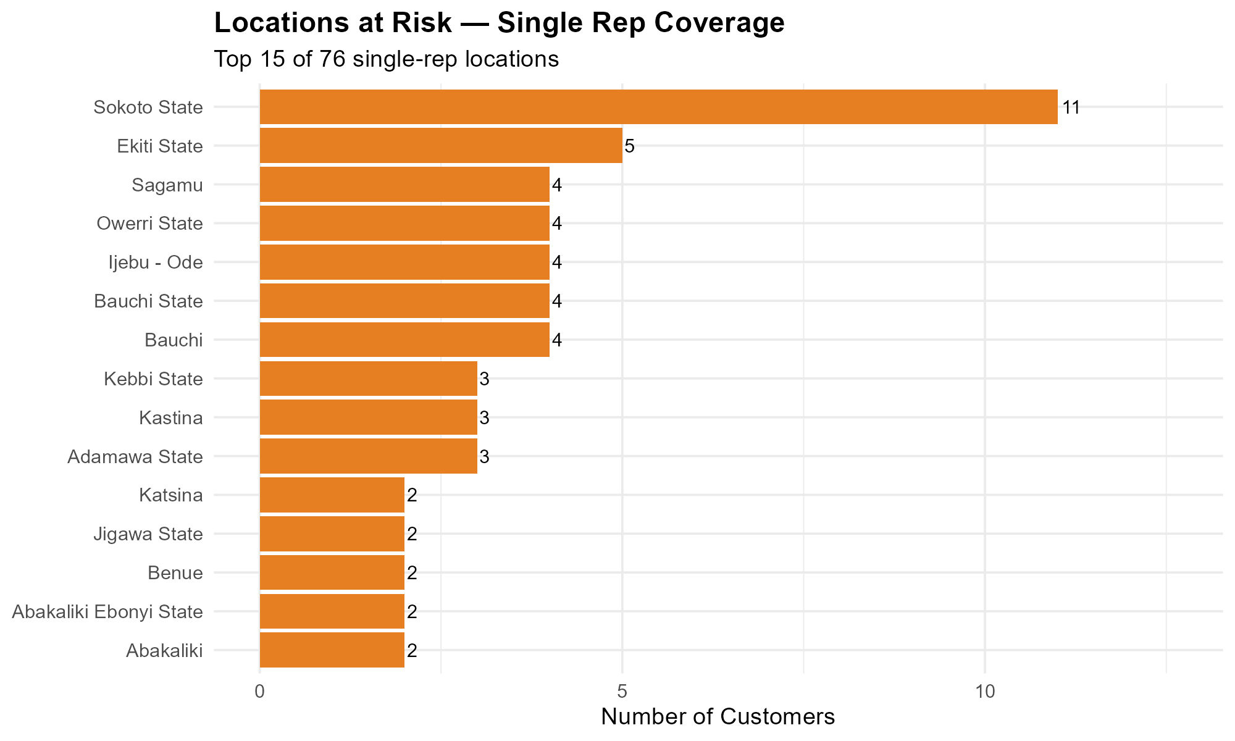
Locations at Risk — Single Rep Coverage

Slide 29
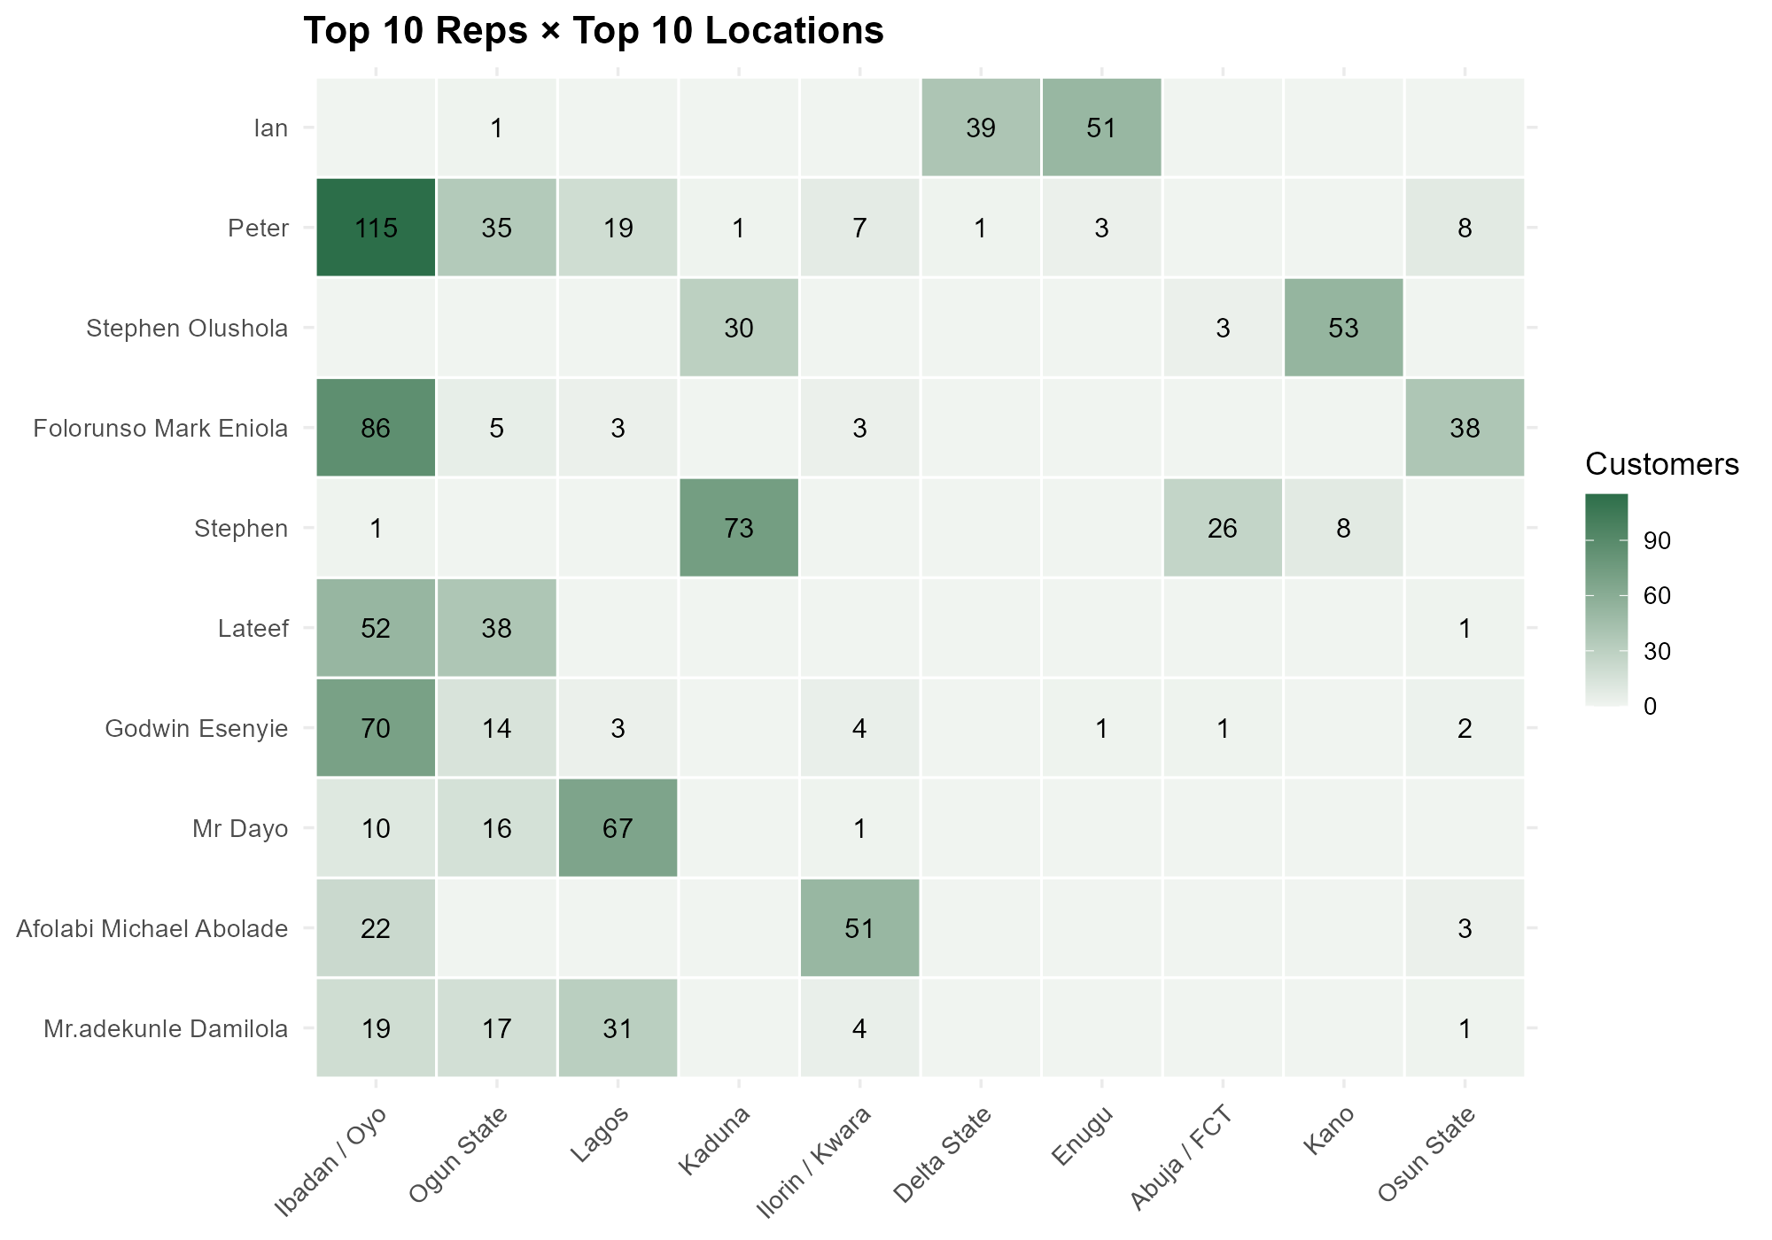
Rep × Location Heatmap (Top 10 × 10)

Slide 30
CEO Recommendations
CEO Recommendations

Slide 31
CEO Recommendations
1. Rebalance territories — Redistribute customers from overloaded reps to underutilized ones. Target max ~120 per rep.
2. Formalize territory mapping — Assign each location a primary and backup rep to eliminate overlap and ensure continuity.
3. Audit low-activity reps — 8 reps have 5 or fewer customers. Review for reassignment or retraining.
4. Diversify geographic reach — Develop growth plans beyond the Ibadan-Ogun-Lagos corridor to reduce concentration risk.
5. Add performance data — Integrate revenue and visit-frequency data to move from headcount to value-based territory management.

Slide 33
Thank you
Interactive Dashboard Highlights
Customer & Sales Rep Analysis
Prepared by: Akinbami Oluwashola
For: Agro Bar Magen Nigeria LTD
June 2026
Questions or feedback? Please reach out to the analyst.

