Slide 1



BUSINESS PERFORMANCE ANALYSIS
CORE DATA ENGINEERS
INSIGHTS ON PARCH AND POSEY DATABASE
BY:
(GROUP 6)
Members :- Akinbuwa Oluwadare
Ayesha Younus
Okwu Ogechukwu Sylvia
September 2024

Slide 2

OUTLINE
Introduction
Methodology
Analysis and Interpretation of Results
Conclusion
Recommendation
Limitations

Slide 3

INTRODUCTION
The primary challenge for some business is to gain a comprehensive understanding of sales performance. This helps the business make decisions and grow. The objectives of this analysis includes:
to analyze business performance to highlight top companies, sales channels, and sales reps contributing the most revenue.

Slide 4

METHODOLOGY
Data Collection:
This analysis relies on provided dataset of the Parch and Posey database. The dataset includes sales records from 4th December 2013 to 2nd January 2017.

Slide 5

ANALYSIS AND INTERPRETATIONS OF RESULTS

Slide 6
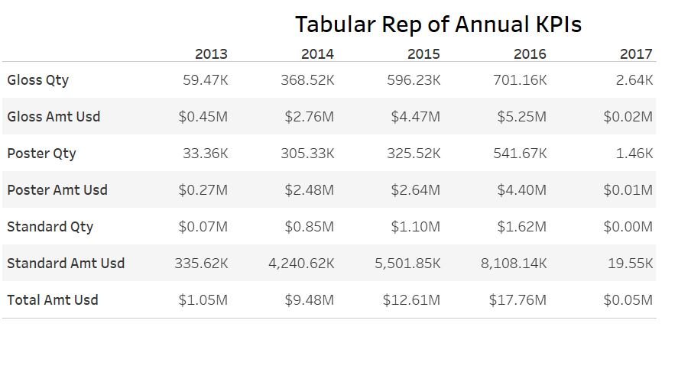
KEY PERFORMANCE INDICATORS
Figure 1 presents the annual KPI of the company
From the figure, There has been continuous growth in the sales amount and quantity over the years.
It should be noted that the year 2013 and 2017 have incomplete data
Standard paper type generates more sales quantity and revenue more than the other paper types
Figure 1: Key Performance Indicators (KPI)

Slide 7
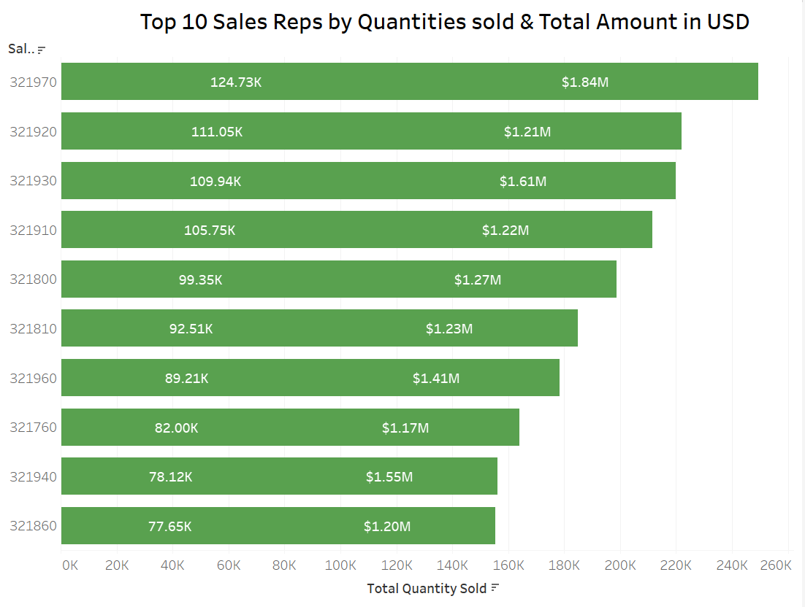
SALESPERSON PERFORMANCE
The bar charts in figure 3 shows the distribution of salesperson performance. The top sales rep, ID 321970, is far ahead of the others, selling 124.73K units and generating $1.84M.
It can also be noticed that while the sales rep 321940 has one of the least sales quantity, the sales rep has generated the second highest sales amount
Figure 3: SalesPerson Performance

Slide 8
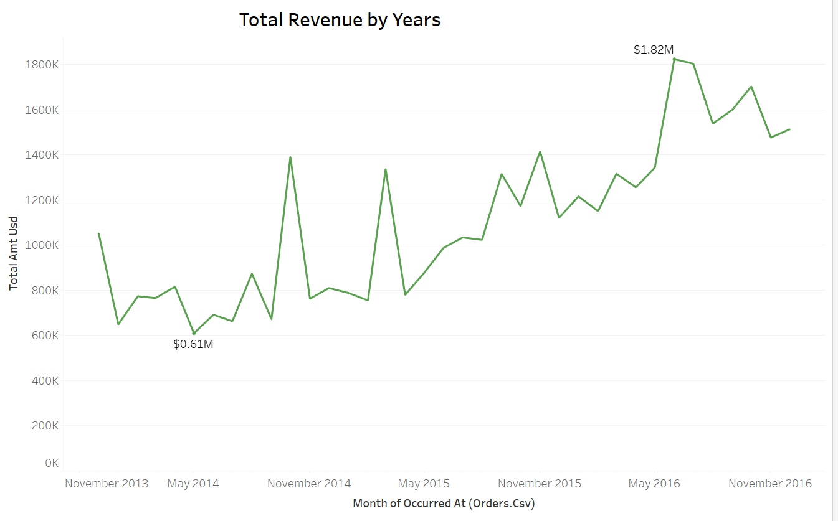
MONTHLY SALES TRENDS
The line chart shows the monthly trend of revenue, highlighting fluctuations over time.
The data shows that there has been a steady growth in the company’s revenue over the years despite the fluctuations.
The company recorded it’s lowest revenue in May 2014 while the peak occurred at July 2016.
Figure 4: Monthly Sales Trend

Slide 9
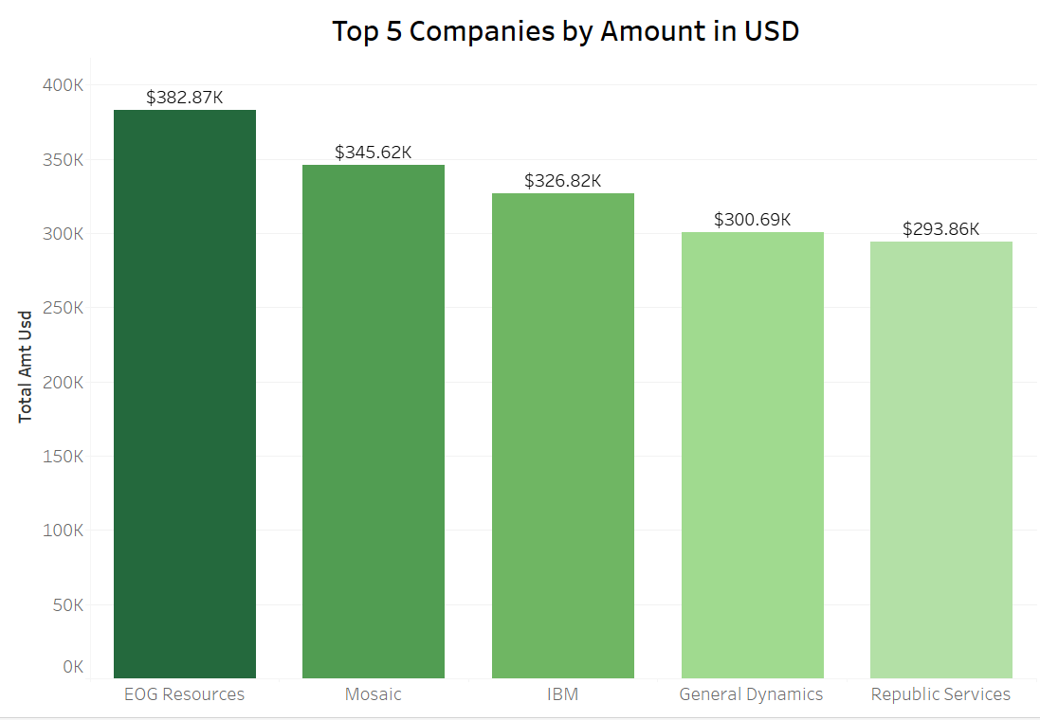
SALES PERFORMANCE BY COMPANIES
Figure 3 shows the bar chart of the top 5 companies by total sales amount. EOG Resources leads the group of top performing companies by revenue with about $382 thousand in sales
Figure 6: Sales Performance by Companies

Slide 10
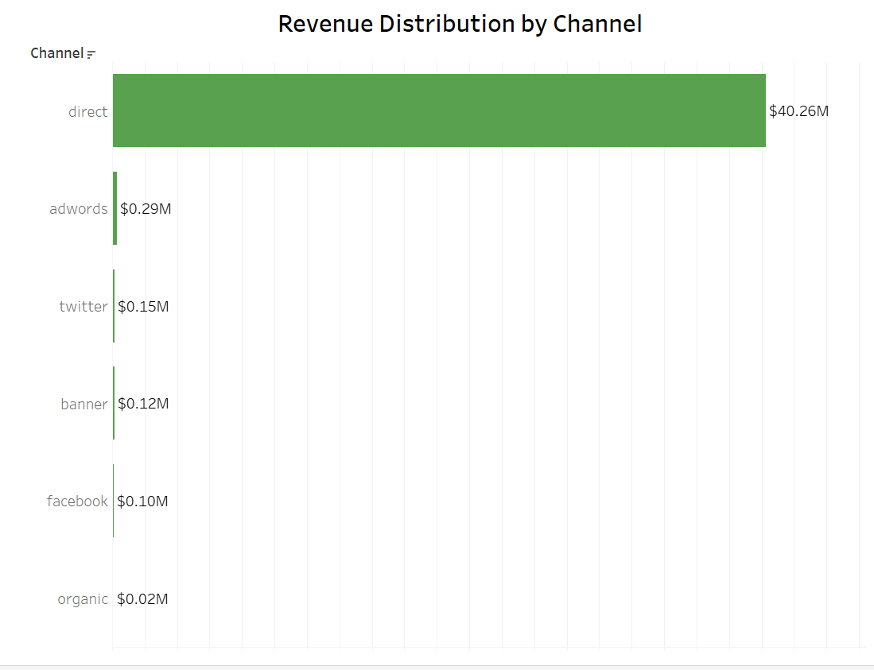
REVENUE DISTRIBUTION BY CHANNEL
Direct sales generated $40.26M, which is by far the largest channel while Digital channels like adwords and social media (Twitter, Facebook) contribute much smaller amounts to overall revenue
Figure 7: Sales by Reason

Slide 11

CONCLUSION
Key findings include:
Revenue growth shows an overall upward trend from $0.61M in November 2013 to $1.82M in May 2016..
More sales is generated through direct channel than all other channels combined.

Slide 12

RECOMMENDATION
Continue fostering relationships with EOG Resources, Mosaic, and IBM.
Reduce dependence on direct sales by exploring and expanding digital channels, which are currently underperforming but have significant potential.
Recognise sales rep performance and also consider years the rep has been employed while calculating such metrics
Implement knowledge-sharing sessions to uplift overall sales performance.
Analyze high-performing periods to replicate successful strategies. Investigate reasons behind periodic revenue dips and address any internal or external factors affecting growth

Slide 13

LIMITATIONS OF THE ANALYSIS
Data Quality and Accuracy
Limited Scope
User Interpretation

Slide 14

THANK YOU!

