Slide 1


VIRASAT
India's heritage in 3D, AR and travel
Learn a monument, walk around it in 3D, then plan the trip — in one free app for students, teachers and travellers.
virasatdesh.netlify.app
Photo: Yann (edited by King of Hearts), Wikimedia Commons, CC BY-SA 4.0
Notes:
Virasat is a heritage companion: it lets anyone learn about an Indian monument in 3D and AR and then plan a real visit to it. Today it covers six monuments and is live on Netlify.

Slide 2



Heritage is hard to learn and hard to plan
Learning is flat
Planning is messy
Access is unequal
Textbooks and photos can't show scale, structure or how a monument was built.
Travellers juggle maps, hotel sites, guides and bookshops to plan one visit.
Most students never visit these sites; schools need a way to bring them into class.
Virasat answers all three: an interactive monument you can explore, and a travel guide built around it.
Notes:
Three problems: heritage education is two-dimensional, trip planning is fragmented across many apps, and most students can't visit the monuments they study.

Slide 3




One app to learn, explore and plan
Explore in 3D and AR
Guided tours that talk
Turn and zoom every monument; place it on your table with a phone.
Tap a landmark: the camera flies in and narrates its story.
Plan your visit
Heritage Library
Nearby sights, directions, best time, hours and stays to book.
Hand-picked books per monument, delivered across India.
Notes:
The four pillars of the product. The first two are about learning; the second two turn learning into a visit and into revenue.

Slide 4
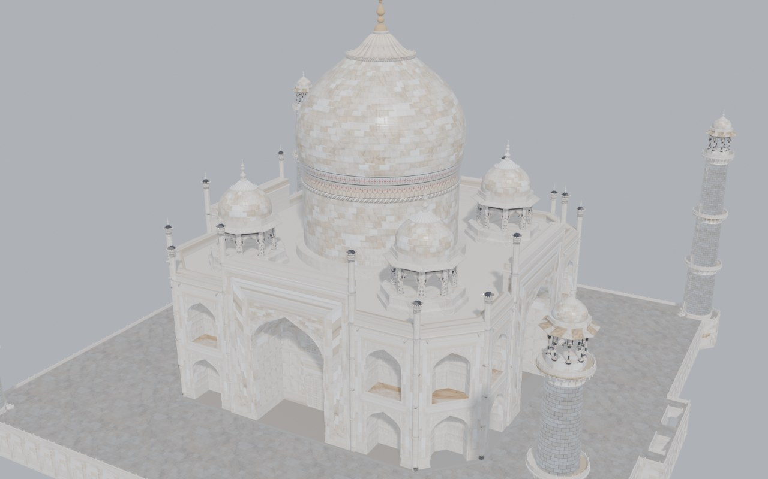
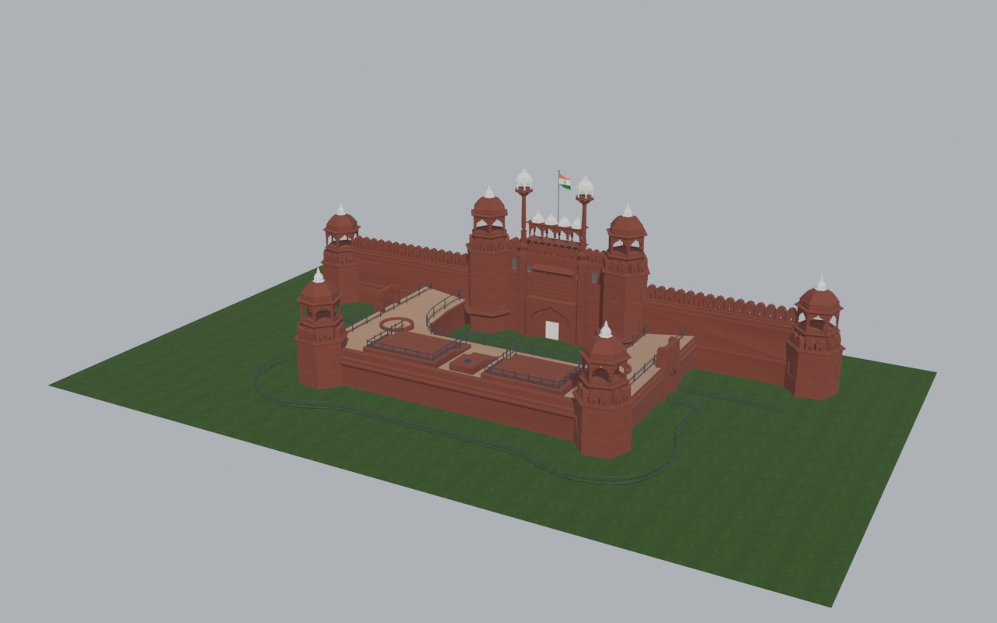
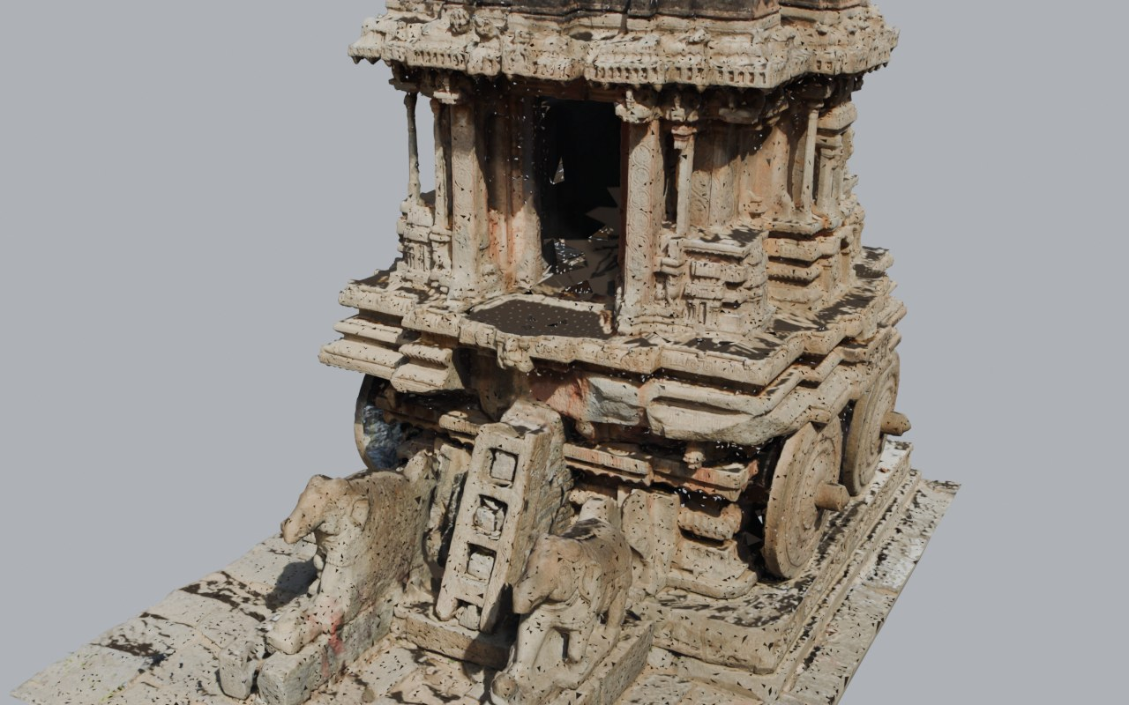
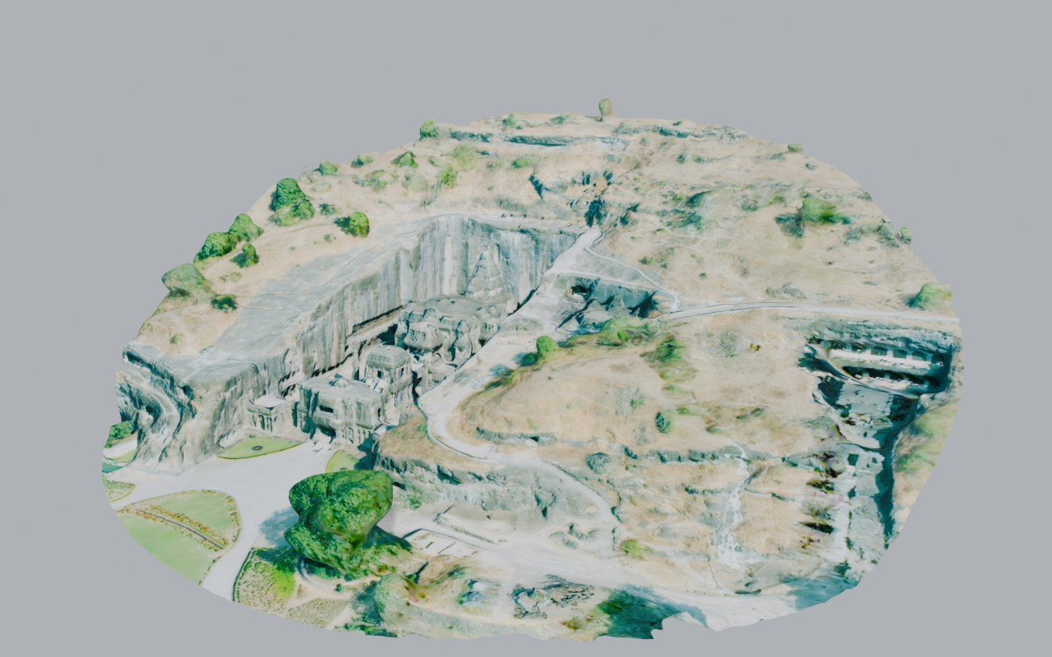
Six monuments, prepared in Blender for the web
6
monuments in 3D
3
Taj Mahal
Red Fort
views per site: Virasat model, detailed scan, Sketchfab
AR
on Android and iPhone
Hampi Stone Chariot
Ellora site scan
Notes:
Models were repaired, textured, decimated and compressed in a scripted Blender pipeline. The Red Fort model shipped without textures; we added red sandstone, marble, paving, lawn and the national flag.

Slide 5
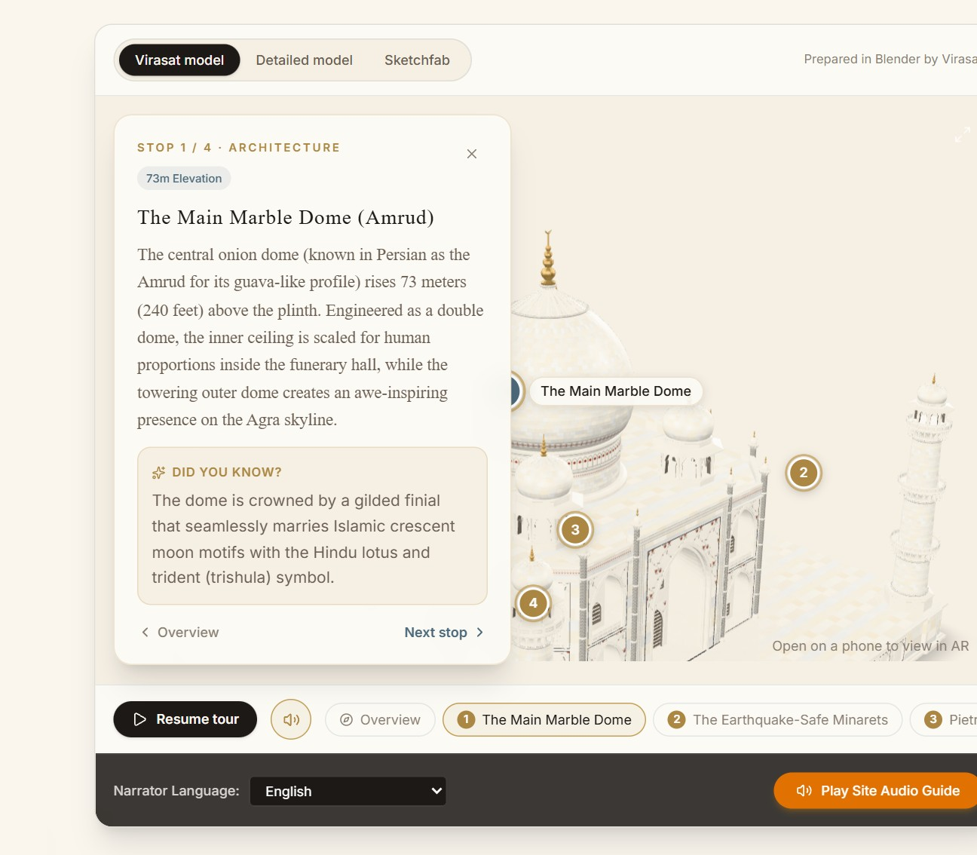
Guided tours that zoom in and talk
1
Tap a numbered landmark
Pins sit on the dome, minarets, inlay and gateway.
2
The camera flies in
The viewer orbits to the best angle for that feature.
3
Hear the story
Narration reads the history; the card adds a 'Did you know?'
Notes:
Tours run hands-free with autoplay, or one landmark at a time. A mute button turns narration off. Audio guides are also available in Hindi, Telugu, Tamil and Malayalam.

Slide 6
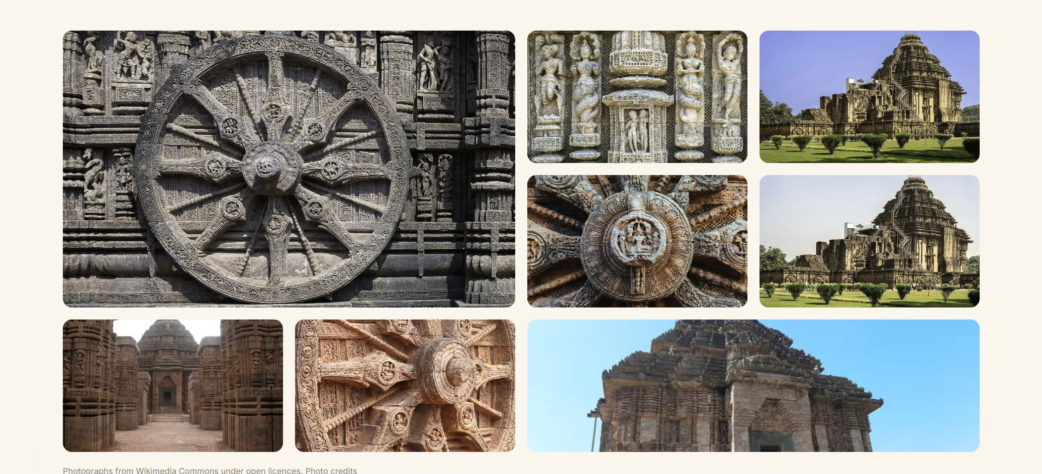



Every monument tells its full story
History, architecture and significance
8-photo gallery per site, openly licensed
Timeline from construction to UNESCO listing
Recommended books on every page
48 photographs across six monuments, credited on the site's Credits page.
Notes:
Each heritage page reads like an article with a sticky section bar: overview, history, architecture, gallery, 3D model, plan your visit, timeline and books.

Slide 7
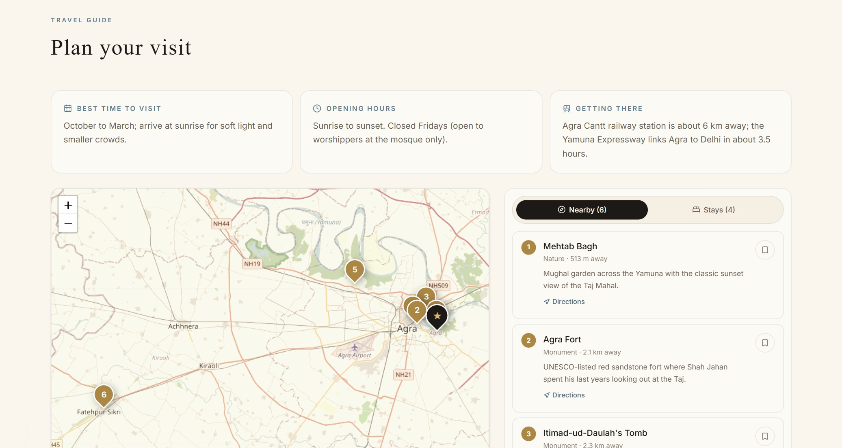
Plan the whole visit from the monument page
36
nearby sights with distances and directions
21
stays from heritage hotels to budget guesthouses
1 tap
to check dates and prices on Booking.com
Save places and stays to My trip; everything is kept in the visitor's account.
Notes:
The map shows the monument and nearby places, numbered by distance. The Stays tab takes dates and opens Booking.com. We never show prices ourselves because they change daily.

Slide 8
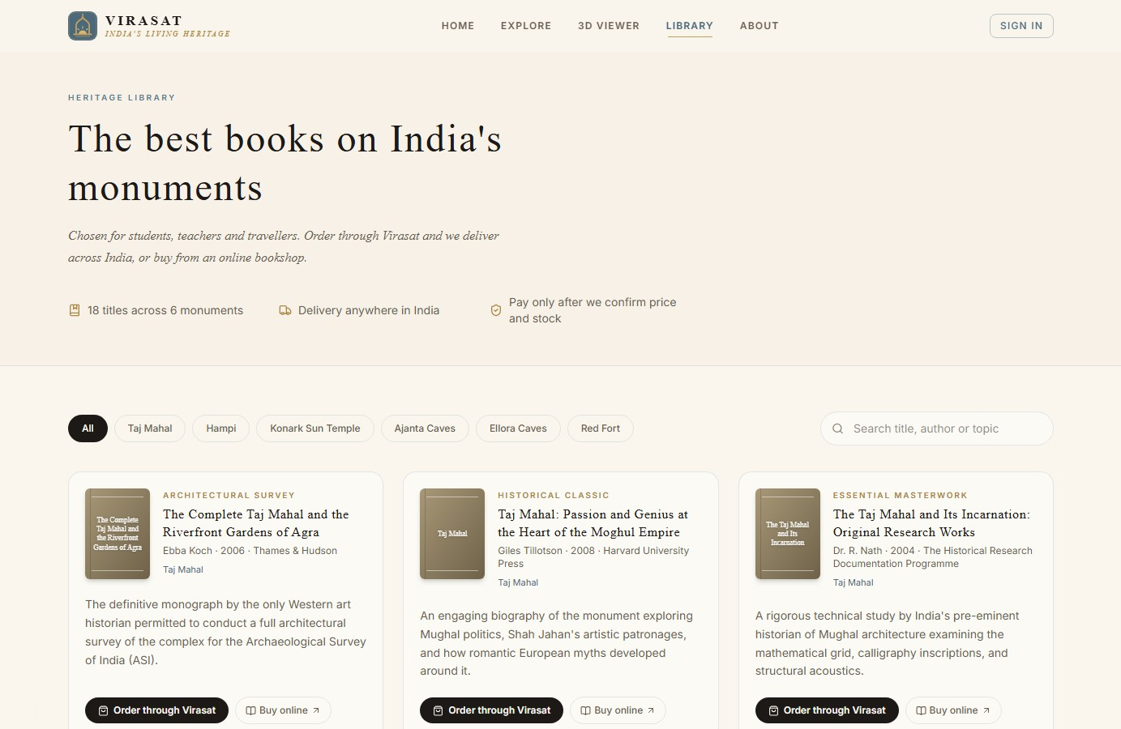


A heritage library you can order from
18 titles
Three books per monument, from surveys to histories
Order through Virasat
Delivery anywhere in India; pay after we confirm
Tracked in the account
Requested, confirmed, shipped, delivered
Notes:
Readers can also buy online through Amazon.in. Every book links back to its monument, and every monument lists its books.

Slide 9
How Virasat is built
Accounts
Auth.js, email and Google
Virasat web app
Next.js 16 on Netlify
Pages, 3D viewer, server actions
Visitors
Web, phone, AR
Data
Netlify Blobs: users, orders, trips
Partners
Booking.com, Amazon.in
Blender pipeline
Models to compressed GLB files
Notes:
No separate server to run: Netlify hosts the app and its storage. Moving to Postgres later uses the existing Prisma schema.

Slide 10



An admin dashboard that runs the business
Book orders
Partner clicks
Users and roles
Content overview
See every order with delivery details and move it from requested to delivered.
Which hotels and books visitors open, by monument — the revenue report.
Registered users; promote or remove administrators.
Each monument's 3D models, photos, nearby places, stays and books.
Notes:
Only emails in ADMIN_EMAILS, or users an admin promotes, can open it. Every admin action re-checks the role on the server.

Slide 11




Five ways Virasat earns, content stays free
Hotel referrals
Book sales
School plan
Local experiences
Institutions
Booking.com affiliate commission on stays
Amazon referrals and our own order desk
Teacher dashboard, worksheets, offline packs
Guides and heritage walks on commission
3D and AR kiosks for museums and tourism boards
Now
Now
Next
Later
Later
Notes:
The first two streams are built and only need affiliate ids. The school plan is the main next revenue line; content stays free for individual learners.

Slide 12
Roadmap for the next six months
Weeks 1–2
Weeks 3–6
Months 2–3
Months 4–6
Launch-ready
Grow the catalogue
Scale the backend
Go mobile
Netlify settings and affiliate ids
Order emails
Privacy, terms, analytics
Five more monuments
Tours on scanned models
Hindi interface, itineraries
Postgres via Prisma
Content editor in admin
Online payments, school pilot
Installable app, offline packs
ASI and tourism boards
Experiences marketplace
Notes:
The full plan is in docs/ROADMAP.md in the repository.

Slide 13
Live today, with the groundwork for growth
6
48
36
21
18
monuments
photographs
nearby sights
stays
books
Next actions
Join the Booking.com and Amazon affiliate programmes and add their ids in Netlify
Send order confirmation emails to readers and alerts to the team
Pilot the school plan with three schools
Notes:
Everything on the earlier slides is live on virasatdesh.netlify.app.

Slide 14
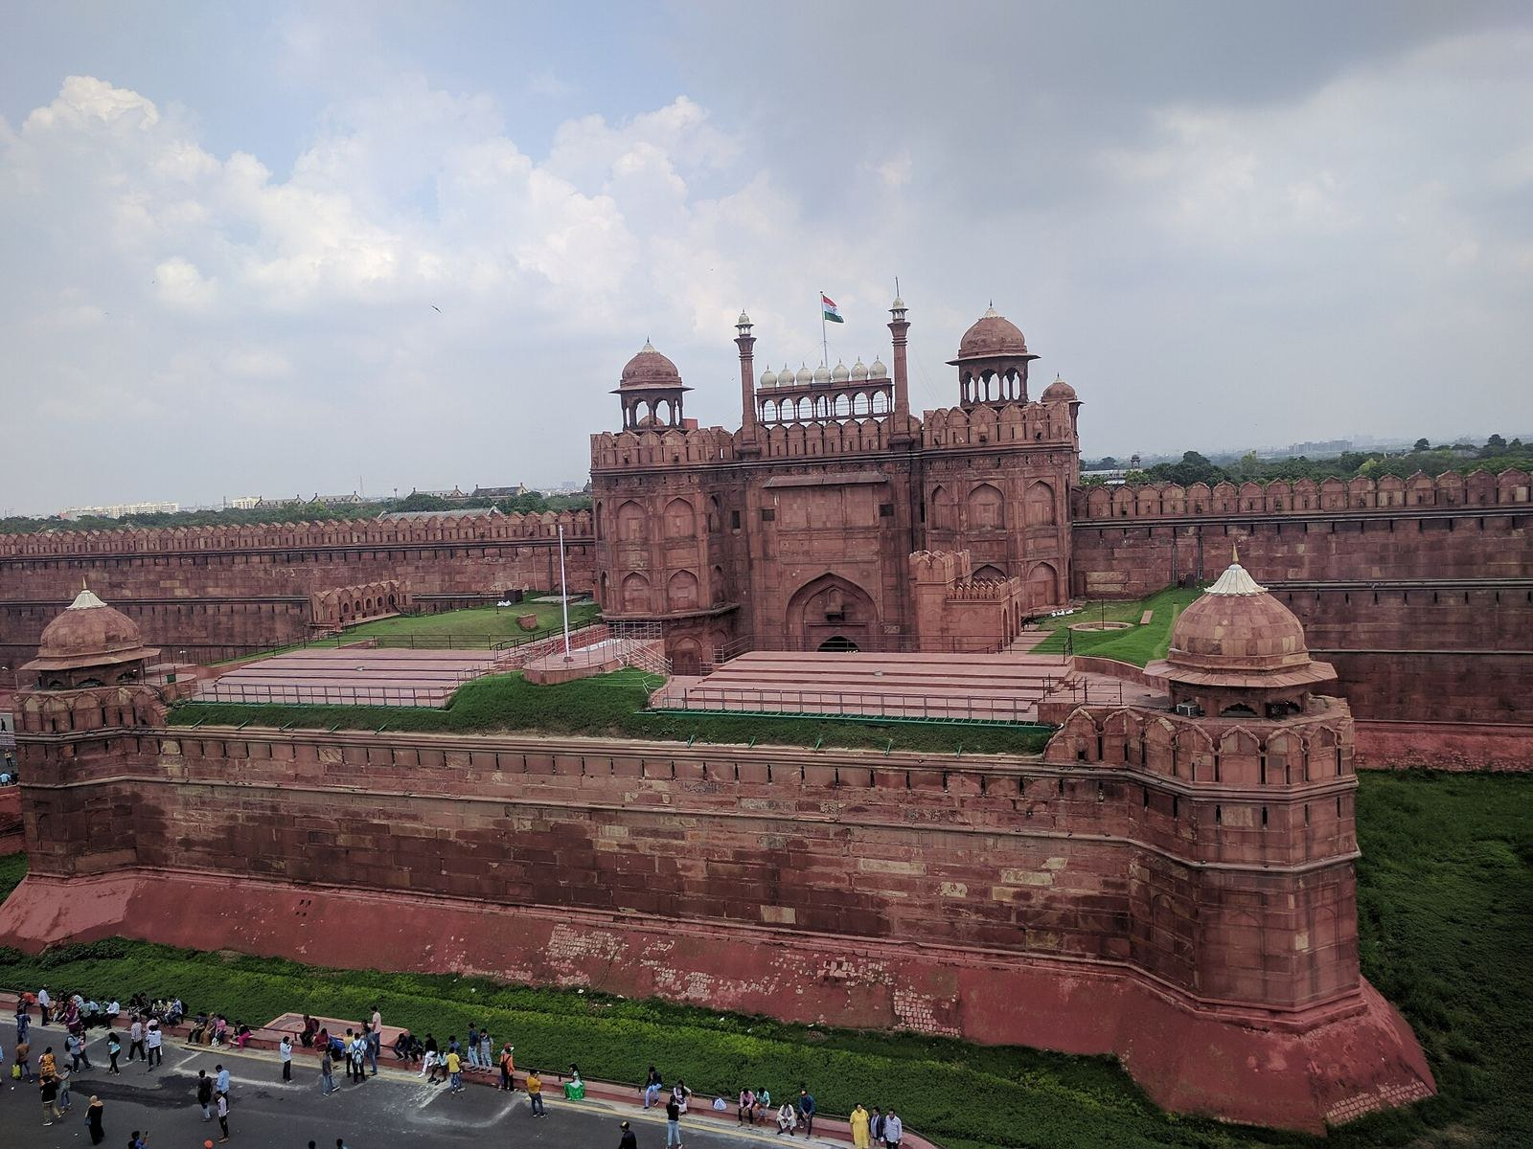
Explore India's heritage with Virasat
virasatdesh.netlify.app
Free for schools, teachers and students
Photo: Lucky181993, Wikimedia Commons, CC BY-SA 4.0
Notes:
Thank you. Open the live site to try the 3D tours and the visit planner.

