Slide 1
N-ATLAS Dev Kit
NAIC 2026 · INNOVATION & ENTERPRISE · PROBLEM STATEMENT 01
Add Nigeria's own AI to any app in minutes
Peachel Innovations Limited
github.com/Akindats1/natlas-devkit
Notes:
The N-ATLAS Dev Kit is developer infrastructure for Nigeria's own AI model. It answers Problem Statement 01: build the tools that make N-ATLAS easy to build with. Built by Peachel Innovations Limited.

Slide 2
N-ATLAS is open, but hard to build with
16 GB
0
Python
of weights to download
hosted endpoints, SDKs or starter apps
is the only way in today
before a developer can send a single prompt
so every team rebuilds the same plumbing
while most Nigerian developers build in JavaScript or C#, on laptops
Result: N-ATLAS stays in research notebooks instead of in products.
Notes:
N-ATLAS is open source, but there is no hosted endpoint, no SDK and no starter app. A developer must download up to 16 GB of weights, write Python inference code, handle the chat template, and host and secure their own API. Most Nigerian developers work on laptops and build in JavaScript or C#.

Slide 3
Five parts, one goal: N-ATLAS in your app in minutes
1
OpenAI-compatible server
Runs N-ATLAS behind chat (with streaming), translate and detect-language endpoints. Laptop, Docker or Colab.
Live
2
TypeScript SDK
@akindats/natlas: ask, chat, stream, translate. Zero dependencies; Node, browsers, Next.js.
On npm
3
.NET SDK
The same features for C#, including .NET Framework apps such as Revit and AutoCAD plugins.
In repo
4
Next.js starter app
A complete multilingual chat app. Clone it, set one variable, ship.
Runs
5
Browser playground
Chat and translate in four languages, with copy-ready code for every request.
Live
Notes:
The kit has five parts. The server speaks the OpenAI API, so existing apps switch by changing one URL. The TypeScript SDK is published on npm as @akindats/natlas. The .NET SDK reaches C# and desktop engineering software. The Next.js starter is a complete chat app. The playground lets anyone try it in a browser.

Slide 4
Every client reaches N-ATLAS through one server
Browser playground
TypeScript SDK
.NET SDK
Any OpenAI client
chat, translate, code
npm; Next.js starter
.NET 8 and Framework
change one URL
Public URL and API key check
HTTPS tunnel · Authorization: Bearer key · requests without it are refused (401)
N-ATLAS server · FastAPI · OpenAI-compatible
/v1/chat/completions (streaming) · /v1/translate · /v1/detect-language · /v1/stats (no message text) · /health
llama.cpp · live demo
transformers
mock
N-ATLaS Q4 GGUF, 4.9 GB
laptop CPU or 6 GB GPU
Official NCAIR1/N-ATLaS weights
GPU, e.g. free Colab T4
No model
CI and SDK tests only
Notes:
Every client, from the playground to existing OpenAI code, calls the same server. The server checks the API key, then hands generation to the configured backend. The live demo runs llama.cpp with the quantised N-ATLaS model on a laptop GPU. The transformers backend loads NCAIR's official weights on a GPU such as Colab.

Slide 5
Existing OpenAI code switches by changing one URL
Python · the official OpenAI SDK
TypeScript · @akindats/natlas
from openai import OpenAI
client = OpenAI(
base_url="https://<server>/v1",
api_key=NATLAS_API_KEY,
)
r = client.chat.completions.create(
model="n-atlas",
messages=[{"role": "user",
"content": "Sannu!"}],
)
import { NAtlas } from "@akindats/natlas";
const natlas = new NAtlas({ apiKey });
await natlas.ask("Explain inflation",
{ replyIn: "ha" });
await natlas.translate("Delivered", "ig");
for await (const t of natlas.stream("Hi"))
process.stdout.write(t);
Python, JavaScript, C# or curl: the same API, plus reply_language to force English, Hausa, Igbo or Yoruba replies.
Notes:
On the left, an existing Python app that uses the OpenAI SDK. The only change is the base URL; it now talks to N-ATLAS. On the right, the TypeScript SDK: one line to ask, with the reply forced into Hausa, one line to translate into Igbo, and streaming.

Slide 6
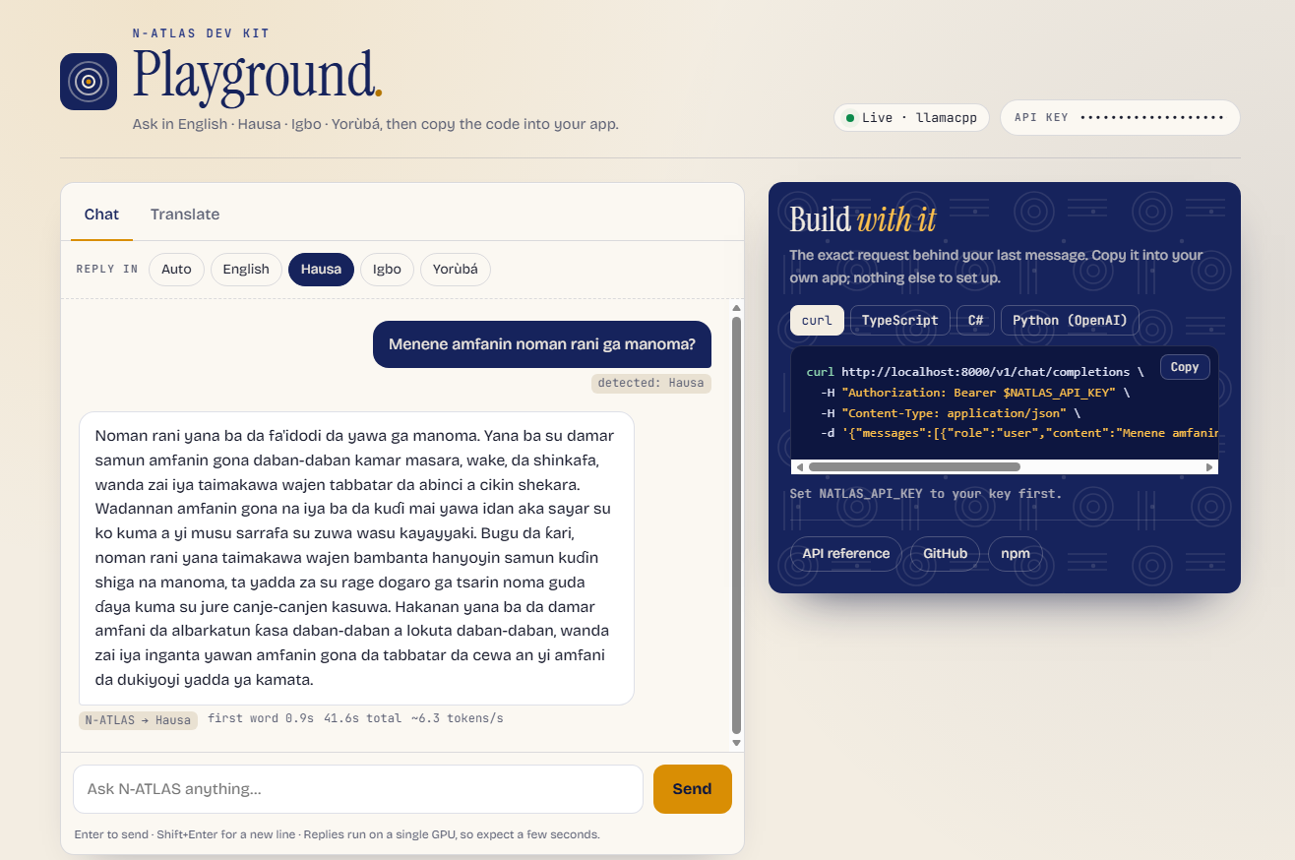
A browser playground that teaches the API as you use it
1
Chat in four languages
Streamed answers, a reply-language picker and the detected language on every message.
2
"Build with it" panel
Copy-ready curl, TypeScript, C# and Python code for the request you just made.
3
Honest speed
Time to first word, total time and tokens per second under every answer.
Notes:
The playground is served by the server itself, so the same link is both the API and the demo. Here N-ATLAS answers a Hausa farming question, streamed word by word, with the first word after 0.9 seconds. The panel on the right shows the exact code to make the same request from your own app.

Slide 7
N-ATLAS is the only model, loaded directly
Backend | Model loaded | Runs on
llama.cpp (live demo) | NCAIR1/N-ATLaS, Q4_K_M quantised · 4.9 GB · SHA-256 checked | Laptop CPU or 6 GB GPU
transformers | Official NCAIR1/N-ATLaS weights · optional 4-bit | GPU, e.g. free Colab T4
mock | No model | CI and SDK tests only
Model card followed
Four languages only
Attribution in every layer
Llama-3 chat template with date_string, repetition penalty 1.12, Awarri system prompt.
English, Hausa, Igbo and Yoruba, the languages the model supports. Nothing wraps another model.
X-Powered-By header on every response; ATTRIBUTION constant in both SDKs.
Notes:
N-ATLAS is the only model the kit uses. The live demo loads a 4.9 GB quantisation of NCAIR1/N-ATLaS whose checksum we verified. The transformers backend loads the official weights and follows NCAIR's model card exactly. Language features are limited to the four languages N-ATLAS supports.

Slide 8
Verified end to end on the real model
7/7
6/6
0.9 s
~6
server API tests pass
SDK tests pass through the public URL
to the first word in the playground
tokens per second on a 6 GB laptop GPU
Also checked
Fresh npm install of @akindats/natlas returned an Igbo answer and a Hausa translation from the live server
Requests without the API key are refused (HTTP 401); the usage log stores no message text
Known limits, passed on honestly: Yoruba quality is lower (NCAIR's own evaluation: 2.69/5); about 8,000 tokens of context
Notes:
Everything was verified on the real model, not the mock. Seven server tests and six SDK tests pass, the SDK installs cleanly from npm, and the playground streams the first word in under a second. On battery, the laptop GPU runs about 6 tokens per second; a larger GPU is faster. We pass the model's known limits on honestly.

Slide 9
Real-world validation with external developers
Try the playground
First request in a Nigerian language
SDK in their own script
Run the starter app
1
2
3
4
Each tester's requests are tagged with their name, so the server's anonymous usage log (/v1/stats) records real activity.
Tester | Role and organisation | SDK used | Minutes to first reply | Ease (1–5) | Would use it?
1
2
[Fill in from real tester feedback and /v1/stats before submitting]
Notes:
Problem Statement 01 requires at least two external beta testers. Each tester followed the guide: playground, a first request in a Nigerian language, the SDK in their own script, and the starter app. Replace this note and the table with the real results.

Slide 10
From days of ML setup to minutes
1
A larger developer base
2
No ML expertise needed
Opens N-ATLAS to JavaScript and .NET developers, a far larger group in Nigeria than ML specialists.
Startups, agencies and NGOs can prototype Nigerian-language support, civic and education services.
3
Existing apps switch in one line
4
Enterprise and engineering software
Any product built on the OpenAI API can try N-ATLAS by changing its base URL.
The .NET SDK reaches desktop and CAD tools used across Nigerian construction and engineering.
Notes:
The impact is speed and reach. The kit cuts the time to a first N-ATLAS app from days of ML setup to minutes, and opens the model to the JavaScript and .NET developers who build most Nigerian products. Every app built on it adds users and real-world feedback for N-ATLAS.

Slide 11
Built to scale, and to keep growing
Scalability and sustainability
Roadmap
1
Stateless server
1
Speech
Add instances behind a load balancer for more users
N-ATLAS ASR endpoints for voice-first apps
2
Runs anywhere
2
More SDKs
Laptop, Docker, free Colab or GPU cloud
Python SDK and a NuGet release of the .NET SDK
3
Open source
3
Hosted endpoint
MIT licence, public on GitHub, SDK on npm
No setup at all for developers
4
Low cost
4
Framework adapters
The default model runs on a 6 GB consumer GPU
LangChain and the Vercel AI SDK
5
Sustained by Peachel
5
Evaluation dashboard
Paid integration and deployment support, within N-ATLaS terms
Per-language quality tracking
Notes:
The server is stateless, so it scales by adding instances. It is MIT-licensed and the SDK is on npm, so the community can extend it. Peachel Innovations Limited sustains it through paid integration and deployment support. Next on the roadmap: speech endpoints, more SDKs, a hosted endpoint and framework adapters.

Slide 12
Responsible by default
The kit's code is MIT-licensed. The model stays under the N-ATLaS Terms of Use, which the kit passes on to every developer: free for research, education, civic and community use, up to 1,000 active users without a commercial licence.
Permitted uses
Prohibited uses
Academic and non-profit research
Accessibility for persons with disabilities
Language and cultural preservation
Civic technology and public-benefit apps
Education, training and community innovation
Surveillance or unlawful monitoring
Discriminatory profiling or exclusion
Disinformation, impersonation or synthetic fraud
Military, intelligence or weaponised deployment
Exploitative, harmful or unlawful applications
Notes:
Responsible use is built in. Attribution appears in every response header, both SDKs and every footer. The usage log stores no message text. The README passes the N-ATLaS permitted and prohibited uses on to every developer who builds with the kit.

Slide 13
Team
Abdulrasheed Akinbola Bello (Akindats)
CTO, Peachel Innovations Limited · lead developer
[Teammate: name, role and background]
Software developer in C#/.NET, Next.js and TypeScript. Builds commercial Autodesk Revit, AutoCAD and Civil 3D plugins; technical lead for ConTech Nigeria.
The Innovation & Enterprise track requires 2 to 5 team members.
Notes:
Introduce the team. Replace the placeholder card with the second team member before submitting.

Slide 14
Try it now
Nigeria's own AI, ready for every developer
Playground and API
exalted-herbal-bulge.ngrok-free.dev
Source code
github.com/Akindats1/natlas-devkit
npm package
npmjs.com/package/@akindats/natlas
Notes:
Thank you. The playground, the source code and the npm package are all live today. N-ATLaS is an initiative of the Federal Ministry of Communications, Innovation and Digital Economy, and powered by Awarri Technologies.

