Slide 1

EDEN EMPOWERMENT INITIATIVE
BUILDING
LASTING
IMPACT
The Social Impact Arm of Bitachon, The VMO Group

Slide 2

WHO WE ARE
EEI is the dedicated social impact arm of Bitachon, The VMO Group.
We are committed to building systems that drive excellence and sustainable development in our communities.

Slide 3

UN • SDGs
ALIGNED WITH
GLOBAL GOALS
DRIVING GLOBAL PROGRESS THROUGH THE UN SUSTAINABLE DEVELOPMENT GOALS
[
]
Our work is strategically focused on creating meaningful impact by supporting initiatives that align closely with the SDGs.

Slide 4
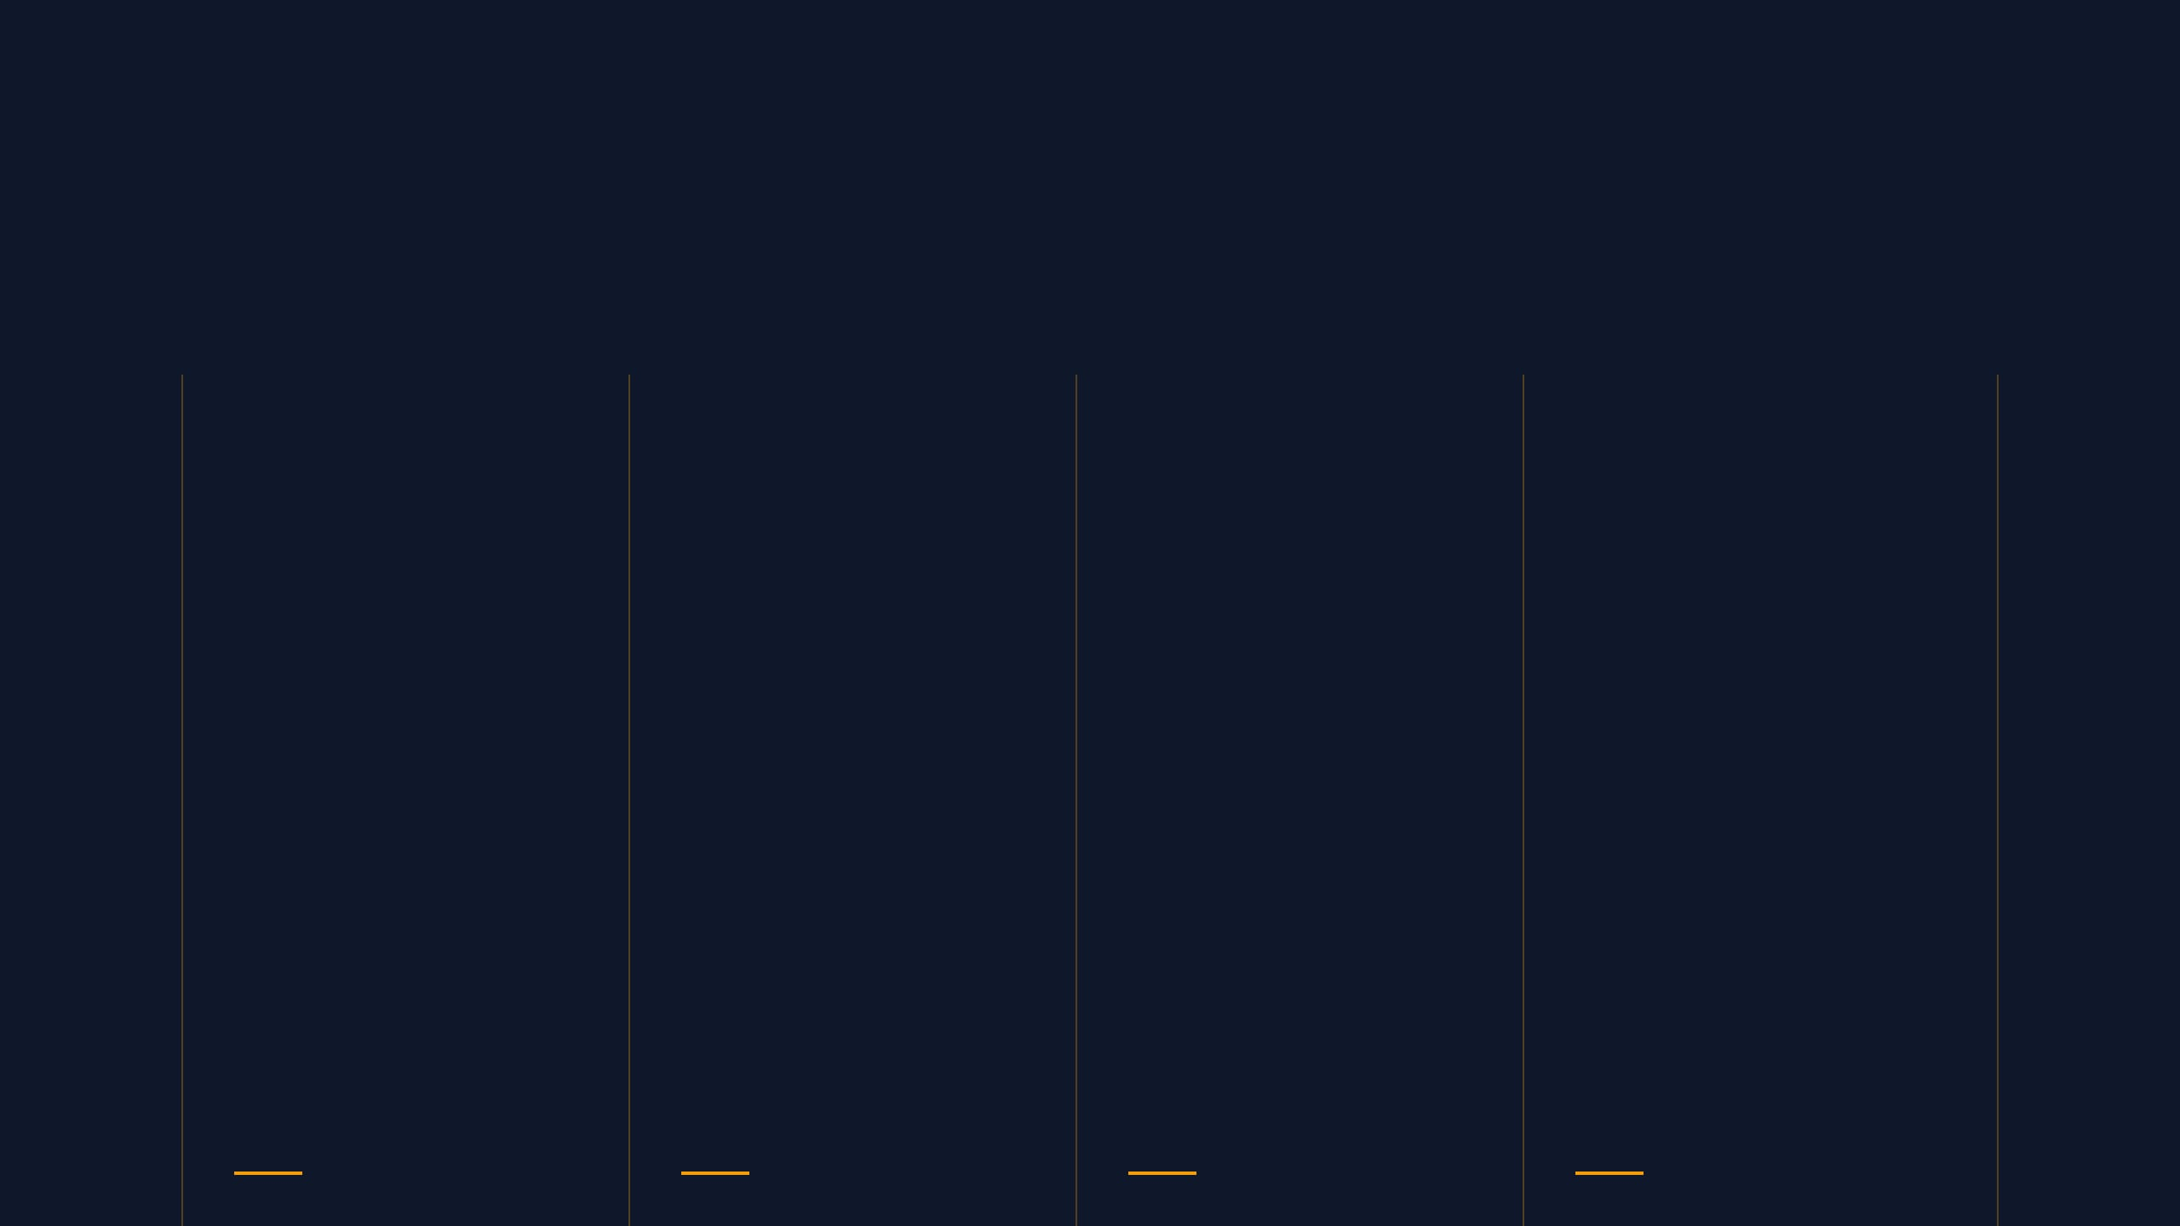




AREAS OF IMPACT
QUALITY
EDUCATION
POVERTY
REDUCTION
DECENT
WORK
GLOBAL
PARTNERSHIPS
Ensuring inclusive and equitable quality education and promoting lifelong learning opportunities for all.
Implementing strategic initiatives to end poverty in all its forms and support vulnerable communities.
Promoting sustained, inclusive economic growth, full and productive employment, and decent work for all.
Strengthening the means of implementation and revitalizing global partnerships for sustainable development.

Slide 5


EMPOWERING
COMMUNITIES
CREATING OPPORTUNITIES FOR MEASURABLE GROWTH
We are passionate about empowering individuals and supporting communities to create lasting, positive change for all stakeholders.
LASTING CHANGE

Slide 6

IMPACT BEYOND
BUSINESS
MAKING A TANGIBLE DIFFERENCE THROUGH PARTNERSHIPS
True impact extends far beyond corporate operations. We believe in leveraging our core strengths for the greater good.
Through EEI, we are committed to using our resources and strategic partnerships to create measurable, positive change in the world.
RESOURCES
PARTNERSHIPS
EXPERTISE

Slide 7

BITACHON • THE VMO GROUP
JOIN THE
JOURNEY
Together, we look forward to making a significant contribution to the future we are building. Welcome to the family.
BUILDING A SUSTAINABLE FUTURE TOGETHER

