Slide 1
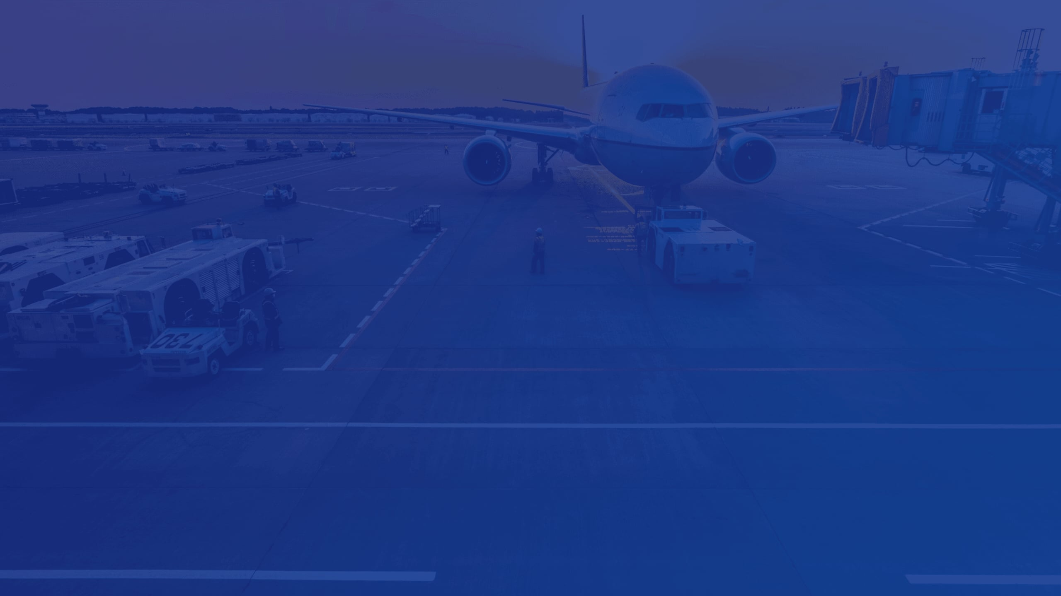

VMOAERO
OPERATIONS
CONTROL CENTER

Slide 2

VMOAERO
Onboarding Objective
By the end of this session, participants will:
Understand the role and functions of the Operations Control Centre (OCC).
Gain an overview of the end-to-end operational process.
Identify key OCC roles, responsibilities.
Understand safety, compliance, and risk management principles.
Appreciate the importance of teamwork, accurate information, and timely decision-making.

Slide 3

VMOAERO
What is an Operations
Control Centre?
The OCC is the central operational function responsible for coordinating, monitoring and supporting flight operations while exercising operational control in accordance with the operator's approved procedures and applicable regulations.

Slide 4




VMOAERO
WHO WORKS IN THE OCC?
Director of Flight Operations
Operations/Flight Dispatchers
OCC Manager/Supervisor
Flight Crew
Ground Operations

Slide 5



VMOAERO
FLIGHT PLANNING TOOLS
Skylegs
ForeFlight
Comprehensive flight management platform for scheduling, dispatch, and operational control.
Advanced integrated flight application for charts, weather, and precise route planning.

Slide 6



VMOAERO
Flight Monitoring Tools

Slide 7
CONTENT
VMOAERO
Flight Dispatch Release Process
Review operational requirements
Prepare flight documentation
Dispatcher–flight crew coordination
Required approvals
Flight release/dispatch
Pre-departure briefing
Post Flight Briefing

Slide 8


VMOAERO
Communication & Coordination
Who needs to know what?
Internal vs external communication
Shift handovers
Dispatcher-crew communication
OCC–maintenance communication
OCC–ground/airport coordination
Clear, concise and professional communication

Slide 9

VMOAERO
Regulatory Compliance
ICAO requirements
Nigerian Civil Aviation Authority requirements
Company Operations Manual
Flight Dispatch/OCC procedures
MEL/CDL considerations
Record-keeping requirements
Importance of following approved procedures

Slide 10





4. Content
VMOAERO
Roles, Responsibilities & Accountability
Know your assigned responsibilities
Know your authority limits
Know when to escalate
Follow procedures
Maintain situational awareness
Own your actions and decisions
Support the wider operation

Slide 11

VMOAERO
A Typical Day in the OCC
Flight request → planning → dispatch → departure → monitoring → operational disruption → arrival → records

Slide 12

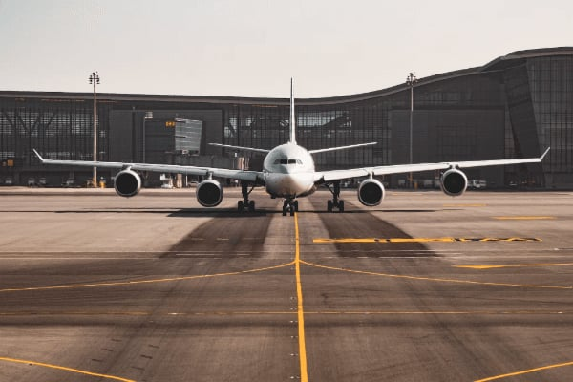
VMOAERO
Thank you!

