Slide 1
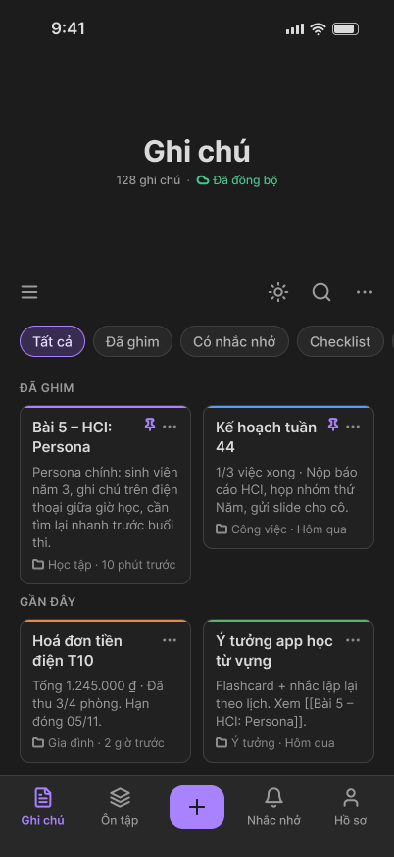
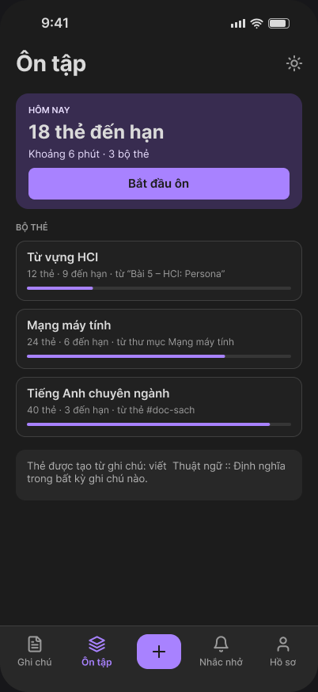
Opportunities
How might we help people capture, organize and find notes again, without having to learn Markdown first?
Introduction to Human-Computer Interaction · VNUK Final Project
Notes:
Introduce the product in one sentence: a note app that lets people capture anything and find it again.

Slide 2
Team
TNQ
NK
Trần Ngọc Quân
Ngô Hoàng Nhật Khang
Lecturer: Nguyen Thi Diem Chi

Slide 3
Table of Contents
1
Introduction
2
Analyze
3
Produce
Problem: notes scattered, hard to find
4
Personas: Thư and Đức Anh
7
Flow chart
10
Solution: one app for every note
5
Scenario: a day with Thư
8
Navigation structure
11
Project brief: brand, audience, goals
6
Sympathy map
9
UX wireframes
12
Design system
13
4
Prototype
5
Evaluate and next steps
Mobile app: main screens
14
Test cases and usability targets
27
App map and features by section
15–24
Next steps: user testing, web update
28
Improvements from lecturer review
25
Web app: desktop layout with sidebar
26
Notes:
Walk through what the project contains, section by section. Slide numbers are on the right of each item.

Slide 4
Notes get lost across too many places
Scattered
Unsearchable
Notes live on the phone, the laptop, paper and chat apps.
Handwriting, screenshots and scans cannot be searched.
Forgotten
Too complex
Deadlines slip, and work is lost when offline.
Many tools ask users to learn syntax before they can start.
“My notes are everywhere... When I need one, I can never find it.” Thư, primary persona

Slide 5
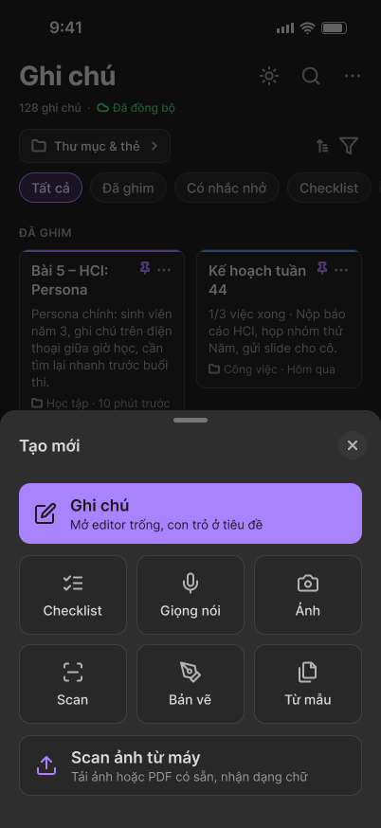
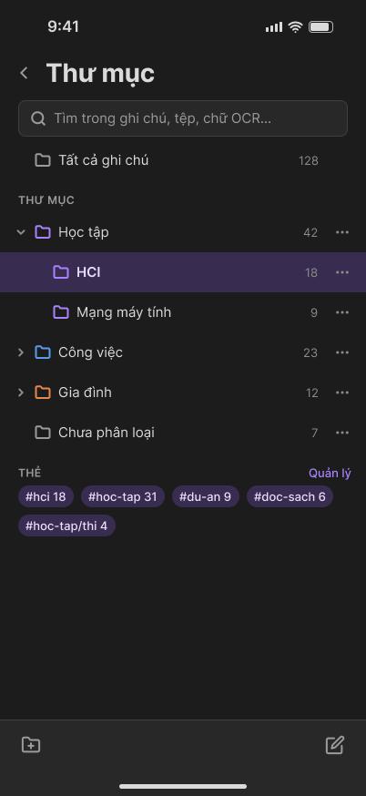
One app for every kind of note
Capture text, voice, photos, scans, checklists, tables and formulas
Organize with folders, smart folders and tags
Search inside photos and PDFs
Revise with flashcards made from your notes
Reminders, auto-save, offline work and sync

Slide 6
Project brief
Brand
Opportunities
Client
Course project, no external client
Audience
Students, tutors, knowledge workers
Platforms
iOS, Android and web
Budget
N/A, academic project
Objective
Keep every note in one place, and make it easy to find

Slide 7
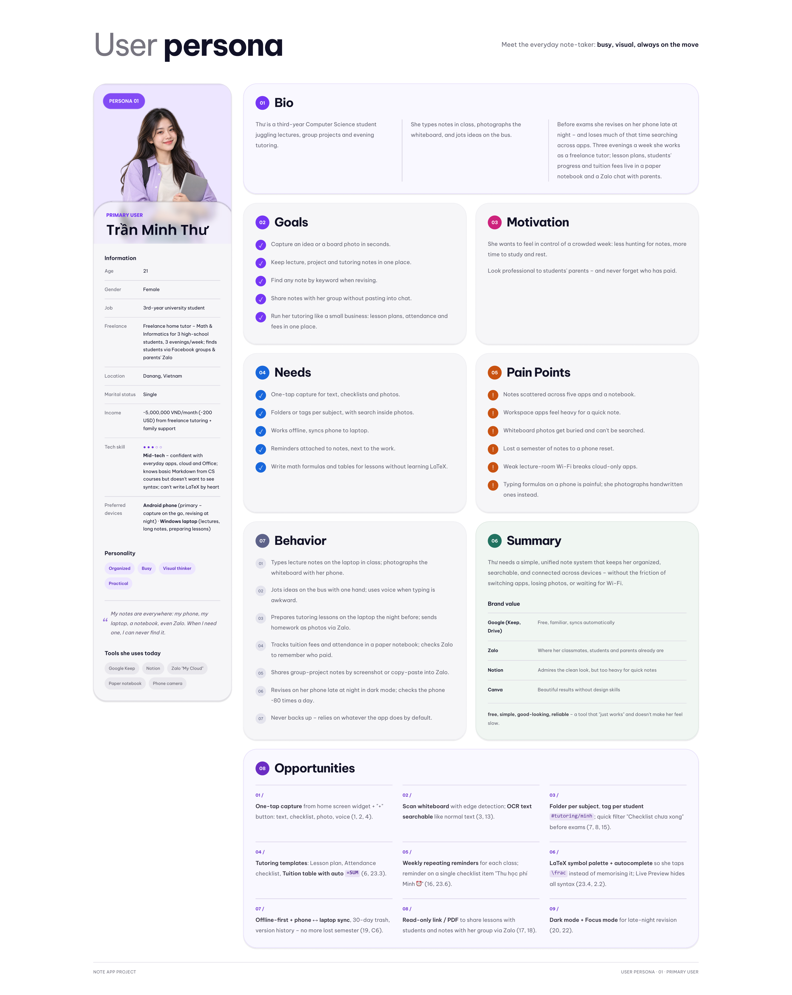
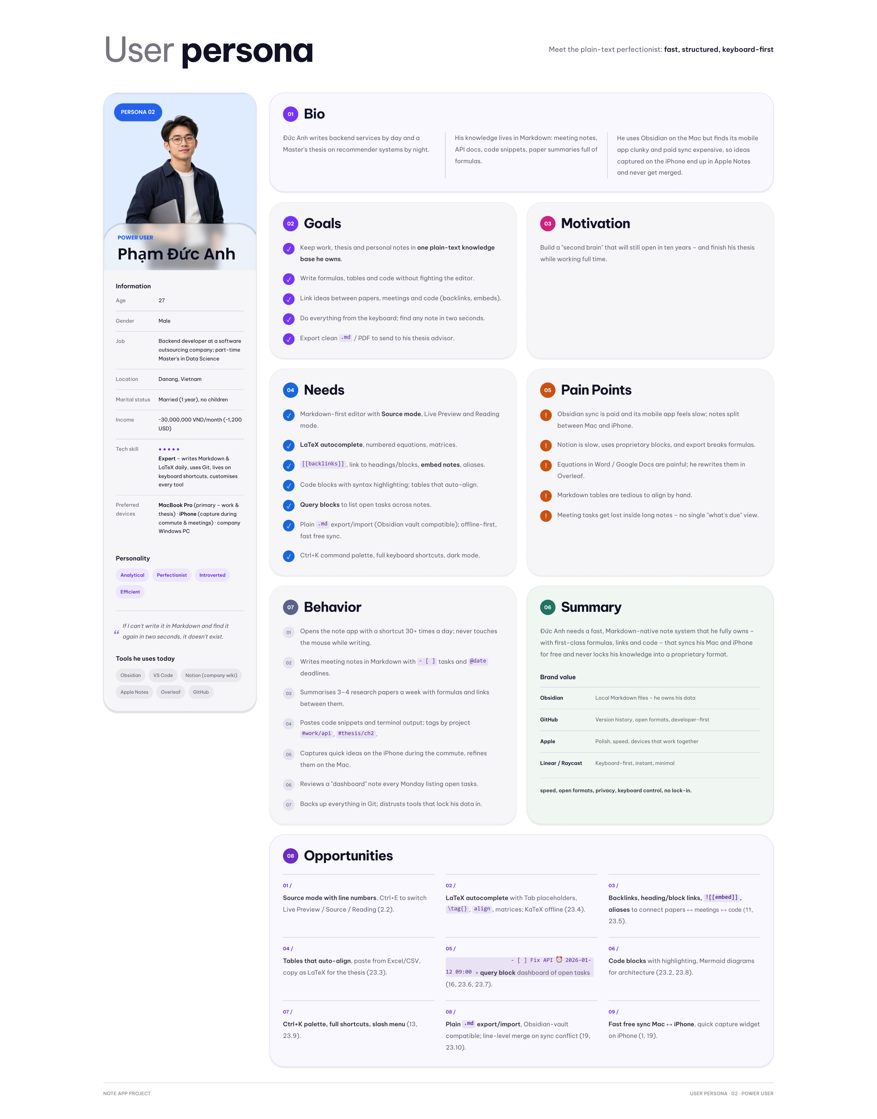
Two personas, two ways of working
Notes:
Thư, 21, student and tutor: one-tap capture, search inside photos. Đức Anh, 27, backend developer: Markdown, LaTeX, backlinks, keyboard-first.

Slide 8
Scenario: a day with Thư
07:55
09:40
17:30
23:00
On the bus
In class
Reminder
Before the exam
Dictates a meeting note by voice
Scans the whiteboard, checks the recognized text
Marks a tuition fee as collected
Finds a word inside this morning’s scan, then reviews flashcards

Slide 9
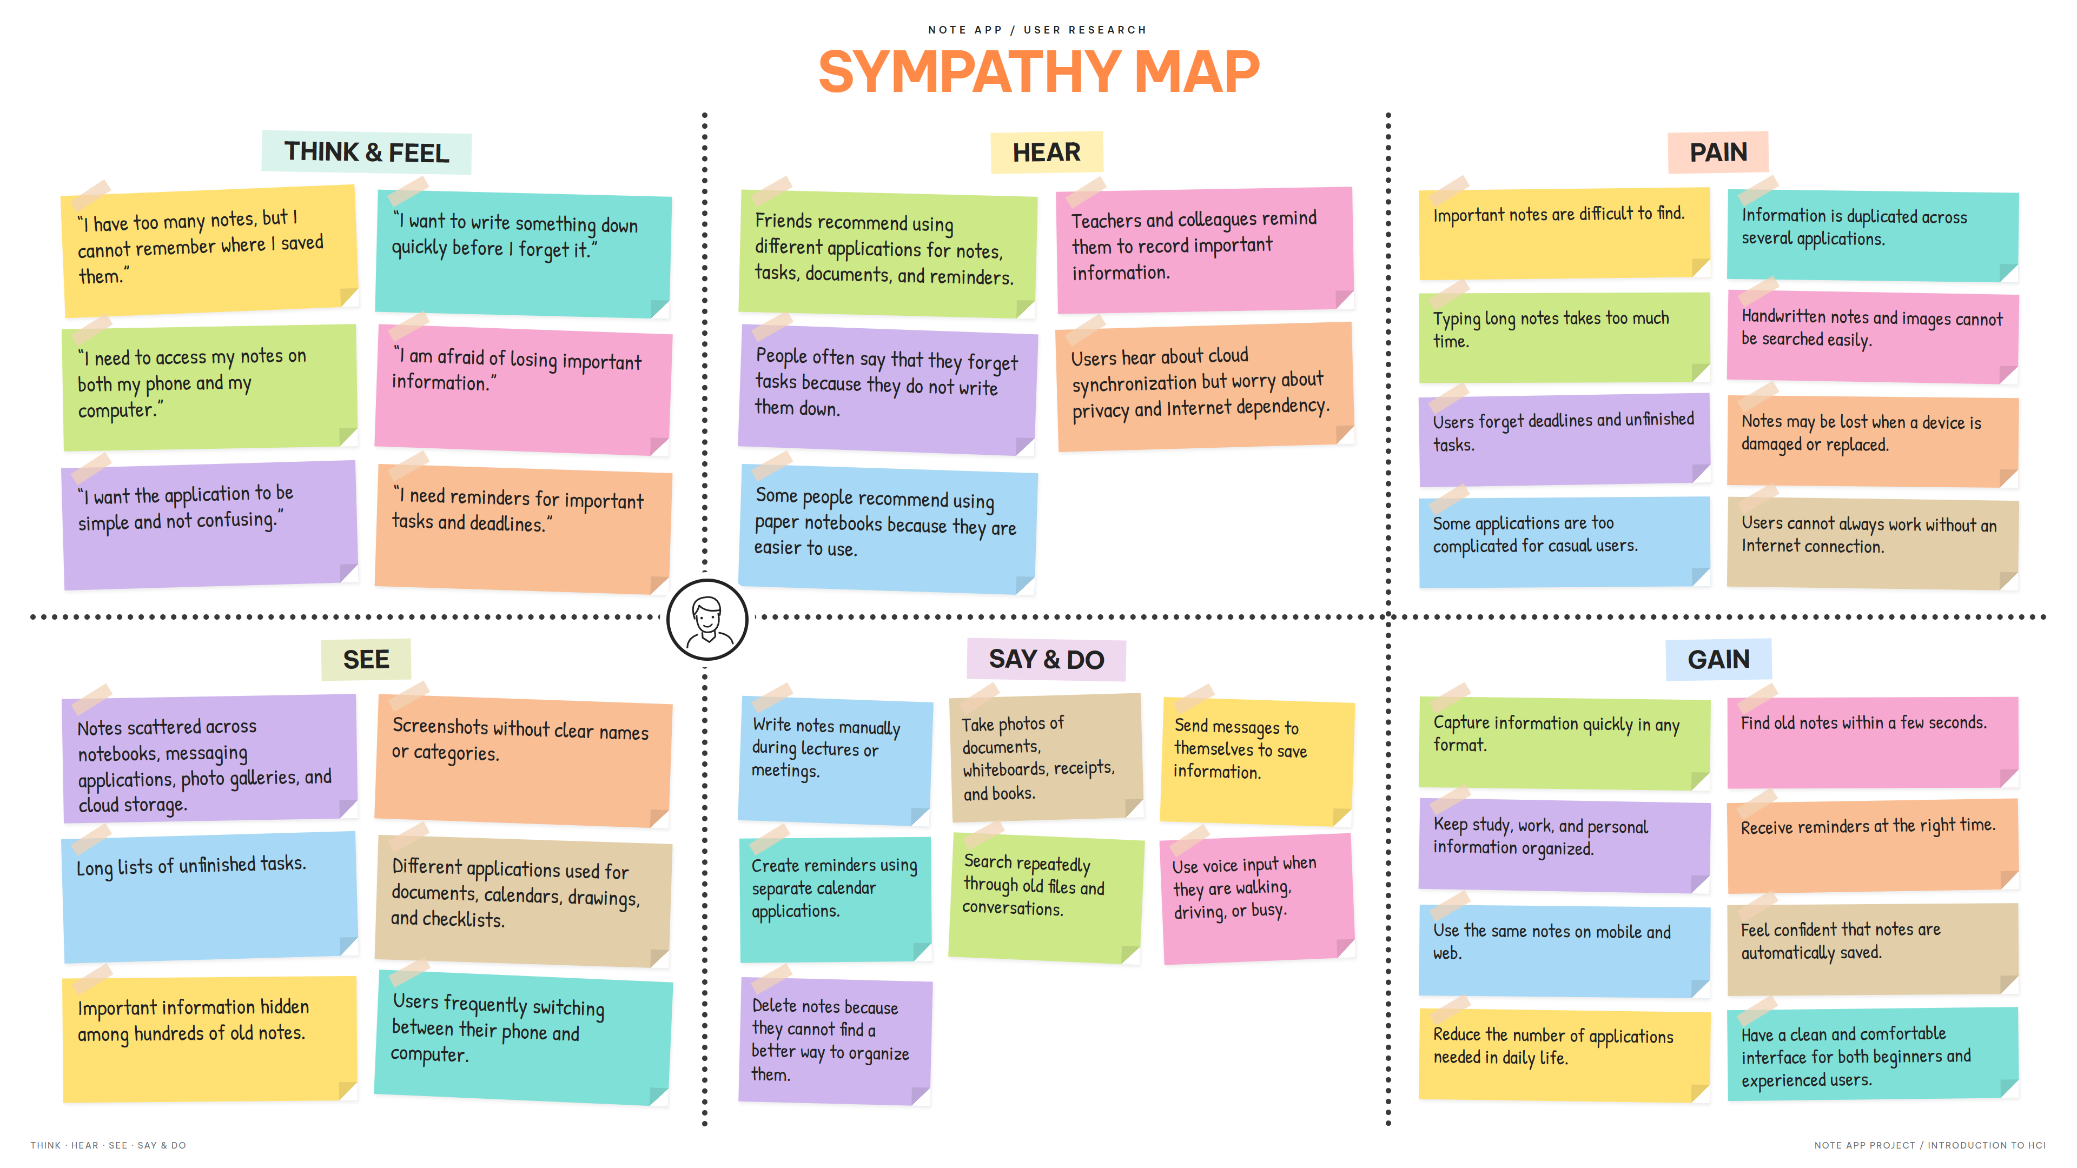
Sympathy map

Slide 10
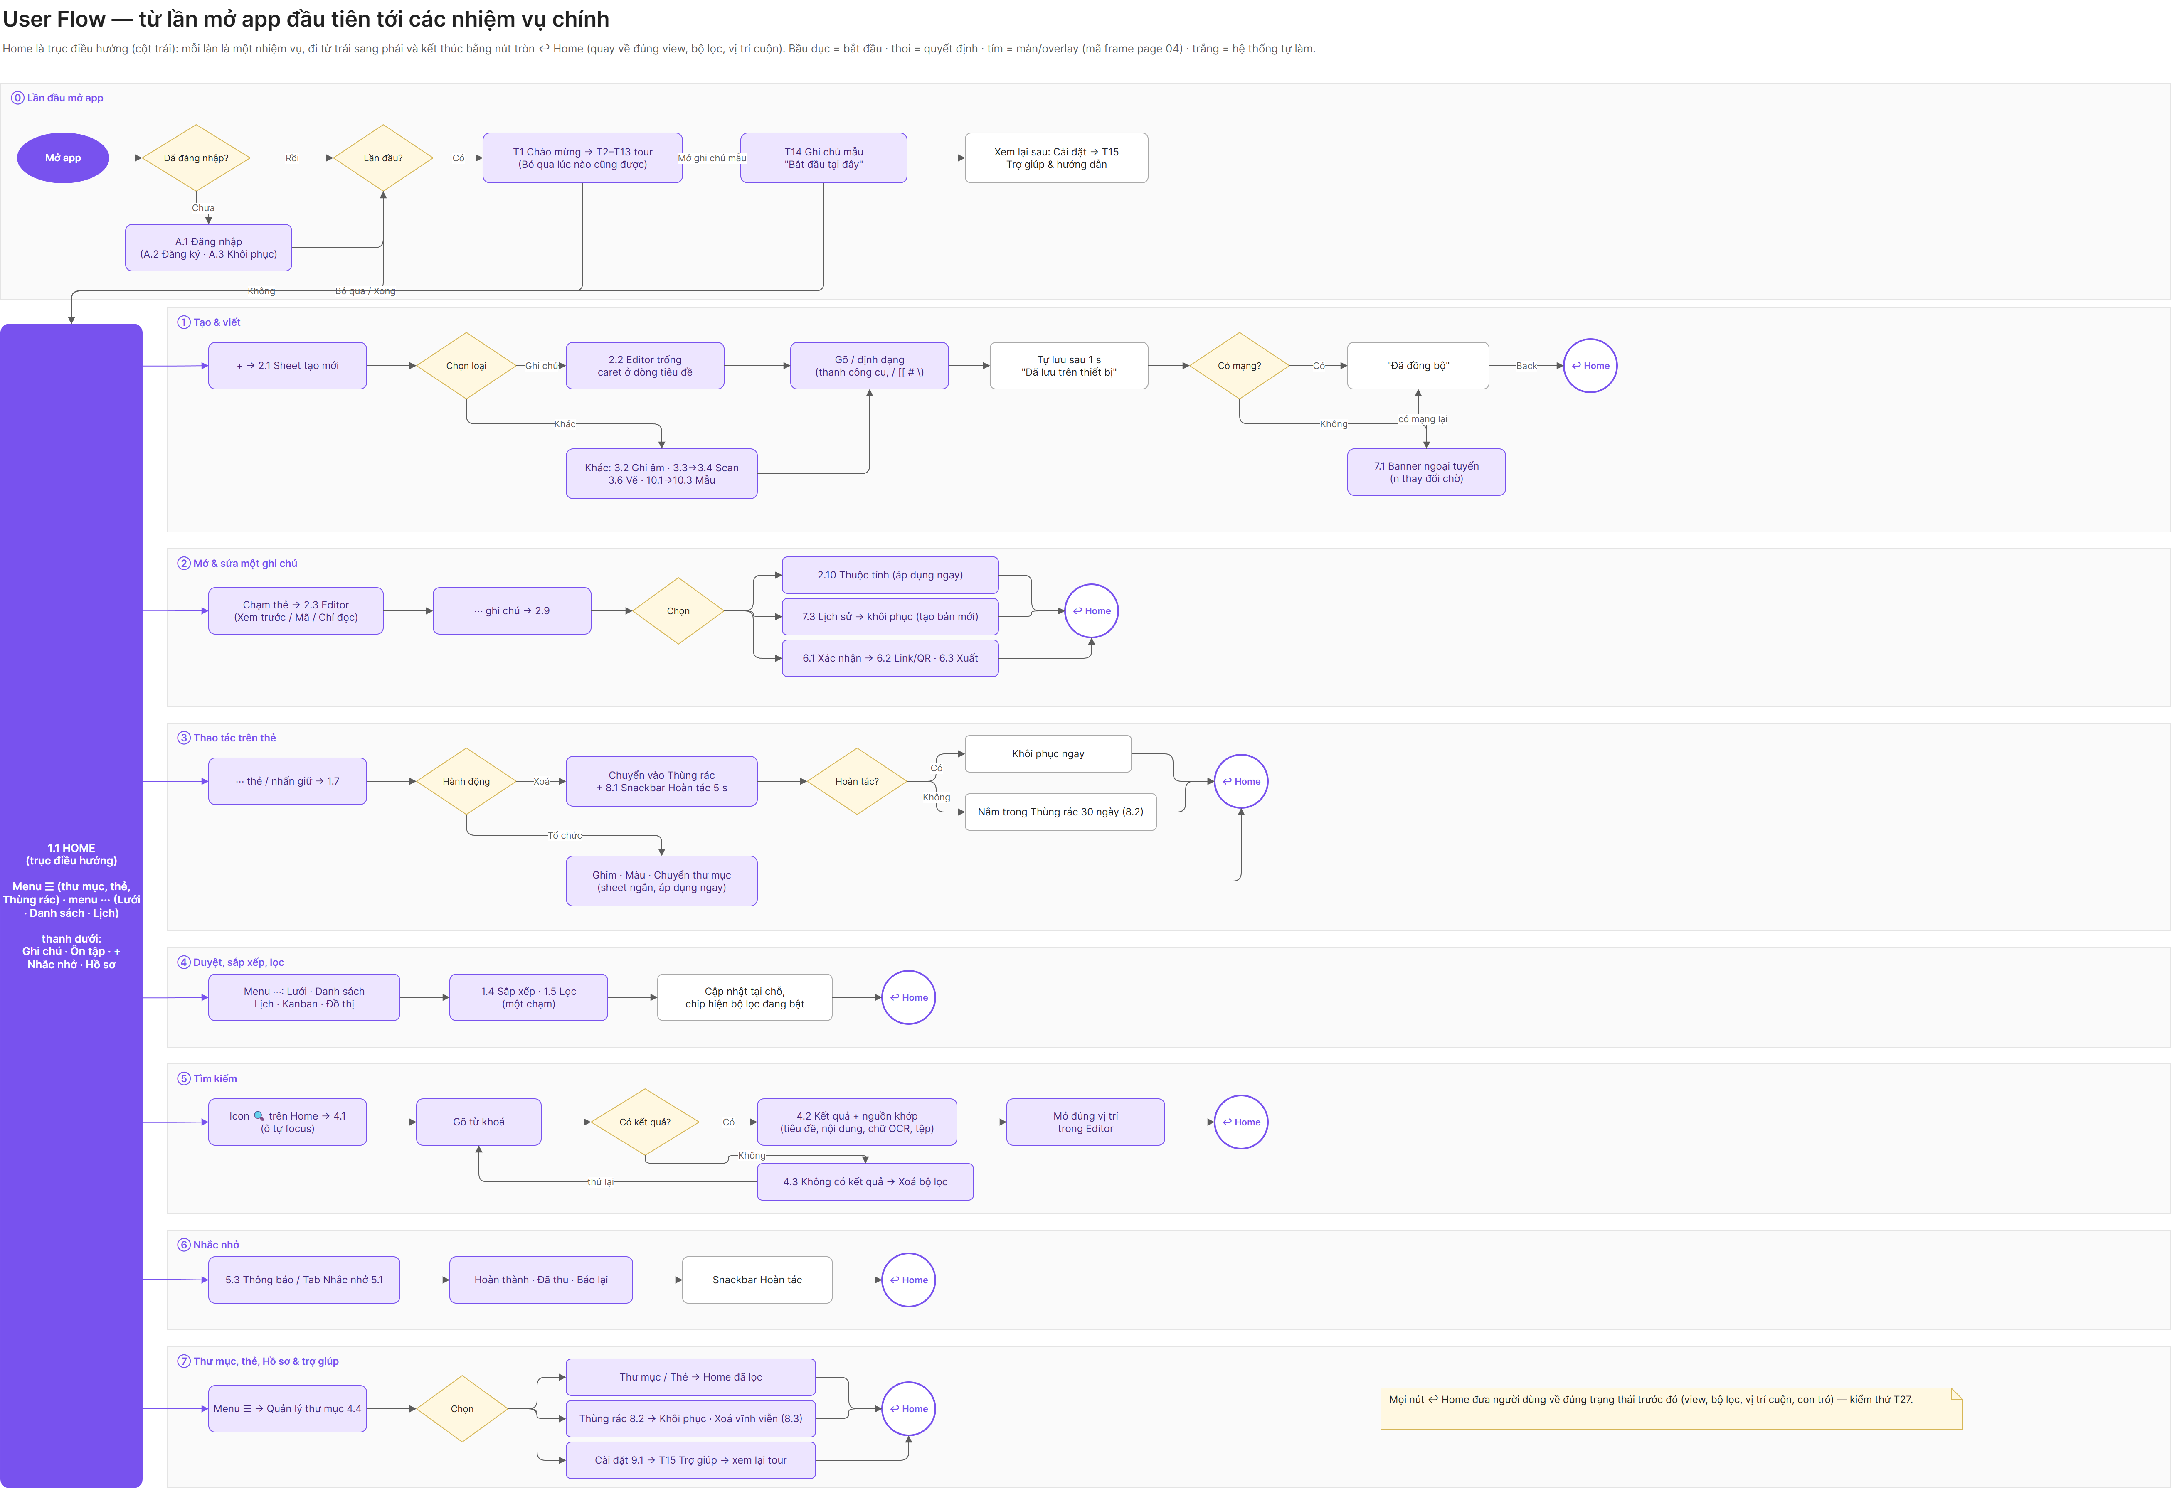
Flow chart

Slide 11
Navigation after review
Bottom bar
Notes
Review
+
Reminders
Profile
Home
Folders
Profile
Spacious header in the style of Samsung Notes. ☰ opens Pinned, Trash, folders and tags. ⋯ holds views, sort and filter.
A dedicated screen like Apple Notes: search, all notes, folders, smart folders, tags.
All settings on one screen: account, writing, notifications, sync, security, and other settings.

Slide 12
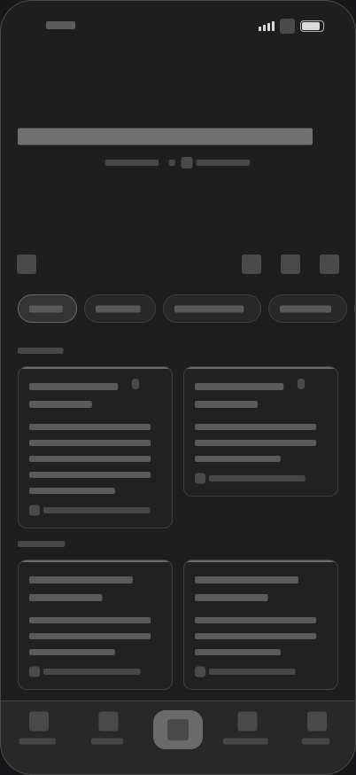
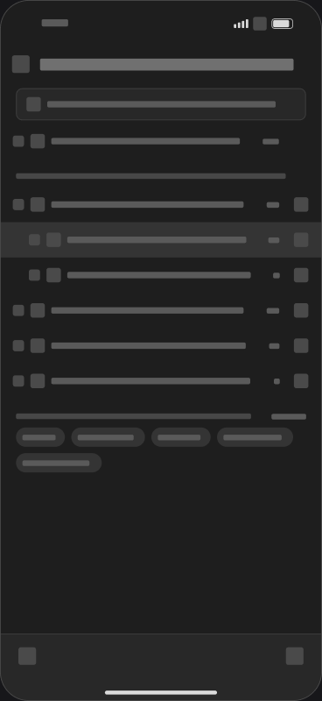
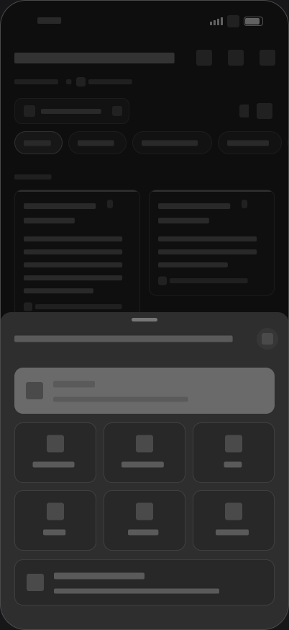
UX wireframes
Low-fidelity gray blocks, no icons or real data
One wireframe per mobile screen in the main sections
Each carries a note on the HCI reasoning
Kept in sync after the lecturer’s review

Slide 13
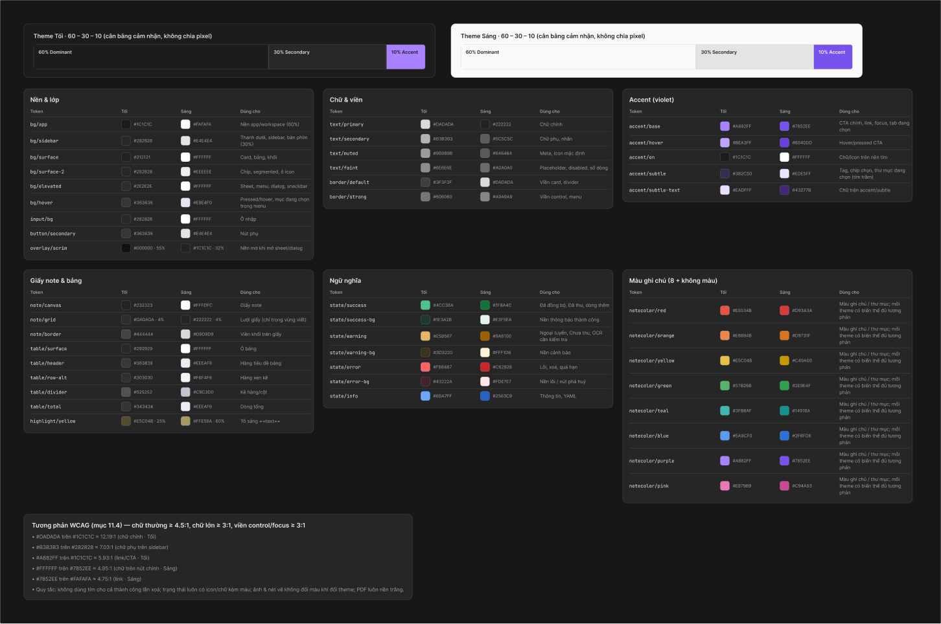
Design system
Charcoal neutrals with one violet accent
Dark and Light themes from shared tokens
Inter typeface and line icons
Reusable components across every screen

Slide 14
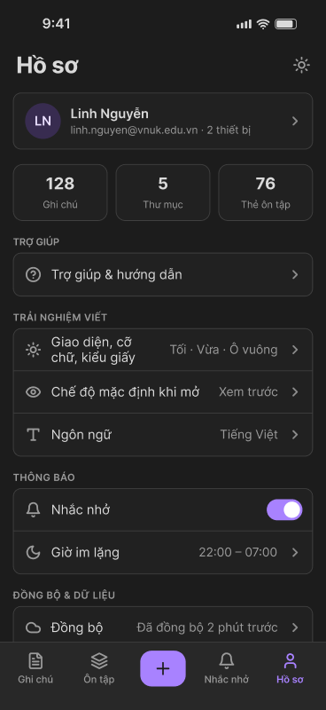
Mobile prototype
Home
Folders
Review
Profile
Create
Notes:
Demo live from Figma page 04 UI Prototype if time allows.

Slide 15
App map: 20 sections, 297 screens
Start
Browse
Create and write
Capture
00
Sign-in and first run
3
01
Entry and browse
28
02
Create, write, organize
30
03
Files, handwriting, voice
14
01b
Guided tour
18
01c
Side menu
5
02b
New note by type
22
02c
Editor modes
3
Find and organize
Remind and revise
Share and protect
Personalize
04
Search, folders, tags
17
05
Reminders
9
06
Share and export
13
09
Profile and settings
21
04b
Folder actions
40
05b
Reminder details
20
07
Sync and version history
8
10
Templates
10
12
Smart folders, scan from device
7
11
Flashcard review
5
08
Delete, undo, restore
10
10b
Built-in and saved templates
14
Notes:
Same structure as Figma page 04 UI Prototype. Each screen exists in Dark and Light. The next slides list the features by section.

Slide 16
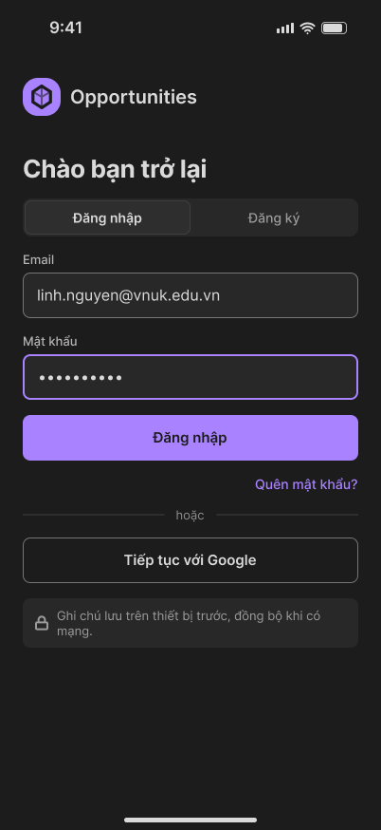
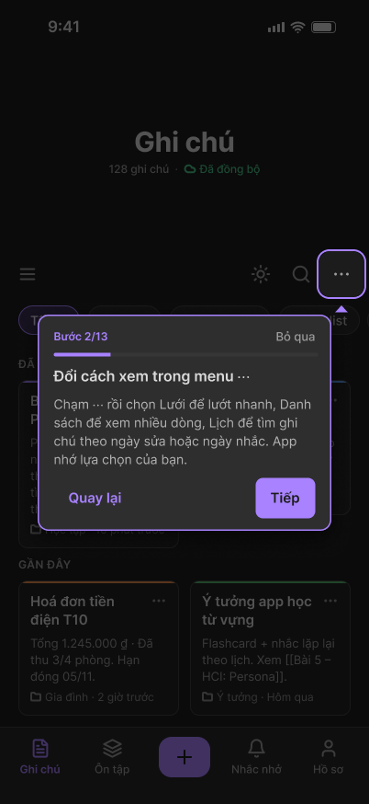
Getting started
Sections 00, 01b · 21 screens
Account
Guided tour
Sign in and sign up
Inline form validation
Password recovery
Spotlight tour with skip at any step
Covers Home, Create, Editor, Search, Reminders, Folders
Learning aids
Contextual tips
Sample note “Start here”
Help and guide screen
Markdown syntax cheat sheet
Tip shown the first time a tool opens, such as Scan
Notes:
Figma: Sections 00, 01b · 21 screens. Walk through the four groups, then point at the screens on the right.

Slide 17
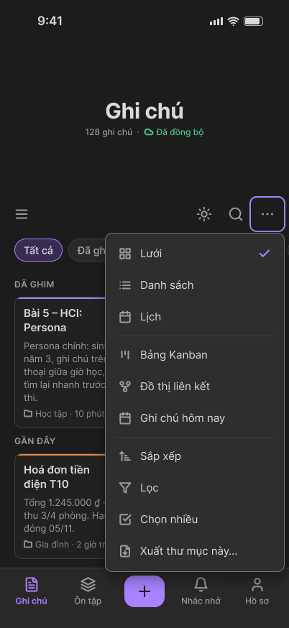
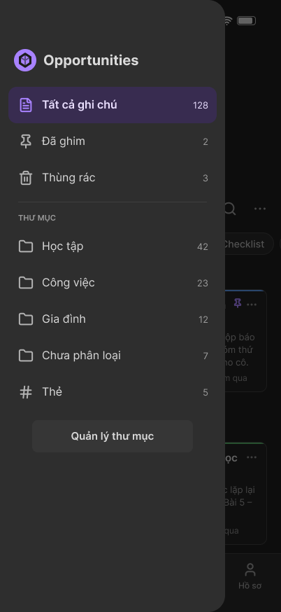
Browse notes
Sections 01, 01c · 33 screens
Views
Sort and filter
Grid, List, Calendar
Kanban board, link graph
Today’s notes
Sort and filter sheets
Quick filter chips: pinned, reminders, checklist, files
Note actions
Side menu ☰
Pin, move, color, remind
Duplicate, share, archive, delete
Multi-select for bulk actions
All notes, Pinned, Trash
Folders, tags, manage folders
Empty and loading states on Home
Notes:
Figma: Sections 01, 01c · 33 screens. Walk through the four groups, then point at the screens on the right.

Slide 18
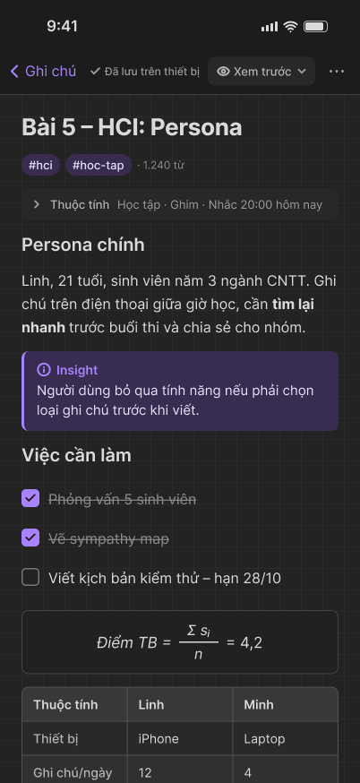
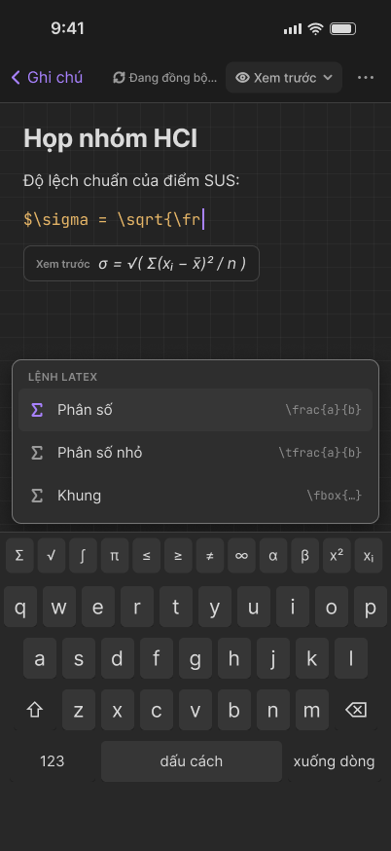
Write and organize
Sections 02, 02c · 33 screens
Editor modes
Rich content
Preview, Markdown source, Read only, Focus mode
Auto-save status
Slash menu to insert blocks
Wiki-links with [[ suggestions
Formula suggestions and symbol row
Note properties
Inside a note
Note color, custom color wheel
Tags and custom properties
Move to folder
Find in note
Lock with Face ID or passcode
Note menu for share, export, history
Notes:
Figma: Sections 02, 02c · 33 screens. Walk through the four groups, then point at the screens on the right.

Slide 19
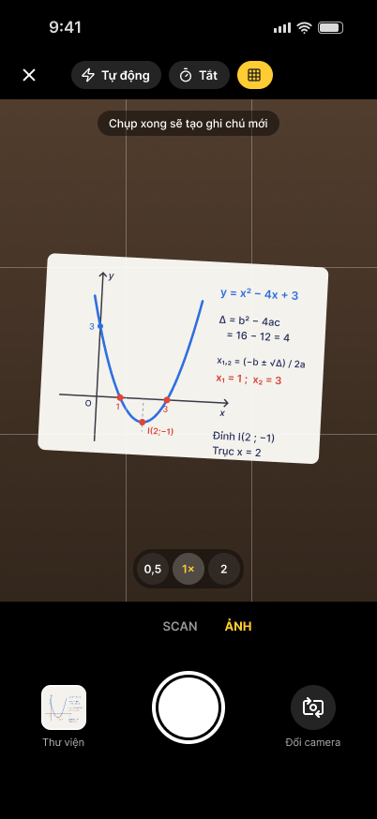
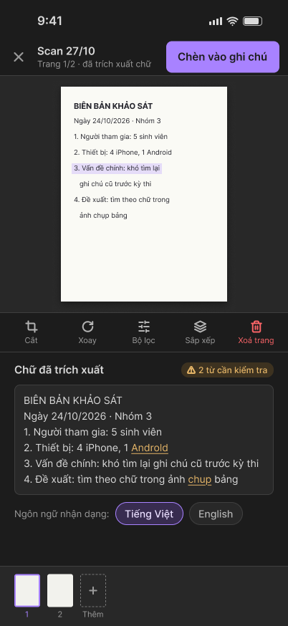
Capture anything
Sections 02b, 03, 12 · 38 screens
Create from +
Camera and photos
Note, checklist, voice, photo, scan, drawing, template
Each opens its own new note
Flash, timer, gallery
Choose which extracted items to keep
Scan and OCR
Voice, drawing, files
Edge detection, multi-page
Review recognized text
Scan images or PDFs from device
Voice recording in the editor
Full-screen drawing canvas
Attach PDF or DOCX
Notes:
Figma: Sections 02b, 03, 12 · 38 screens. Walk through the four groups, then point at the screens on the right.

Slide 20
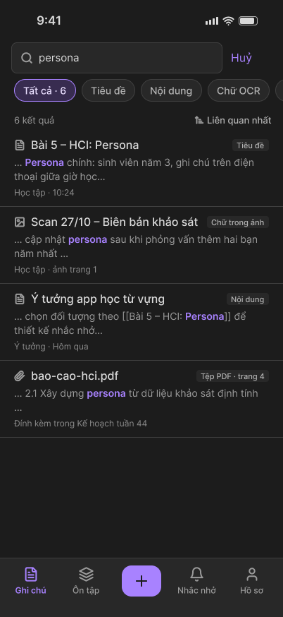
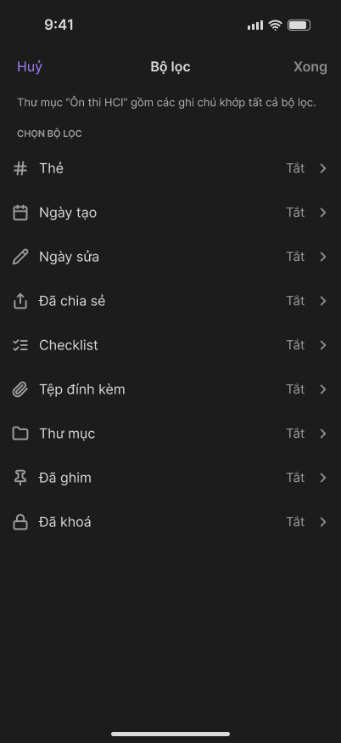
Find and organize
Sections 04, 04b, 12 · 62 screens
Search
Folders
Search notes, files and text inside photos
Results and no-result states
Create, edit, delete, subfolders
Icon and color per folder
Open folder to see its notes
Smart folders
Tags and files
Built from filters: tags, dates, type, pinned, locked
Update automatically
Create, rename, delete tags
Attachment library
Notes:
Figma: Sections 04, 04b, 12 · 62 screens. Walk through the four groups, then point at the screens on the right.

Slide 21
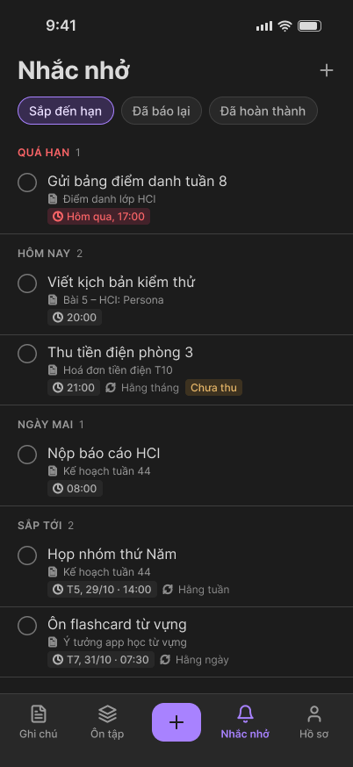
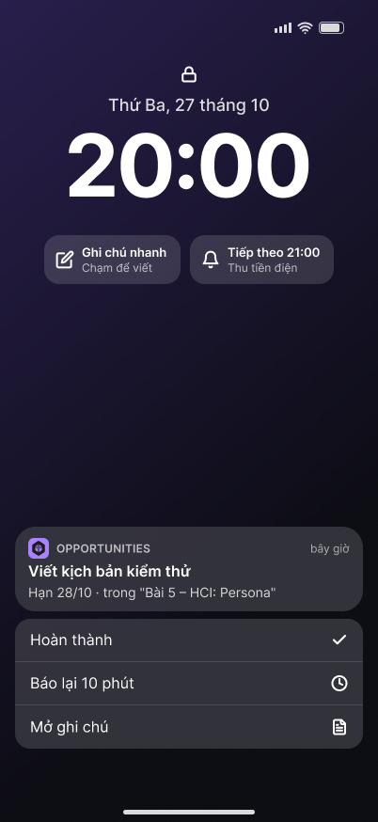
Reminders
Sections 05, 05b · 29 screens
Reminder list
From a note
Grouped by due date
Completed list
New reminder from the list
Set a reminder inside the editor
Open the linked note from its reminder
Details
Notifications
Reminder detail sheet
Mark as done with result state
Lock screen notification sample
Snooze 10 minutes
Quiet hours in Profile
Notes:
Figma: Sections 05, 05b · 29 screens. Walk through the four groups, then point at the screens on the right.

Slide 22
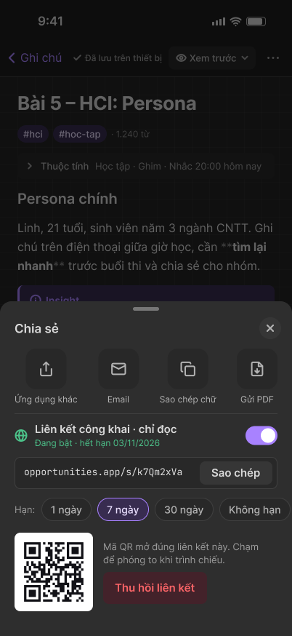
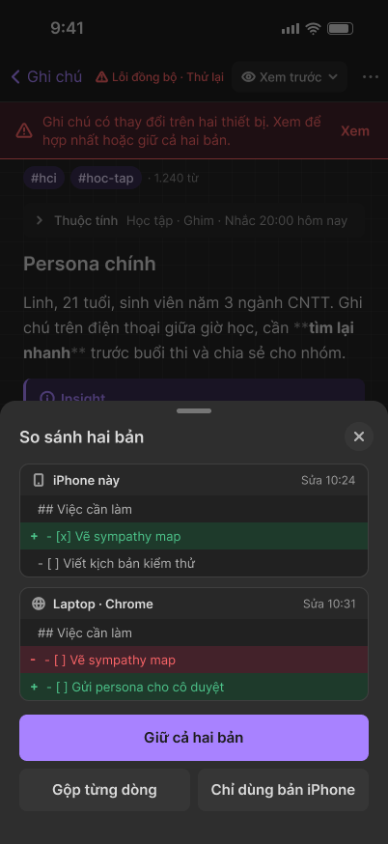
Share, sync and recover
Sections 06, 07 · 21 screens
Share
Export PDF
Public link with QR code
Copy or revoke the link
Read-only page for viewers
Preview with options
Page size and orientation
Text size
Offline and conflicts
Version history
Works offline, syncs later
Compare two versions
Keep both, merge or pick one
Browse past versions
Restore or copy content
Notes:
Figma: Sections 06, 07 · 21 screens. Walk through the four groups, then point at the screens on the right.

Slide 23
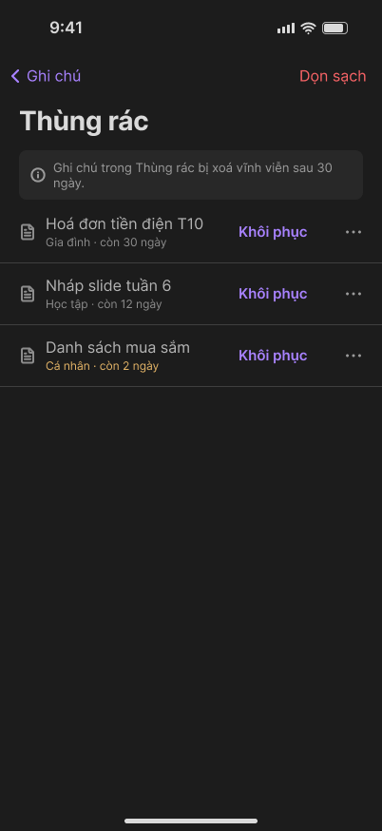
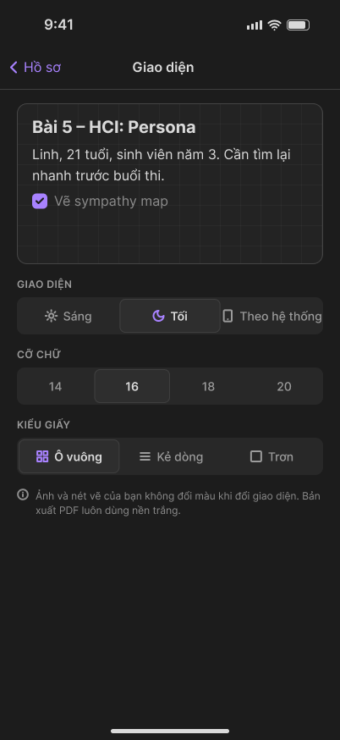
Safety and settings
Sections 08, 09 · 31 screens
Delete safely
Archive
Undo snackbar
Trash with restore
Permanent delete with confirmation
Separate from Trash
Unarchive from its menu
Writing comfort
Profile and account
Dark and Light with live preview
Text size, paper style
Default open mode, language
Account and devices
Change password, note lock PIN
Import Markdown, export ZIP
Notes:
Figma: Sections 08, 09 · 31 screens. Walk through the four groups, then point at the screens on the right.

Slide 24
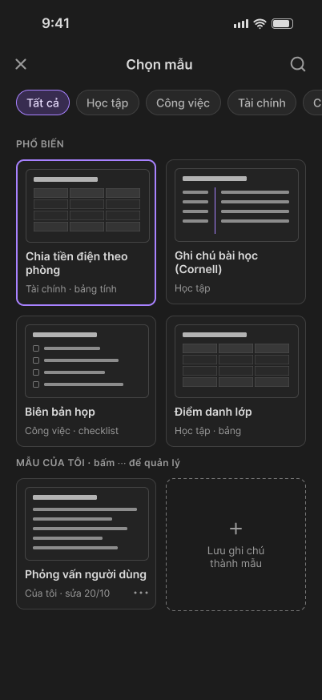
Templates and flashcards
Sections 10, 10b, 11 · 29 screens
Built-in templates
My templates
Cornell notes, meeting minutes
Class attendance, user interview
Preview before using
Save a note as a template
Edit, rename, duplicate, delete
Flashcard review
Spaced repetition
Cards due today, decks
Cards created from notes
Session with progress
Rate: Forgot, Hard, Good, Easy
Session summary
Next review date
Notes:
Figma: Sections 10, 10b, 11 · 29 screens. Walk through the four groups, then point at the screens on the right.

Slide 25
What changed after lecturer review
Home
Review tab
Views moved into the ⋯ menu; roomier header
Replaces the Search tab; search stays on Home
Profile tab
Folders screen
Replaces Library; holds all settings on one screen
Opened from the ☰ menu, like Apple Notes, with smart folders
Lock icon
Scan from device
Recolored to match the violet palette
Pick an image or PDF when adding a note

Slide 26
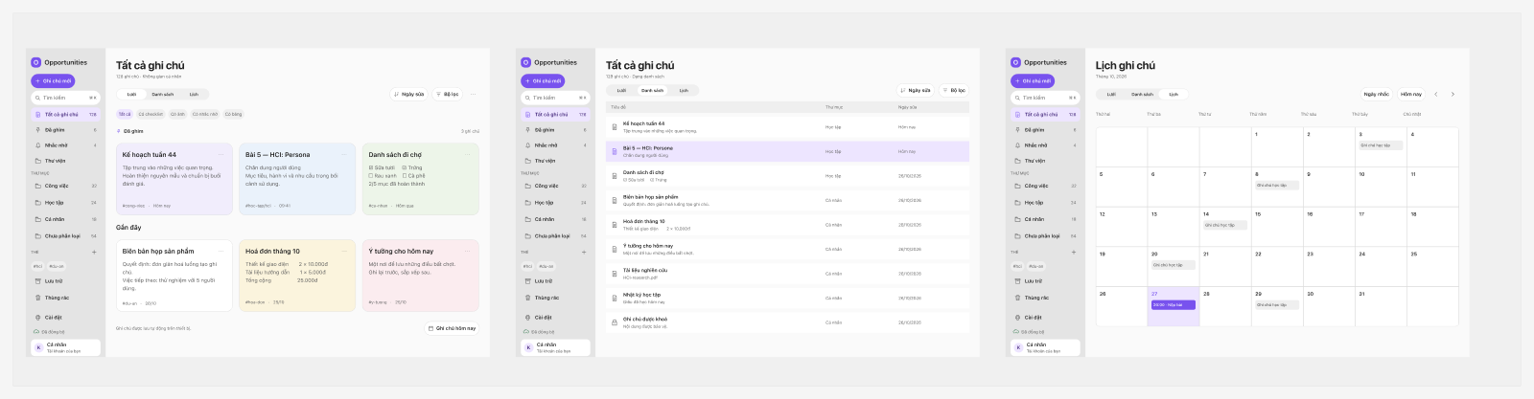
Web prototype
The same note app adapted for desktop, with a sidebar and keyboard shortcuts.
Notes:
Web still uses its own navigation. Say so if asked: aligning it with the updated mobile navigation is a next step.

Slide 27
Test cases and usability targets
Planned targets, not yet measured
≤ 2
≤ 3
0
80+
taps to capture a note
actions to find any note
notes lost
SUS score
Save a whiteboard photo so it can be found later: 4 taps or fewer
Find a word that appears only inside a photo: 3 actions or fewer
Restore a note deleted by mistake: 2 taps or fewer

Slide 28
Next steps
1
Run usability tests with 5 participants per persona
2
Iterate on any task under 80 percent success
3
Bring the web prototype in line with the updated mobile navigation

Slide 29
Thank you
Questions and feedback are welcome

