Slide 1







BIG DATA ANALYTICS 2026 · VNUK · WEEK 4
FINAL DASHBOARD
& DECISIONS
Segment-based movie promotion and content discovery on MovieLens 10M
MySQL → KNIME → K-Means + Logistic Regression → Power BI
TEAM
Hồ Anh Tuấn · Trần Ngọc Quân
LECTURER
Trần Thế Vũ
Notes:
State the final model version (logit_v1) and the dashboard data refresh time (16/10/2026 20:37) before starting the live demo.

Slide 2

WEEK 4 AT A GLANCE
WHAT · WHEN · WHY · HOW MUCH
WHAT
End-to-end demo: MySQL → KNIME → MySQL → Power BI
5-page interactive dashboard
4 evidence-based recommendations
IEEE paper + reproducible repository
WHEN
Model logit_v1 and dashboard data frozen 16/10/2026
Live demo and Q&A in the Week 4 session
Paper (PDF + DOCX) submitted with the repository
WHY
The grade needs one traceable chain from raw data to decision
Every recommendation is tied to model evidence, support and limits
HOW MUCH
Planned: 16–20 team hours
Actual: ____ hours
Gap: ____ hours
Action on gap: ____________
Model version logit_v1 · Last run 16/10/2026 20:37 · Split TRAIN 70 / VALID 15 / TEST 15
Notes:
Answer the four tutor questions directly. Fill in the actual hours and the gap action before presenting.

Slide 3
END-TO-END SYSTEM
ONE TRACEABLE CHAIN FROM RAW FILES TO DECISIONS
MOVIELENS 10M
MYSQL
KNIME
MYSQL WRITE-BACK
POWER BI
DECISIONS
10,000,054 ratings
10,681 movies
95,580 tags
ratings, movies, tags, movie_genres, rating_split, train_*_stats
Scripts 01–05
WF0 data quality
K-Means (K = 4)
Logistic Regression
user_segments
rating_predictions
model_metrics
dashboard_* views
5 pages · 4 filters
4 recommendations
A/B test design
RERUN ORDER
Python 01–05 → KNIME segmentation → 06 features → KNIME logistic regression → knime_logit_metrics.sql → 07 dashboard views → Refresh Power BI
Notes:
Trace one number across the layers, e.g. 76,633 TEST rows: rating_split in MySQL, scored in KNIME, written to rating_predictions, shown on the Model Governance page. Prove integration, do not tour every script.

Slide 4
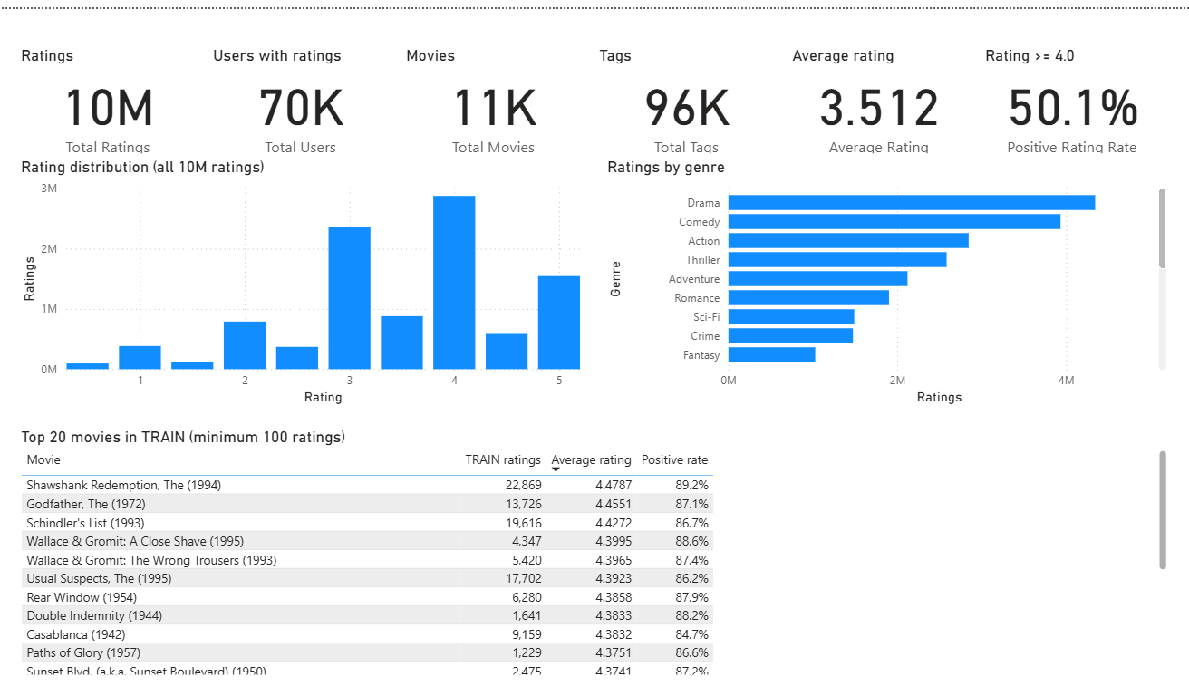
FINAL INTERACTIVE DASHBOARD
POWER BI · 5 PAGES · READS MYSQL VIEWS ONLY
1
Executive Overview
Is there usable evidence?
2
Audience Segments
Who are the four segments?
3
Positive Engagement Model
How good is the model, and where?
4
Content Opportunity Matrix
Which titles to promote or test?
5
Model Governance
When are results safe to use?
Shown: page 1, Executive Overview
GLOBAL FILTERS
Model version
Segment
Genre
Min. TEST support
Notes:
Switch to the live .pbix. Keep the same filter path across pages (model version logit_v1, segment Selective Critics, minimum support 50) so the audience sees one question become one governed decision.

Slide 5
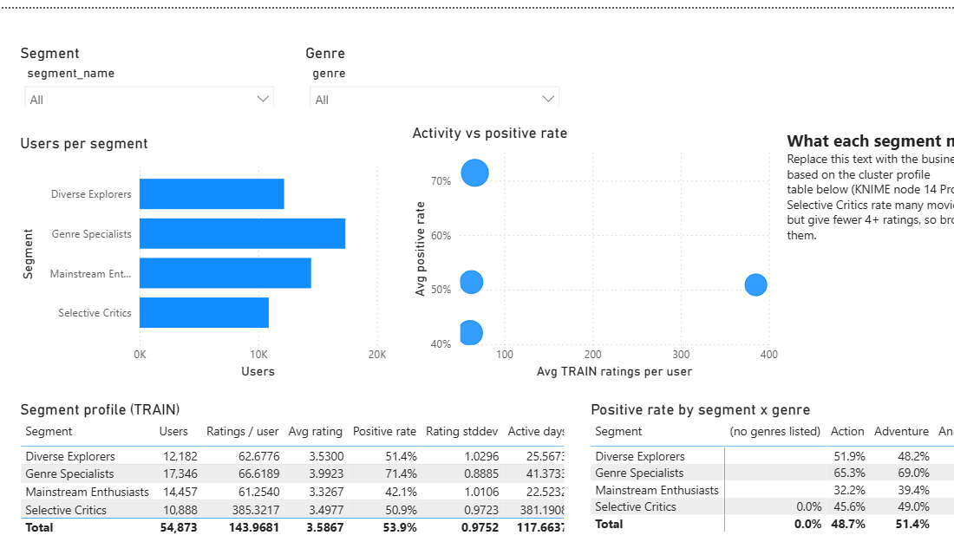
AUDIENCE SEGMENTS
K-MEANS · K = 4 · 54,873 USERS SEGMENTED
Positive-rating rate (rating ≥ 4)
Genre Specialists
17,346 users
71.43%
Largest segment, most positive raters
Diverse Explorers
12,182 users
51.38%
Relative thriller, action and mystery affinity
Dashboard page 2: Audience Segments
Selective Critics
10,888 users
50.88%
385.3 TRAIN ratings per user: strongest title-level support
Mainstream Enthusiasts
14,457 users
42.06%
Family and animation affinity, lowest positive rate
Silhouette K = 4: 0.0686 (K = 5: 0.0692). Low separation, so labels are behavioural lenses for curation, not fixed identities.
Notes:
Translate profiles into curation hypotheses. K = 4 was kept for interpretability although K = 5 scored 0.0006 higher.

Slide 6
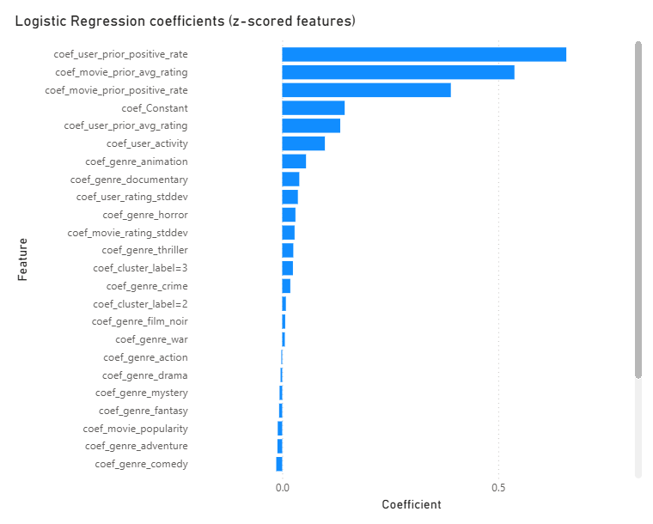
MODEL PERFORMANCE
LOGISTIC REGRESSION · TARGET: RATING ≥ 4.0 · TEST SET
69.26%
59.32%
+9.93 pp
0.758
Accuracy
Majority baseline
Lift
ROC-AUC
CONFUSION MATRIX (TEST)
Precision 60.58%
Recall 69.94%
F1 64.92%
 | Predicted 0 | Predicted 1
Actual 0 | 31,273 | 14,189
Actual 1 | 9,369 | 21,802
Dashboard page 3: Positive Engagement Model
STRONGEST SIGNALS
User prior positive rate
Movie prior average rating
Movie prior positive rate
5.11%
TEST coverage
76,633 of 1,500,006 TEST rows are warm start: user and movie both have TRAIN history.
Use as a warm-start decision aid; cold start needs a popularity or editorial fallback.
Notes:
Answer performance questions with quality and applicability together: how well the model ranks covered rows, and how many rows it covers.

Slide 7
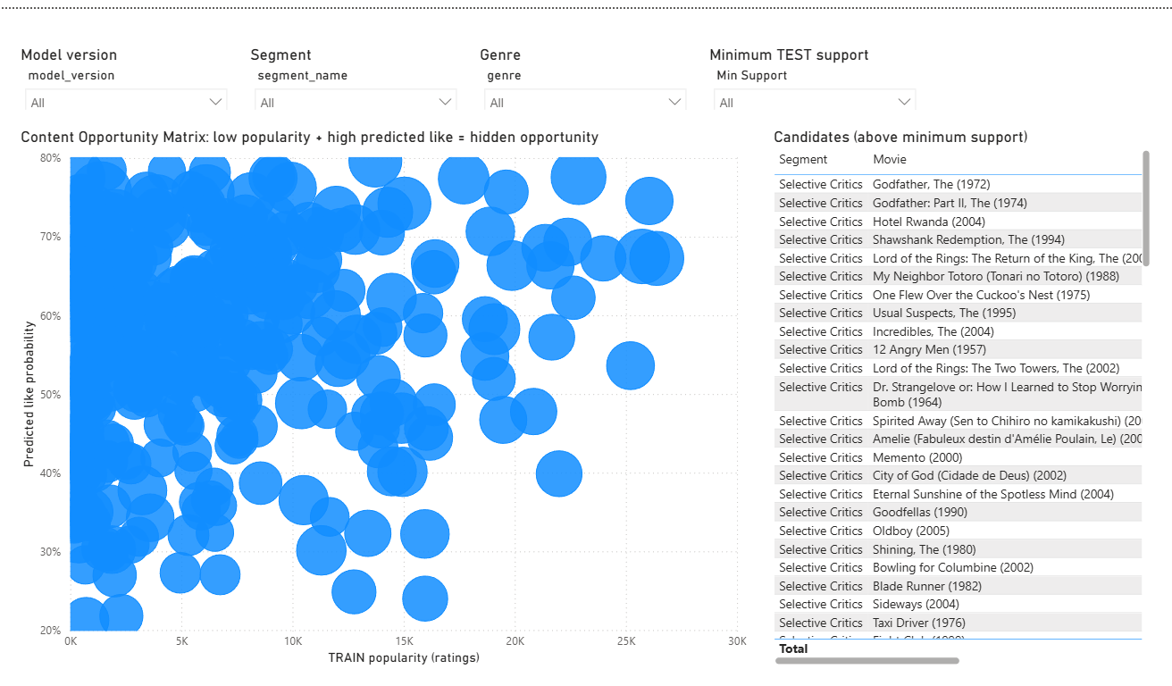
CONTENT OPPORTUNITIES
PREDICTED APPEAL × ACTUAL RESPONSE × POPULARITY × SUPPORT
Only Selective Critics has title-segment pairs with TEST support ≥ 50 (107 pairs). Hidden opportunities:
Title | Support | Predicted | Actual | TRAIN pop.
Hotel Rwanda | 108 | 76.72% | 77.78% | 215
My Neighbor Totoro | 58 | 74.87% | 74.14% | 487
City of God | 60 | 71.66% | 70.00% | 968
Oldboy | 52 | 69.94% | 67.31% | 72
Dashboard page 4: Content Opportunity Matrix
OVEREXPOSED FOR THIS SEGMENT
High popularity, low actual positive rate (support > 50):
Home Alone 17.65% · Star Wars Ep. I 19.61% · Twister 10.17% · The Mask 5.66%
Diagnostic: The Incredibles predicted 74.45% vs actual 60.75% (107 obs)
Notes:
Opportunity is a prioritisation signal, not proof that a campaign will cause higher engagement. Support thresholds keep unstable small samples out.

Slide 8
PROMOTE HIDDEN OPPORTUNITIES
RECOMMENDATIONS 1–2 · SELECTIVE CRITICS
1
Test Hotel Rwanda and My Neighbor Totoro in a discovery row
2
Add City of God and Oldboy to the candidate pool
Evidence Hotel Rwanda: support 108, predicted 76.72%, actual 77.78%. Totoro: support 58, 74.87% vs 74.14%.
Impact More discovery of low-popularity titles (TRAIN 215 and 487 ratings) with aligned predicted and observed appeal.
Assumption Rating ≥ 4 is a fair proxy for satisfaction; warm-start users only.
Risk Rating is not viewing; A/B test before any rollout.
Evidence City of God: support 60, 71.66% vs 70.00%, popularity 968. Oldboy: support 52, 69.94% vs 67.31%, popularity 72.
Impact Broadens the slate beyond blockbusters for the most active segment.
Assumption Segment taste in 2007–2009 TEST still applies.
Risk Support of 52–60 gives wide intervals; track each title separately.
Owner: content strategy + analytics · Measure: positive-rating rate · Guardrails: support ≥ 50, exposure count
Notes:
These titles qualify because predicted appeal is high, actual response agrees, support is sufficient and historical popularity is comparatively low.

Slide 9
REDUCE, FALL BACK, TEST
HOW WE TEST BEFORE ROLLOUT
1
Eligible warm-start users
RECOMMENDATIONS 3–4 · CONTROLS
2
Random assignment A / B
3
Reduce default placement of overexposed titles for Selective Critics
3
Same slot, timing, exposure
Evidence Home Alone 17.65%, Star Wars Ep. I 19.61%, Twister 10.17%, The Mask 5.66% actual positive, support > 50.
Risk Reallocate within one segment only; keep titles in the catalogue.
4
Positive-rating rate + 95% CI
4
Use a popularity or editorial fallback when history is missing
Evidence Classifier covers 5.11% of TEST; segments cover 54,873 of 69,878 users (78.5%).
Measure Track coverage as a deployment KPI next to accuracy.
Diagnostic A/B case: The Incredibles, predicted 74.45% vs actual 60.75%. No revenue claims without exposure and commercial data.
Notes:
Frame reduction as reallocation inside one segment, not a global removal. Randomise eligible users, keep placement and timing equal, compare positive response with confidence intervals.

Slide 10
IEEE PAPER & REPOSITORY
BEFORE SUBMISSION
✓
Fresh dashboard refresh
RESEARCH-STYLE PAPER · REPRODUCIBLE SUBMISSION
PAPER: 6–10 PAGES, TWO-COLUMN
REPOSITORY
✓
Clean credentials and relative paths
Abstract & Keywords
Introduction
Related Work
Methodology
Experiments & Results
Discussion & Recommendations
Conclusion
References (≥ 5 sources)
movielens-content-strategy/
├─ sql/ python_sql_scripts/
│ 01–07, knime_logit_metrics
├─ knime/ 3 workflows
├─ dashboard/ .pbix .pbip
├─ powerbi/ 5 page images
├─ output/ report, decks
├─ docs/ data dictionary
└─ README.md setup + run order
✓
Archive demo inputs and outputs
✓
Team can explain each part
PDF + editable DOCX · .env ignored, password placeholders only · model version logit_v1 everywhere
Notes:
Name the exact command and workflow sequence that rebuilds the outputs instead of saying the repository is complete.

Slide 11
PLAN VS ACTUAL
REFLECTION · LIMITS · NEXT STEPS
Deliverable | Planned | Actual
MySQL schema + scripts 01–07 | Week 2 | Done
KNIME quality, K-Means, LR, write-back | Week 3 | Done
Power BI, 5 pages | Week 3–4 | Done
IEEE paper, PDF + DOCX | Week 4 | ____
README with run order | Week 4 | ____
Team hours (Week 4) | 16–20 h | ____ h
WHAT WORKED
End-to-end integration, out-of-time split, interpretable models, versioned write-back
WHAT IS LIMITED
Data ends 2009, no exposure or revenue, overlapping clusters, 5.11% TEST coverage
NEXT
Run controlled experiments on qualifying titles; monitor coverage before expanding
Gap ____ h · Corrective action: ________________________
Notes:
Fill in actual hours, the gap and the corrective action. Be explicit about unresolved issues.

Slide 12
THANK YOU
QUESTIONS?
1 · Evidence
2 · Bounded decision
3 · Controlled experiment
4 · Learning
Q&A BACKUP
Data quality checks · split dates · leakage controls · choice of K · confusion matrix · coverage · support thresholds
Notes:
Invite questions on the evidence chain. If asked about business impact, separate model performance from causal campaign lift.

