Slide 1

AETERNA-QA
Autonomous Entity-Driven Verification & Reasoning
for Data Quality Assessment
Capstone Project Proposal & Implementation Roadmap
Name: Raghav Vasudevan
SRN No: PES1PG25CA170
Section: C
Project Guide : Dr. Menaka
Designation: Professor
Department: Department of Computer Applications
Department of Computer Applications

Slide 2
Abstract Project Overview & Objectives
Overview:
AETERNA-QA is an autonomous agent-based system for data quality assessment and cleaning. It combines LLM-powered planning, iterative verification loops, and downstream model feedback to autonomously detect, diagnose, and repair data quality issues while proving the effectiveness of each cleaning operation.
Primary Objectives:
1. Reduce manual data cleaning by 80%
2. Achieve verification-driven cleaning with 80%± improvement confidence
3. Provide audit trails for compliance and interpretability
4. Support multi-table schema-aware data governance
Key Metric:
If a cleaning operation doesn't improve downstream model F1 by ≥1%, it's rejected and rolled back.
Department of Computer Applications

Slide 3
Problem Scenario Motivation & Need For Solution
Current Bottleneck / Existing System:
- Data scientists spend 60-80% of time on data preparation
- Static rule engines break when data distributions shift (drift)
- No feedback loop to validate if cleaning improves downstream models
- Enterprise data lakes lack autonomous quality governance
- Cleaning decisions are opaque and non-auditable
Why This Matters:
- Manual cleaning = scalability bottleneck
- Rule-based systems are rigid and inflexible
- No verification means wasted effort on ineffective cleaning
- Regulatory requirements (GDPR, HIPAA) demand audit trails
Proposed Motivation:
1. LLM-based autonomous diagnosis replaces static rules
2. Downstream model performance delta as reward signal
3. Iterative detect-verify-repair with automatic rollback
4. Causal hypothesis generation for interpretability
5. Schema graphs enable multi-table data governance
Department of Computer Applications

Slide 4
Core System Functionalities Key Features & Modules
1. Data Profiling Engine
- Statistical profiling (nulls, outliers, distributions)
- Anomaly detection via ML (PyOD, Isolation Forest)
- Temporal drift monitoring
2. LLM Planner Module
- Chain-of-thought diagnosis of data issues
- Ranked strategy generation with confidence scores
- Multi-hypothesis exploration
3. Autonomous Execution
- Tool-use API (Pandas, imputation, standardization)
- Great Expectations constraint validation
- Semantic string cleaning via regex & fuzzy matching
4. Verification Loop (Novel Contribution)
- Lightweight model trainer (sklearn RandomForest)
- Performance delta measurement (ΔF1, ΔAUC)
- Automatic rollback on negative delta
5. Audit & Explainability
- Provenance tracking for every operation
- Causal hypothesis templates
- Natural language explanations
Department of Computer Applications

Slide 5
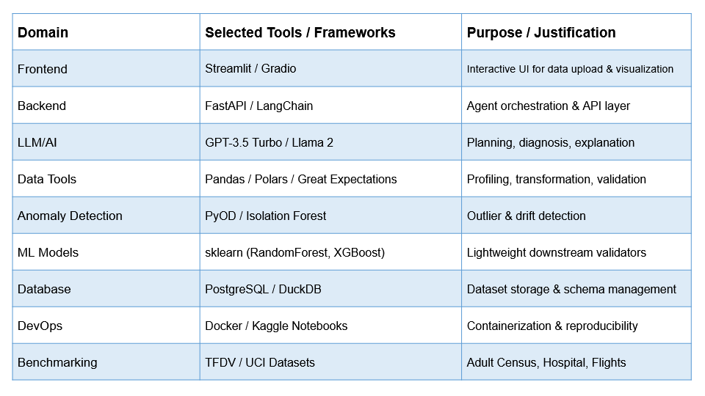
Tools & Technologies Technology Stack Matrix
Subject to Change
Department of Computer Applications

Slide 6
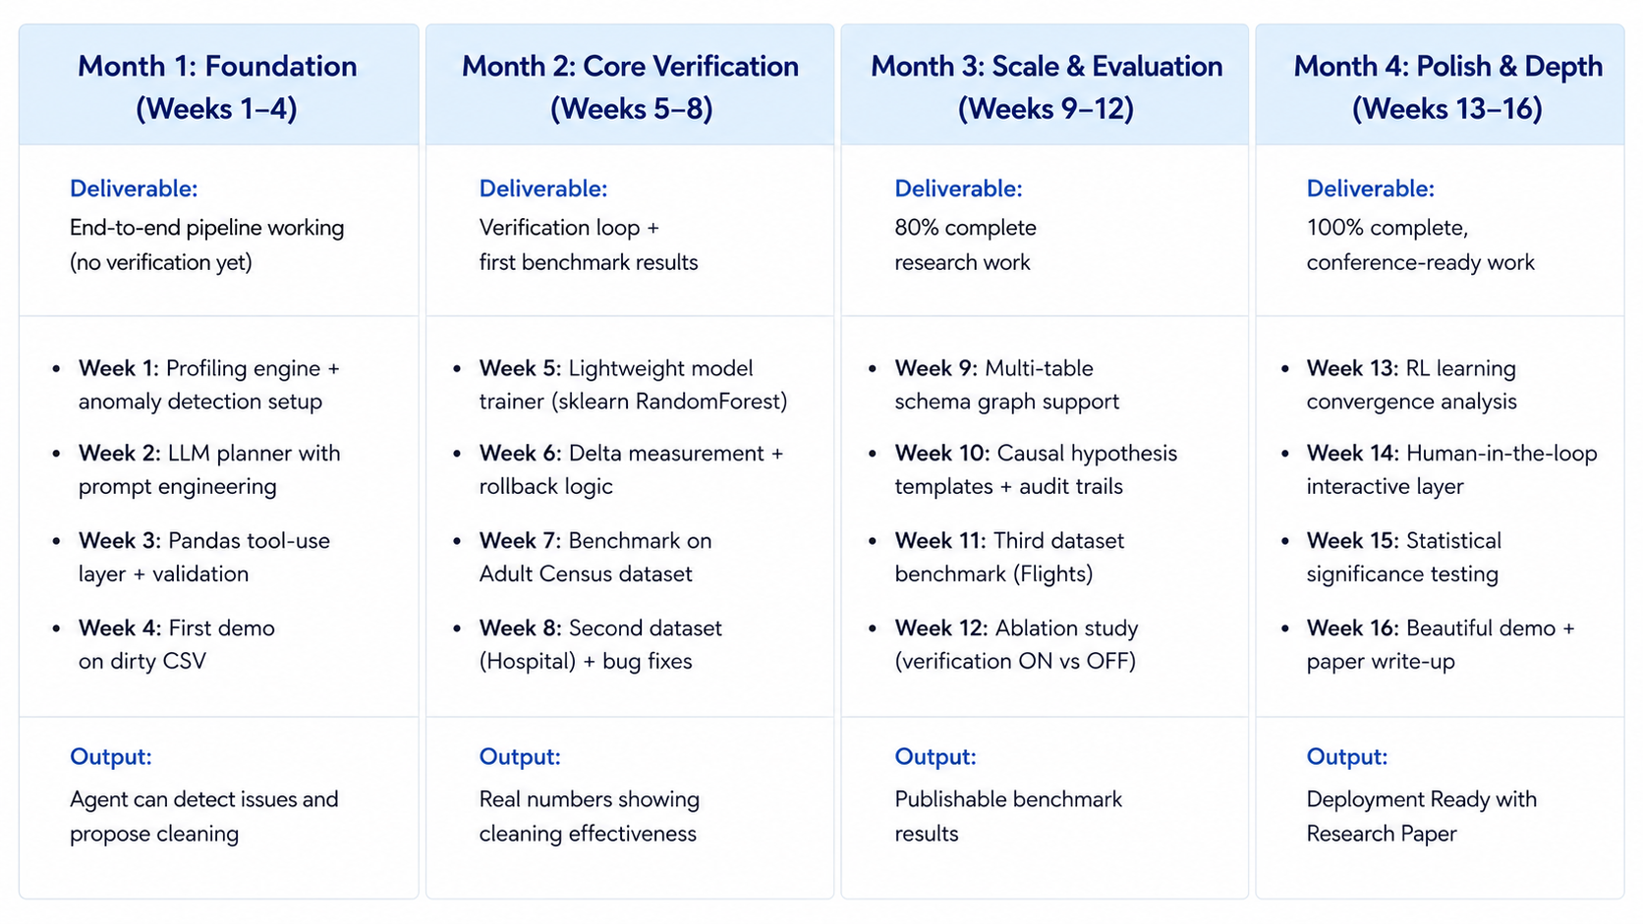
Project Work Status Week-Wise Timeline Plan
Department of Computer Applications

Slide 7
THANK YOU
Department of Computer Applications

