Slide 1
T4GS
Dennis Indrawan
Fahmi Taufikhul Hakim
Gigih Pandega Hanuranto

Slide 2
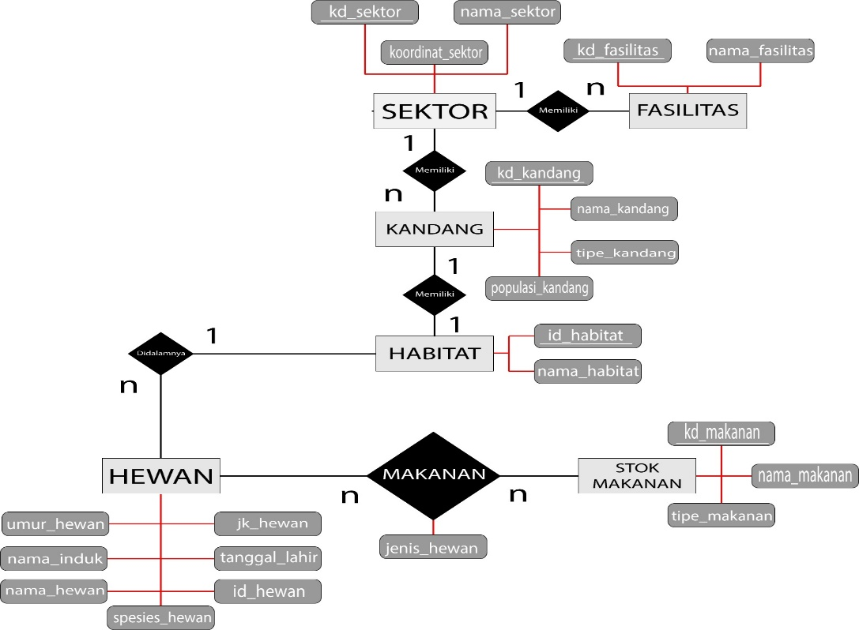
ER Diagram

Slide 3
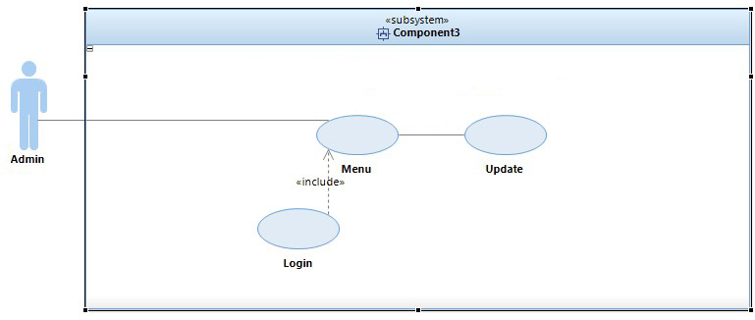
USE CASE

Slide 4
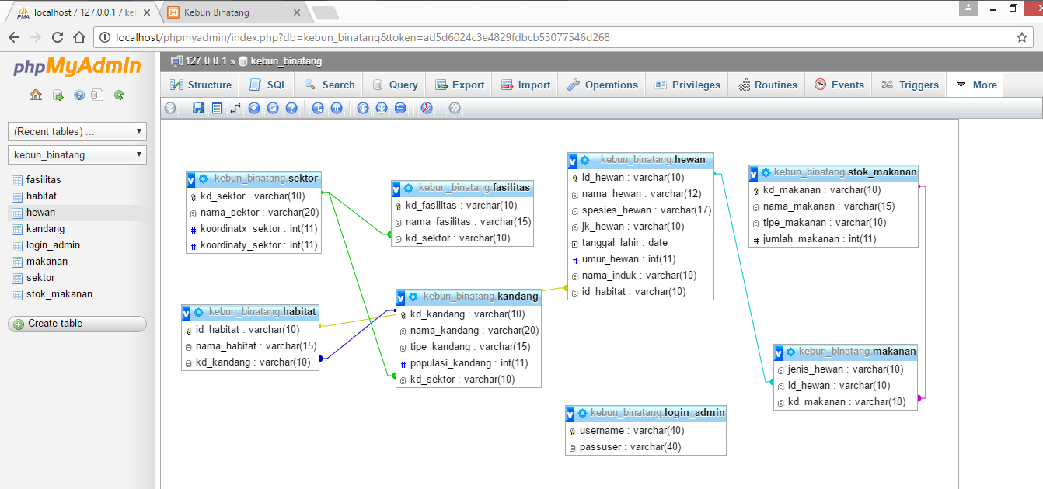
DATABASE OPTIONAL

