Slide 1

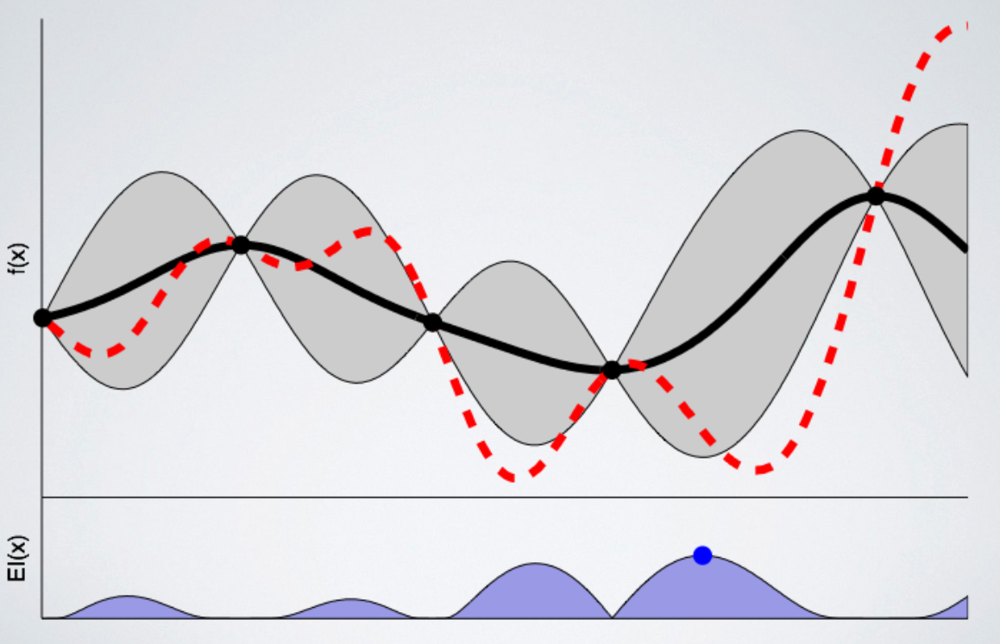
INM431 Machine Learning – Comparative Study of two different Machine Learning Algoithms, Random Forest and Bayesian Ridge Regression, for the purpose of forecasting Sales
Daniel Dixey and Enrico Lopedoto
MSc Data Science, School of Mathematics, Computer Science & Engineering, Department of Computer Science
Motivation and Description
Predictive Analytics can be argued as of the most alluring and effective methods of forecasting the future given past observations for all businesses and organisations. To quote Barton and Court (2012) [7], “Advanced analytics is likely to become a decisive competitive asset in many industries and a core element in companies' efforts to improve performance.”. Machine style solutions offer far more robust methods for this type of analysis.
The aim of this analysis is to explore, compare and contrast two Machine Learning algorithms for the purpose of forecasting (regression) the daily sales of 1,115 stores across Europe for the Rossman Drug Stores. The intention is to provide evidence that once particular algorithm is more effective that other methods for the purpose of this task.
Training and evaluation methods
The high level overview of the processes for comparing the two machine learning algorithms can be written as follows:
Import dataset
Pre-process dataset
Transform and generate via Feature Engineering new variables
Model Selection and Evaluation:
100 trials per algorithm
5 Fold Cross Validation
Good for estimating the generalisation error of a given model
Reduces model biases during model selection
Evaluation Metric: Mean Squared Error (MSE) - based on the evidence from Willmott and Matsuura [8]
Hyper-parameter Optimisation: Bayesian Optimisation
Systematically training, validate and store the mean cost function values
Train models
Test models
Figure 1: One dimensional example of how the hyper-parameters are determined using Bayesian Optimisation, successive choices always try to ensure that the expected probability of improvement is the maximum. In this figure the blue point on the lower axis indicates the maximum point and where the model will be evaluated next.

