Slide 1


Visual Analytics (INM433)
Daniel Dixey
MSc Data Science
Wednesday 8th April

Slide 2


Data
Overview, description and properties of the dataset
Chosen Dataset
Competition Data from the Crossfit Open (2011)
Worldwide competition
5 Week long competition, each week represents one demanding workout (WOD)
Contents of the dataset
Basic Athlete metrics: Weight, Age, Gender and Height
Results and Rankings
Dataset Source
Acquired by Web Crawling
Expectation: Messy and unprocessed
What is Crossfit?
CrossFit is a rigorous fitness methodology that that attempts to unite multiple domains of fitness into one programme
Domains include; Weightlifting, High Intensity Interval Training (HIIT) and Gymnastics
Data [10%]. Description of the data chosen for the analysis: type, structure, size, properties of the components.
<number>
Notes:
<number>

Slide 3
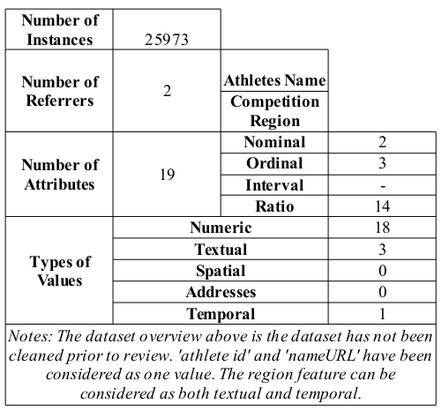
Data
Overview, description and properties of the dataset
Type of Data: Multi-dimensional dataset
Class of Data: Object Referenced Data
Data Quality:
Incompleteness
For all the attributes there exists a degree of incompleteness
Consideration will be determined on a feature by feature basis
Uncertainty
The credibility and integrity of the data could be of some concern,
Data [10%]. Description of the data chosen for the analysis: type, structure, size, properties of the components.
<number>
Notes:
<number>

Slide 4
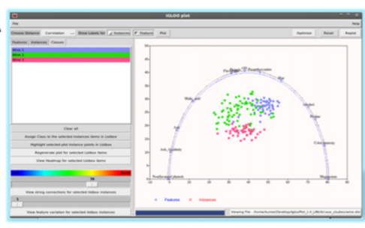
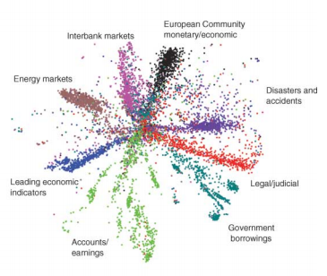
Analysis Tasks
Literature review, work to be undertaken and synoptic task
Literature Review: Dimensionality Reduction (DR)
Exploitation: The focus of the review was deliberately limited to DR as the number of considerations and techniques available in the area of multidimensional analysis are vast.
Limitation: DR was specifically identified as very useful in assisting with the visualisation of multidimensional datasets.
Challenges:
- Trying to understand the data model would find it difficult to interpret and make meaningful interpretations of the data
- Minimising Information loss
Work Accessed and Discussed:
- Visual Hierarchical Dimensionality Reduction (VHDR) – Methodology for avoiding gaining maximum information
- Neural Networks (Autoencoders) – An alternative approach to DR, can “learn” non-linearities
- Igloo Plots – A visual approach to visualising many dimensions simultaneously
Analysis tasks [10%]. Analysis task(s) chosen for your analysis: Do these relate to the tasks you addressed in your literature review (part 1)? If so, how? Specific task formulations for the chosen data and the corresponding generic task types.
<number>
Notes:
<number>

Slide 5
Analysis Tasks
Literature review, work to be undertaken and synoptic task
Research Question/Statements:
“Are there significant variations in athlete scores that enable the ability to identify cohorts of similar performance”
Intermediate Questions
Who are the top individuals globally and by region? Are they comparative and exhibit the same types of characteristics?
How does the drop of participation of each of the Open events distort the comparison of athletes?
What key features do the top athletes have that the less competitive do not?
How do gender, height and weight relate to the performance of athletes in the Crossfit Open competition?
It is expected that during the analysis that further questions (elementary and intermediate) will arise as a result of these pre-determined questions.
Analysis tasks [10%]. Analysis task(s) chosen for your analysis: Do these relate to the tasks you addressed in your literature review (part 1)? If so, how? Specific task formulations for the chosen data and the corresponding generic task types.
<number>
Notes:
<number>

Slide 6
Analysis Methodology
Overview, description and techniques used in the process
5 Phases of the Analysis
1. Understanding of the characteristics of the attributes
understanding of each of the distributions and basics statistics about every feature
2. Understanding of the Relationships between the attributes
Investigate the relationships between features perception
Using a variety of different visual display types
Careful consideration of the types of visual encodings: shape, size, colour and labelling, to aid and complement with the understanding
3. Describing the relationships
Two computational methods will be utilised at this stage; Gaussian Mixture Models (GMM) and Self Organising Maps (SOM)
Answer the intermediate and research questions
4. Exploring the findings iteratively through interaction
It is expected that navigating many times between phase 1-3
5. Final presentation
Final Improvement and refinement of the visualisations
Analysis methodology [30%]. Methodology of your analysis.
<number>
Notes:
<number>

Slide 7
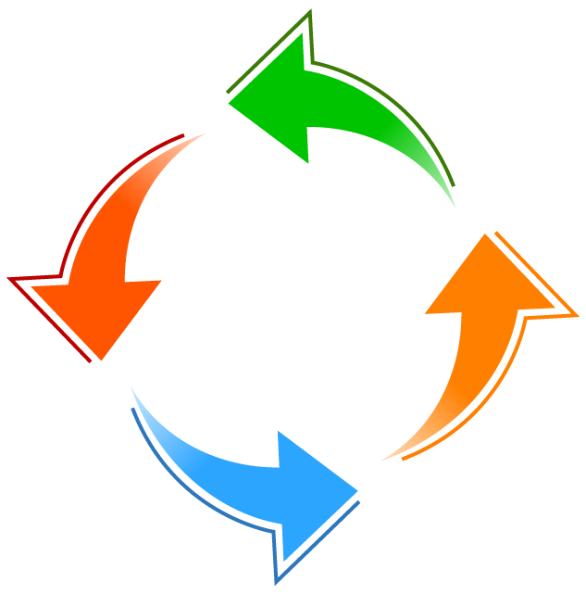

Implementation
Software and process work flow
Preprocessing Exploratory Analysis Final Presentation
Python
Orange Canvas
LibreOffice
Calc
Python
Seaborn
“attractive statistical graphics”
Javascript
D3.js
“helps you bring data to life”
Interactive work flows
Widgets
Machine learning
Transformation
Testing and evaluation
Implementation [30%]. Implementation of the analysis methodology: software used, links between methods (integrated in the same software or data transfer)
<number>
Notes:
<number>

Slide 8
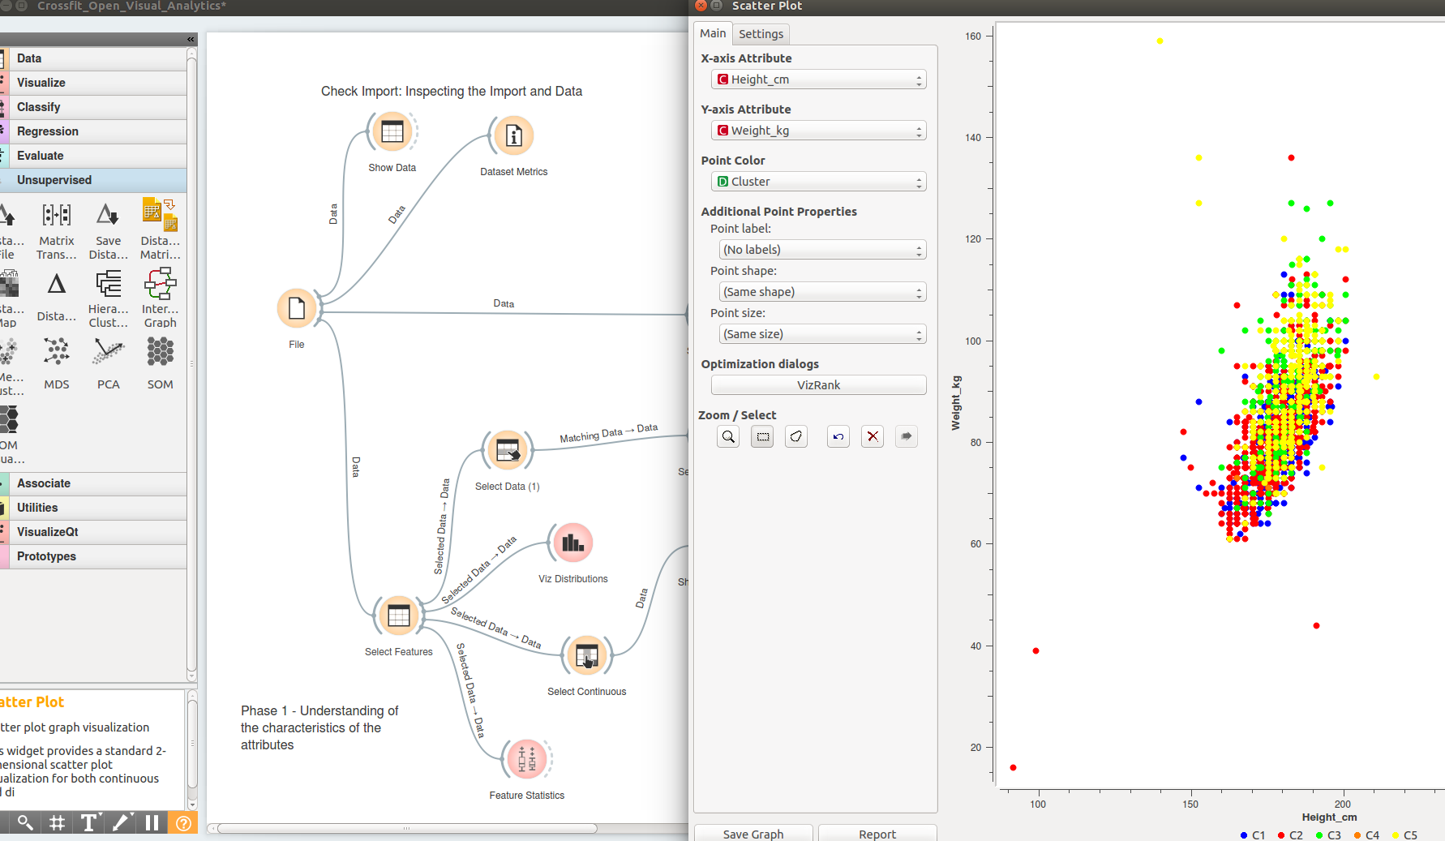
Analysis process
Work to be undertaken and results
Analysis process [10%]. Illustrated description of the analysis process
<number>
Notes:
<number>

Slide 9
Analysis Methodology
Overview, description and techniques used in the process
5 Phases of the Analysis
1. Understanding of the characteristics of the attributes
understanding of each of the distributions and basics statistics about every feature
2. Understanding of the Relationships between the attributes
Investigate the relationships between features perception
Using a variety of different visual display types
Careful consideration of the types of visual encodings: shape, size, colour and labelling, to aid and complement with the understanding
3. Describing the relationships
Two computational methods will be utilised at this stage; Gaussian Mixture Models (GMM) and Self Organising Maps (SOM)
Answer the intermediate and research questions
4. Exploring the findings iteratively through interaction
It is expected that navigating many times between phase 1-3
5. Final presentation
Final Improvement and refinement of the visualisations
Analysis methodology [30%]. Methodology of your analysis.
<number>
Notes:
<number>

Slide 10
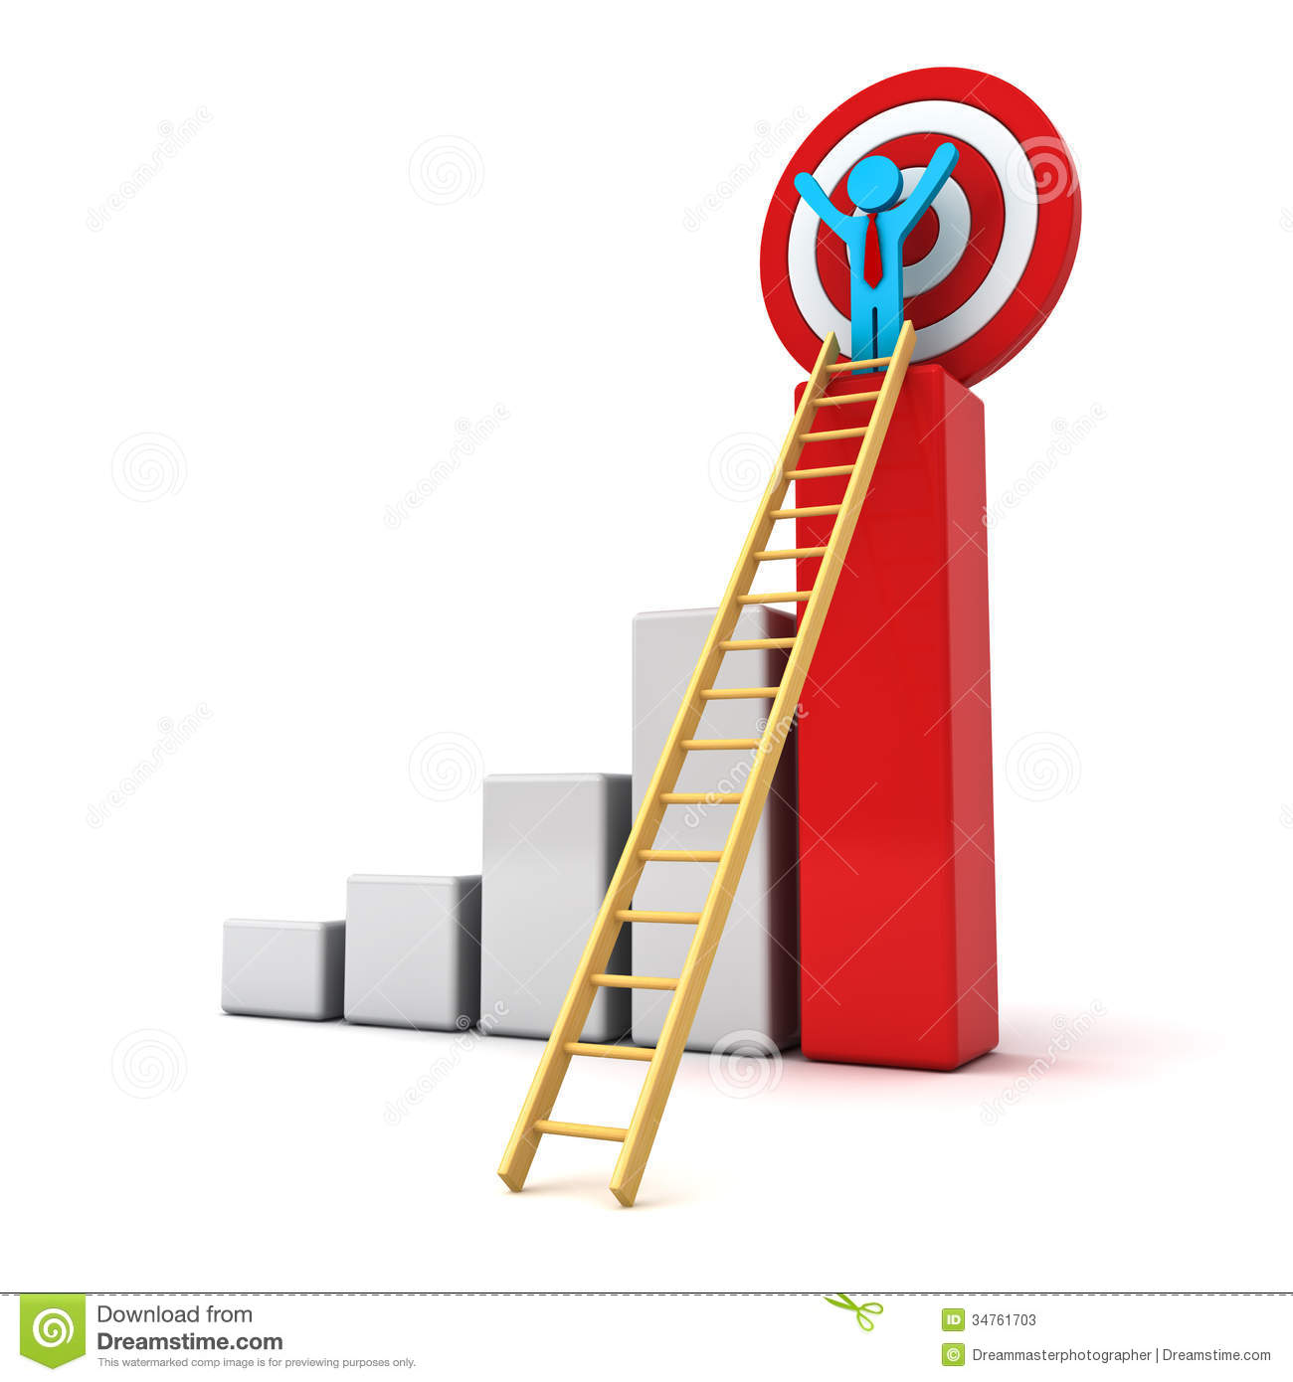
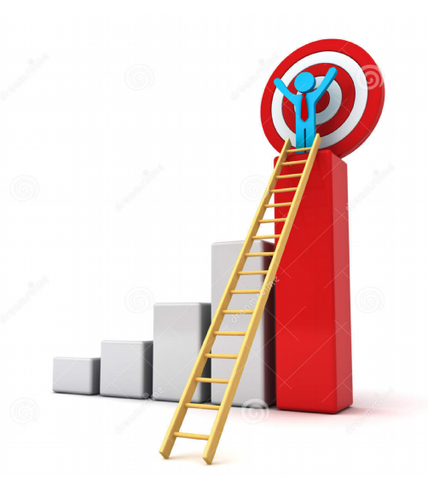
Results and conclusion
Current status of the report/analysis
Work is still ongoing...
Report and analysis progress: 70%
Results and conclusion [10%]. To what extent the posed task(s) have been fulfilled?
<number>
Notes:
<number>

