Slide 1
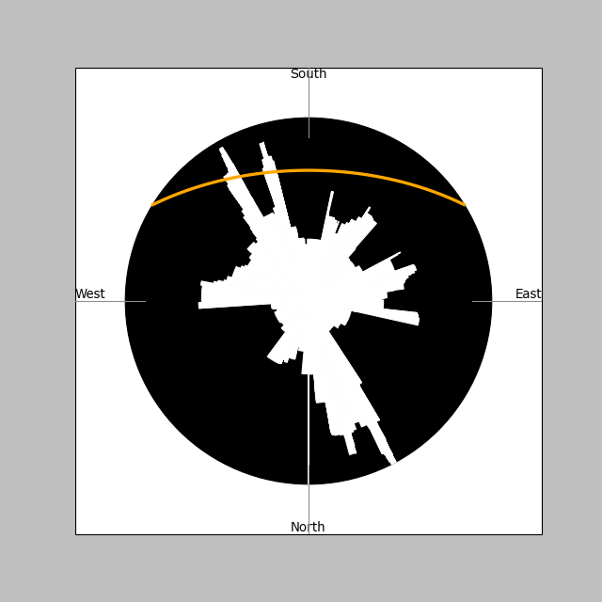
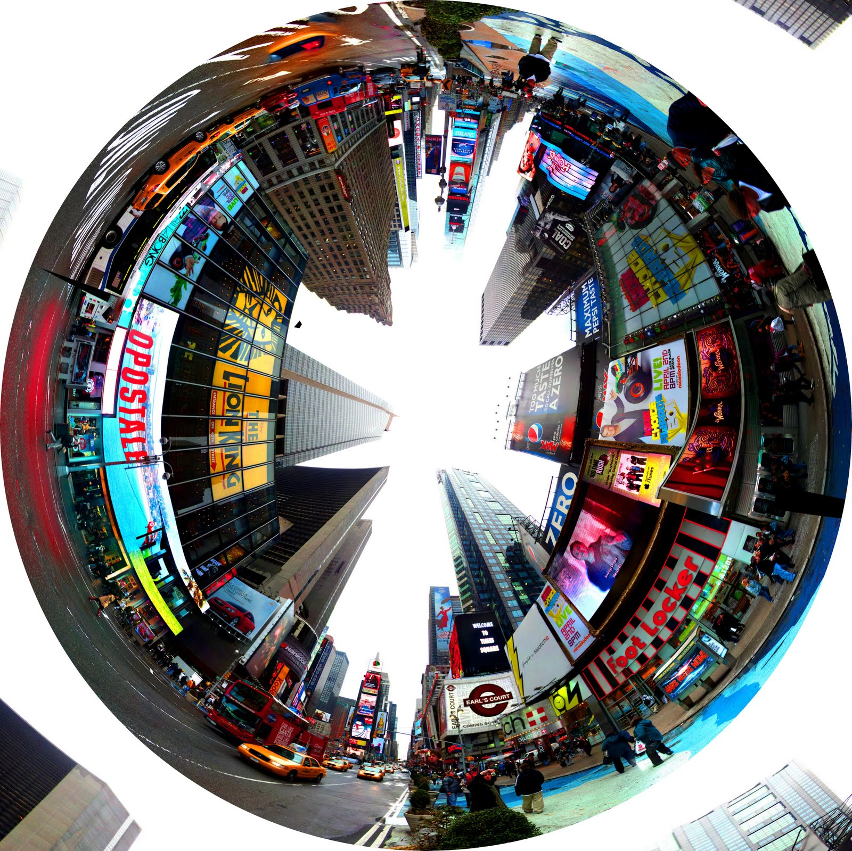
Times Square (40.757589,-73.98565)
http://2.bp.blogspot.com/-o-EsjcQTHng/TZhrugbxivI/AAAAAAAAA0U/Eu71sqtAoW0/s1600/Times%2BSquare%2B360%2Bblog%2Bwrap.jpg

Slide 2
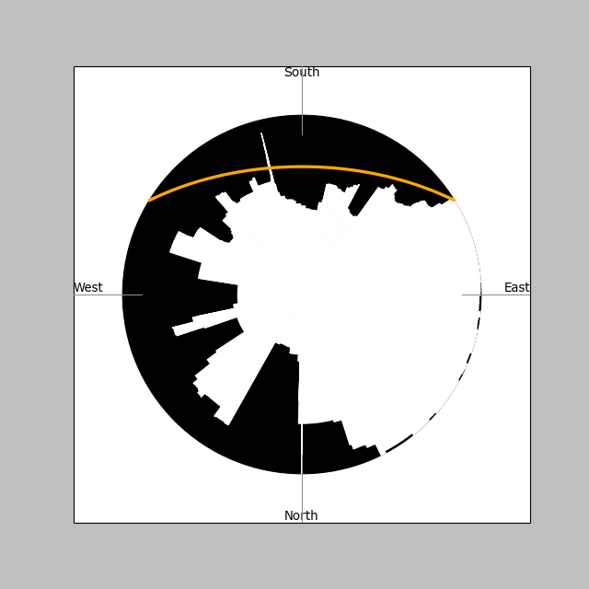
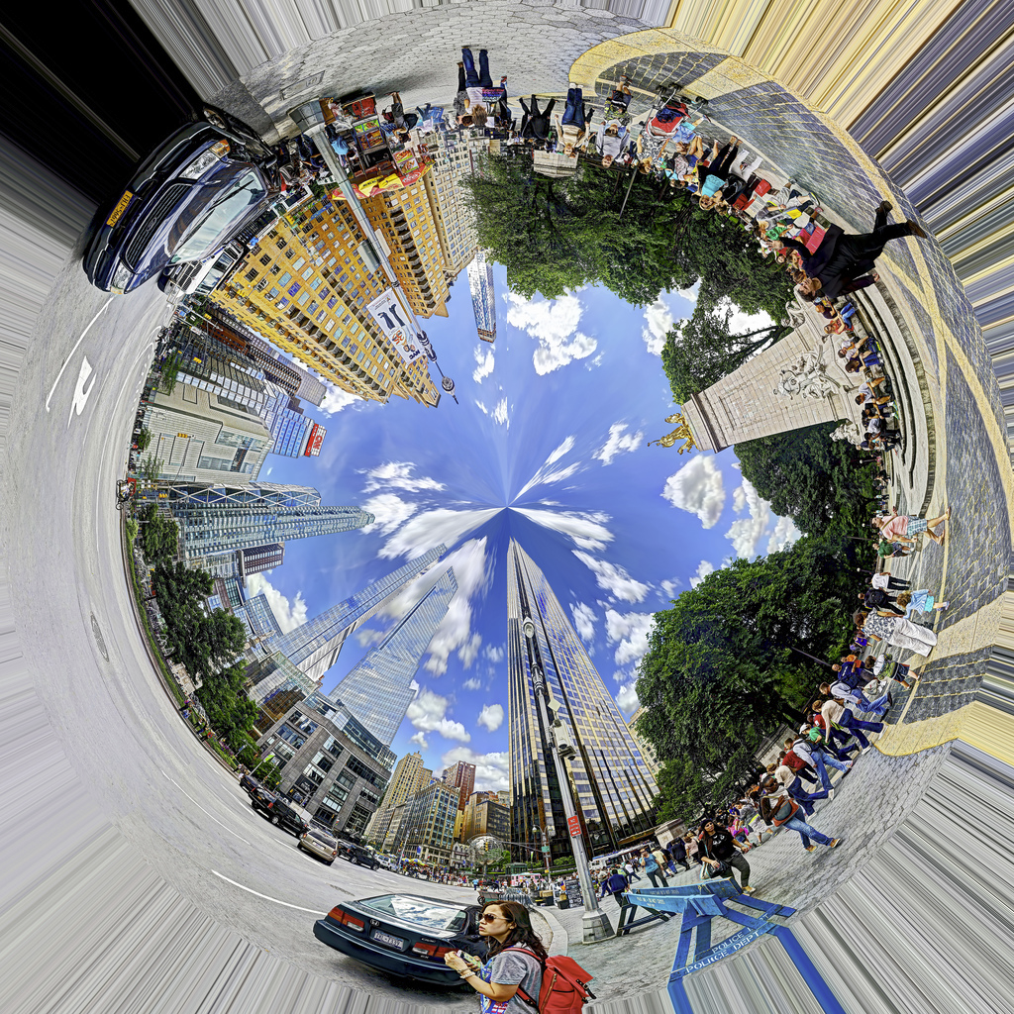
Columbus Circle (40.768203, -73.981239)
https://c4.staticflickr.com/8/7321/9117506005_72a6d056cc_b.jpg

