Slide 1
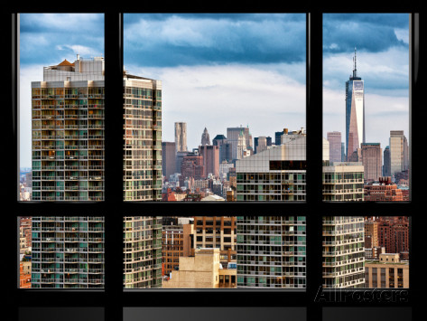
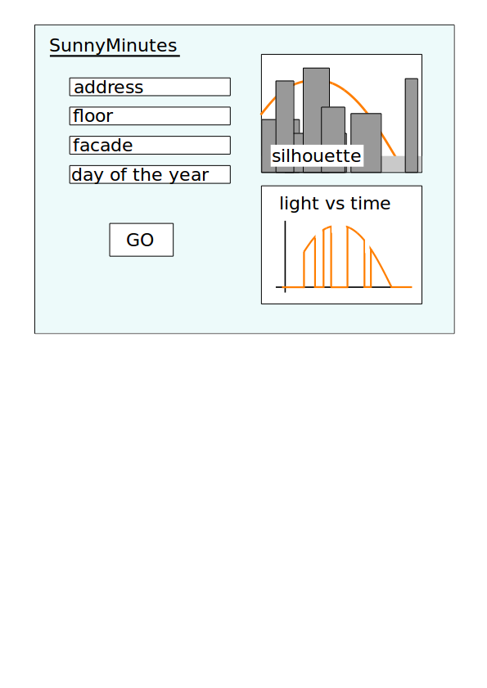
SunnyMinutes – by Peter Komar
Problem:
There's no easy way to know how much sunlight an office or apartment in downtown Manhattan will get during the year before renting
Format:
Web application

Slide 2
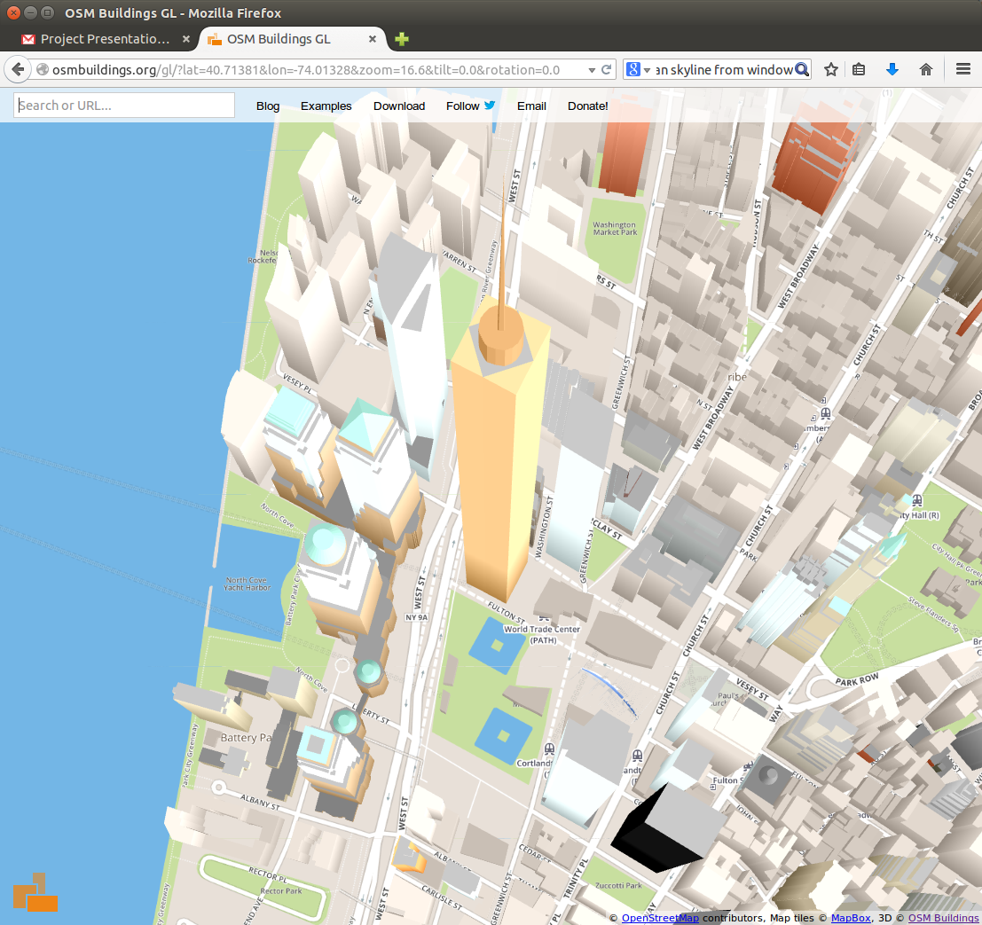
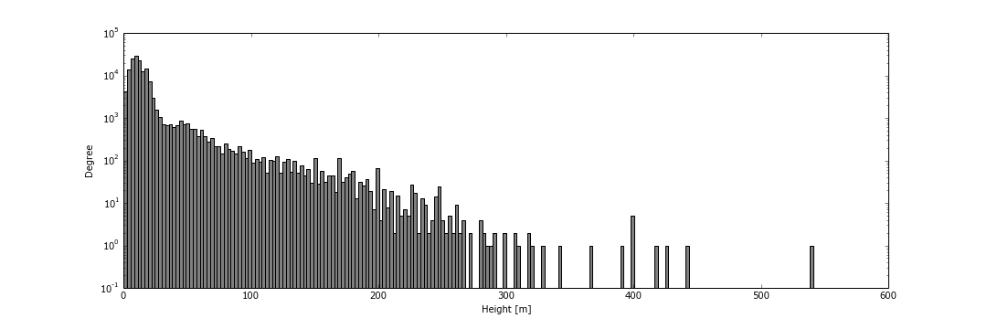
SunnyMinutes – by Peter Komar
Data:
- OpenStreetMap data of heights of buildings in Manhattan
[http://osmbuildings.org/?lat=40.78251&lon=-73.96590&zoom=15]
- native format: OSM, exported into XML with Overpass API
- filtered with [“building”] and '[“building:part”] tags
Simple plot:
- Histogram of building heights
One World Trade Center

Slide 3
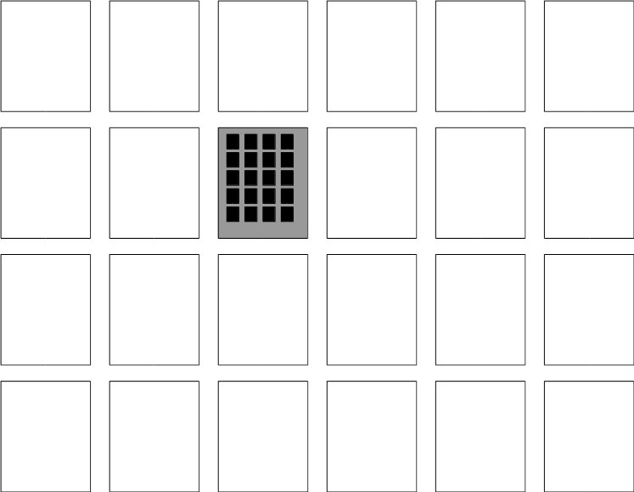
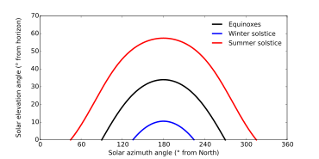
SunnyMinutes – by Peter Komar
Algorithm to draw the silhouette:
1. Group the buildings into larger rectangular blocks
2. For each block calculate and store:
i. max height
ii. 2D coordinates of the 4 vertices of the block
3. When rendering the silhouette:
o. Exclude all blocks with max height smaller than observer's altitude
i. Start with self
ii. Continue with the buildings in the same block
iii. Continue with the buildings in the neighboring blocks
iv. Continue with all remaining buildings
v. Exclude blocks that are completely shadowed by the new silhouette
Algorithm to calculate Sun's path and light curve:
1. Minute by minute, calculate the Sun's (phi, theta) as seen by the observer
2. For each minute, determine whether the Sun is blocked

