Slide 1

SunnyMinutes – by Peter Komar
Problem
There's no easy way to know how much sunlight an office or apartment in downtown Manhattan will get during the year before renting
Business insight
Pricing of apartments/offices can be
supported by this new feature:
Minutes of direct sunlight

Slide 2
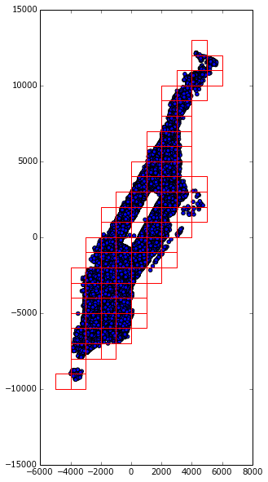
SunnyMinutes – by Peter Komar
Data:
- OpenStreetMap data of heights of buildings
Building = list of Nodes + height (+ other tags)
Node = longitude + latitude
- Stored in mySQL tables:
Nodes(
Id INT,
X FLOAT(20,10),
Y FLOAT(20,10),
Z FLOAT(20,2),
Order_in_building INT,
Number_of_nodes_in_building INT,
Building_id INT,
Block_id INT
)
Blocks(
Id INT,
Xmin FLOAT(20,10),
Xmax FLOAT(20,10),
Ymin FLOAT(20,10),
Ymax FLOAT(20,10),
X_id INT,
Y_id INT,
Max_height FLOAT(20,10)
)

Slide 3
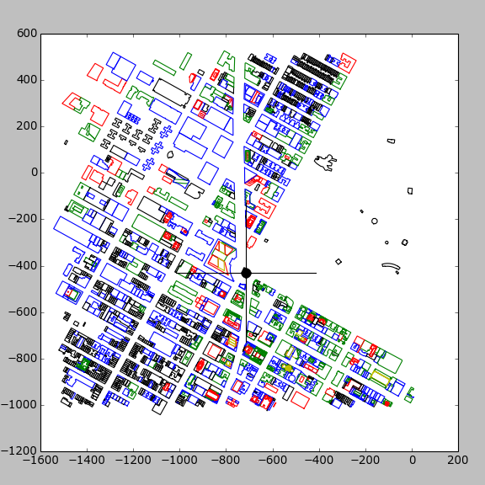
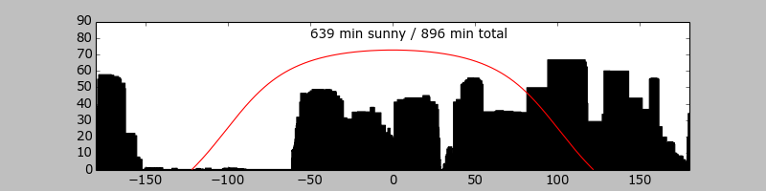
SunnyMinutes – by Peter Komar
Algorithm:
1. Group the buildings into larger
rectangular blocks of
500m x 500m (1640 ft x 1640 ft)
2. Find the observer's block
3. Render the entire
360 degrees skyline above
observer's horizon from block
and neighboring blocks
4. Minute by minute, calculate the
Sun's position on the sky
5. For each minute, determine
whether the Sun is blocked

