Slide 1
Spam Classification and Spam Filtering
By Girish Sastry

Slide 2
My interests
CS major, undergrad, senior
Interested in not only methods and results for machine learning, but the tools used to effectively express machine learning computations
Spam is interesting
  The internet
  Lots of data points → Big Data
  Google, Facebook, Twitter, LinkedIn, etc

Slide 3
What is spam?

Slide 4
Stuff that we don't want, but is delivered to us anyway

Slide 5
What is spam?
Internet gives rise to instant communication
Cheap to send information in bulk to many people
This mechanism is abused by spammers

Slide 6
Stuff that we don't want, but is delivered to us anyway

Slide 7
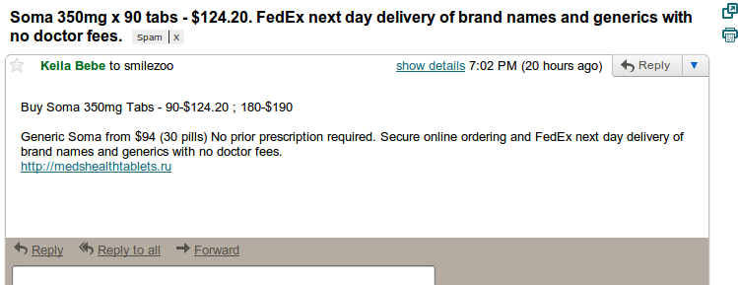

Slide 8
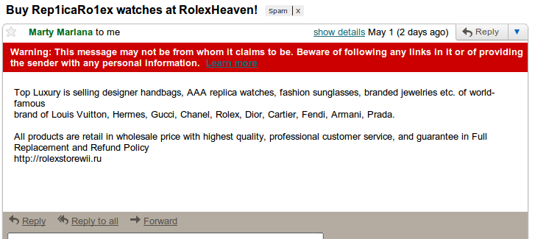

Slide 9
Spam is ...
Lost time
Lost money
Frustration
Unhappy users

Slide 10
How do we know if an email is spam?

Slide 11
SpamBase
HP Labs collected spam data
Spam emails: postmasters & individuals who marked them as spam
Nonspam emails: filed work & personal emails

Slide 12
SpamBase
57 features
  48 are percentage numbers for word frequencies (percent of email that “WORD” appears)
  6 are percentage numbers for character frequencies (percentage of email that CHAR occurs)
  Average length of uninterrupted sequence of CAPITAL characters
  Absolute length of longest uninterrupted sequence of CAPITAL characters
  Sum of lengths of uninterrupted sequences of CAPITAL characters

Slide 13
Goals for this project
Explore different classification methods
  Minimize classification error
  Minimize # of false-positives
  False positives are very bad!
Explore different tools for these classification methods

Slide 14
Classification Methods
Stuff learned in class
  Trees
  K-NN
  Regression (logistic, etc)
  .. more
Other methods
  Naïve bayes
  Perceptron Classification
  .. more

Slide 15
Tools
R
Clojure
Python
Weka/Java
… maybe more

Slide 16
Initial Results
Decision Trees
Naïve Bayes

Slide 17
Decision Trees
10-fold cross validation
R
Training error: 7.24 %
Test error: 8.15%
# False-positives (training): 24
# False-positives (test): 27

Slide 18
Naïve Bayes
Clojure
Training Error: 10.16%
Test Error: 10.32%
# False positives (training): 42
# False positives (test): 42

Slide 19
Plan
Refine and tweak current classification methods
Use new ones
Is there a way to enforce minimization of false-positives and still maintain “good” misclassification error?

