Slide 1
Introduction to Git and GitHub
By Kevin Markham
dataschool.io

Slide 2
Agenda
What is Git? What is GitHub?
Why are we learning this?
Reflections on learning Git
Getting set up
Practical exercises (many!)
Further resources
What we didn’t cover

Slide 3
What is Git?
Version control system that allows you to track files and file changes in a repository (“repo”)
Primarily used by programmers
Runs from the command line (usually)
Can be used alone or in a team

Slide 4
What is GitHub?
A website, not a version control system
Allows you to put your Git repos online
Benefits of GitHub:
Backup of files
Visual interface for navigating repos
Makes repo collaboration easy
“GitHub is just Dropbox for Git”
Note: Git does not require GitHub

Slide 5
Why are we learning this?
Version control is useful when you write code, and data scientists write code
Enables teams to easily collaborate on the same codebase
Enables you to contribute to open source projects
Attractive skill for employment

Slide 6
Git can be hard for beginners
Designed (by programmers) for power and flexibility over simplicity
Hard to know if what you did was right
Hard to explore since most actions are “permanent” (in a sense) and can have serious consequences
Most learning resources are command-focused instead of workflow-focused

Slide 7
Don’t sweat it!
We’ll focus on the most important 10% of Git
Being slow to learn Git will not hold you back in the rest of the course
We can help you to troubleshoot
We’re all in this together!

Slide 8
Installation
GitHub:
Create an account at github.com
There’s nothing to install
Note: “GitHub for Windows” & “GitHub for Mac” are GUI clients (alternatives to command line)
Git:
Download from git-scm.com/downloads
Install

Slide 9
Setup
Open Git Bash (Windows) or Terminal (Mac/Linux):
git config --global user.name “YOUR FULL NAME”
git config --global user.email “YOUR EMAIL”
Use the same email address you used with your GitHub account
Generate SSH keys: tiny.cc/gitssh
Not required, but more secure that HTTPS

Slide 10
Navigating a GitHub repo (1 of 2)
Example repo: git.io/ggplot2
Account name, repo name, description
Folder structure
Viewing files:
Rendered view (with syntax highlighting)
Raw view
README.md:
Describes a repo
Automatically displayed
Written in Markdown

Slide 11
Navigating a GitHub repo (2 of 2)
Commits:
One or more changes to one or more files
Revision highlighting
Commit comments are required
Most recent commit comment shown by filename
Profile page

Slide 12
Creating a repo on GitHub
Click “Create New” (plus sign):
Define name, description, public or private
Initialize with README (if you’re going to clone)
Notes:
Nothing has happened to your local computer
This was done on GitHub, but GitHub used Git to add the README.md file

Slide 13
Cloning a GitHub repo
Cloning = copying to your local computer
Like copying your Dropbox files to a new machine
First, change your working directory to where you want the repo to be stored: cd
Then, clone the repo: git clone <URL>
Get SSH or HTTPS URL from GitHub (ends in .git)
Clones to a subdirectory of the working directory
No visual feedback when you type your password
Navigate to the repo (cd) then list the files (ls)

Slide 14
Checking your remotes
A “remote alias” is a reference to a repo not on your local computer
Like a connection to your Dropbox account
“origin” remote was set up by “git clone”
View remotes: git remote -v

Slide 15
Making changes, checking your status
Making changes:
Modify README.md in any text editor
Create a new file: touch <filename>
Check your status:
git status
File statuses (possibly color-coded):
Untracked (red)
Tracked and modified (red)
Staged for committing (green)
Committed

Slide 16
Committing changes
Stage changes for committing:
Add a single file: git add <filename>
Add all “red” files: git add .
Check your status:
Red files have turned green
Commit changes:
git commit -m “message about commit”
Check your status again!
Check the log: git log

Slide 17
Pushing to GitHub
Everything you’ve done to your cloned repo (so far) has been local
You’ve been working in the “master” branch
Push committed changes to GitHub:
Like syncing local file changes to Dropbox
git push <remote> <branch>
Often: git push origin master
Refresh your GitHub repo to check!

Slide 18
Quick recap of what you’ve done
Created a repo on GitHub
Cloned repo to your local computer (git clone)
Automatically set up your “origin” remote
Made two file changes
Staged changes for committing (git add)
Committed changes (git commit)
Pushed changes to GitHub (git push)
Inspected along the way (git remote, git status, git log)

Slide 19
Forking a repo on GitHub
What is forking?
Copy a repo to your account (including history)
Does not stay in sync with the “upstream”
Do it! git.io/gadsdc2
Why fork?
You want to make modifications
You want to contribute to the upstream
Clone your fork: git clone <your URL>
Don’t clone inside your other local repo

Slide 20
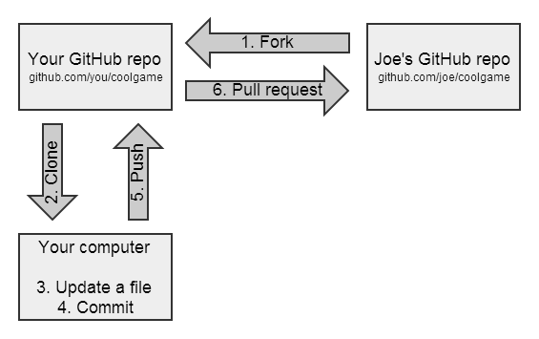
GitHub flow for contributing

Slide 21
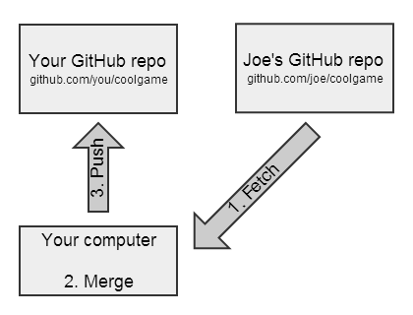
GitHub flow for syncing a fork

Slide 22
Sync your gadsdc2 fork
We’ve added a new file to gadsdc2
Add an “upstream” remote (one-time operation):
git remote add upstream <Aaron’s URL>
Check that it worked: git remote -v
Pull the changes from the upstream:
Like updating your local files from Dropbox
git pull upstream master
Pull = fetch + merge (basically)
Push the changes up to GitHub (optional):
git push origin master

Slide 23
Working with branches
A branch is a “context” for your work:
Controls your files
Managed by the “.git” folder
View your branches: git branch
Try branching in the test repo you created:
Create branch and switch to it: git checkout -b new_branch
Create a file, stage the change, commit it
Switch to the master branch: git checkout master
ls: the file is gone!
git log: the commit is gone!
Switch to the new branch: git checkout new_branch
The file and commit are back

Slide 24
Recipe for submitting homework
git checkout master
git pull upstream master
git checkout -b name_of_branch
do your assignment
git add .
git commit -m “message”
git push origin name_of_branch
GitHub: switch to branch, submit pull request

Slide 25
Further resources
Pro Git (book): git-scm.com/book
Git Reference: gitref.org
Recipe for submitting homework: git.io/recipe
My quick reference guide: tiny.cc/gitref
Common sets of commands explained
My video series: tiny.cc/gitvideos
Watch most of this presentation again!

Slide 26
Not covered (but useful to learn!)
Initializing a repo locally (git init), then later pushing it to GitHub
Deleting or moving a repo locally
Deleting a branch
Using .gitignore to ignore certain files
Rolling back or unstaging changes
Resolving merge conflicts
Fixing LF/CRLF issues

