Slide 1
INTRO to DATA SCIENCE dimensionality reduction

Slide 2
I. dimensionality reduction II. Principal components analysis III. Singular value decomposition iv. Other methods exercise: IV. Dimensionality reduction in scikit-learn
agenda

Slide 3
I. dimensionality reduction
INTRO TO DATA SCIENCE

Slide 4
Dimensionality reduction
Q: What is dimensionality reduction?

Slide 5
Dimensionality reduction
Q: What is dimensionality reduction?
A: A set of techniques for reducing the size (in terms of features,
records, and/or bytes) of the dataset under examination.

Slide 6
Dimensionality reduction
Q: What is dimensionality reduction?
A: A set of techniques for reducing the size (in terms of features,
records, and/or bytes) of the dataset under examination.
In general, the idea is to regard the dataset is a matrix and to decompose the matrix into simpler, meaningful pieces.

Slide 7
Dimensionality reduction
Q: What is dimensionality reduction?
A: A set of techniques for reducing the size (in terms of features,
records, and/or bytes) of the dataset under examination.
In general, the idea is to regard the dataset is a matrix and to decompose the matrix into simpler, meaningful pieces.
Dimensionality reduction is frequently performed as a pre-processing step before another learning algorithm is applied.

Slide 8
Dimensionality reduction
Q: What are the motivations for dimensionality reduction?

Slide 9
Dimensionality reduction
Q: What are the motivations for dimensionality reduction?
The number of features in our dataset can be difficult to manage, or even misleading (eg, if the relationships are actually simpler than they appear).

Slide 10
Dimensionality reduction
For example, suppose we have a dataset with some features that are related to each other.

Slide 11
Dimensionality reduction
For example, suppose we have a dataset with some features that are related to each other.
Ideally, we would like to eliminate this redundancy and consolidate the number of variables we’re looking at.

Slide 12
Dimensionality reduction
For example, suppose we have a dataset with some features that are related to each other.
Ideally, we would like to eliminate this redundancy and consolidate the number of variables we’re looking at.
If these relationships are linear, then we can use well-established techniques like PCA/SVD.

Slide 13
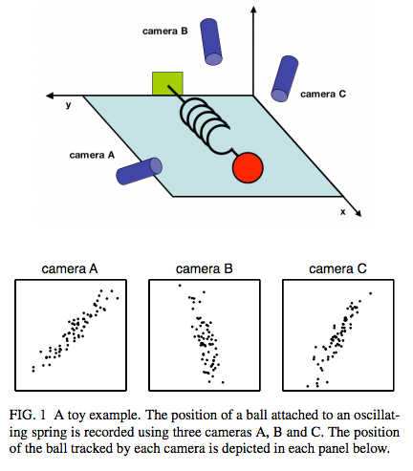
Example: 1d harmonic oscillator
source: http://www.snl.salk.edu/~shlens/pca.pdf

Slide 14

Example: 1d harmonic oscillator
NOTE
In this case the “truth” is (nearly) one-dimensional. We don’t generally know what the “truth” is, but the same techniques can apply.
source: http://www.snl.salk.edu/~shlens/pca.pdf

Slide 15
aside: Curse of dimensionality
The complexity that comes with a large number of features is due in part to the curse of dimensionality.

Slide 16
aside: Curse of dimensionality
The complexity that comes with a large number of features is due in part to the curse of dimensionality.
Namely, the sample size needed to accurately estimate a random variable taking values in a d-dimensional feature space grows exponentially with d (almost).

Slide 17
aside: Curse of dimensionality
The complexity that comes with a large number of features is due in part to the curse of dimensionality.
Namely, the sample size needed to accurately estimate a random variable taking values in a d-dimensional feature space grows exponentially with d (almost).
(More precisely, the sample size grows exponentially with l ≤ d, the dimension of the manifold embedded in the feature space).

Slide 18
aside: Curse of dimensionality
Another way of characterizing this is to say that high-dimensional spaces are inherently sparse.

Slide 19
aside: Curse of dimensionality
Another way of characterizing this is to say that high-dimensional spaces are inherently sparse.
ex: A high-dimensional orange contains most of its volume in the rind!
ex: A high-dimensional hypercube contains most of its volume in the corners!
Notes:
consider ratio of volume of sphere / volume of cube < 1 (diameter = length of side)
extended to high dimensions (d -> inf), this ratio goes to zero!

Slide 20
aside: Curse of dimensionality
In either case, most of the points in the space are “far” from the center.

Slide 21
aside: Curse of dimensionality
In either case, most of the points in the space are “far” from the center.
This illustrates the fact that local methods will break down in these circumstances (eg, in order to collect enough neighbors for a given point, you need to expand the radius of the neighborhood so far that locality is not preserved).

Slide 22
aside: Curse of dimensionality
In either case, most of the points in the space are “far” from the center.
This illustrates the fact that local methods will break down in these circumstances (eg, in order to collect enough neighbors for a given point, you need to expand the radius of the neighborhood so far that locality is not preserved).
The bottom line is that high-dimensional spaces can be problematic.

Slide 23
Dimensionality reduction
Q: What is the goal of dimensionality reduction?

Slide 24
Dimensionality reduction
Q: What is the goal of dimensionality reduction?
We’d like to analyze the data using the most meaningful basis (or coordinates) possible.

Slide 25
Dimensionality reduction
Q: What is the goal of dimensionality reduction?
We’d like to analyze the data using the most meaningful basis (or coordinates) possible.
More precisely: given an n x d matrix A (encoding n observations of a d-dimensional random variable), we want to find a k-dimensional representation of A (k < d) that captures the information in the original data, according to some criterion.

Slide 26
Dimensionality reduction
Q: What is the goal of dimensionality reduction?
- reduce computational expense
- reduce susceptibility to overfitting
- reduce noise in the dataset
- enhance our intuition

Slide 27
Dimensionality reduction
Q: How is dimensionality reduction performed?

Slide 28
Dimensionality reduction
Q: How is dimensionality reduction performed?
A: There are two approaches: feature selection and feature extraction.

Slide 29
Dimensionality reduction
Q: How is dimensionality reduction performed?
A: There are two approaches: feature selection and feature extraction.
feature selection – selecting a subset of features using an external criterion (filter) or the learning algo accuracy itself (wrapper)
feature extraction – mapping the features to a lower dimensional space
Notes:
note: external criterion = info gain
note: methods for feature extraction = svd, pca, nmf, lle, mds

Slide 30
Dimensionality reduction
Q: How is dimensionality reduction performed?
A: There are two approaches: feature selection and feature extraction.
feature selection – selecting a subset of features using an external criterion (filter) or the learning algo accuracy itself (wrapper)
feature extraction – mapping the features to a lower dimensional space
NOTE
We’ve already seen examples of feature selection for regression such as backward elimination.
Notes:
note: external criterion = info gain
note: methods for feature extraction = svd, pca, nmf, lle, mds

Slide 31
Dimensionality reduction
Feature selection is important, but typically when people say dimensionality reduction, they are referring to feature extraction.

Slide 32
Dimensionality reduction
Feature selection is important, but typically when people say dimensionality reduction, they are referring to feature extraction.
The goal of feature extraction is to create a new set of coordinates that simplify the representation of the data.

Slide 33
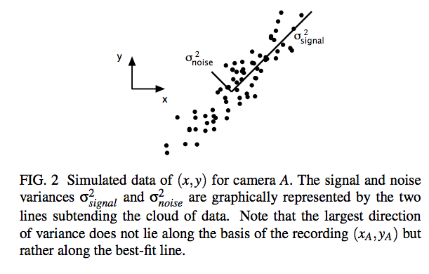
Dimensionality reduction
source: http://www.snl.salk.edu/~shlens/pca.pdf
Notes:
Want to maximize SNR

Slide 34
Dimensionality reduction
Q: What are some applications of dimensionality reduction?

Slide 35
Dimensionality reduction
Q: What are some applications of dimensionality reduction?
- topic models (document clustering)
- image recognition/computer vision
- bioinformatics (microarray analysis)
- speech recognition
- astronomy (spectral data analysis)
- recommender systems

Slide 36
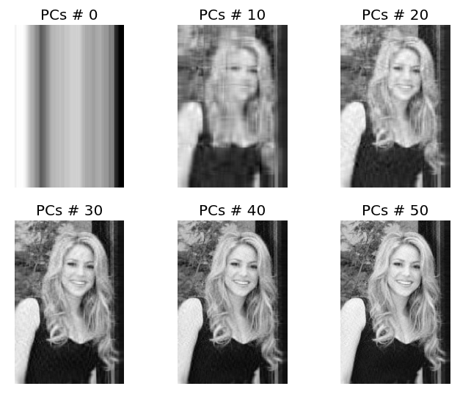
Dimensionality reduction
source: http://glowingpython.blogspot.it/2011/07/pca-and-image-compression-with-numpy.html
Notes:
Due to Python (and the guy who made this image) weirdness, “PCs # 0” means one principal component.

Slide 37
iI. Principal component analysis
INTRO TO DATA SCIENCE

Slide 38
Principal component analysis
Principal component analysis is a dimension reduction technique that can be used on a matrix of any dimensions.

Slide 39
Principal component analysis
Principal component analysis is a dimension reduction technique that can be used on a matrix of any dimensions.
This procedure produces a new basis, each of whose components retain as much variance from the original data as possible.

Slide 40
Principal component analysis
Principal component analysis is a dimension reduction technique that can be used on a matrix of any dimensions.
This procedure produces a new basis, each of whose components retain as much variance from the original data as possible.
The PCA of a matrix A boils down to the eigenvalue decomposition of the covariance matrix of A.

Slide 41
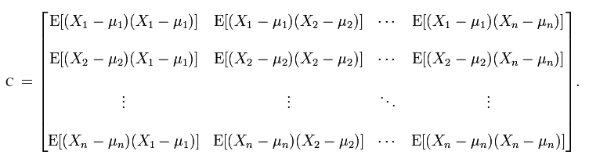
Covariance matrices
The covariance matrix C of a matrix A is always square:
off-diagonal elements C_{ij} give the covariance between X_{i}, X_{j} (i ≠ j)
diagonal elements C_{ii} give the variance of X_{i}

Slide 42
aside: eigenvalue decomposition
The eigenvalue decomposition of a square matrix A is given by:
A = QΛQ⁻¹

Slide 43
aside: eigenvalue decomposition
The eigenvalue decomposition of a square matrix A is given by:
A = QΛQ⁻¹
The columns of Q are the eigenvectors of A, and the values in Λ are the associated eigenvalues of A.

Slide 44
aside: eigenvalue decomposition
The eigenvalue decomposition of a square matrix A is given by:
A = QΛQ⁻¹
The columns of Q are the eigenvectors of A, and the values in Λ are the associated eigenvalues of A.
For an eigenvector v of A and its eigenvalue λ, we have the important relation:
Av = λv

Slide 45
aside: eigenvalue decomposition
The eigenvalue decomposition of a square matrix A is given by:
A = QΛQ⁻¹
The columns of Q are the eigenvectors of A, and the values in Λ are the associated eigenvalues of A.
For an eigenvector v of A and its eigenvalue λ, we have the important relation:
Av = λv
NOTE
This relationship defines what it means to be an eigenvector of A.

Slide 46
Principal component analysis
The eigenvectors form a basis of the vector space on which A acts (eg, they are orthogonal).

Slide 47
Principal component analysis
The eigenvectors form a basis of the vector space on which A acts (eg, they are orthogonal).
Furthermore the basis elements are ordered by their eigenvalues (from largest to smallest), and these eigenvalues represent the amount of variance explained by each basis element.

Slide 48
Principal component analysis
The eigenvectors form a basis of the vector space on which A acts (eg, they are orthogonal).
Furthermore the basis elements are ordered by their eigenvalues (from largest to smallest), and these eigenvalues represent the amount of variance explained by each basis element.
This can be visualized in a scree plot, which shows the amount of variance explained by each basis vector.

Slide 49
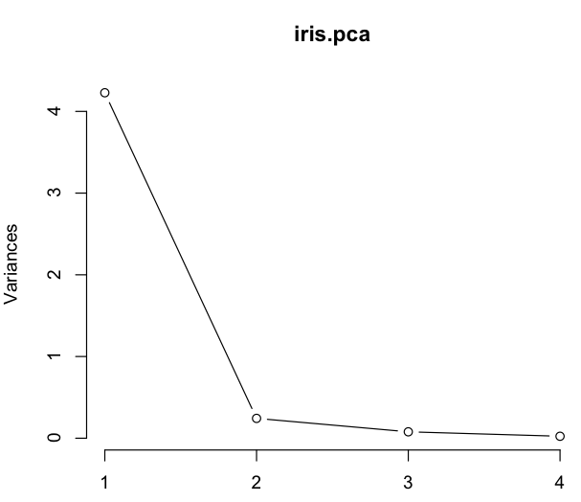
Principal component analysis

Slide 50
Principal component analysis
NOTE
Looking at this plot also gives you an idea of how many principal components to keep.
Apply the elbow test: keep only those pc’s that appear to the left of the elbow in the graph.
Notes:
(alt) kaiser criterion: keep only egvals that exceed avg egval

Slide 51
iIi. Singular value decomposition
INTRO TO DATA SCIENCE

Slide 52
Singular value decomposition
Consider a matrix A with n rows and d features.

Slide 53
Singular value decomposition
Consider a matrix A with n rows and d features.
The singular value decomposition of A is given by:
A = U Σ V^{T}
Notes:
note: U, V rotations; S scaling

Slide 54
Singular value decomposition
Consider a matrix A with n rows and d features.
The singular value decomposition of A is given by:
A = U Σ V^{T}
(n x d) (n x n) (n x d) (d x d)

Slide 55
Singular value decomposition
Consider a matrix A with n rows and d features.
The singular value decomposition of A is given by:
A = U Σ V^{T}
(n x d) (n x n) (n x d) (d x d)
st. U, V are orthogonal matrices and Σ is a diagonal matrix.
Notes:
Orthogonal matrices have columns and rows orthogonal unit vectors; transpose equal to inverse. (Real unitary matrix.)

Slide 56
Singular value decomposition
Consider a matrix A with n rows and d features.
The singular value decomposition of A is given by:
A = U Σ V^{T}
(n x d) (n x n) (n x d) (d x d)
st. U, V are orthogonal matrices and Σ is a diagonal matrix.
→ UU^{T}=I_{n}, VV^{T}=I_{d} → Σ_{ij}=0 (i≠j)
Notes:
note: orthogonal matrix = real-valued version of a unitary matrix

Slide 57
Singular value decomposition
The singular value decomposition of A is given by:
A = U Σ V^{T}
(n x d) (n x n) (n x d) (d x d)
The columns of U & V are the (left- and right-) singular vectors of A.

Slide 58
Singular value decomposition
The singular value decomposition of A is given by:
A = U Σ V^{T}
(n x d) (n x n) (n x d) (d x d)
The columns of U & V are the (left- and right-) singular vectors of A.
These singular vectors provide orthonormal bases for the spaces K_{n} & K_{d} (columns of U & V, respectively).

Slide 59
Singular value decomposition
The singular value decomposition of A is given by:
A = U Σ V^{T}
(n x d) (n x n) (n x d) (d x d)
The nonzero entries of Σ are the singular values of A. These are real, nonnegative, and rank-ordered (decreasing from left to right).

Slide 60
Singular value decomposition
The singular value decomposition of A is given by:
A = U Σ V^{T}
(n x d) (n x n) (n x d) (d x d)
The nonzero entries of Σ are the singular values of A. These are real, nonnegative, and rank-ordered (decreasing from left to right).
NOTE
The number of singular values is equal to the rank of A.
The rank of a matrix measures its non-degeneracy.
Notes:
note: for fin-dim map A, rank = dim of image

Slide 61
Singular value decomposition
For a general SVD, the columns of U are the eigenvectors of AA^{T}, and the columns of V are the eigenvectors of A^{T}A.
Also, the singular values of A are the square roots of the eigenvalues of AA^{T} and A^{T}A.
Notes:
this gives you one way to compute the svd

Slide 62
Singular value decomposition
For a general SVD, the columns of U are the eigenvectors of AA^{T}, and the columns of V are the eigenvectors of A^{T}A.
Also, the singular values of A are the square roots of the eigenvalues of AA^{T} and A^{T}A.
NOTE
If data is centered, these are covariance matrices.
Notes:
this gives you one way to compute the svd

Slide 63
Singular value decomposition
Q: How do you interpret the SVD?

Slide 64
Singular value decomposition
Q: How do you interpret the SVD?
A: Recall that given a set of n points in d-dimensional space (eg, a
matrix A), we want to find the best k < d dimensional subspace to
represent the data.

Slide 65
Singular value decomposition
Q: How do you interpret the SVD?
A: Recall that given a set of n points in d-dimensional space (eg, a
matrix A), we want to find the best k < d dimensional subspace to
represent the data.
NOTE
Here “best” refers to the representation that minimizes the squared orthogonal distances from the points to the subspace.

Slide 66
Singular value decomposition
Q: How do you interpret the SVD?
A: Recall that given a set of n points in d-dimensional space (eg, a
matrix A), we want to find the best k < d dimensional subspace to
represent the data.
For k = 1, this subspace is a line passing through the origin.

Slide 67
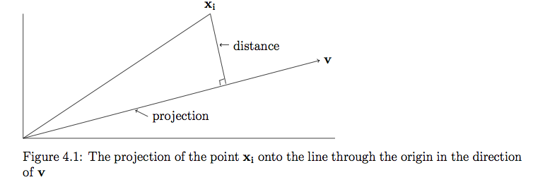
Singular value decomposition
source: http://www.cs.princeton.edu/courses/archive/spring12/cos598C/svdchapter.pdf
Notes:
X = vector in feature space
V = lower-dim linear subspace of feature space

Slide 68
Singular value decomposition
For a geometric interpretation of the singular values, consider a unit sphere in R_{n} and a linear map T (eg, a rotation and a stretch) that sends this sphere to an ellipsoid in R_{d}.

Slide 69
Singular value decomposition
For a geometric interpretation of the singular values, consider a unit sphere in R_{n} and a linear map T (eg, a rotation and a stretch) that sends this sphere to an ellipsoid in R_{d}.
The singular vectors of T correspond to the lengths of the axes of the d-dimensional ellipsoid.

Slide 70
Singular value decomposition
For a geometric interpretation of the singular values, consider a unit sphere in R_{n} and a linear map T (eg, a rotation and a stretch) that sends this sphere to an ellipsoid in R_{d}.
The singular vectors of T correspond to the lengths of the axes of the d-dimensional ellipsoid.
The singular values give the magnitudes of the projection of each column of the original dataset on the elements of the new basis.

Slide 71
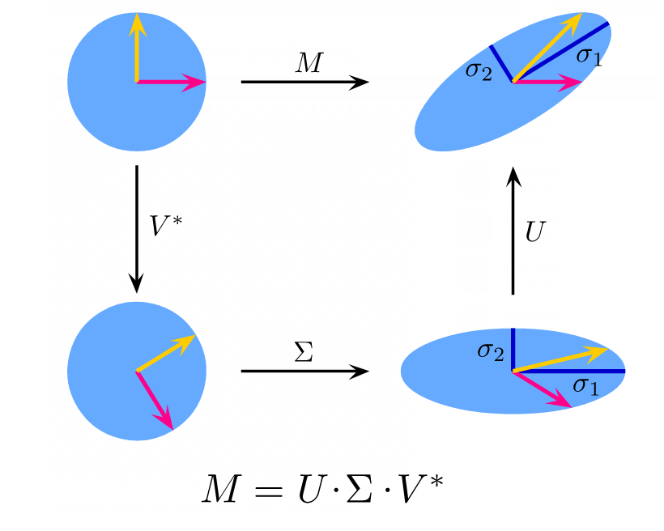
Singular value decomposition
source: http://en.wikipedia.org/wiki/Singular_value_decomposition

Slide 72
Singular value decomposition
Why do we care about SVD?

Slide 73
Singular value decomposition
Why do we care about SVD?
More numerically stable and can be more efficient to calculate (than PCA)

Slide 74
Singular value decomposition
Why do we care about SVD?
More numerically stable and can be more efficient to calculate (than PCA)
Latent semantic analysis, etc.

Slide 75
Iii. Other methods
INTRO TO DATA SCIENCE

Slide 76
Factor analysis
Whereas PCA and SVD create new coordinates by transforming the old coordinates without any accompanying theory of what anything means, factor analysis refers to a broader array of techniques.

Slide 77
Factor analysis
Whereas PCA and SVD create new coordinates by transforming the old coordinates without any accompanying theory of what anything means, factor analysis refers to a broader array of techniques.
In factor analysis, which may be exploratory or confirmatory, we hypothesize that our data depends on some hidden or latent features.

Slide 78
Factor analysis
Whereas PCA and SVD create new coordinates by transforming the old coordinates without any accompanying theory of what anything means, factor analysis refers to a broader array of techniques.
In factor analysis, which may be exploratory or confirmatory, we hypothesize that our data depends on some hidden or latent features.
The old coordinates are then modeled as linear combinations of the latent features.

Slide 79
Factor analysis
For example, consider a dataset that represents the results of a decathalon (rows = participants, columns = events, entries = times).

Slide 80
Factor analysis
For example, consider a dataset that represents the results of a decathalon (rows = participants, columns = events, entries = times).
Though this dataset contains 10 features X_{i}, we may be interested in modeling these features as functions of latent variables such as the speed and strength of the participants:
X_{i} = λ₁f₁ + λ₂f₂ + ε
Notes:
note: lambda = “factor loadings”

Slide 81
Factor analysis
For example, consider a dataset that represents the results of a decathalon (rows = participants, columns = events, entries = times).
Though this dataset contains 10 features X_{i}, we may be interested in modeling these features as functions of latent variables such as the speed and strength of the participants:
X_{i} = λ₁f₁ + λ₂f₂ + ε
This is a now model with an error term!
Notes:
note: lambda = “factor loadings”

Slide 82
Factor analysis
In practice, PCA is often used for factor analysis, after modifying the covariance matrix somewhat. But it can also allow for non-isotropic errors, and there are other methods for fitting as well, and different theoretical concerns.
Notes:
Diagonals set with communalities, etc.

Slide 83
Nonlinear methods
SVD, PCA, and factor analysis are all linear techniques (eg, we use a linear transformation to embed the data in a lower-dimensional space).
But as we saw with SVM’s, sometimes linear techniques are not sufficient.

Slide 84
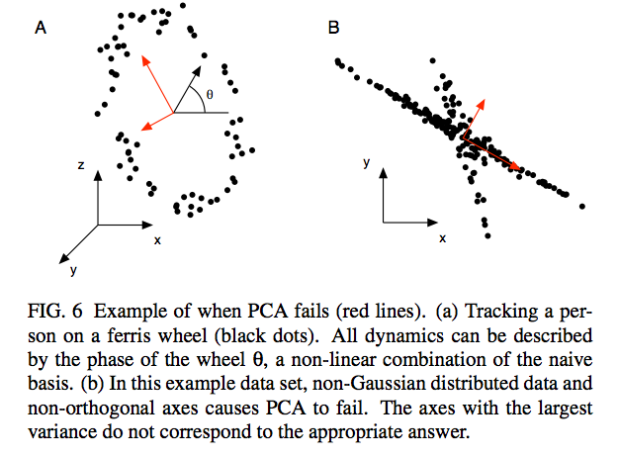
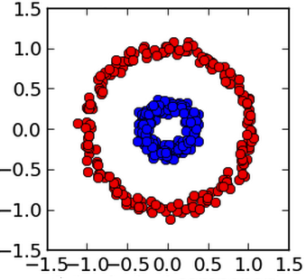
Nonlinear methods

Slide 85
Nonlinear methods
Notes:
(From sklearn kernel PCA example.)

Slide 86
Nonlinear methods
Some methods for nonlinear dimensional reduction (or manifold learning) include:
multidimensional scaling: low-dim embedding that preserves pairwise distances
locally linear embedding: approximates local structure of data (neighborhood preserving embedding)

Slide 87
Nonlinear methods
Some methods for nonlinear dimensional reduction (or manifold learning) include:
multidimensional scaling: low-dim embedding that preserves pairwise distances
locally linear embedding: approximates local structure of data (neighborhood preserving embedding)
NOTE
See sklearn.manifold

Slide 88
Nonlinear methods
Some methods for nonlinear dimensional reduction (or manifold learning) include:
kernel PCA: exploits PCA dependence on inner product
(same logic as SVM)
isomap: nonlinear dimension reduction via MDS using geodesic (surface-bound) distances
Notes:
isomap: mds not in feature space, but in geodesic space of nonlin manifold; isomap adds some graph ideas

Slide 89
Nonlinear methods
Some methods for nonlinear dimensional reduction (or manifold learning) include:
kernel PCA: exploits PCA dependence on inner product
(same logic as SVM)
isomap: nonlinear dimension reduction via MDS using geodesic (surface-bound) distances
NOTE
See sklearn.decomposition and sklearn.manifold
Notes:
isomap: mds not in feature space, but in geodesic space of nonlin manifold; isomap adds some graph ideas

Slide 90
Nonlinear methods
Some methods for nonlinear dimensional reduction (or manifold learning) include:
kernel PCA: exploits PCA dependence on inner product
(same logic as SVM)
isomap: nonlinear dimension reduction via MDS using geodesic (surface-bound) distances
NOTE
See sklearn.decomposition and sklearn.manifold
NOTE
And more!
Notes:
isomap: mds not in feature space, but in geodesic space of nonlin manifold; isomap adds some graph ideas

Slide 91
Nonlinear methods
In any case, key difficulties with dimensionality reduction are time/space complexity, randomness (eg different results for different runs), and selecting the number of dimensions in the lower-dim subspace.

Slide 92
Nonlinear methods
In any case, key difficulties with dimensionality reduction are time/space complexity, randomness (eg different results for different runs), and selecting the number of dimensions in the lower-dim subspace.
Furthermore, there’s an obvious (bias/variance) tradeoff involved with the number of subspace dimensions and the size of approximation error.

Slide 93
IV. Exercise
INTRO TO DATA SCIENCE

