Slide 1
DATA SCIENCE Class 3: Data Visualization
Notes:
~15-20 min on initial stuff
Note: example DS problem…write down some features, how could you build a predictive model from these?

Slide 2
I. The importance of visualization II. Visualization as a medium Lab: III. Visualization in R
agenda
Notes:
All of our classes will involve some hands-on work (in the exercises section)

Slide 3
I. The importance of visualization
INTRO TO DATA SCIENCE
Notes:
~45 min?

Slide 4
Visualization vs. summary statistics
THE IMPORTANCE OF DATA VISUALIZATION
Notes:
~15-20 min for this section?

Slide 5
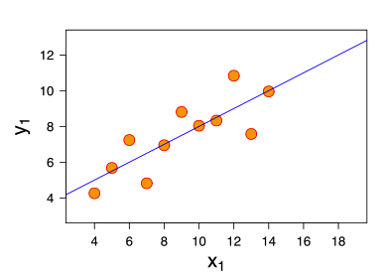
THE IMPORTANCE OF DATA VISUALIZATION
Consider the following dataset:
eleven (x, y) points
Notes:
So far so good

Slide 6
THE IMPORTANCE OF DATA VISUALIZATION
Consider the following dataset:
eleven (x, y) points
mean of x = 9, mean of y = 7.5
Notes:
Q: Does everyone know what the mean is?

Slide 7
THE IMPORTANCE OF DATA VISUALIZATION
Consider the following dataset:
eleven (x, y) points
mean of x = 9, mean of y = 7.5
variance of x = 11, variance of y = 4.1
Notes:
Q: Does anyone know what the variance is?
Q: More importantly, do you know what the variance tells you?

Slide 8
THE IMPORTANCE OF DATA VISUALIZATION
Consider the following dataset:
eleven (x, y) points
mean of x = 9, mean of y = 7.5
variance of x = 11, variance of y = 4.1
correlation of x and y = 0.8
Notes:
Q: Does everyone know what correl is?
Q: More importantly, do you know what correl tells you?
(Pearson’s correlation, of course)

Slide 9
THE IMPORTANCE OF DATA VISUALIZATION
Consider the following dataset:
eleven (x, y) points
mean of x = 9, mean of y = 7.5
variance of x = 11, variance of y = 4.1
correlation of x, y = 0.8
line of best fit: y = 3.00 + 0.500x
Notes:
Q: Does everyone know what a line of best fit is?
Q: More importantly, do you know what the line of best fit tells you?

Slide 10
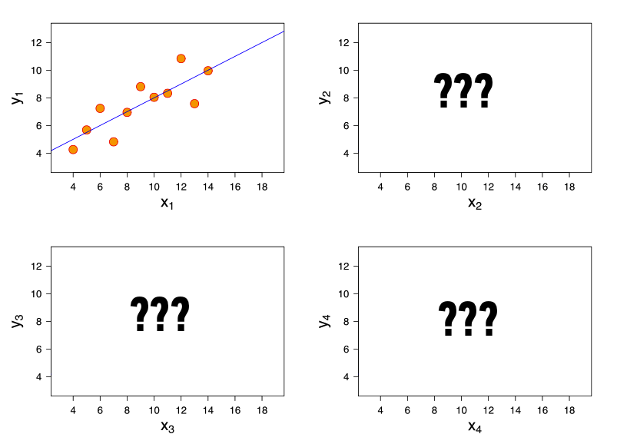
THE IMPORTANCE OF DATA VISUALIZATION
Now, suppose I give you
three more datasets
with exactly the same
characteristics…
Q: how similar are these datasets?

Slide 11
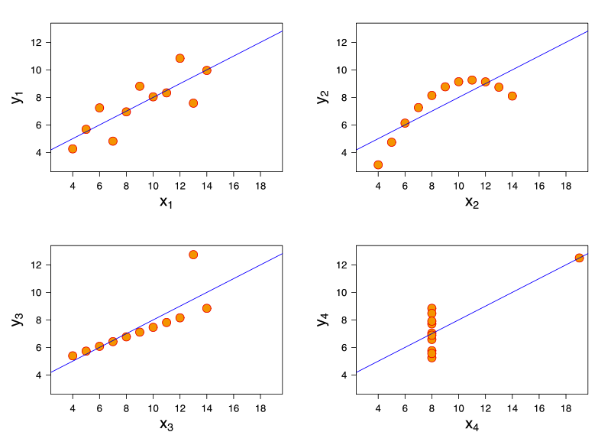
THE IMPORTANCE OF DATA VISUALIZATION
Now, suppose I give you
three more datasets
with exactly the same
characteristics.
Q: how similar are these datasets?
A: not very!
http://en.wikipedia.org/wiki/Anscombe's_quartet

Slide 12
II. Visualization as a medium
INTRO TO DATA SCIENCE
Notes:
Show some viz, talk about viz

Slide 13
III. Visualization in R
INTRO TO DATA SCIENCE

