Slide 1
Introduction to Git and GitHub
By Kevin Markham

Slide 2
Agenda
What is Git? What is GitHub?
Why are we learning this?
Reflections on learning Git
Getting set up
Practical exercises (many!)
What we didn’t cover
Further resources

Slide 3
What is Git?
System for version control
Primarily used by programmers
Runs from the command line
Allows you to track files and file changes in a repository (aka “repo”)
Can be used alone or in a team
Team members can work independently on the same files and merge changes together

Slide 4
What is GitHub?
A website, not a version control system
Allows you to put your Git repos online
Benefits of GitHub:
Backup of files
Visual interface for navigating repos
Others can navigate your repos
Easy to collaborate on repos
“GitHub is just Dropbox for Git”
Note: Git does not require GitHub

Slide 5
Why are we learning this?
Data scientists write code
Version control is useful when you write code
Allows you collaborate more effectively with colleagues
Allows you to contribute to open source projects
Attractive skill for employment

Slide 6
Git can be hard for beginners
Designed (by programmers) for power and flexibility over ease of use
Many ways to accomplish the same task
Hard to know if what you did was right
Most actions are permanent (hard to explore)
Hard for others to troubleshoot
Most reference materials are not written for beginners

Slide 7
Beginner mistakes (that we will avoid!)
Misunderstanding the difference between Git and GitHub
Typing commands without knowing what they do (can be a good thing in other languages)
Leaving out optional arguments to commands
Lacking an understanding of the workflow

Slide 8
Don’t sweat it!
We’re going to focus on the most important 10% of Git
You’re going to be doing the same tasks over and over
Being slow to learn Git will not hold you back in the rest of the course
We can help you to troubleshoot
We’re all in this together!

Slide 9
Installation
GitHub:
Create an account at github.com
There’s nothing to install
Note: “GitHub for Windows” & “GitHub for Mac” are GUI clients (alternatives to command line)
Git:
Download from git-scm.com/downloads
Install

Slide 10
Setup
Open Git Bash (Windows) or Terminal (Mac/Linux)
git config --global user.name “YOUR FULL NAME”
git config --global user.email “YOUR EMAIL”
Use the same email address you used with your GitHub account
Generate SSH keys: tiny.cc/gitssh
More secure that HTTPS

Slide 11
Navigating a GitHub repo (1 of 2)
Example repo: git.io/ggplot2
Account name, repo name, description
Folder structure
Viewing files
Rendered vs raw
Change history
README.md
Side note: What is Markdown?

Slide 12
Navigating a GitHub repo (2 of 2)
Commits:
One or more changes to one or more files
Commit comments
Revision highlighting
Most recent commit: comment and date
Issues, pull requests, branches, contributors
Profile page, repo list

Slide 13
Creating a repo on GitHub
Creating a repo:
Name, description, public/private
Initialize with README (if you’re going to clone)
Do it!
Notes:
Nothing has happened to your local computer
This was done on GitHub, but GitHub used Git to add the README.md file

Slide 14
Cloning a GitHub repo
Cloning a repo:
Copies it to your local computer
Commands:
Change your working directory: cd
Clone: git clone <URL>
Notes:
Copy SSH or HTTPS URL from GitHub (ends in .git)
No visual feedback when you type your password

Slide 15
Examining your cloned repo
Cloned repo is a subdirectory of your working directory (with the same name as the repo)
Navigate to the repo (cd) then list files (ls)
Branch name is shown:
Folder is being tracked by Git
Working on master branch
No need to initialize Git
Everything is managed by “.git” folder

Slide 16
Check your remotes
A “remote alias” is a reference to a repo not on your local computer
“origin” remote was set up by “git clone”
View remotes: git remote -v
Add remote: git remote add <alias> <URL>

Slide 17
Making changes, checking your status
Making changes
Modify README.md
Create new file with “touch” (not a Git command)
Check your status
git status
Possible file statuses:
Untracked (red)
Tracked and modified (red)
Staged for committing (green)
Committed

Slide 18
Committing changes
Stage changes for committing:
Add single file: git add <filename>
Add all “red” files: git add .
Check your status
Red files have turned green
Commit changes:
git commit -m “message about commit”
Check your status again!
Check the log: git log

Slide 19
Pushing to GitHub
Everything you’ve done to your cloned repo (so far) has been local
Push committed changes to GitHub:
git push <remote> <branch>
Usually: git push origin master
Refresh your GitHub repo to check!

Slide 20
Forking a repo on GitHub
What is forking?
Copy a repo to your account (includes everything!)
Links to the “upstream” (but does not stay in sync)
Do it! git.io/gadsdc2
Note: This is a GitHub operation!
Why fork?
You want a copy of the files on GitHub
You want to contribute
Now clone this repo: git clone <your URL>

Slide 21
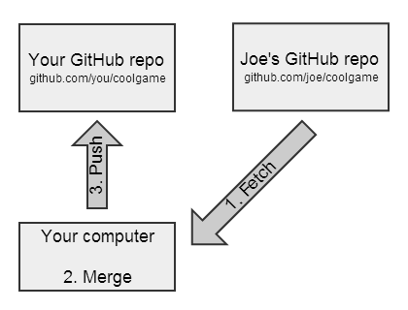
GitHub flow for syncing a fork

Slide 22
Sync your gadsdc2 fork!
We’ve added a new file to gadsdc2
Add an “upstream” remote (one-time operation):
git remote add upstream <Aaron’s URL>
Check that it worked: git remote -v
Pull the changes from the upstream:
git pull upstream master
(Does the same thing as “git fetch upstream master” + “git merge upstream/master”)
Push the changes up to GitHub (optional):
git push origin master

Slide 23
Working with branches
A branch is a “context” for your work
Branches control your files:
Create new branch and switch to it: git checkout -b newbranch
Add a file (touch), check that you added it (ls), add it, commit it
Switch to master branch: git checkout master
ls: the file is gone!
git log: the commit is gone!
Switch to other branch: git checkout newbranch
Phew, it’s still there
Deleting a branch
Switch back to master: git checkout master
git branch -d newbranch (generates error)
git branch -D newbranch (force the deletion)

Slide 24
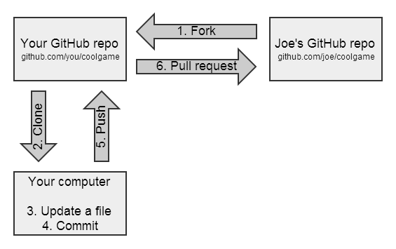
GitHub flow for contributing

Slide 25
Recipe for submitting assignments
git checkout master
git pull upstream master
git checkout -b <branchname>
# do your assignment
git add <filename>
git commit -m “message”
git push origin <branchname>
GitHub: switch to <branchname>, submit PR

Slide 26
Not covered (but useful to learn!)
Initializing a repo locally (git init), then later pushing it to GitHub
Deleting or moving a repo locally
Deleting a repo on GitHub (easy)
Using .gitignore so that Git ignores files
Viewing diffs using Git
Rolling back or unstaging changes
Resolving merge conflicts
Fixing LF/CRLF issues

Slide 27
Further resources
Pro Git (book): git-scm.com/book
Git Reference: gitref.org
My reference guide: tiny.cc/gitref
Common sets of commands explained
Links to my video series (watch most of this presentation again!)

