Slide 1
INTRO to DATA SCIENCE Linear regression

Slide 2
I. Linear regression exercises: II. Linear Regression in R
agenda

Slide 3
I. linear regression
INTRO TO DATA SCIENCE

Slide 4
Regression problems
continuous categorical
supervised ??? ???
unsupervised ??? ???
Notes:
Q: Where does regression belong in this diagram?

Slide 5
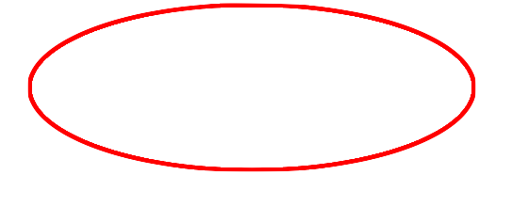
Regression problems
continuous categorical
supervised regression classification
unsupervised dimension reduction clustering
Notes:
Supervised learning problem w/ cts target variables
(predictions are real numbers)

Slide 6
Intro to regression
Q: What is a regression model?

Slide 7
Intro to regression
Q: What is a regression model?
A: A functional relationship between input & response variables.
Notes:
Parametric relationship

Slide 8
Intro to regression
Q: What is a regression model?
A: A functional relationship between input & response variables
The simple linear regression model captures a linear relationship between a single input variable x and a response variable y:

Slide 9
Intro to regression
Q: What is a regression model?
A: A functional relationship between input & response variables
The simple linear regression model captures a linear relationship between a single input variable x and a response variable y:
y = α + βx + ε

Slide 10
Intro to regression
Q: What do the terms in this model mean?
y = α + βx + ε

Slide 11
Intro to regression
Q: What do the terms in this model mean?
y = α + βx + ε
A: y = response variable (the one we want to predict)
Notes:
Dependent var, target var, output var

Slide 12
Intro to regression
Q: What do the terms in this model mean?
y = α + βx + ε
A: y = response variable (the one we want to predict)
x = input variable (the one we use to train the model)
Notes:
Indep var, covariate

Slide 13
Intro to regression
Q: What do the terms in this model mean?
y = α + βx + ε
A: y = response variable (the one we want to predict)
x = input variable (the one we use to train the model)
α = intercept (where the line crosses the y-axis)

Slide 14
Intro to regression
Q: What do the terms in this model mean?
y = α + βx + ε
A: y = response variable (the one we want to predict)
x = input variable (the one we use to train the model)
α = intercept (where the line crosses the y-axis)
β = regression coefficient (the model “parameter”)

Slide 15
Intro to regression
Q: What do the terms in this model mean?
y = α + βx + ε
A: y = response variable (the one we want to predict)
x = input variable (the one we use to train the model)
α = intercept (where the line crosses the y-axis)
β = regression coefficient (the model “parameter”)
ε = residual (the prediction error)
Notes:
Error term, disturbance
White noise (usually assumed to follow Gaussian distribution)

Slide 16
Intro to regression
We can extend this model to several input variables, giving us the multiple linear regression model:

Slide 17
Intro to regression
We can extend this model to several input variables, giving us the multiple linear regression model:
y = α + β₁x₁ + … + β_{n}x_{n} + ε

Slide 18
Intro to regression
Linear regression involves several technical assumptions and is often presented with lots of mathematical formality.
The details are not very important for our purposes, but you can check them out if you’re interested.

Slide 19
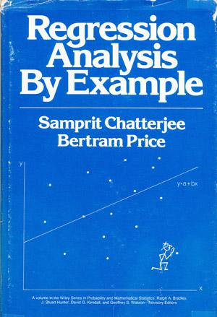
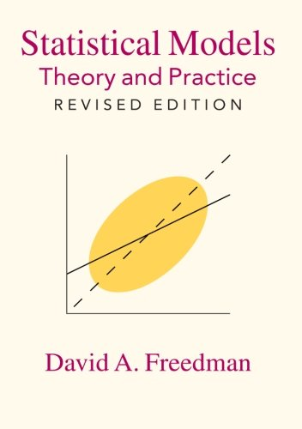
Intro to regression

Slide 20
Intro to regression
Q: How do we fit a regression model to a dataset?

Slide 21
Intro to regression
Q: How do we fit a regression model to a dataset?
A: Minimize the sum of the squared residuals (Ordinary Least Squares).

Slide 22
Intro to regression
Q: How do we fit a regression model to a dataset?
A: Minimize the sum of the squared residuals (Ordinary Least Squares).
In practice, any respectable piece of software will do this for you.

Slide 23
Intro to regression
Q: How do we fit a regression model to a dataset?
A: Minimize the sum of the squared residuals (Ordinary Least Squares).
In practice, any respectable piece of software will do this for you.
And there are other ways.

Slide 24
Intro to regression
Q: How do we fit a regression model to a dataset?
A: Minimize the sum of the squared residuals (Ordinary Least Squares).
In practice, any respectable piece of software will do this for you.
And there are other ways.
And software implements them as well.

Slide 25
Intro to regression
Q: So, how do we select a linear regression model?

Slide 26
Intro to regression
Q: So, how do we select a linear regression model?
Techniques for producing designs

Slide 27
Intro to regression
Q: So, how do we select a linear regression model?
Techniques for producing designs
Theory

Slide 28
Intro to regression
Q: So, how do we select a linear regression model?
Techniques for producing designs
Theory
Forward selection

Slide 29
Intro to regression
Q: So, how do we select a linear regression model?
Techniques for producing designs
Theory
Forward selection
Backward elimination

Slide 30
Intro to regression
Q: So, how do we select a linear regression model?
Techniques for producing designs
Theory
Forward selection
Backward elimination
More

Slide 31
Intro to regression
Q: So, how do we select a linear regression model?
Techniques for producing designs
Theory
Forward selection
Backward elimination
More
Techniques for evaluating designs

Slide 32
Intro to regression
Q: So, how do we select a linear regression model?
Techniques for producing designs
Theory
Forward selection
Backward elimination
More
Techniques for evaluating designs
Training metrics

Slide 33
Intro to regression
Q: So, how do we select a linear regression model?
Techniques for producing designs
Theory
Forward selection
Backward elimination
More
Techniques for evaluating designs
Training metrics
Test set performance / Cross-validation

Slide 34
II. Exercises
INTRO TO DATA SCIENCE

